Slide 1

Unit 7
Where do you live?
Form, meaning & Functions

Slide 2
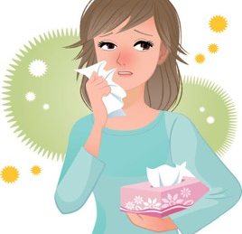
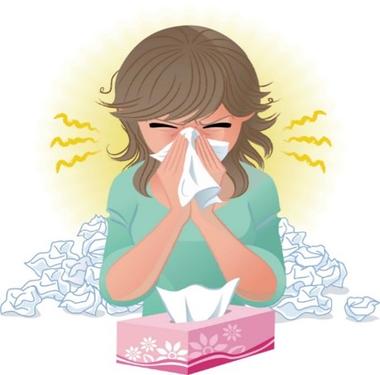
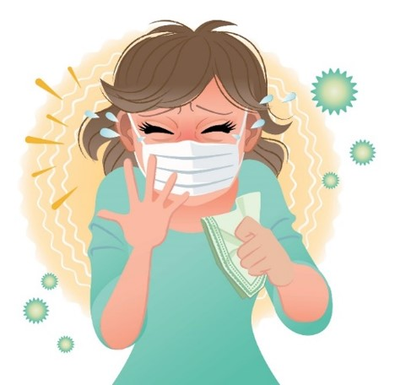
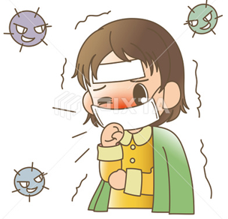

COVID 19
☺ Avoid gathering !
☺ wear a mask before going out
☺ Social distancing is not a choice, it is a must!
☺ Keep a distance of 2 meters to avoid accountability
☺ Wash hands constantly

Slide 3
بسم الله الرحمن الرحيم
Day:
Date:

Slide 4
Learning Objectives
1. Differentiate between short and long adjectives.
2. use comparative form correctly.
3. use superlative form correctly.
4. write the correct form of the adjectives in the comparative and superlative forms.

Slide 5
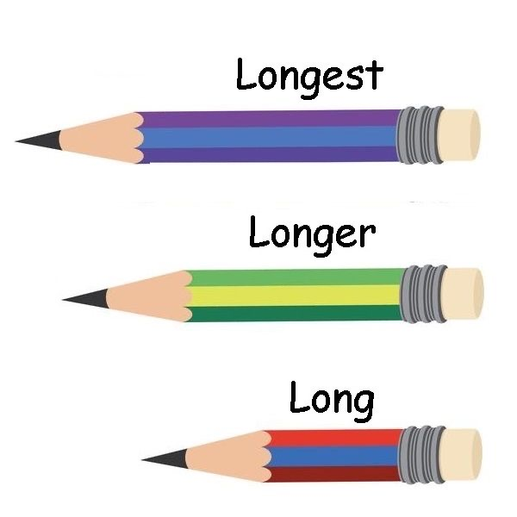
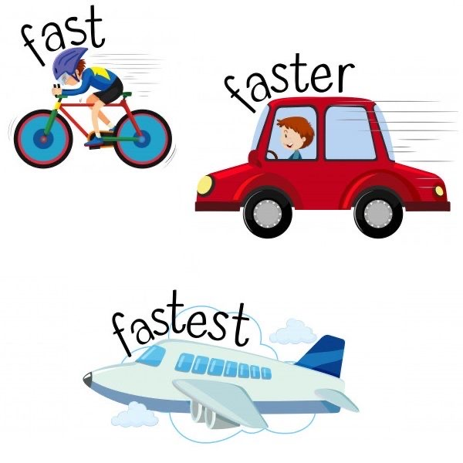
Warm up

Slide 6
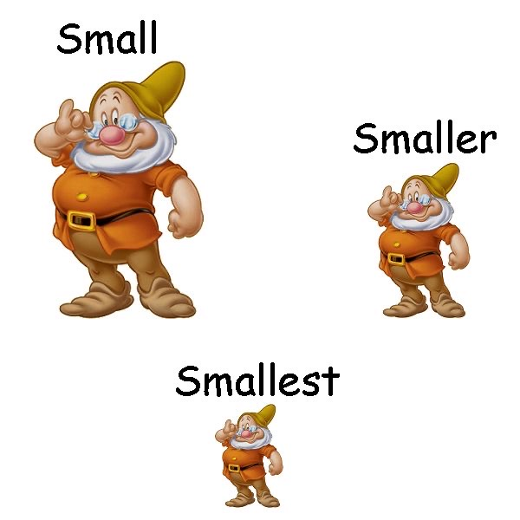
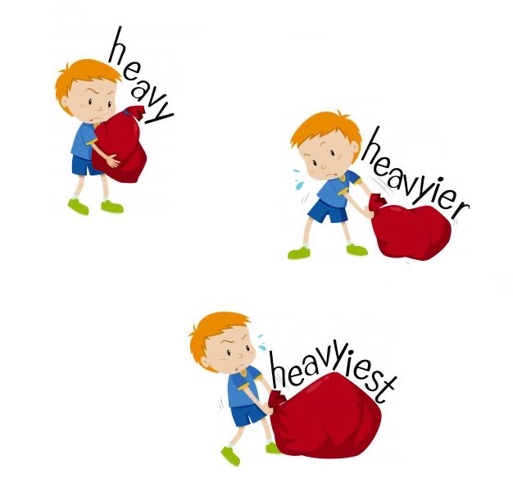
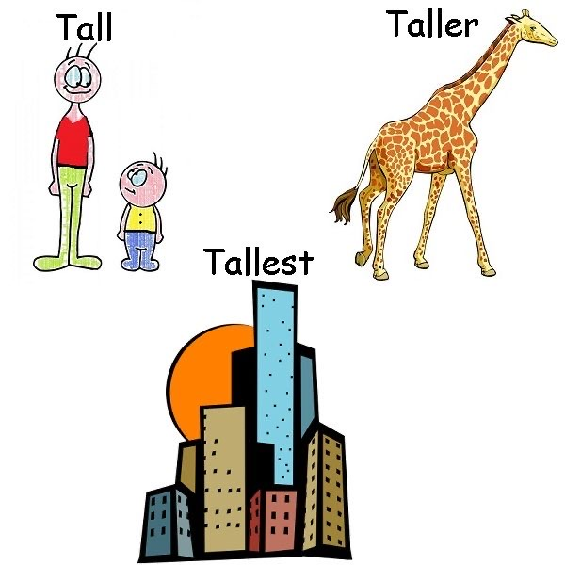
Warm up

Slide 7
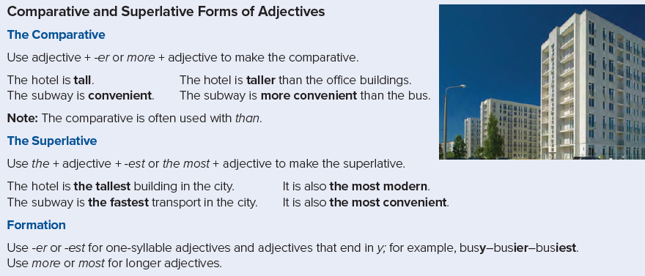
Page 63

Slide 8
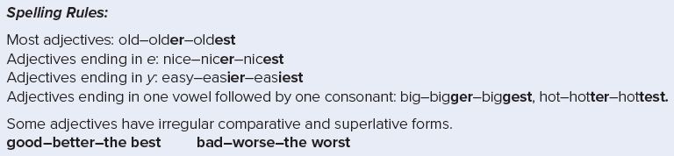

Slide 9
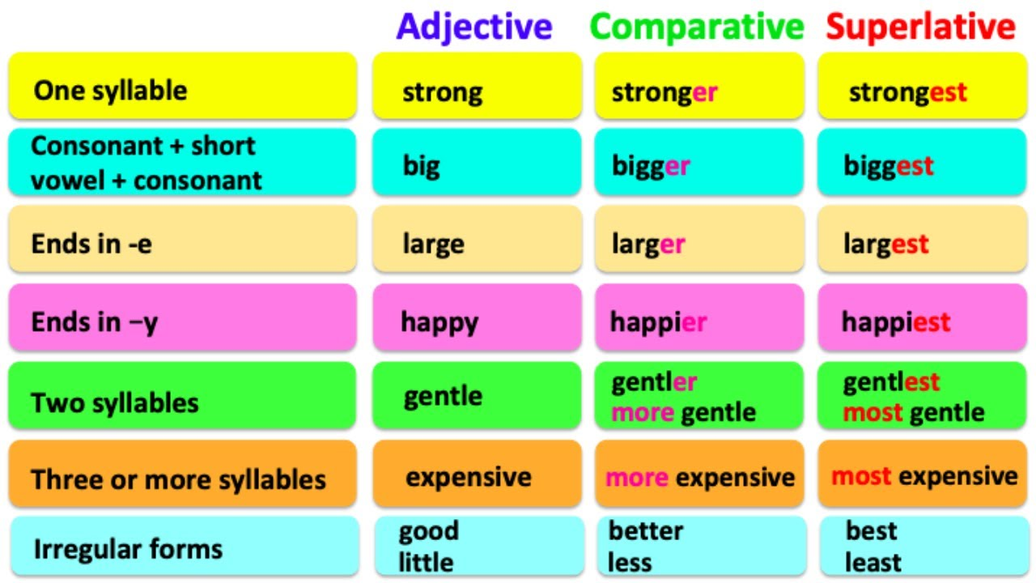

Slide 10


Practice

Slide 11
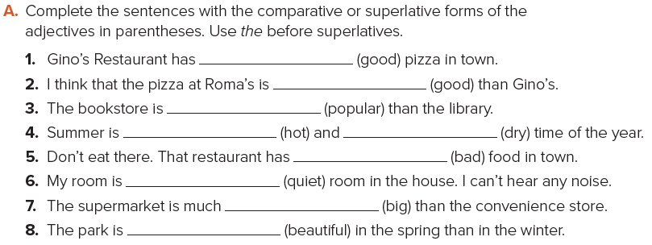
the best
better
more popular
the hottest
the driest
the worst
the quietest
bigger
more beautiful

Slide 12
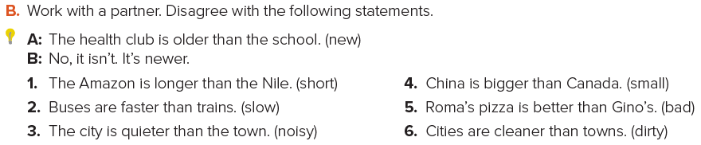
Answers
1. No, it isn’t. It’s shorter.
2. No, they aren’t. They’re slower.
3. No, it isn’t. It’s noisier.
4. No, it isn’t. It’s smaller.
5. No, it isn’t. It’s worse.
6. No, they aren’t. They’re dirtier

Slide 13
Homework
Page 118 (I)

Slide 14
