Slide 1

Super Goal 1
Where Do You Live ?
Listen and Discuss
56

Slide 2
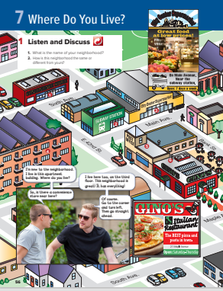

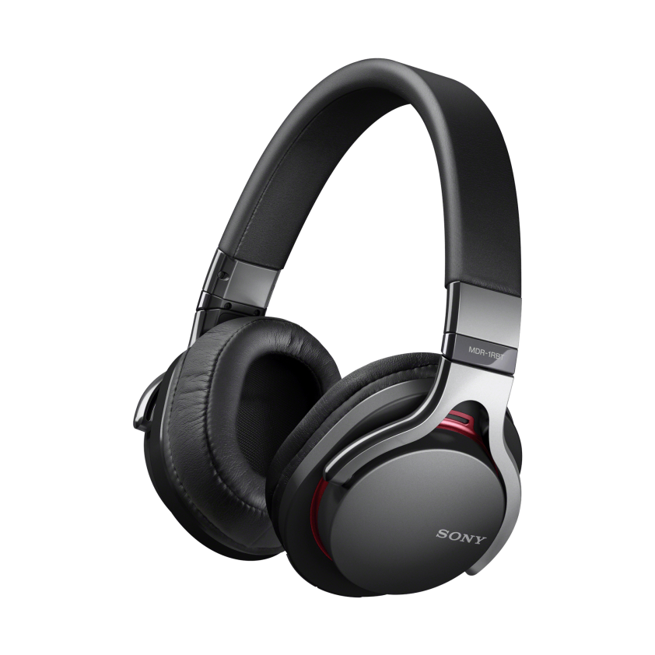
56

Slide 3

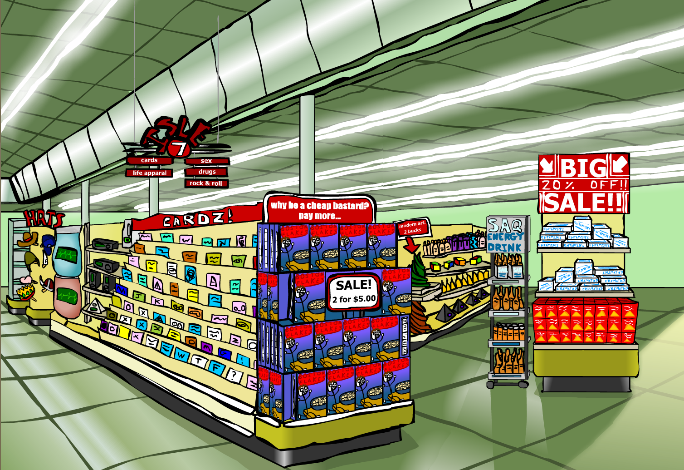
Name the place
Supermarket

Slide 4

Name the place
bookstore

Slide 5

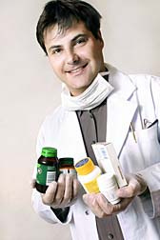
Name the place
pharmacy

Slide 6
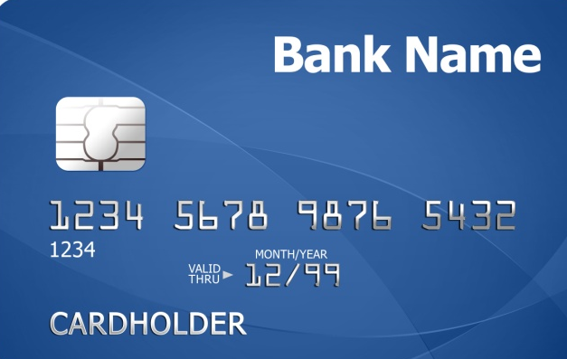
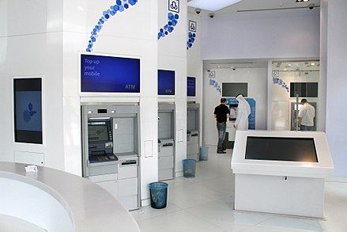

Name the place
Bank

Slide 7
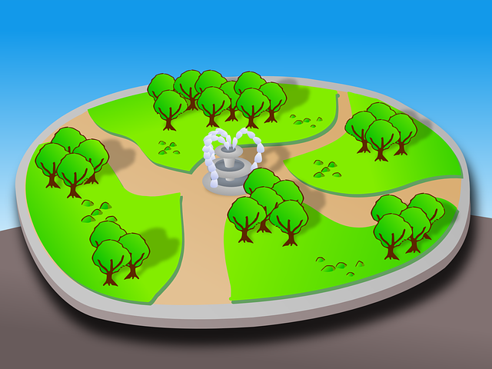

Name the place
Park

Slide 8
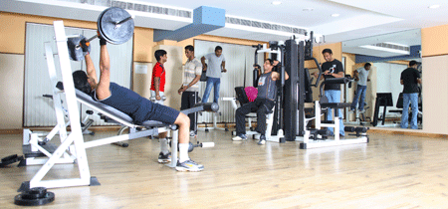
Name the place
Health club

Slide 9
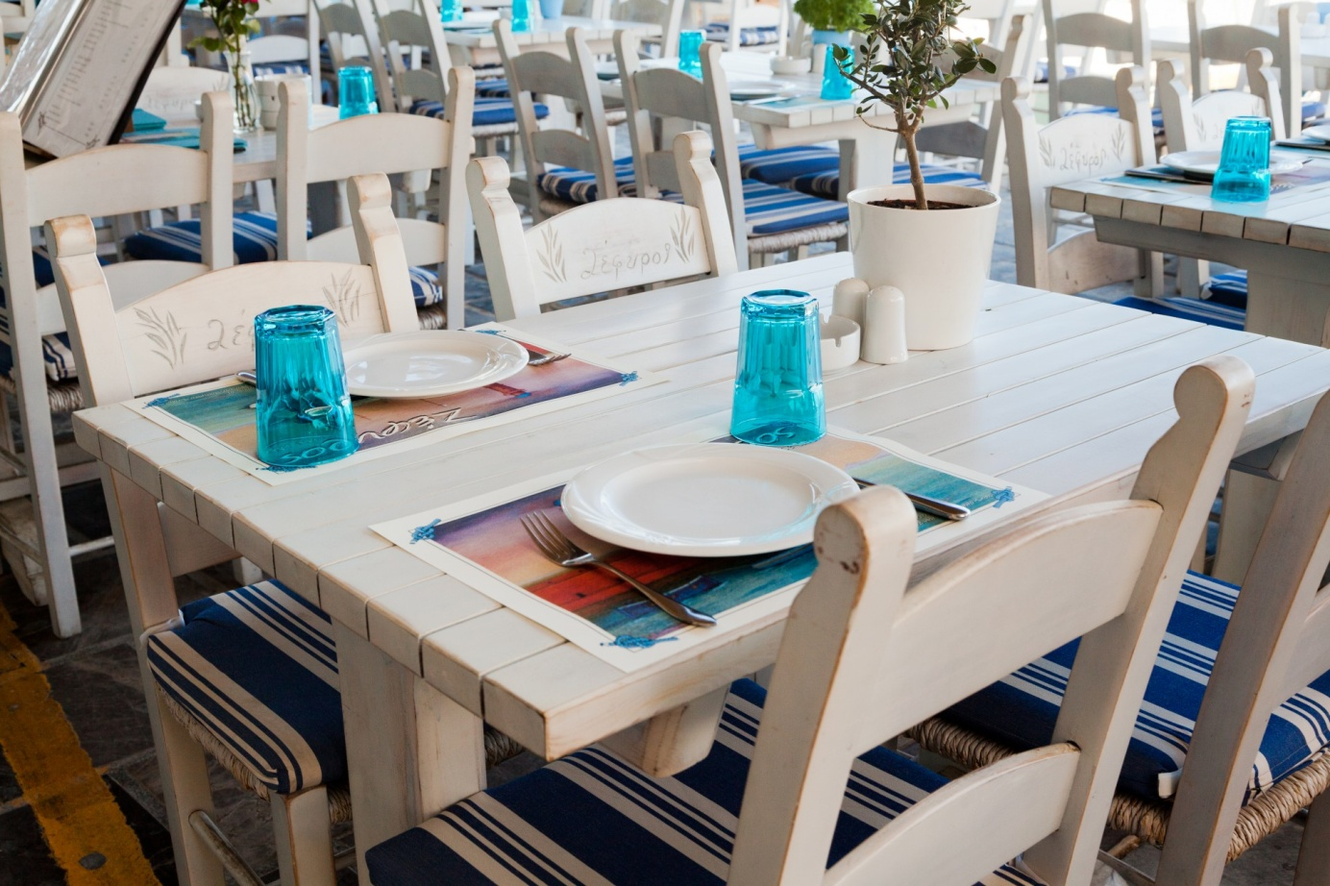
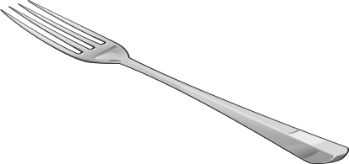
Name the place
Restaurant

Slide 10

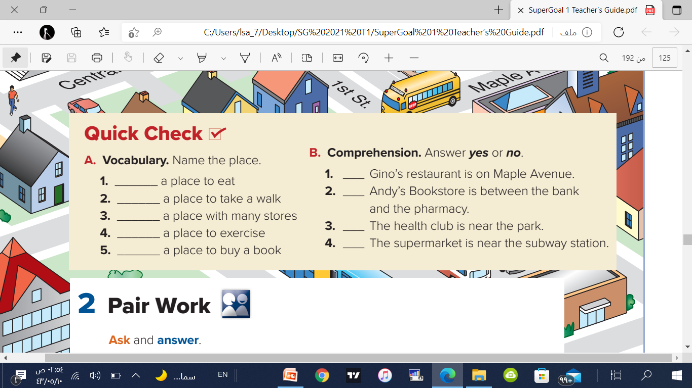
A restaurant
The park
The mall
Health club
Bookstore
57

Slide 11
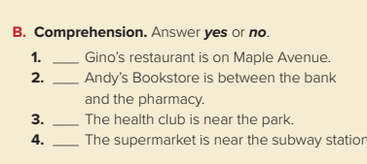
no
yes
yes
yes
57

Slide 12


Fill in the missing litter
St_re
Subw_y
Of_ice
_all
Store
Subway
Office
Mall

Slide 13
115

Slide 14

Good Job Every One

Slide 15
لا تنسانا أخي من دعائك.
Best wishes
Raed Alharbi
@RAE_D_1

