Slide 1
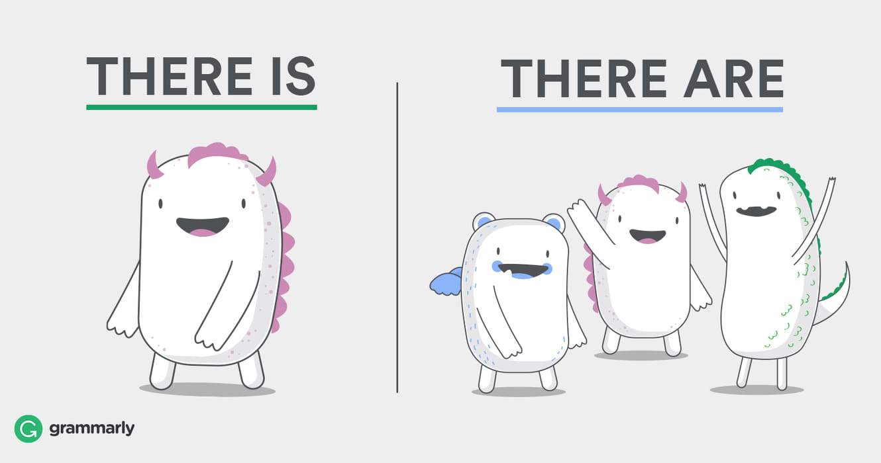
There is / There are

Slide 2
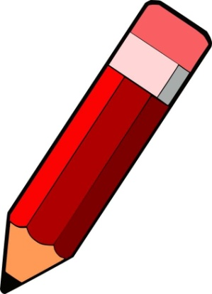

Affirmative + (الجملة المثبتة )
There is + a/an + noun
Ex: There is a pen.
There are + noun +s
Ex: There are pens.

Slide 3
Negative - (نفي)
There isn’t + a + noun .
Ex: There isn’t a book.
There aren’t + noun +s .
Ex: There aren’t books.

Slide 4
Question ? (السؤال)
Plural جمع
There are pens .
. Are there pens?
. Yes, there are .
. No, there aren’t.
Singular مفرد
There is a pen.
Is there a pen ?
Yes, there is .
No, there isn’t .

Slide 5
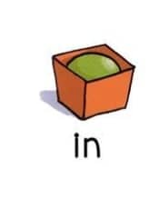
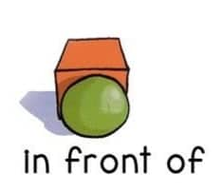
Prepositions (حروف الجر)
In (في/داخل):
The ball is in the box.
In front of (أمام ):
The ball is in front of the box.

Slide 6
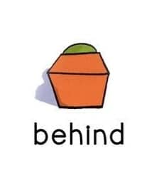
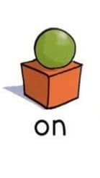
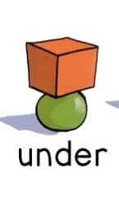
behind (خلف):
The ball is behind the box.
On (على):
The ball is on the box .
Under(تحت):
The ball is under the box .

Slide 7
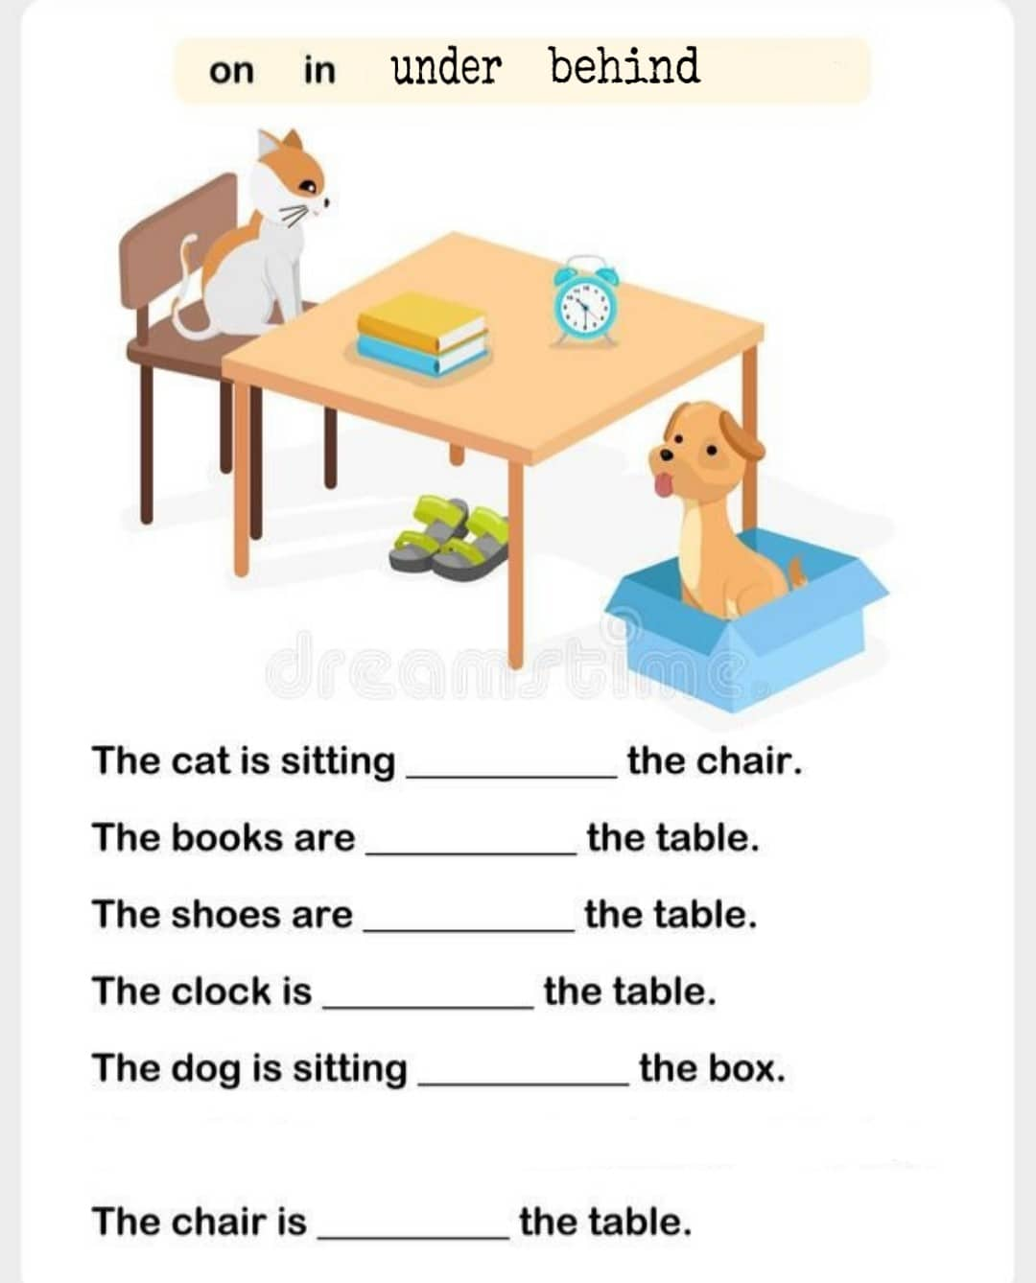
Exercises :
on
on
under
on
In
behind

