Slide 1
Super Goal 1
Where Do You Live ?
Grammar
58

Slide 2
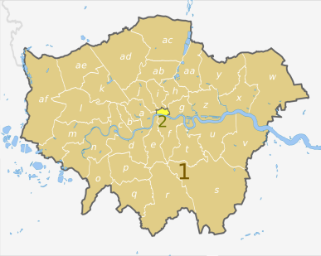
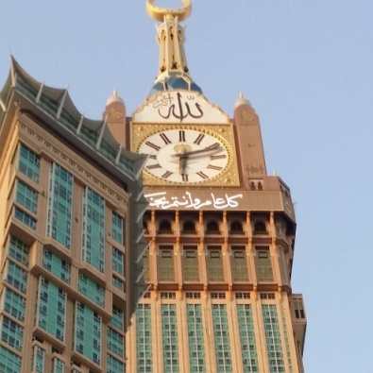

Where Do You Live ?
I live in Jeddah
City
I live on the third floor.
floor
I live on First Avenue
street
58

Slide 3
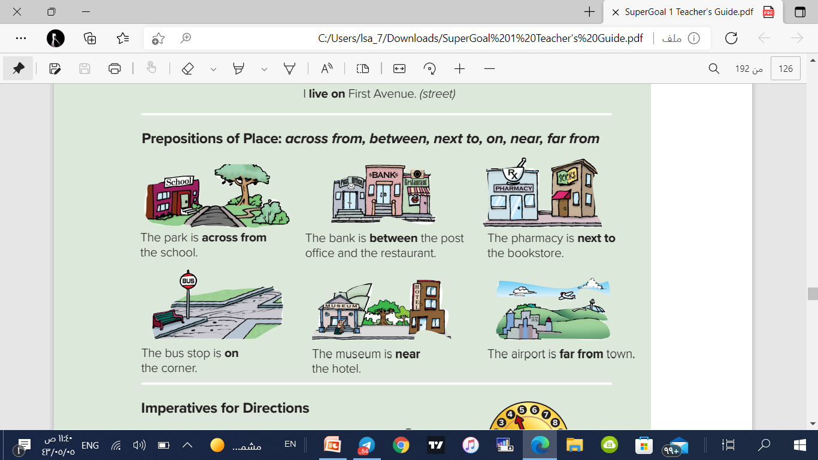
Prepositions of Place
The park is across from
the school.
The bank is between the post office and the restaurant.
The pharmacy is next to the bookstore.
The bus stop is on the corner.
The museum is near the hotel
The airport is far from town.
58

Slide 4
Prepositions of Place
The park is across from
the school.
The museum is near the hotel
The airport is far from town.
The bank is between the post office and the restaurant.
The bus stop is on the corner.
The pharmacy is next to the bookstore.
58

Slide 5
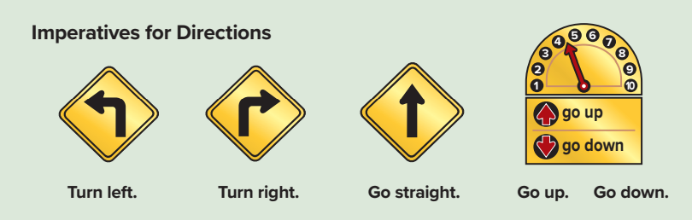



Imperatives for Directions
58

Slide 6
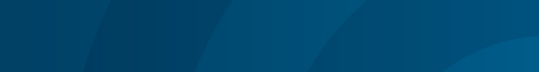
Match the questions with the answers.
Yes, there is. It’s across from the bookstore. | Is there a restaurant in the mall?
No, it isn’t. It’s near the city. | Is the airport far from the city?
It’s on the corner of Dade and Main Streets | Where’s the convenience store?
No, it isn’t. It’s closed. | Is the bank open on Friday?
My apartment’s on the second floor | Where do you live?
No. It’s between the bank and the health club | Is the post office next to the park?
58

Slide 7
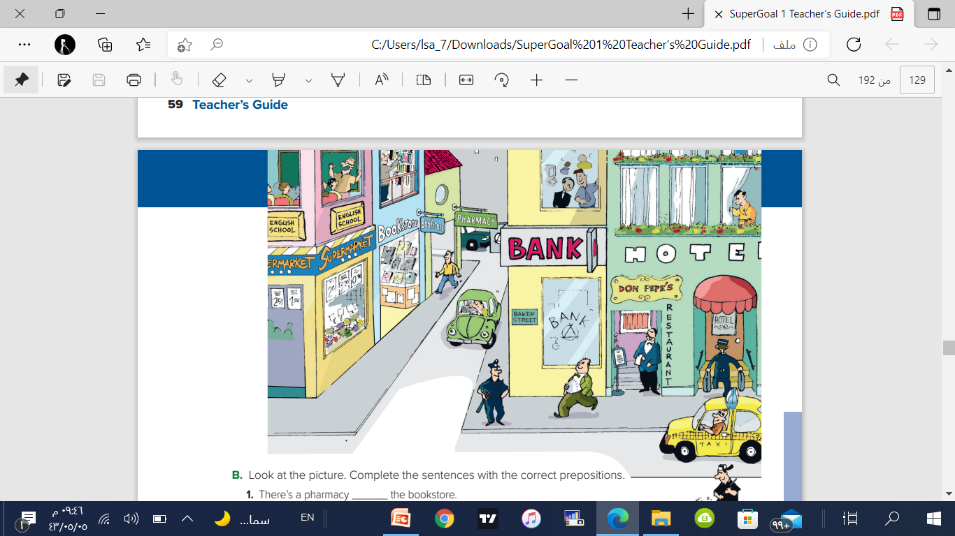
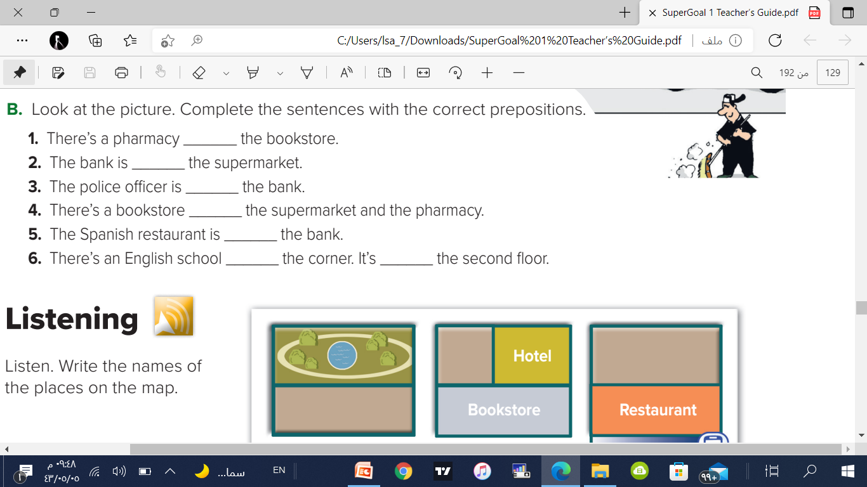
Complete the sentences with the correct prepositions
next to
across from
near
between
next to
on
on

Slide 8
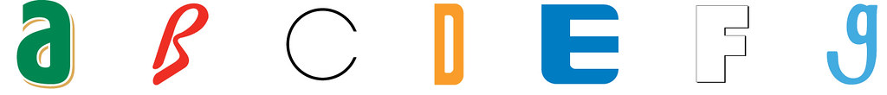
Fill in the missing litter
Flo…r
Street
…ity
Floor
Stree…
City

Slide 9
The End
لا تنسونا من صالح دعائكم – رائد الحربي
@Rae_d_1

