Slide 1
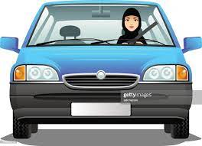
Drive Slowly!

Slide 2
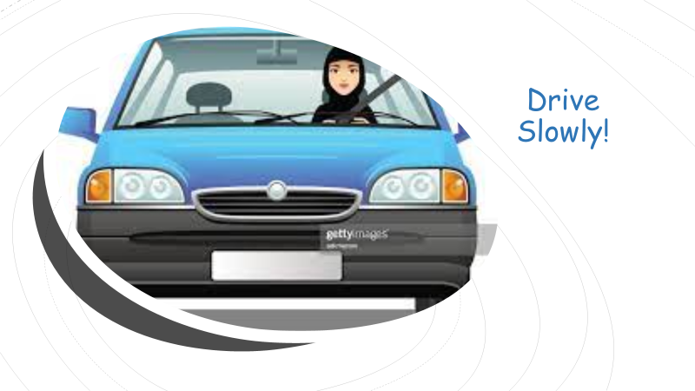
Drive Slowly!
8. Conversation
Objectives:
Mark right or wrong based on listening.
pronounce the vowel sound of /ə/
Talk about driving.
Answer questions about a conversation.

Slide 3
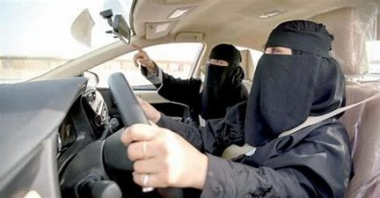
What do you think the driver instructor evaluate students on?

Slide 4
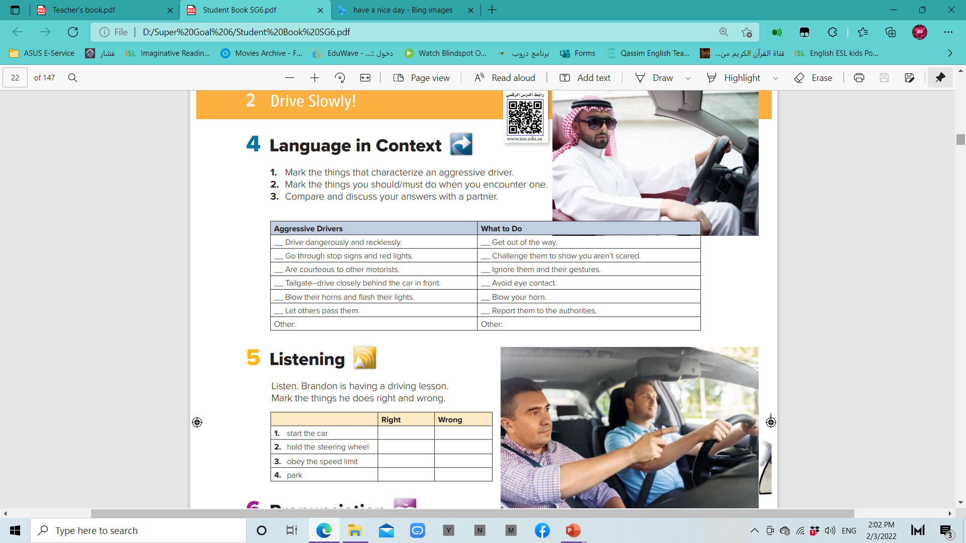

P. B. p.82
*
*
*
*

Slide 5
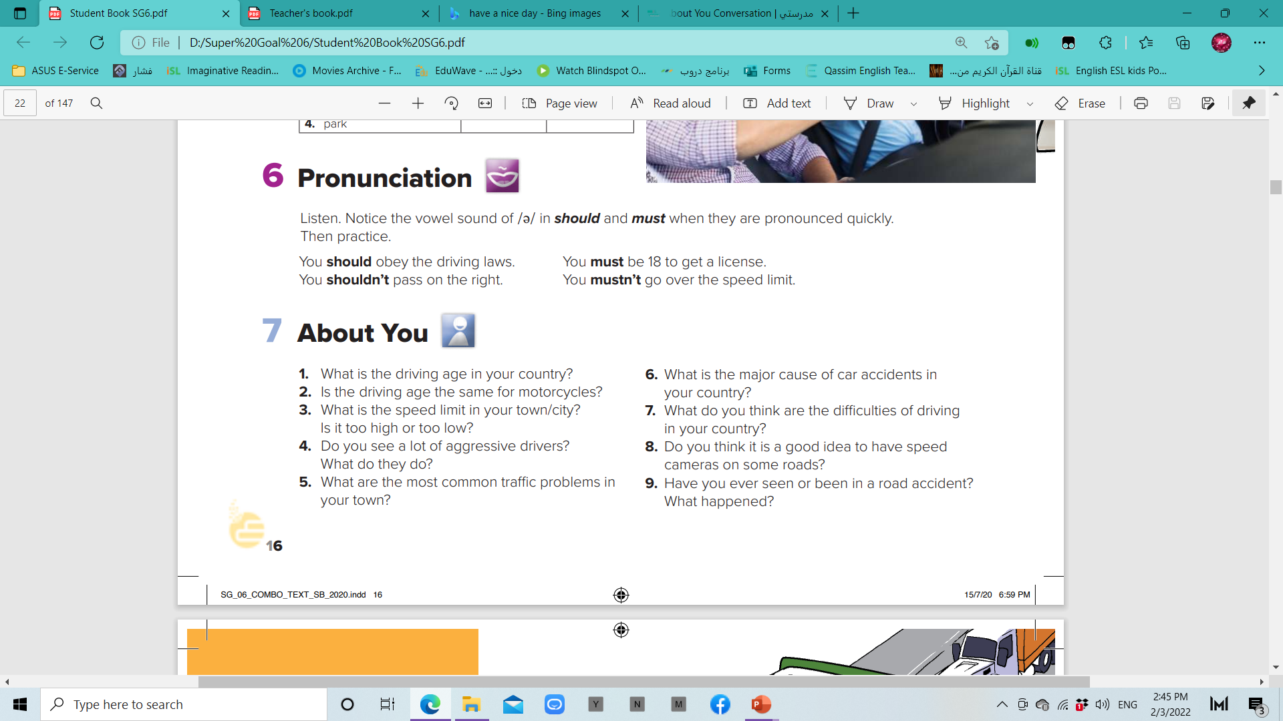
P. B. p.82

Slide 6
P. B. p.82

Slide 7
How does the driver of the red car drive?
Who is in the car?
What is their relationship?
What is happening?
What are they talking about?
Where do you think they are going?

Slide 8
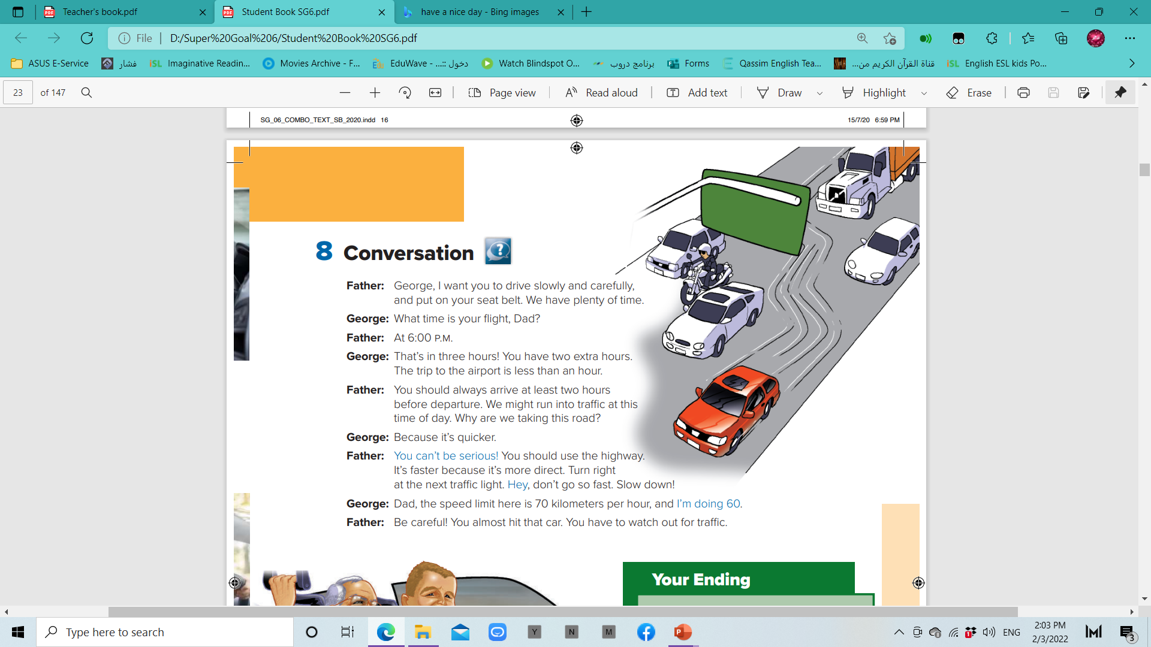
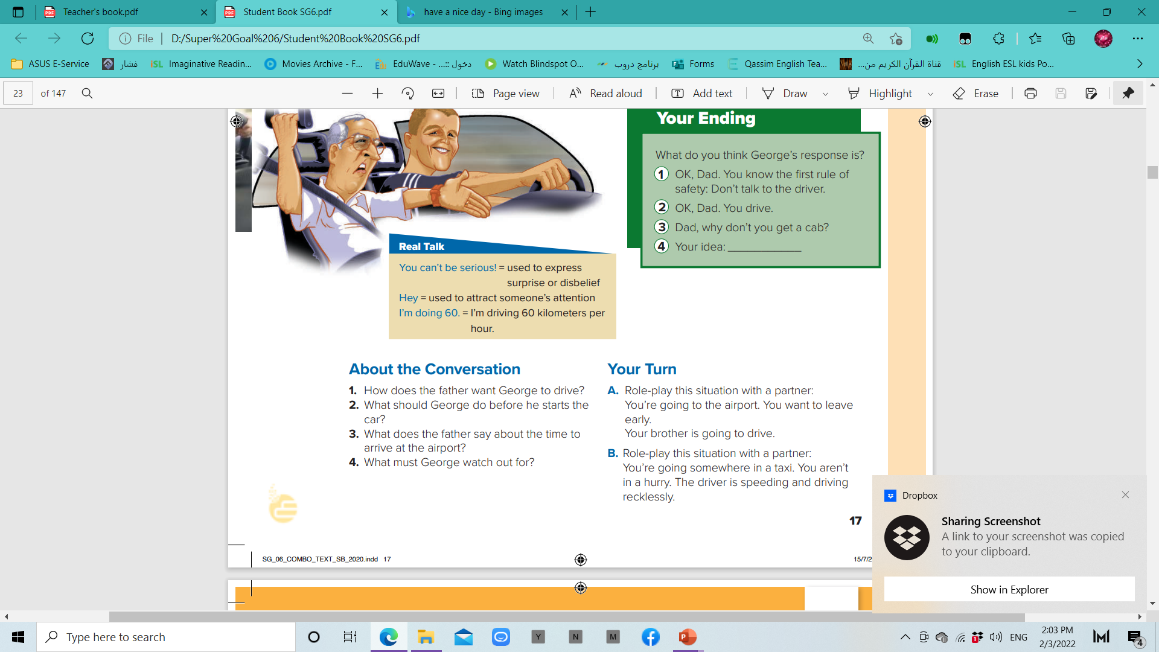
How much time do they have to the flight?
Does the father like George’s driving?

Slide 9
P. B. p.83

Slide 10
P. B. p.83
He wants George to drive slowly and carefully.
2. George should put on his seat belt.
3. He says that you should always arrive at the airport two hours before the departure.
4. George must watch out for traffic

Slide 11
P. B. p.83

Slide 12


