Slide 1

Unit 7
It’s a good deal, isn’t it?
Writing

Slide 2
بسم الله الرحمن الرحيم
Day:
Date:

Slide 3
Learning Objectives
Number sentences to make a paragraph
Differentiate between past tenses
use the correct tense to write about a coincidence

Slide 4
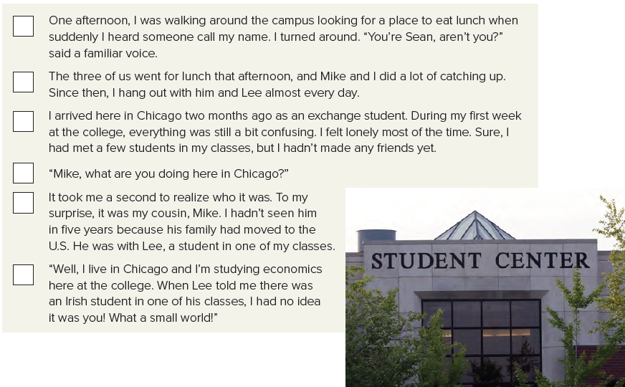
2
6
1
4
3
5
Page 76

Slide 5
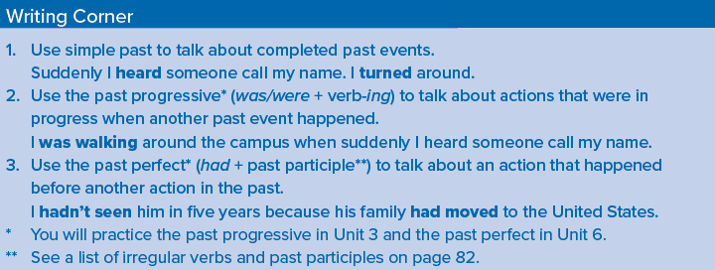
Page 76

Slide 6
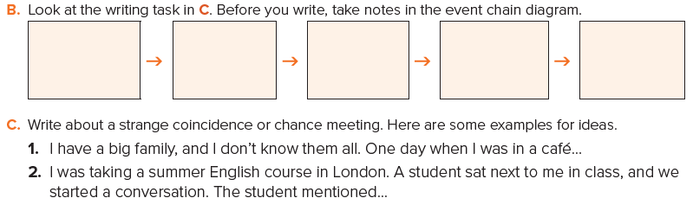
Person has the same full name
A few years ago
in the university
one of my cousins
bad degree
A few years ago I had a wonderful chance. I met a person in the university who has the same full name . He wasn’t good and got a bad degree. I went to the professor to complain and I found it was a degree of another person who has the same name. I told my father who came and discovered that he was his cousin’s son who lives in another city.
Page 76

Slide 7
Page 214 (I)
Homework

Slide 8
