Slide 1

Unit 7
It’s a good deal, isn’t it?
Reading

Slide 2
بسم الله الرحمن الرحيم
Day:
Date:

Slide 3
Learning Objectives
Identify the main idea of reading
Identify specific information
Use new words correctly
Answer questions about the reading
Make an advertisement for an event

Slide 4

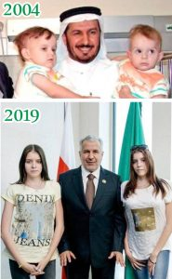
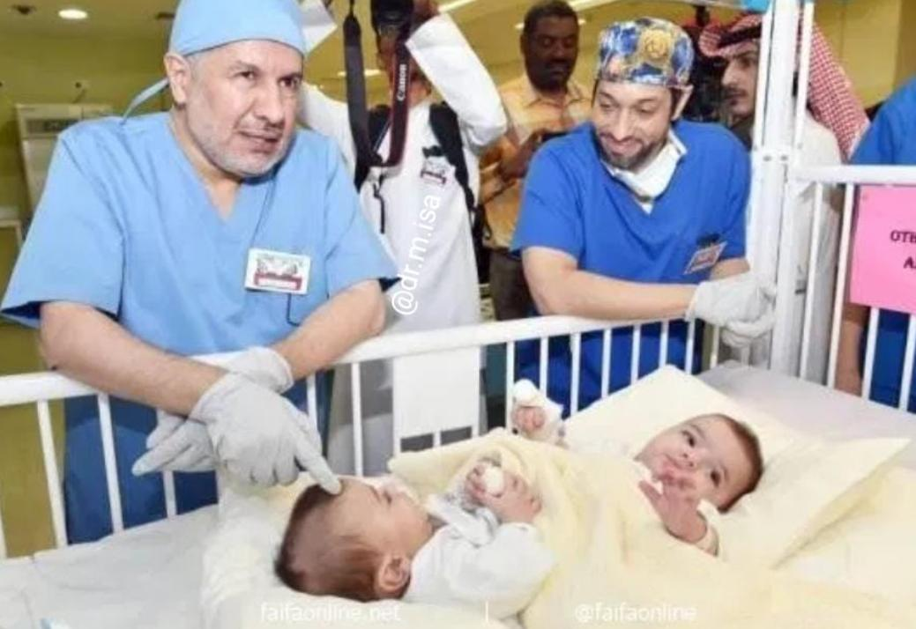

Slide 5
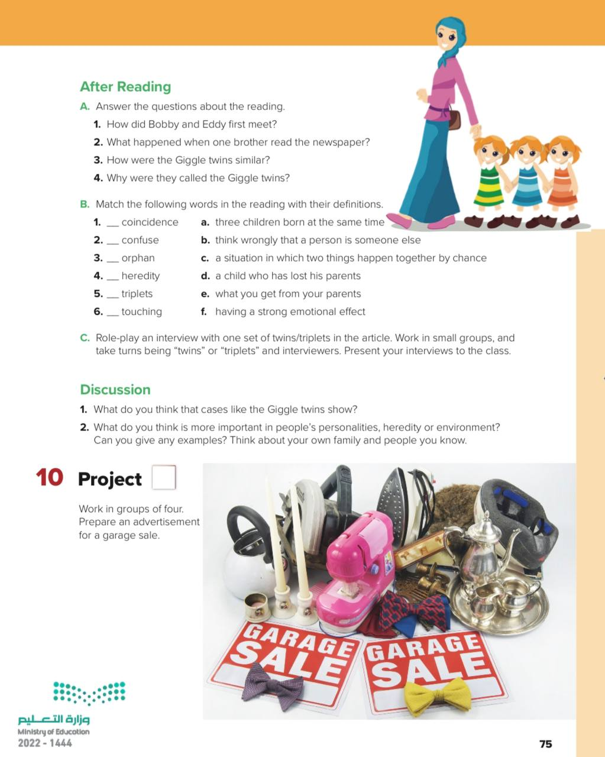
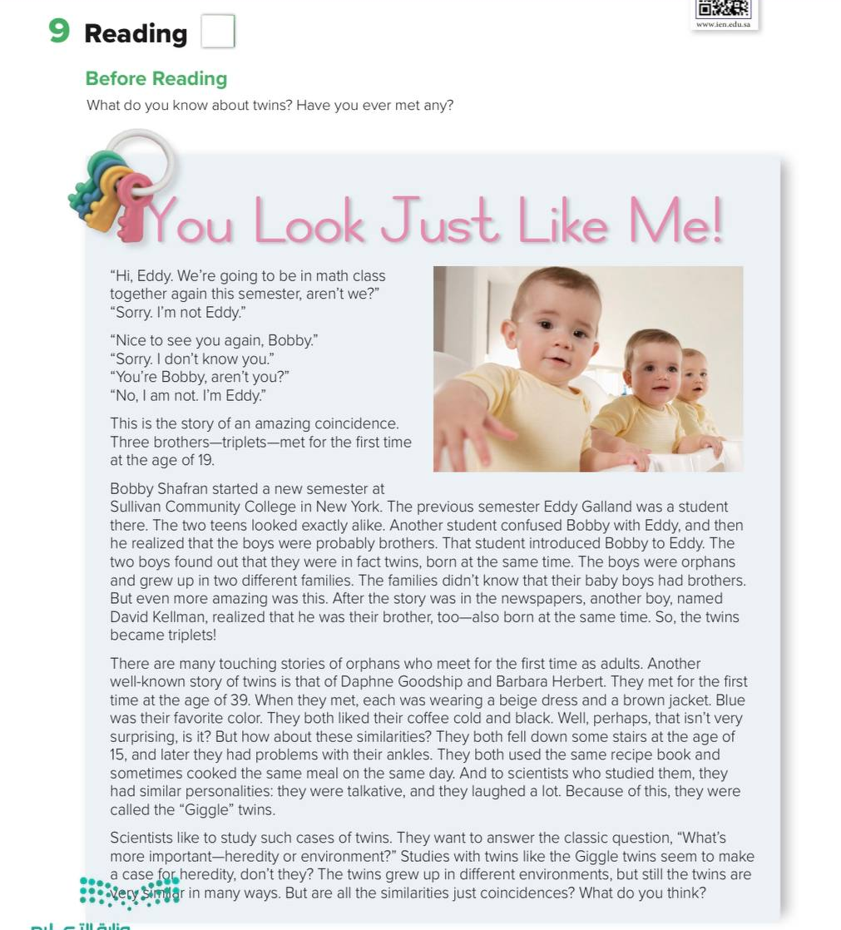
Pages 74 & 75

Slide 6
Before reading
-What is the title?
-Scan: What is the passage talking about?
-Do we have subtitles?
-How many pictures are there? Paragraphs? Lines?
-Skim: Find the following in the passage: numbers, names, famous places, adjectives
What is the meaning of the word “twins”? “Triplet”?
Do you have twins in your family? Triplets?
Pages 74 & 75

Slide 7
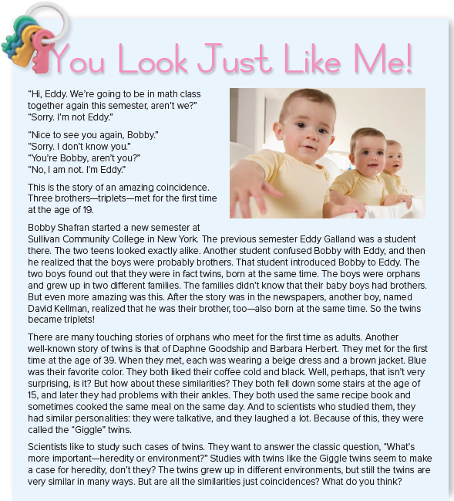

Pages 74 & 75

Slide 8
Mind-map
Main Idea
Paragraph 1
Paragraph 4
Paragraph 2
Paragraph 3

Slide 9
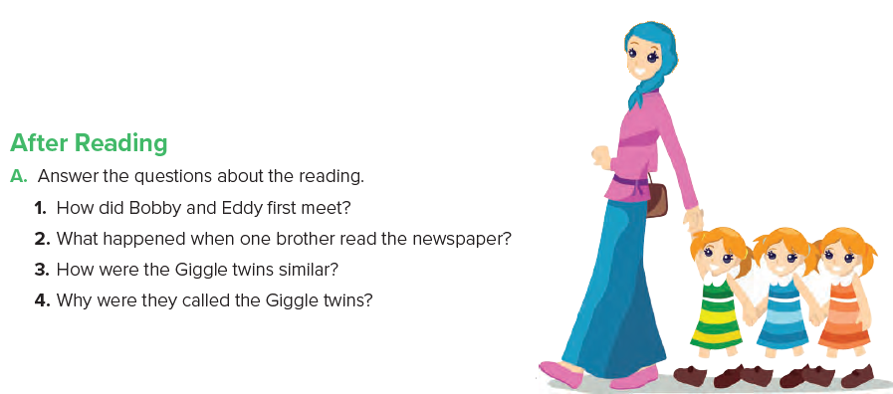
Answers
1. They met when another student introduced them.
2. One brother read the story about Bobby and Eddy and realized that he was their brother, too.
3. They wore similar clothes, had the same favorite color, and liked coffee the same way.
4. They laughed a lot.
Page 75

Slide 10
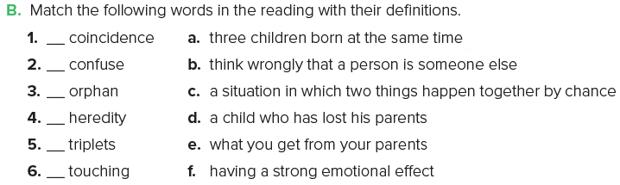
c
b
d
e
a
f
Page 75

Slide 11
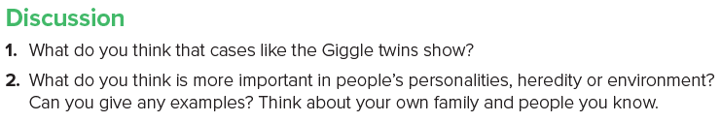
Page 75

Slide 12
After Reading
Did you ever heard of twins cases?
Have you ever met any twins?
How would you feel if you have a twin?

Slide 13
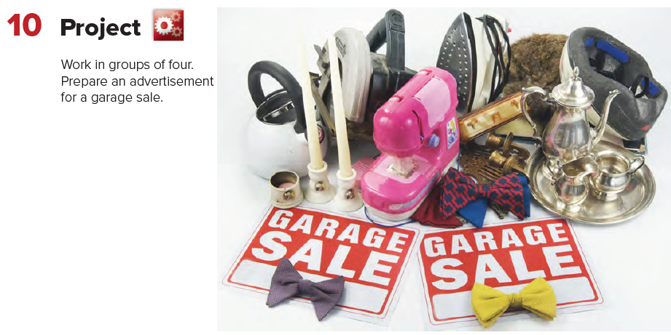
Page 75

Slide 14
Page 213
Homework

Slide 15
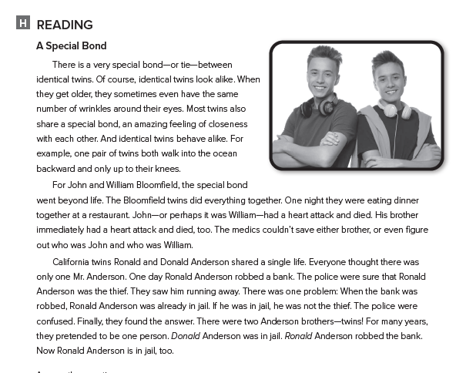

Slide 16

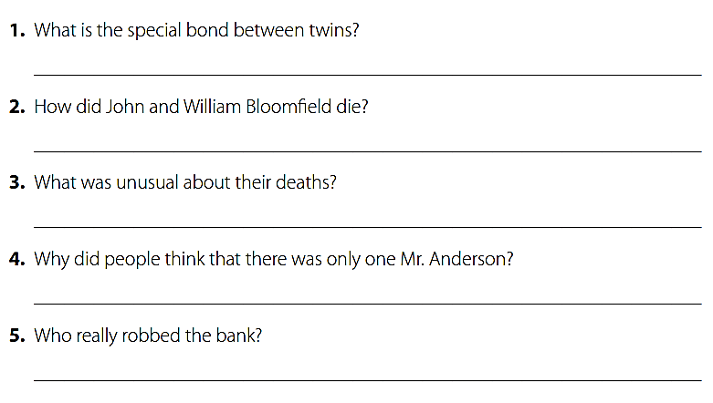
The feeling of closeness twins have for each other .
They both had heart attack .
They both died while eating dinner together .
They were identical twins and shared a single life .
Ronald Anderson .

