Slide 1

Unit 7
It’s a good deal, isn’t it?
Language in Context

Slide 2
بسم الله الرحمن الرحيم
Day:
Date:

Slide 3
Learning Objectives
Play a game using tag questions
Listen for specific information
Produce the rising intonation
Answer questions about personal experience

Slide 4
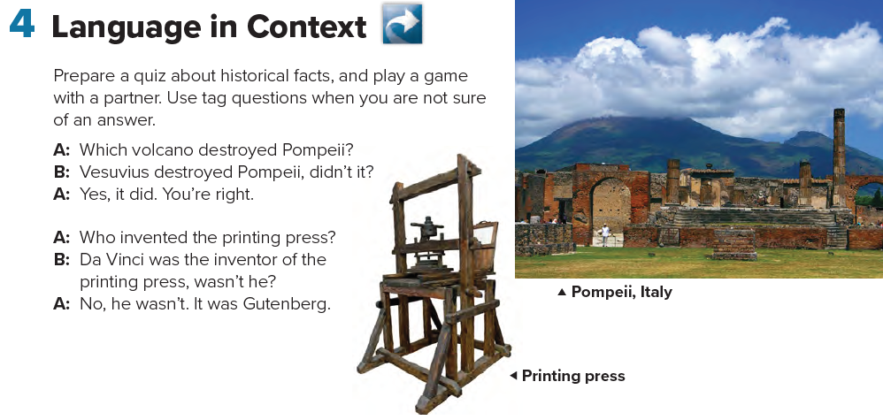
Page 72

Slide 5

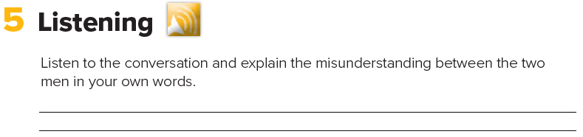
George Scott thinks the man is a famous author named Melvin Dupont.
Page 72

Slide 6
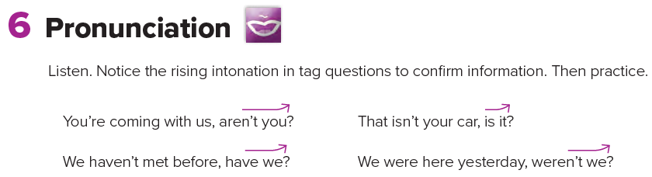
Page 72

Slide 7
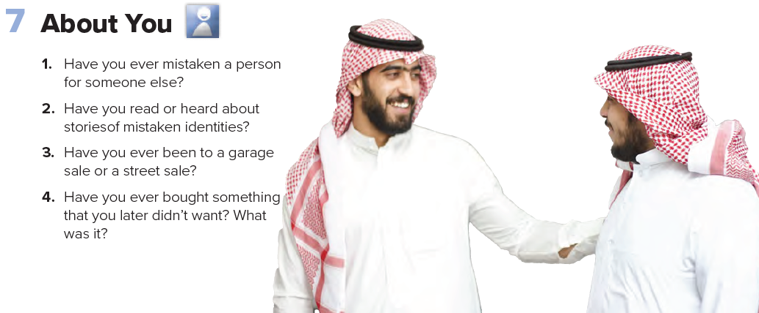
Page 72

Slide 8
Page 211
Homework

Slide 9
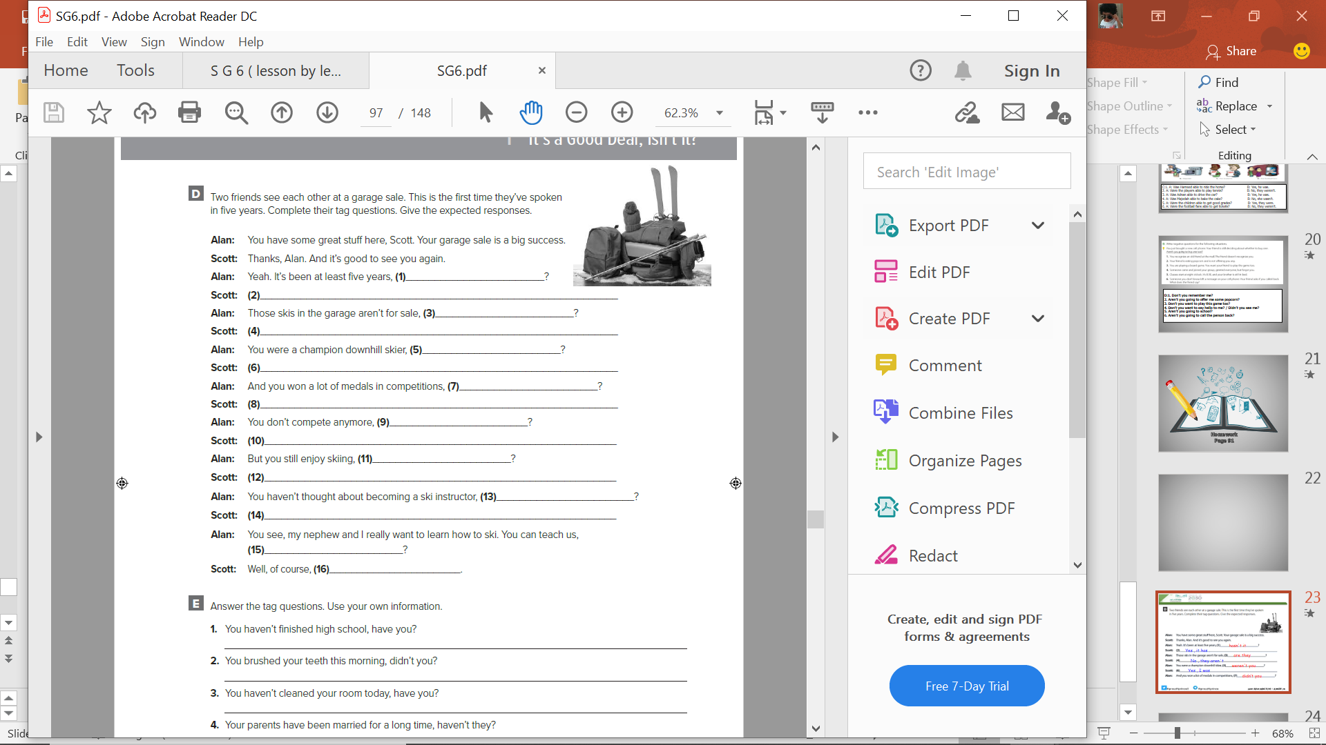
hasn't it
Yes , it has .
are they
No , they aren΄t
weren't you
Yes , I was
didn’t you
Yes , I did
do you
No , I don΄t
don΄t you
Yes , I do
have you
No . I haven΄t
can΄t you
I can

