Slide 1


Unit 4
What do I need to buy?
Conversation
PRESENTATION BY: SLIDECORE

Slide 2
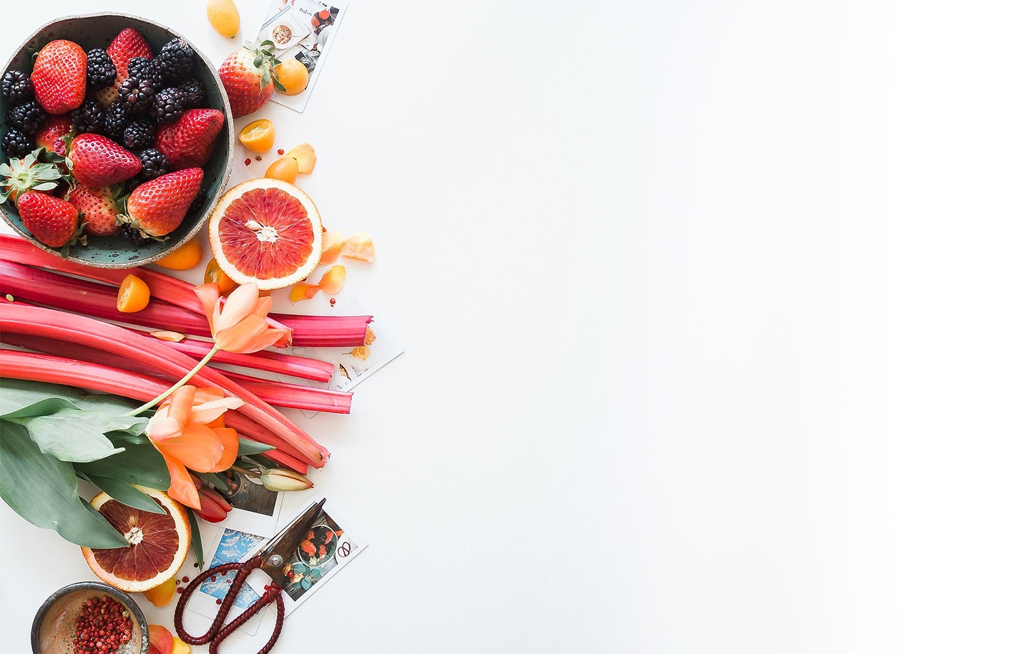
بسم الله الرحمن الرحيم
Day
Date

Slide 3
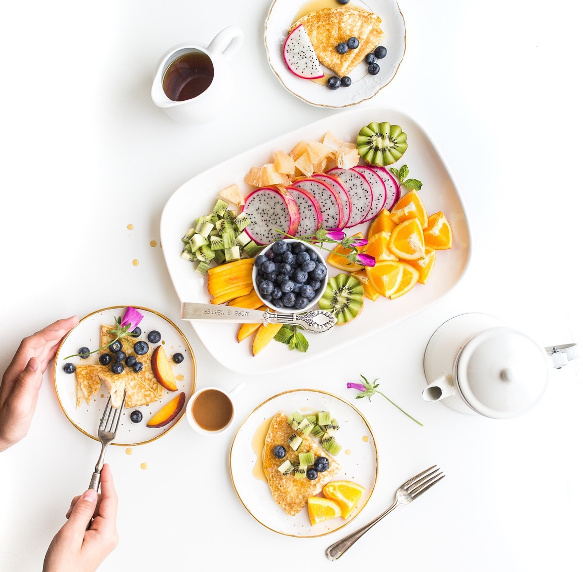

PRESENTATION BY: SLIDECORE

Slide 4
Learning Objectives
02
listen to a conversation
01
answer questions about the conversation.
04
practice using real talk phrases
03
05
discuss food and recipes

Slide 5
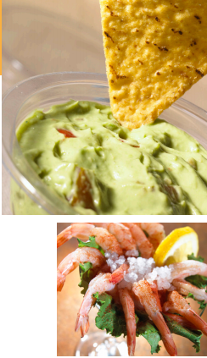
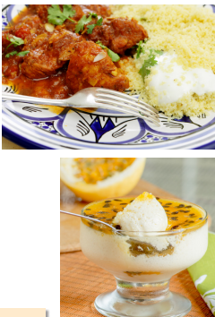
What kinds of foods are these?
What is the appetizer?
What is the main dish?
What is the dessert?
Page:37

Slide 6
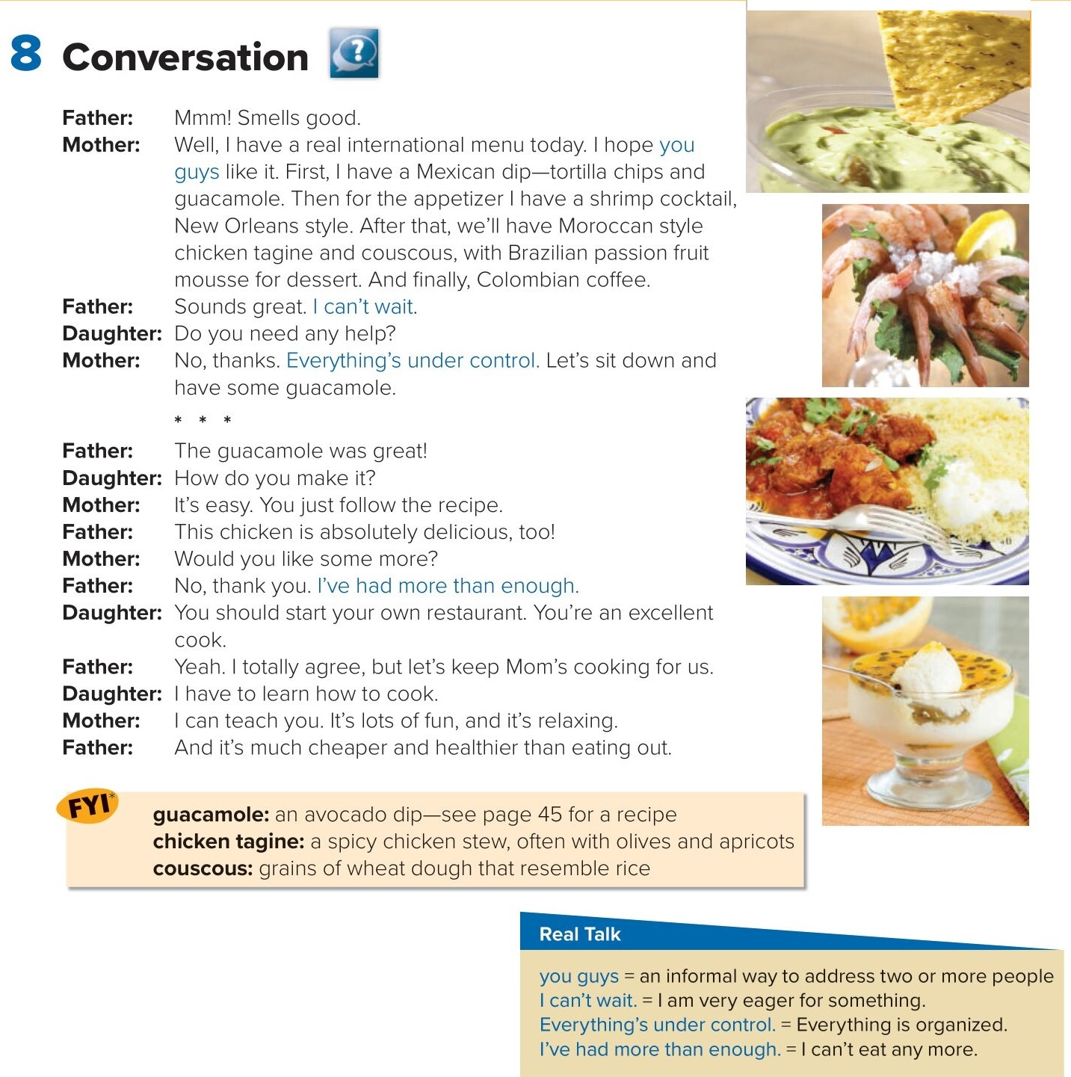

PRESENTATION BY: SLIDECORE

Slide 7
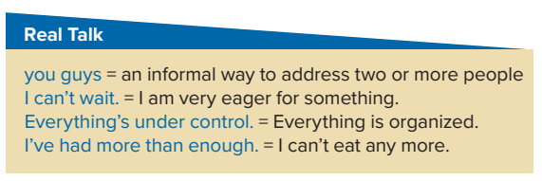
PRESENTATION BY: SLIDECORE

Slide 8
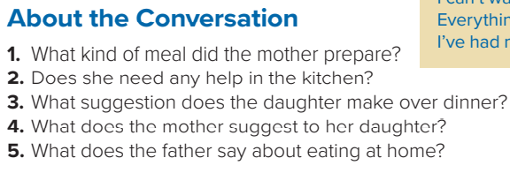
She prepared an international meal.
2. No, she doesn’t.
3. She says that her mother should start her own restaurant.
4. She says that she can teach her daughter how to cook.
5. It is cheaper and healthier than eating out.
PRESENTATION BY: SLIDECORE

Slide 9
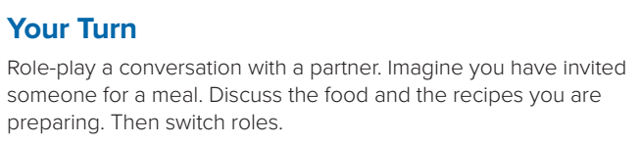
PRESENTATION BY: SLIDECORE

Slide 10
Homework
P.188

Slide 11
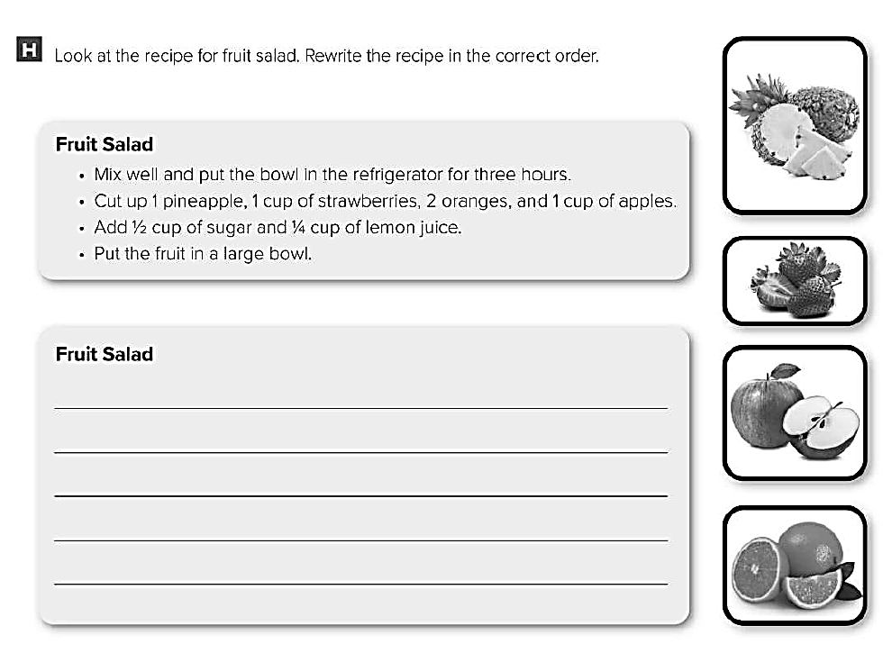
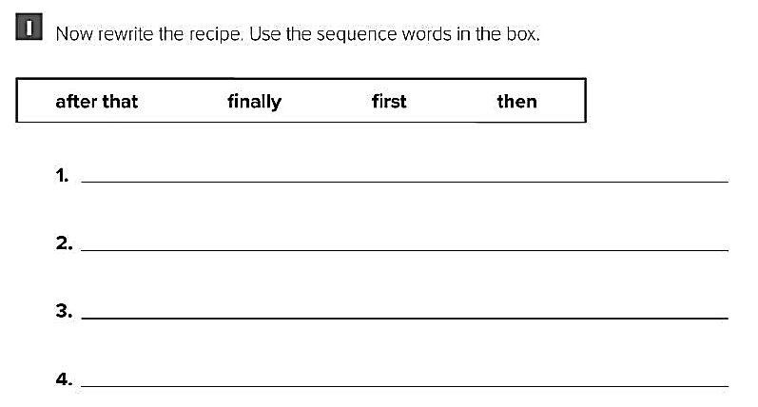
Cut up 1 pineapple , 1 cup of strawberries , 2 oranges , and 1 cup of apples
Add ½ cup of sugar and ¼ cup of lemon juice
Put the fruits in a large bowl .
Mix well and put the bowl in the refrigerator for three hours
First , cut up 1 pineapple , 1 cup of strawberries , 2 oranges , and 1 cup of apples
Then , add ½ cup of sugar and ¼ cup of lemon juice
After that , put the fruits in a large bowl .
Finally , mix well and put the bowl in the refrigerator for three hours

