Slide 1



Welcome to class
T.Hanan Allaheeb

Slide 2
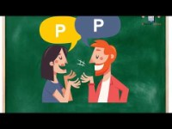

Slide 3


Slide 4
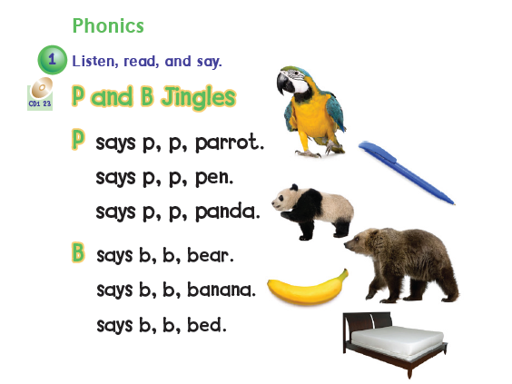

Page 18

Slide 5






Pick a color

Slide 6
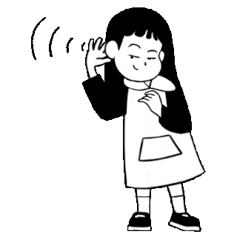



Listen
P or b
___anana

Slide 7

Listen
P or b
___anda

Slide 8

Listen
P or b
___ear

Slide 9

Listen
P or b
___en

Slide 10
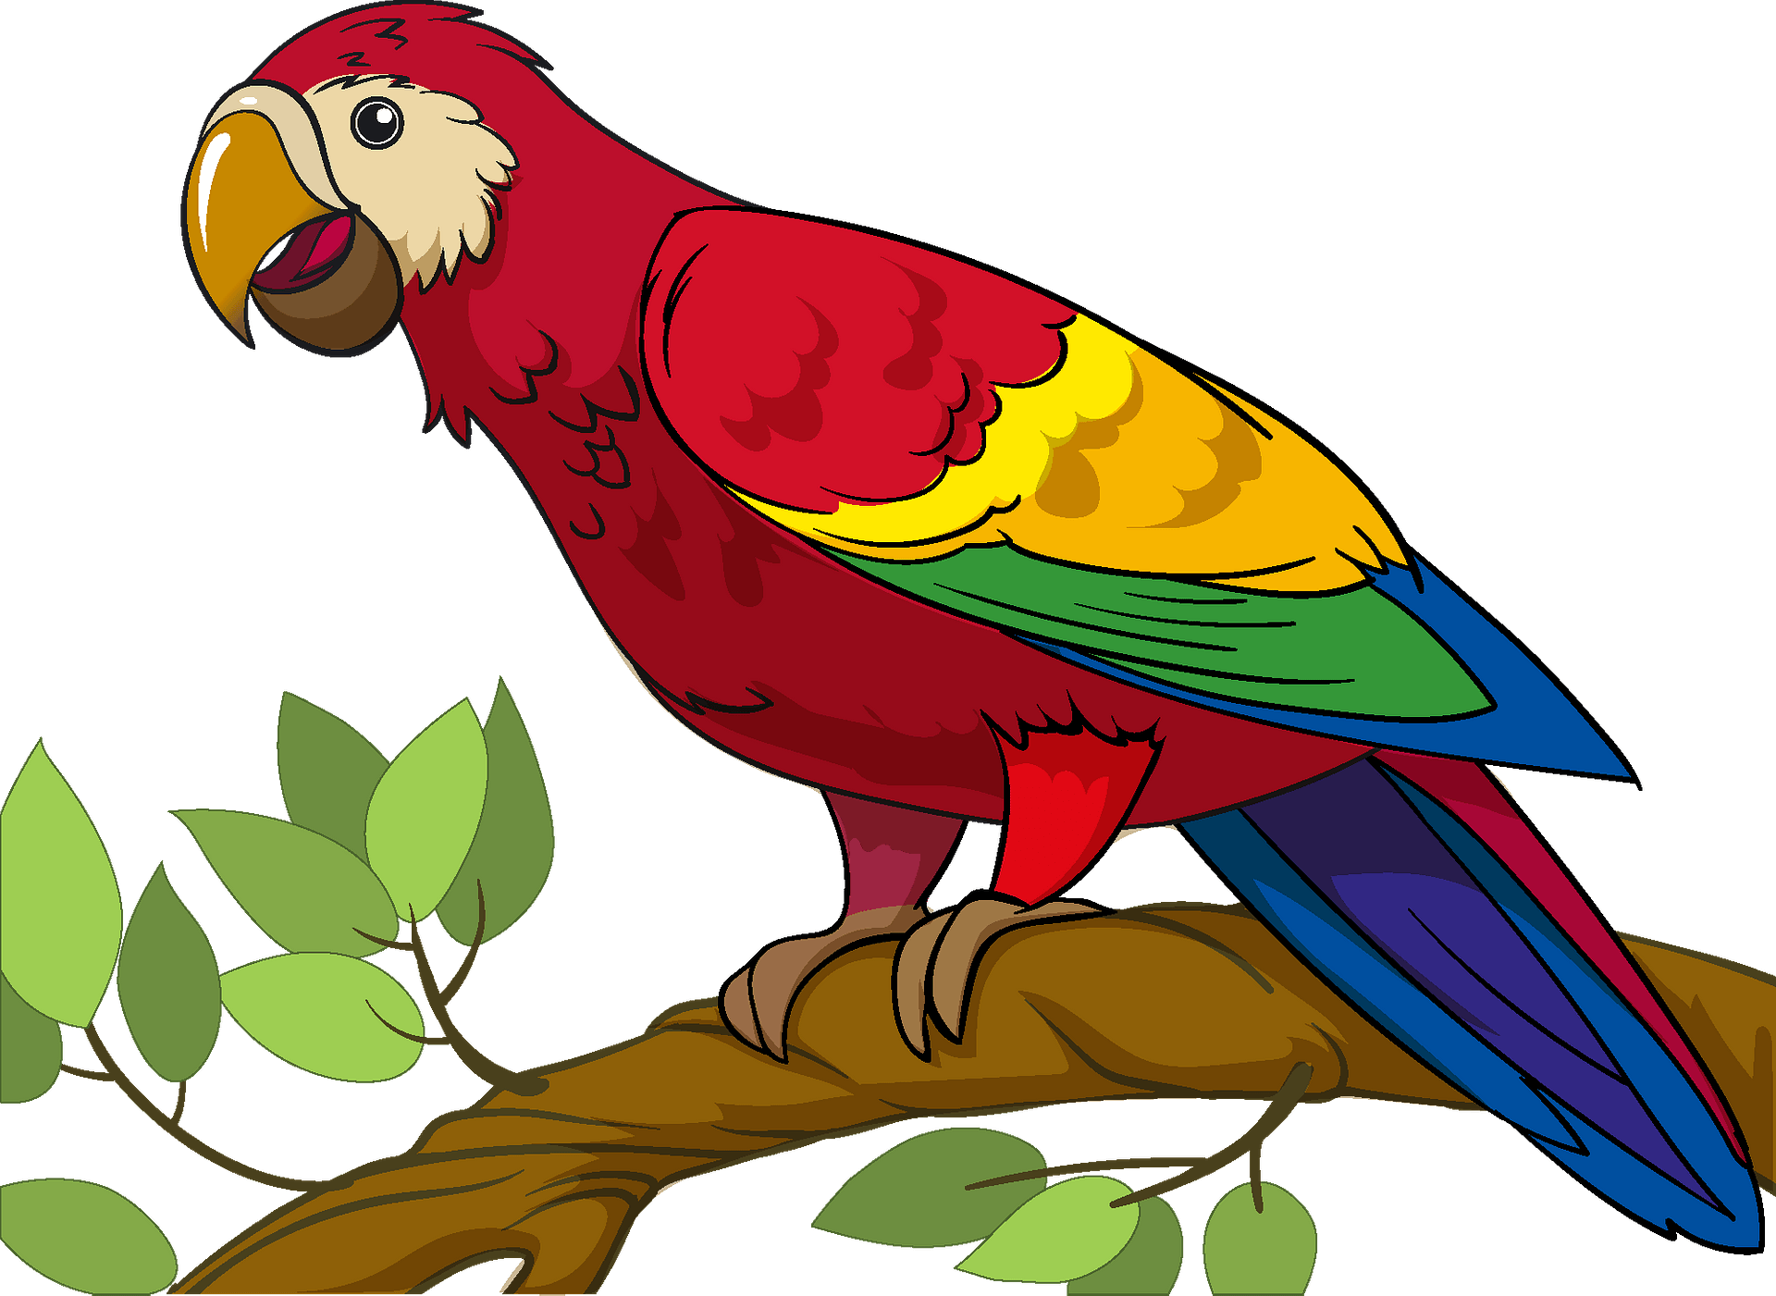
Listen
P or b
___arrot

Slide 11

Listen
P or b
___bed

Slide 12
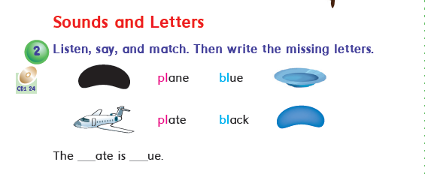
Page 18

Slide 13

Listen
Pl or bl
___ane

Slide 14
Listen
Pl or bl
___ue

Slide 15

Listen
Pl or bl
___ate

Slide 16



