Slide 1
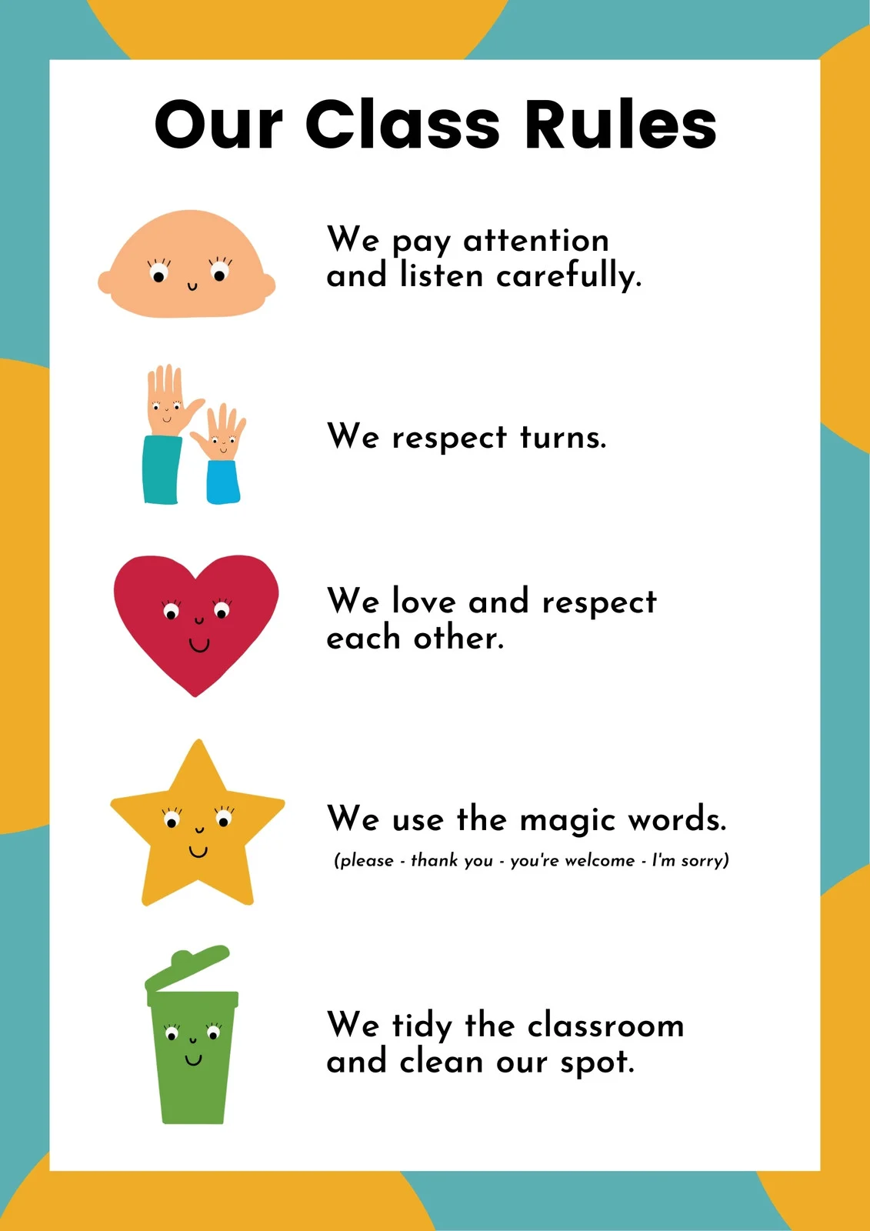



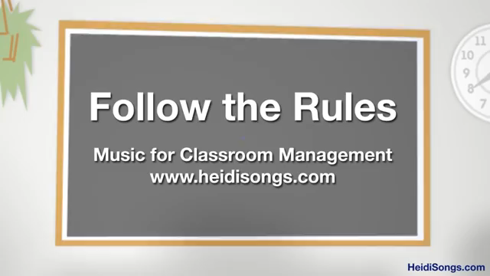

Slide 2
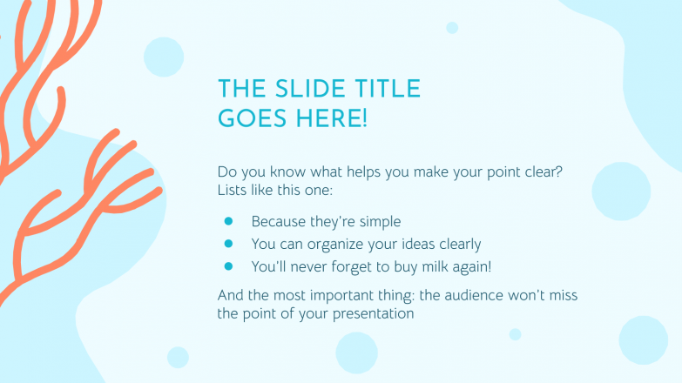

Slide 3
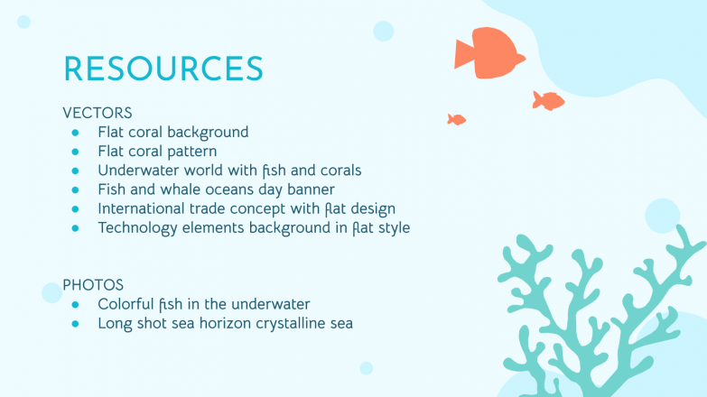
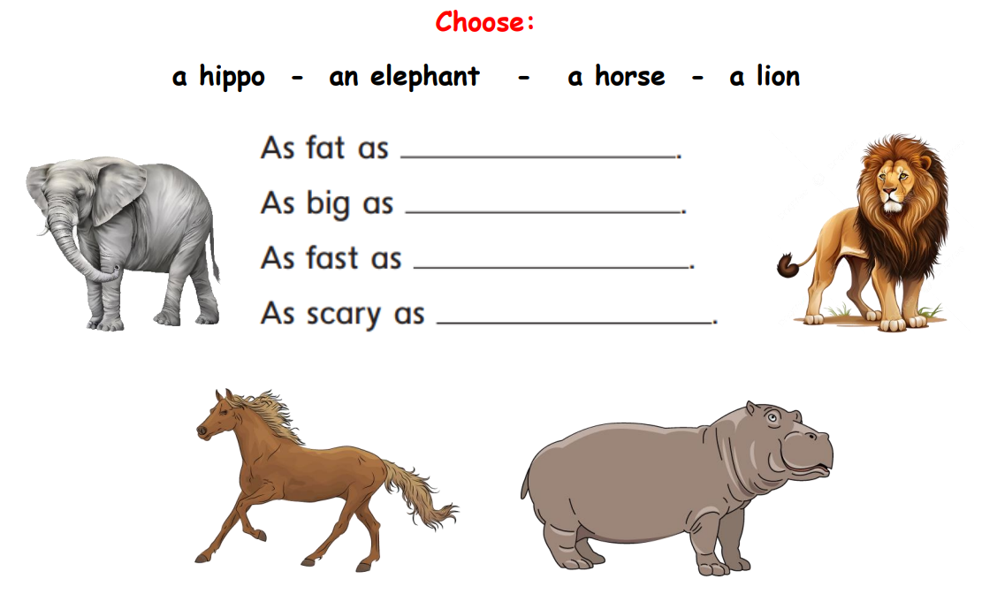
a hippo
an elephant
a horse
a hippo

Slide 4

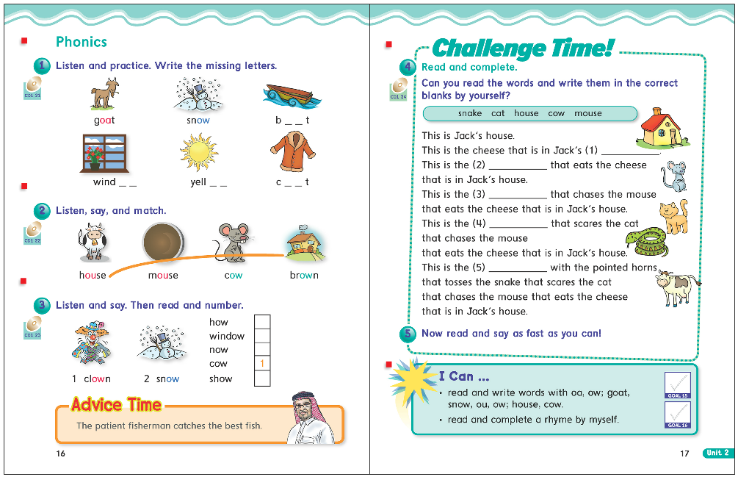

Slide 5


Slide 6
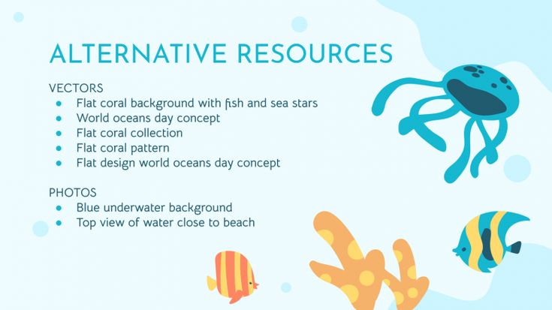
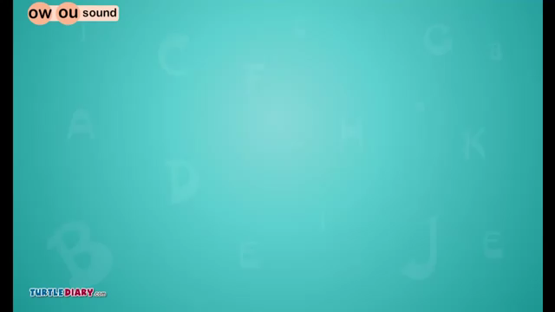

Slide 7
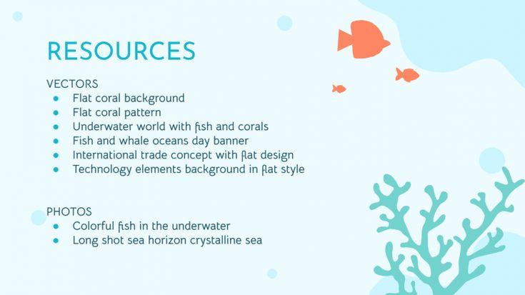
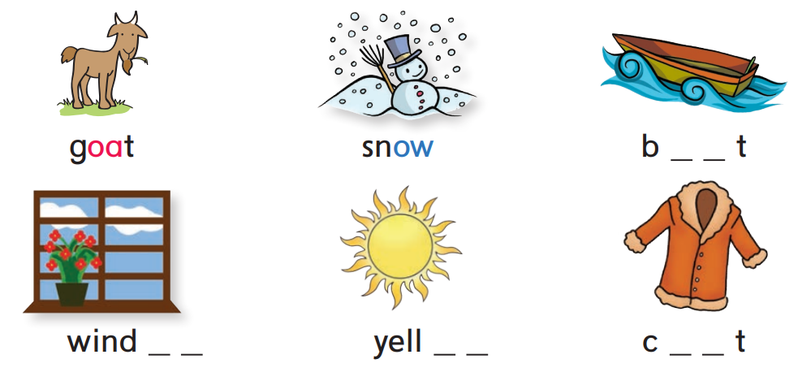

o a
o w
o w
o a

Slide 8




Slide 9
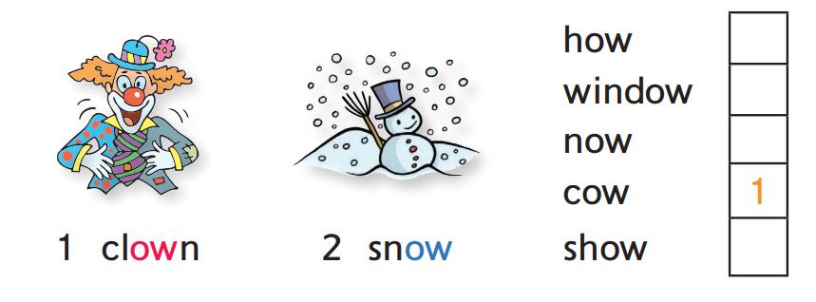

1
2
1
2

Slide 10


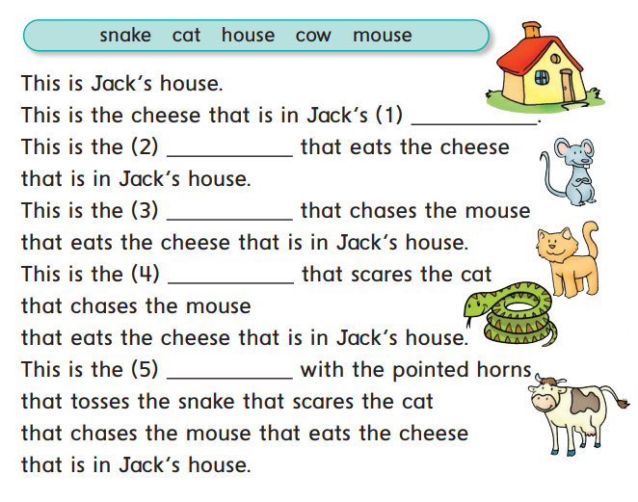


Slide 11
house
mouse
cat
snake
cow

Slide 12
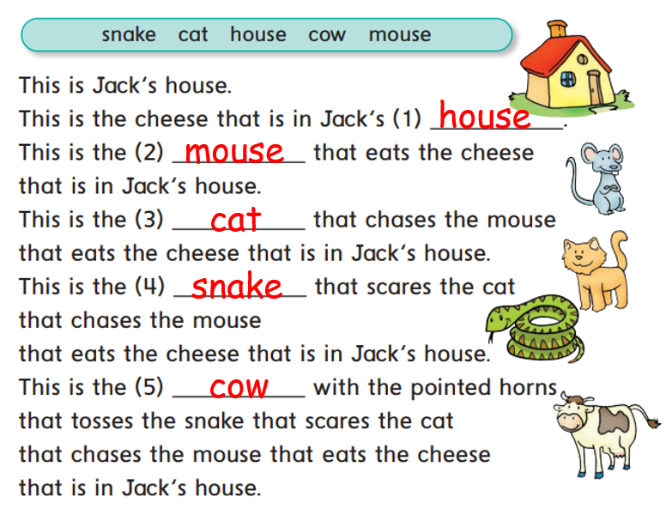

Slide 13



oa
au

Slide 14
oa
au
foam
ouch
goal
blouse
load
cloud
road
loud

Slide 15
ow
ow
cow
window
foam
ouch
goal
blouse
load
cloud
road
loud

Slide 16
ow
ow
bow
low
wow
glow
vow
flow
how
tow

Slide 17


Slide 18

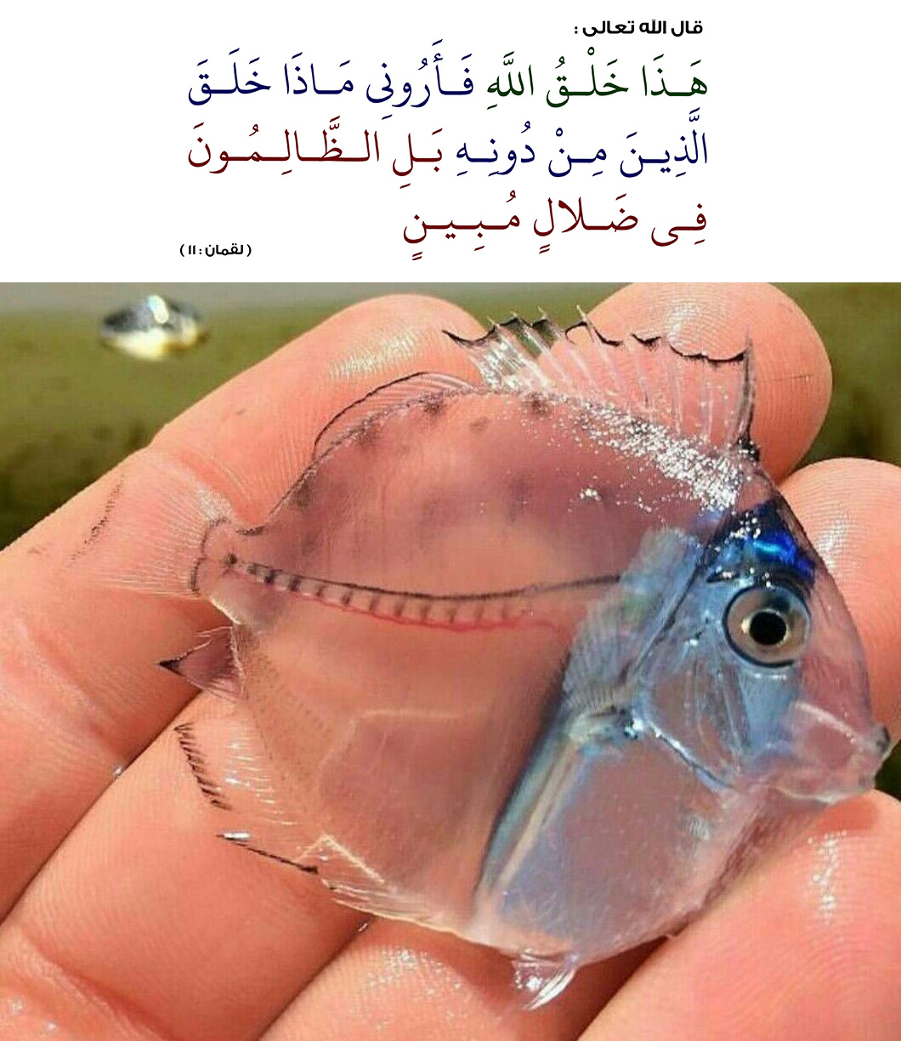

Slide 19


Slide 20
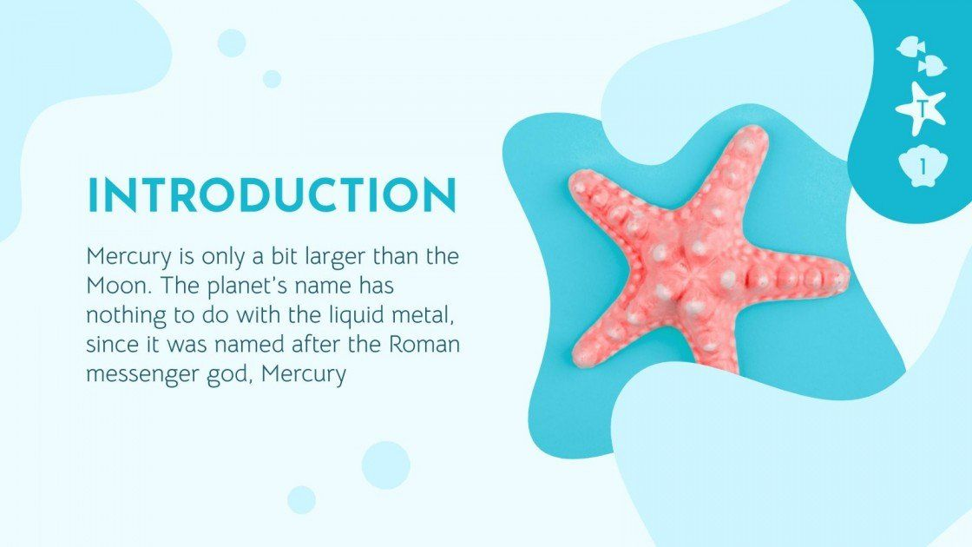


Slide 21

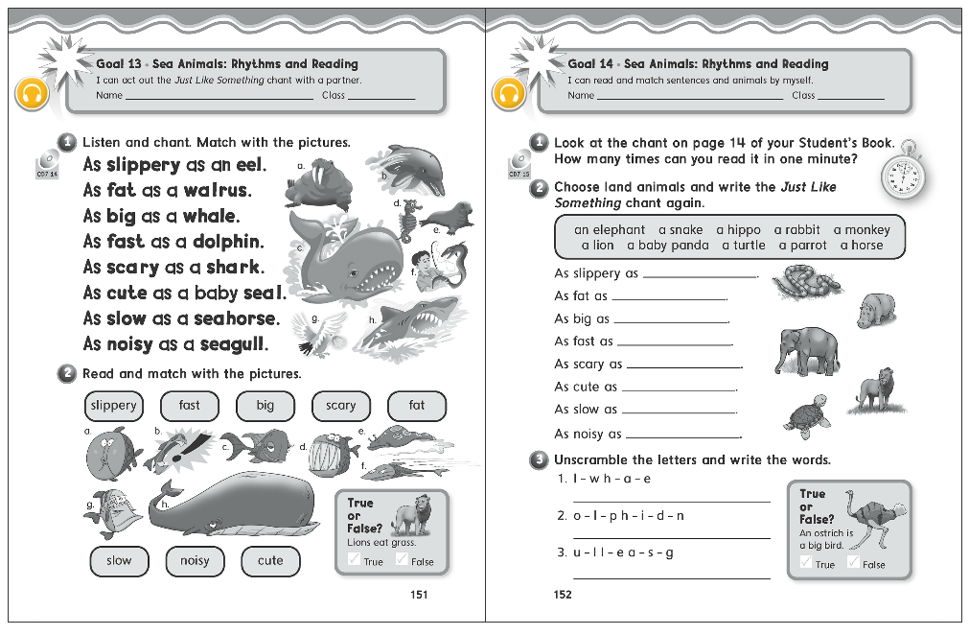

Slide 22
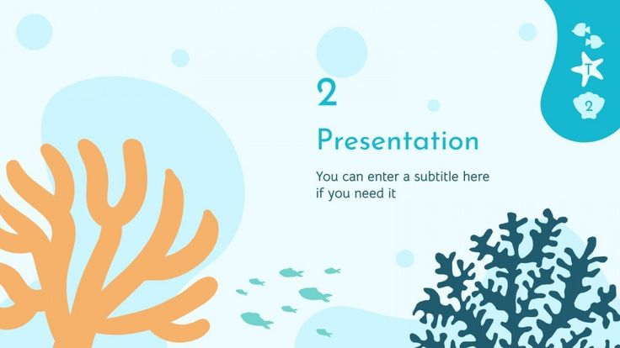
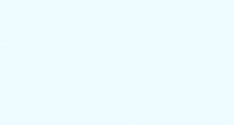
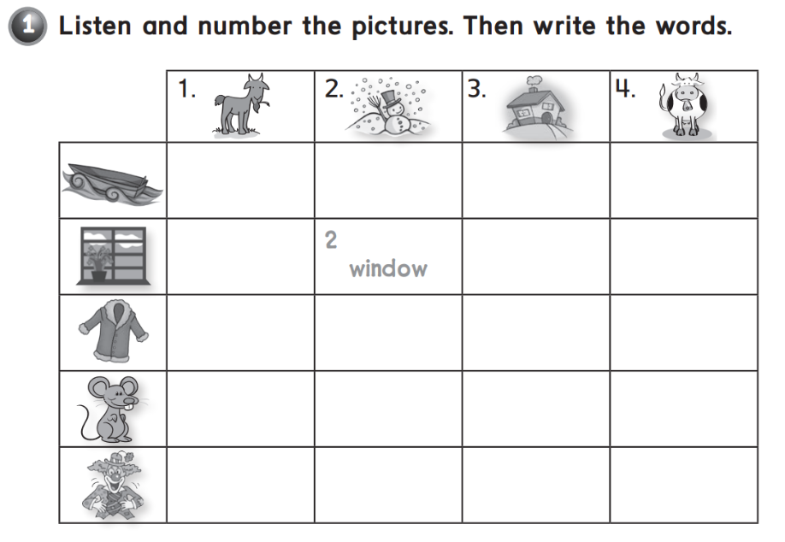

Goat
Snow
House
Cow
1. Boat
1. coat
3. Mouse
4. Clown

Slide 23
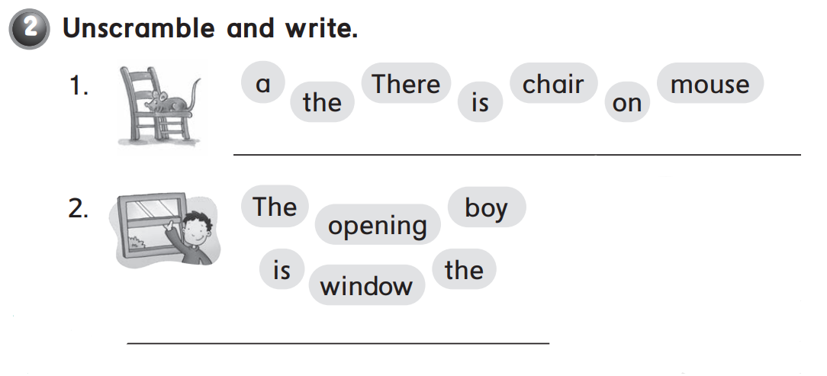
There is a mouse on the chair .
The boy is opening the window .

Slide 24


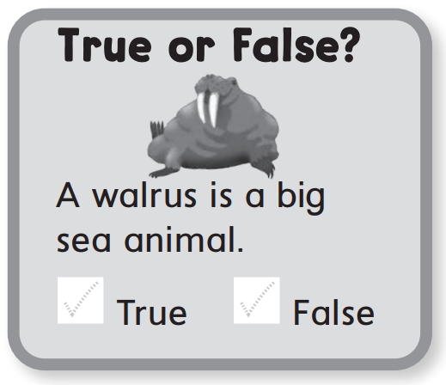

or

Slide 25
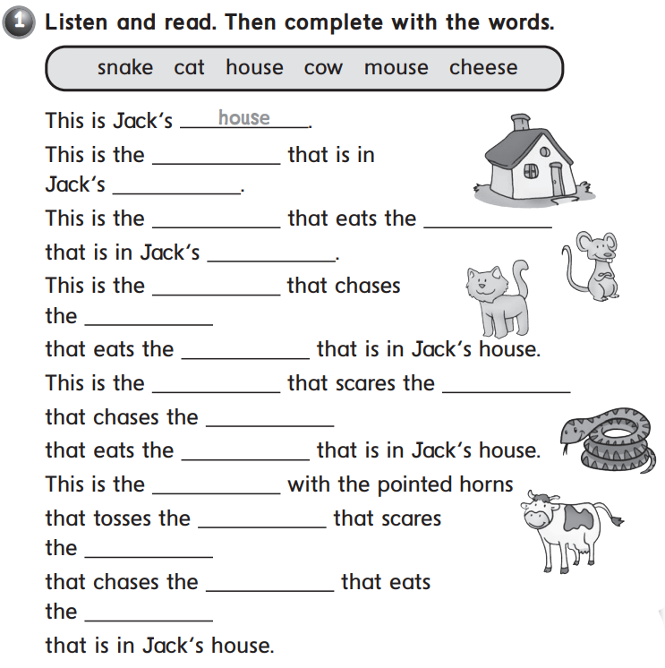


Slide 26
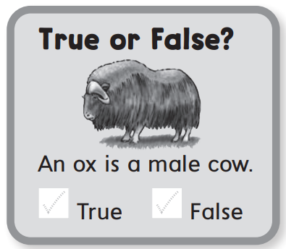
or

Slide 27


Slide 28
