Slide 1
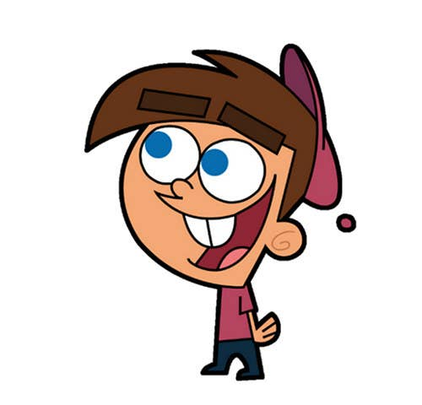


Welcome to class
T.Hanan Allaheeb

Slide 2
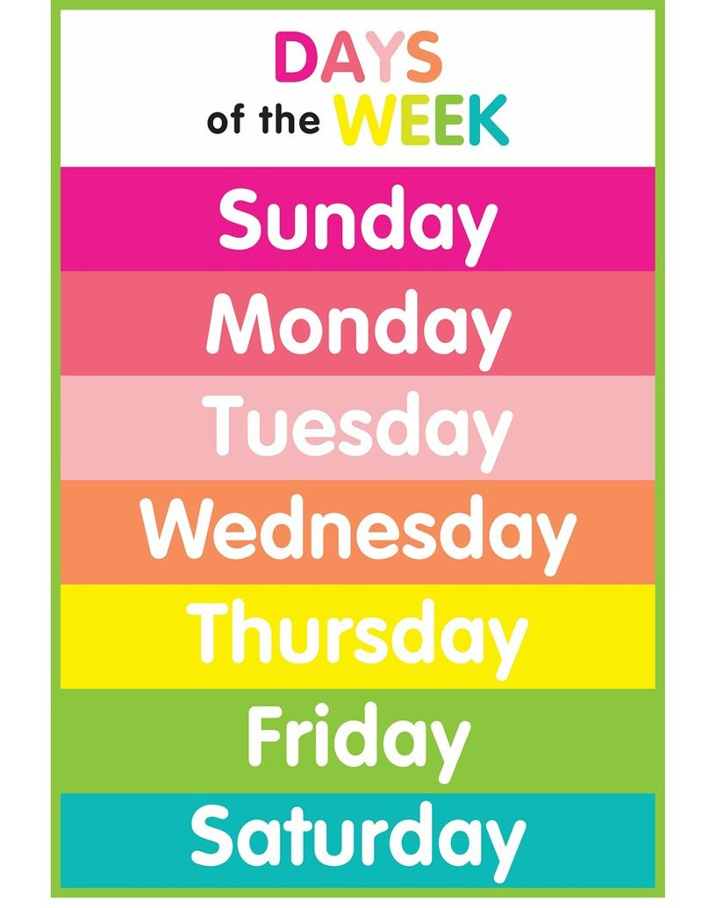

Say the days of the week

Slide 3


W hat day is it today?
It`s…………………..

Slide 4
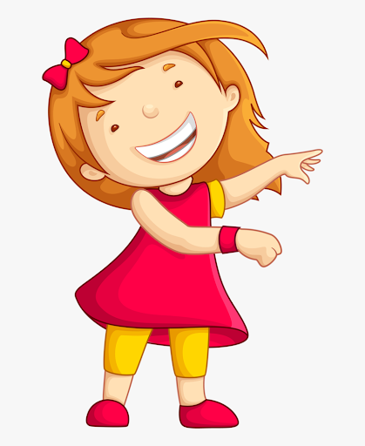


Slide 5
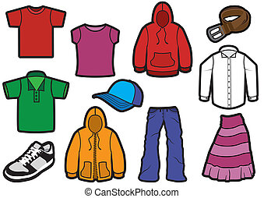
Things we wear

Slide 6
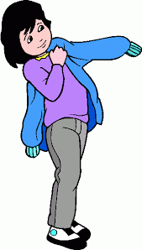
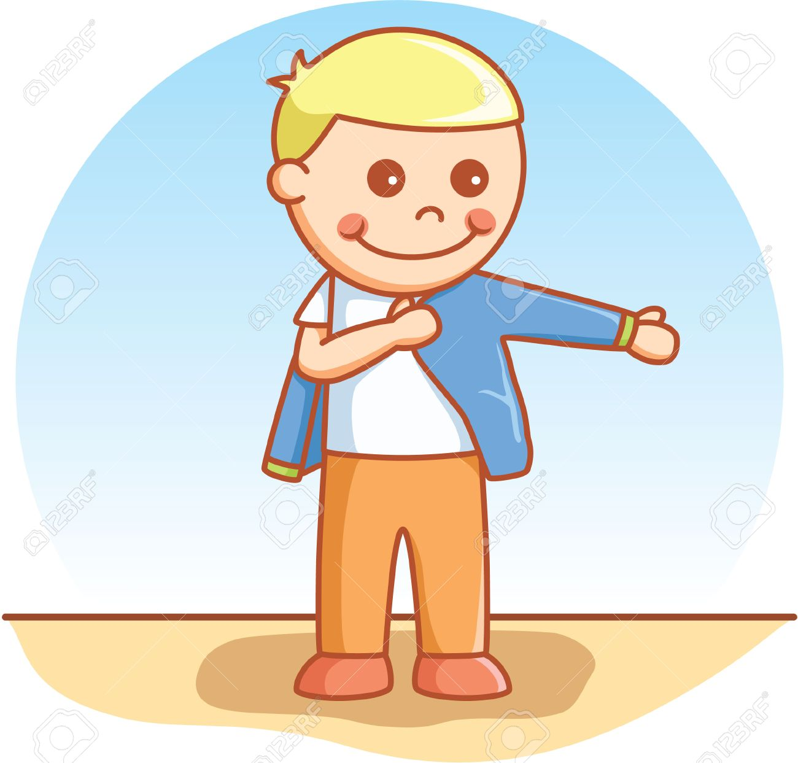
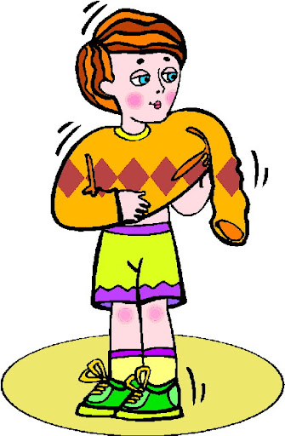
Wear

Slide 7
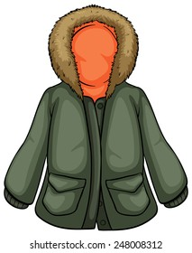

Coat
Hat

Slide 8
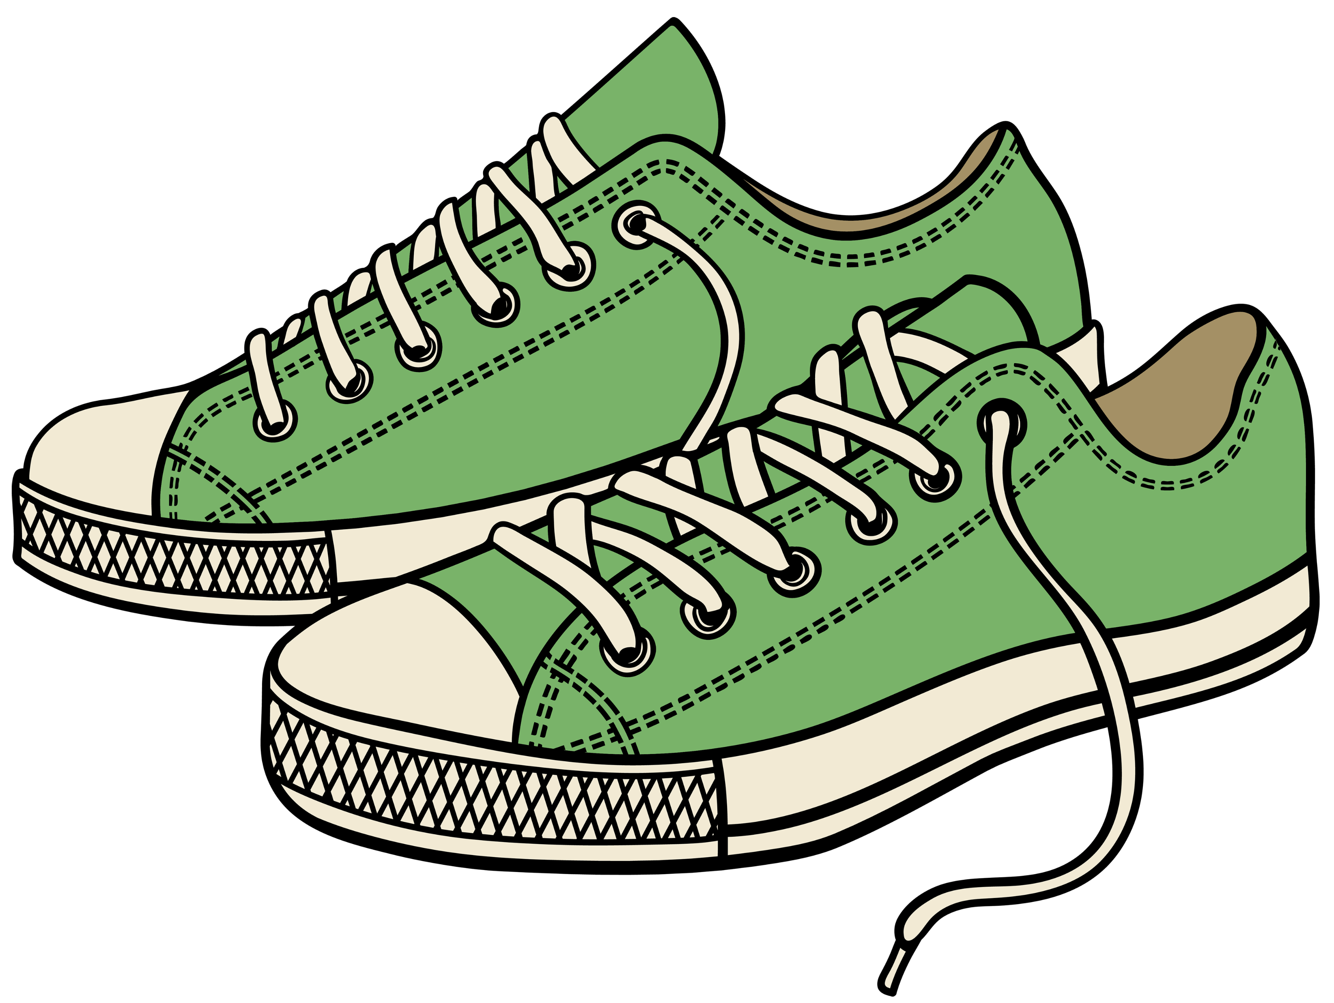
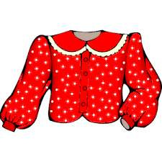
shoes
blouse

Slide 9
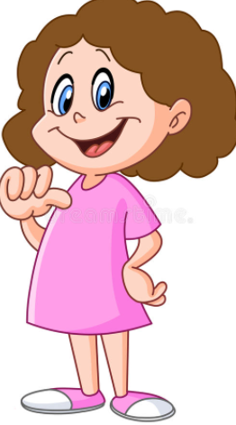
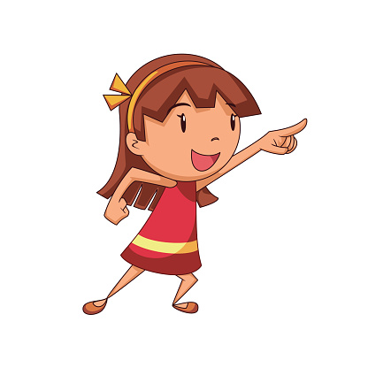
Listen
It`s my hat.
Whose hat is this?

Slide 10
Practice
It`s my hat.
Whose hat is this?

Slide 11
Listen
It`s mine.
Whose hat is this?

Slide 12
Practice
It`s mine.
Whose hat is this?

Slide 13
Practice
mine
It`s ………….
Whose coat is this?

Slide 14
Practice
my
It`s ……coat.
Whose coat is this?

Slide 15

Listen
It`s not my hat.
Whose hat is this?

Slide 16
Practice
It`s not my hat.
Whose hat is this?

Slide 17
Listen
It`s not mine.
Whose hat is this?

Slide 18
Practice
It`s not mine.
Whose hat is this?

Slide 19
Practice
mine
It`s ………….
Whose coat is this?

Slide 20
Practice
my
It`s …….. Coat.
Whose coat is this?

Slide 21
Practice
not mine
It`s ………….
Whose coat is this?

Slide 22
Practice
not my
It`s ……..…coat.
Whose coat is this?

Slide 23
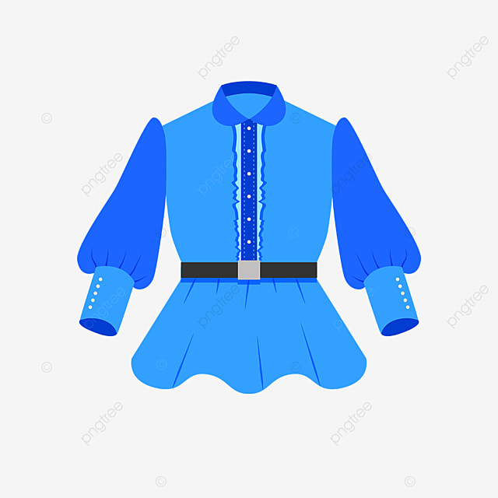
My or mine
My or mine
It`s………….blouse.
It`s…………

Slide 24

My or mine
My or mine
It`s…………..
It`s…………cap

Slide 25

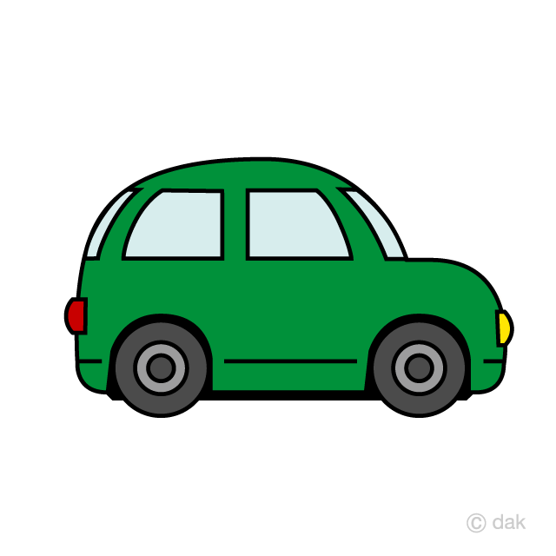
True or false
True or false
It`s mine car.
It`s my car.

Slide 26
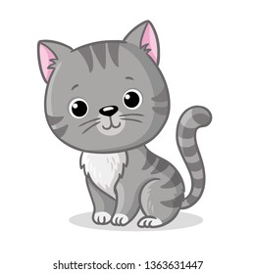
True or false
True or false
It`s mine .
It`s mine cat.

Slide 27

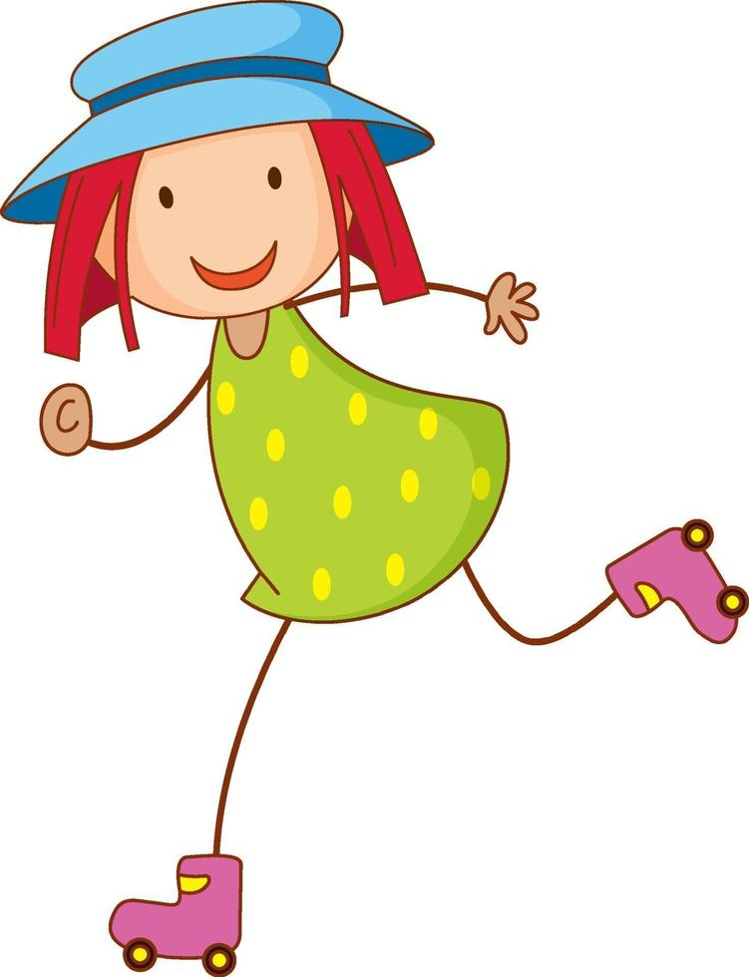
Listen
Wow! I like your hat.
Thank you

Slide 28
practice
Wow! I like your hat.
Thank you

Slide 29
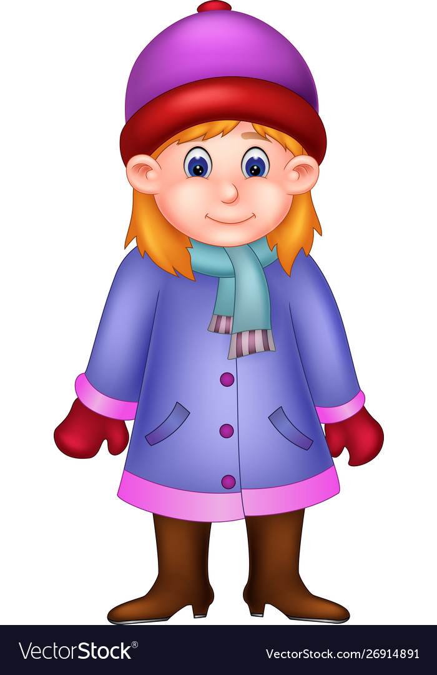
practice
……………….
………….

Slide 30
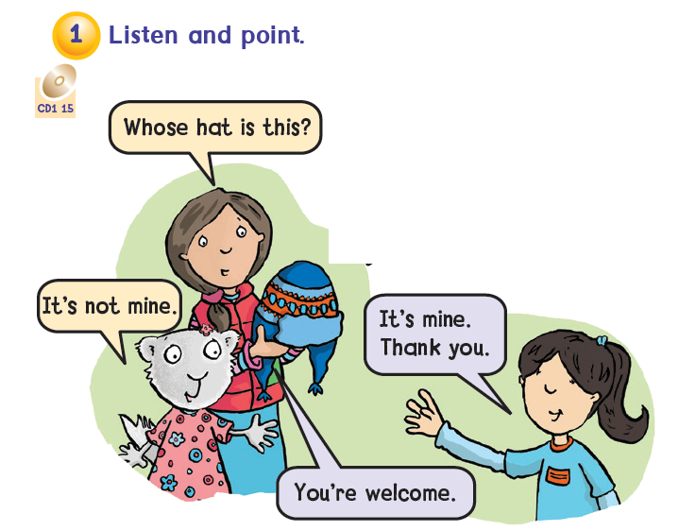


Slide 31
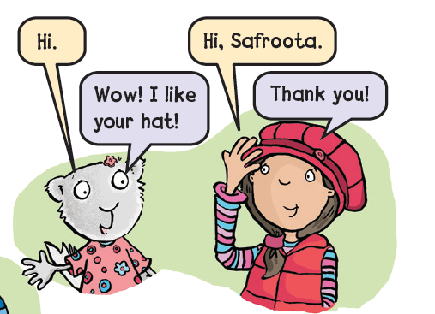

Slide 32
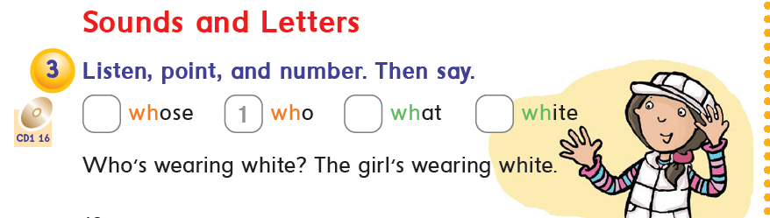

Slide 33


