Slide 1
Unit4 The World of TV Form, Meaning & Function
Mega Goal 3.1
Done by: Entisar Al-Obaidallah

Slide 2
Lesson Objectives
1. Differentiate between comparative and superlative forms.
2. Compare between people or things using comparative forms.
3. Form meaningful sentences using superlative forms.
4. Use as + adj + as to compare things.
5. Practice using words connected with Space and the Planetary System.
6. Distinguish between irregular comparative and superlative adjectives

Slide 3
Warm UP

Slide 4
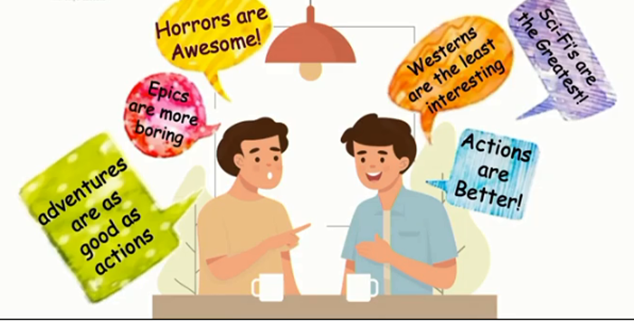
In the following picture two men are discussing the genres of film they like . What did they say about it??

Slide 5
better
The greatest
The least interesting
As good as
awesome
More boring
adjectives
Comparison

Slide 6

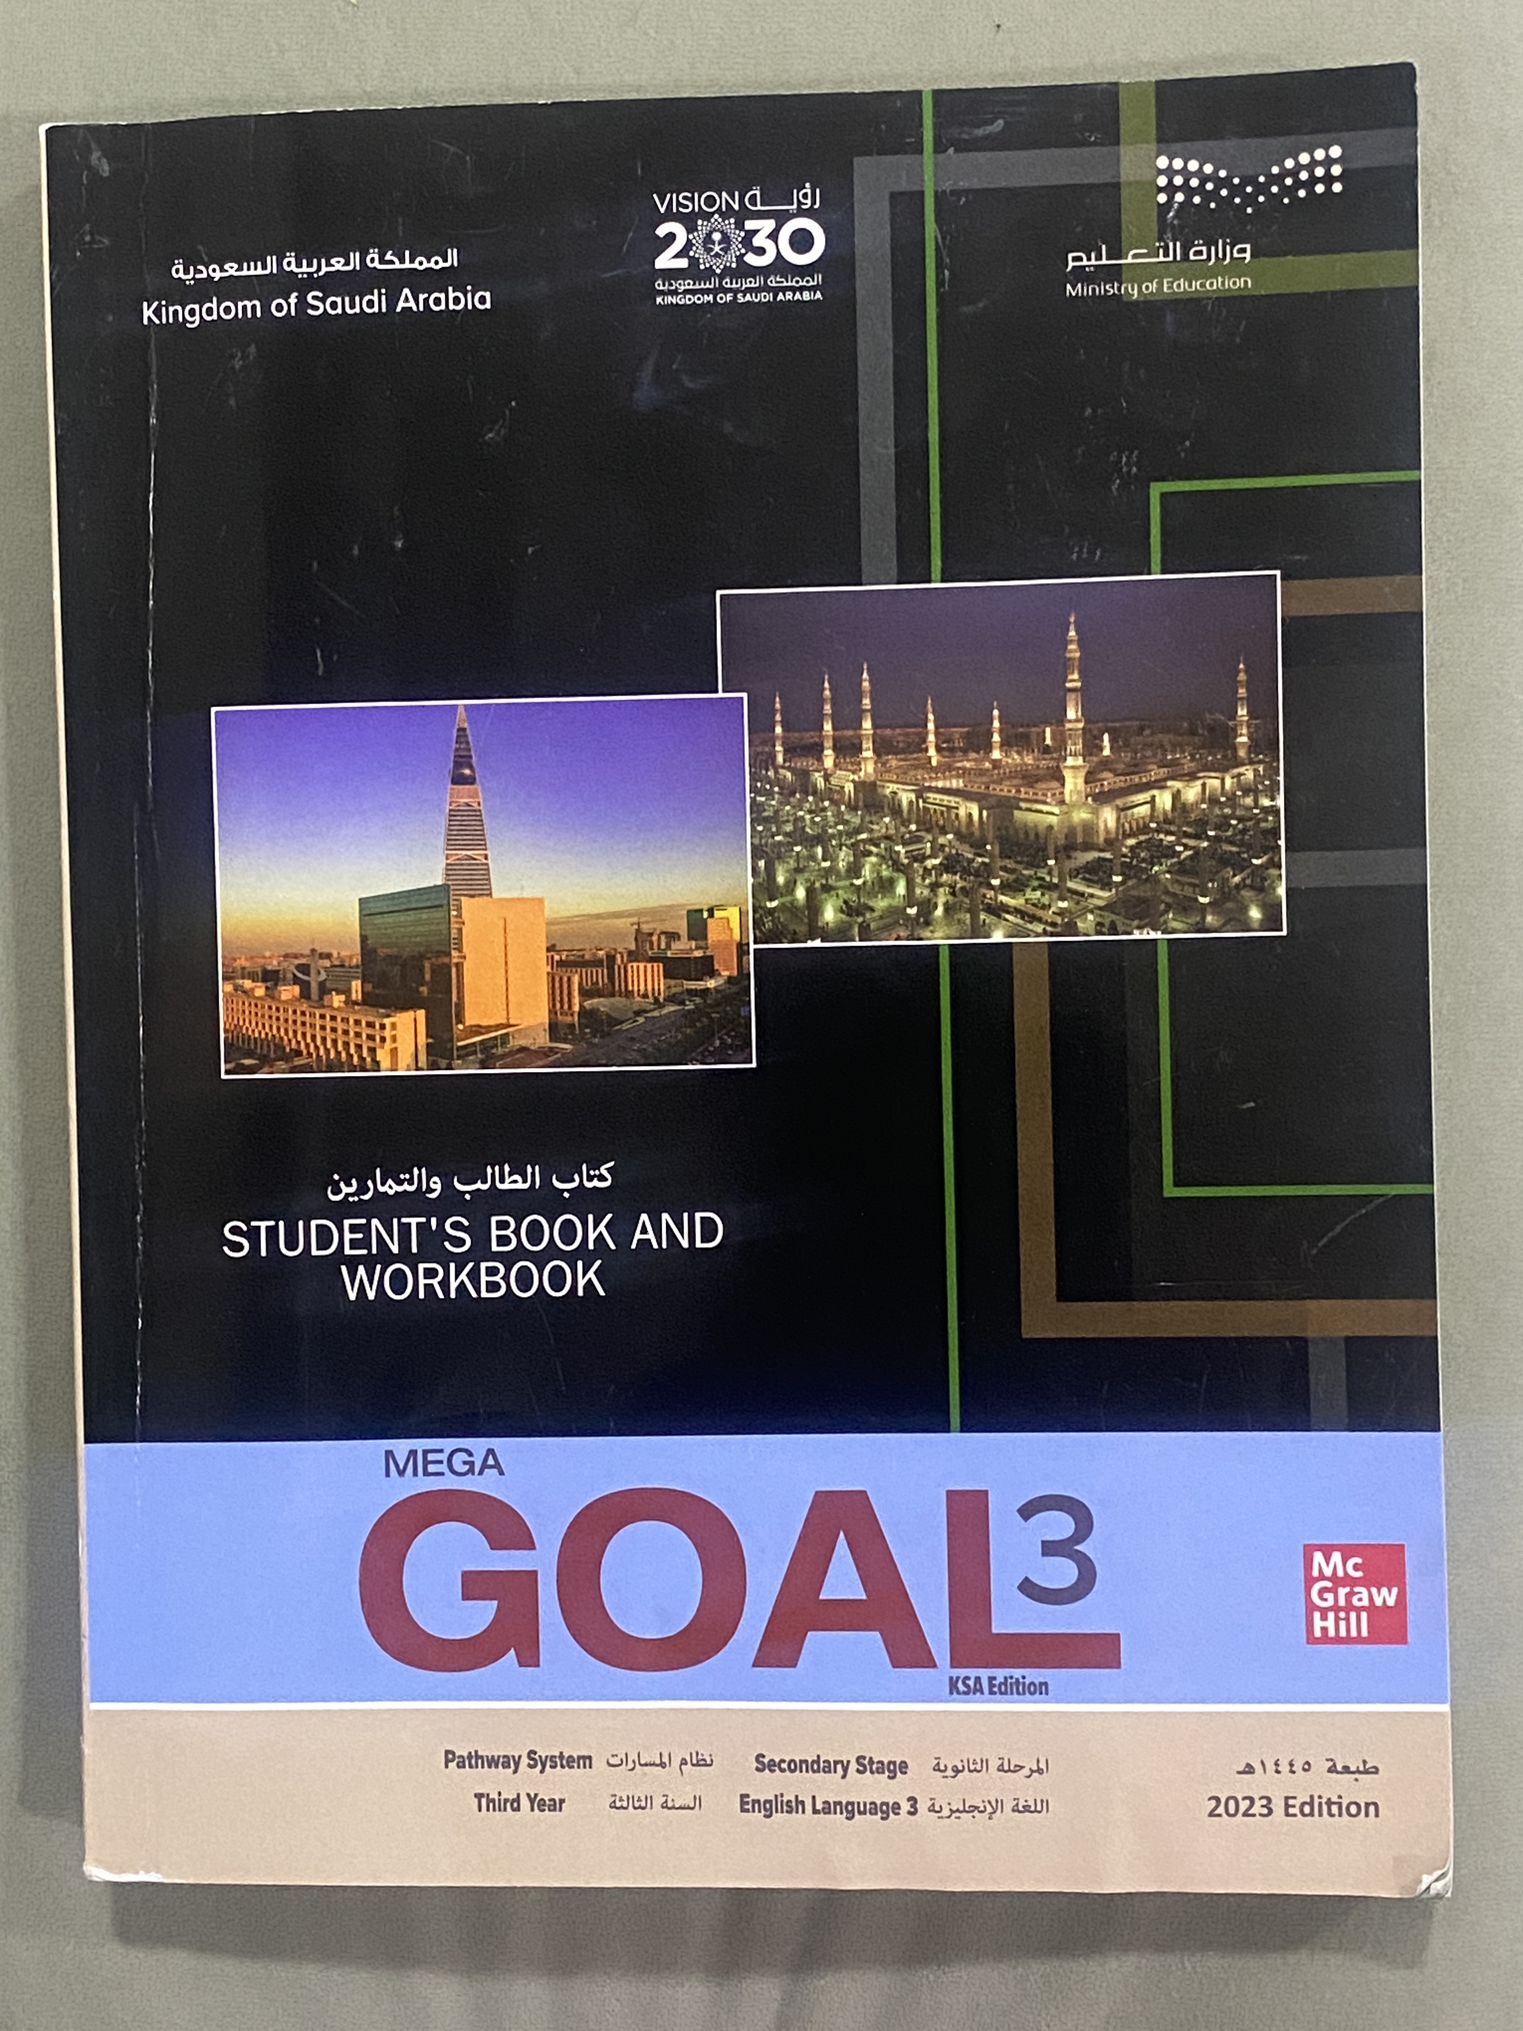
Open
Your student’s book
p. (64)

Slide 7
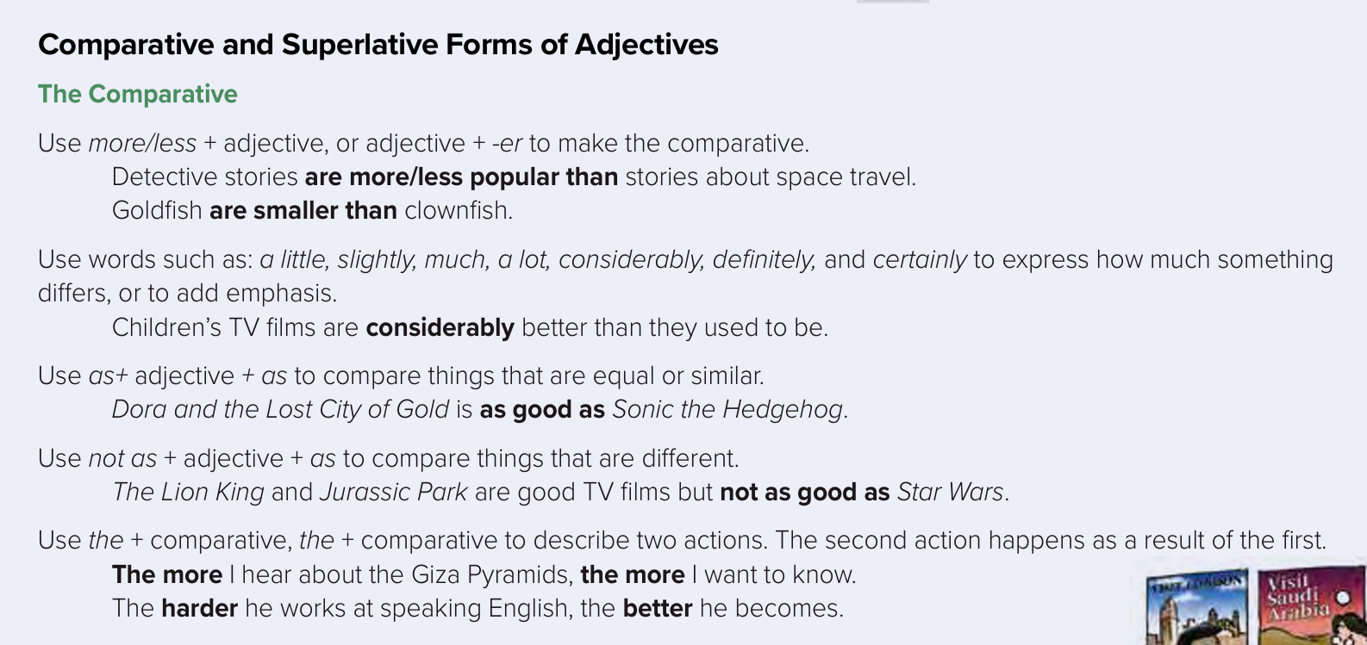

Slide 8


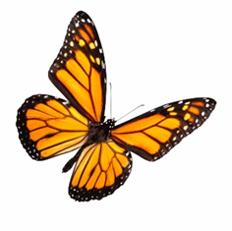
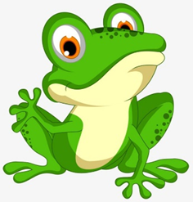
Comparative
➔Comparatives are used to show the difference between two objects.
The ant is smaller than the elephant
Butterfly is more beautiful than frog .

Slide 9
The adjectives are two kinds :
Adjectives
Short adjectives
Long adjectives
5 letters and fewer
More than 5 letters
Small – big – tall - easy
Expensive- beautiful

Slide 10
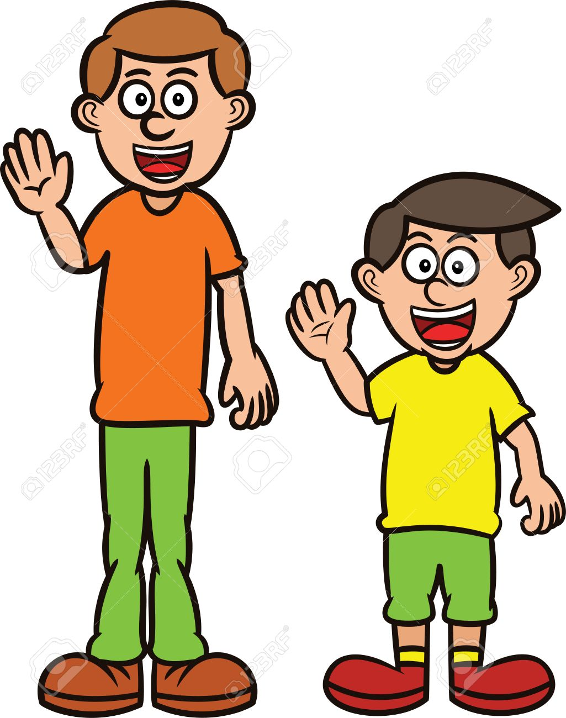
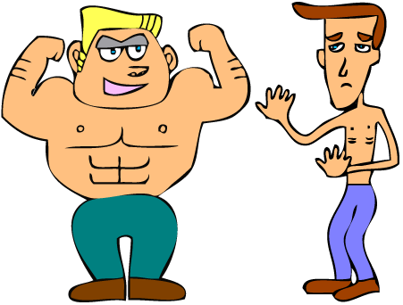
Rules
1- When we compare using short adjectives (one or two syllables), we add –er + than at the end of the adjective.
Example :
Sami is taller than Maher.
tall
taller
The blond man is stronger than the thin man.
strong
stronger

Slide 11
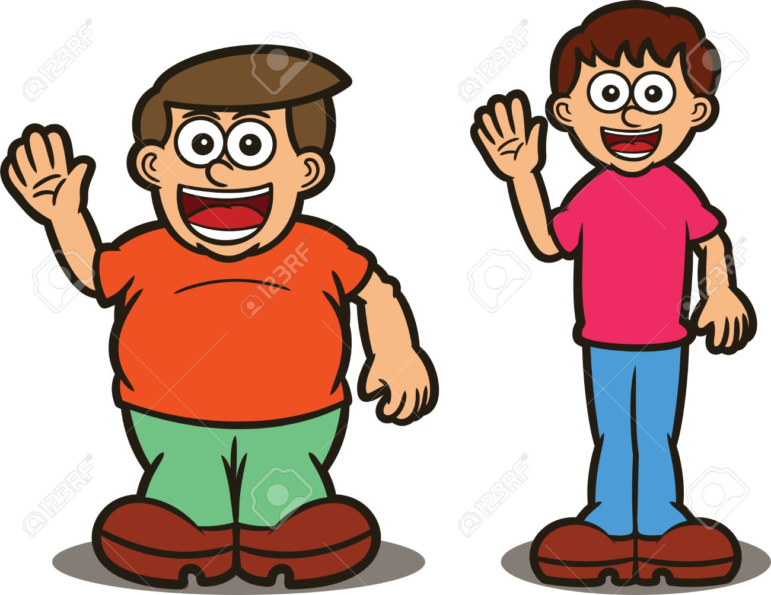
2- If an adjective ends in one vowel + consonant (a,e,i,o,u) (b,c,d,f,g,h,j,k,l,m....) ➔we double the consonant and add -er
Example :
Salem is fatter than Saad
fat
fatter

Slide 12


3- If and adjective ends with –y, we change it to –i and add –er
Example :
The blue whale is heavier than shark
heavy
heavier

Slide 13
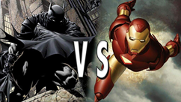
3- If and adjective ends with e, we add –r only
Example :
Batman is braver than iron man
brave
braver

Slide 14
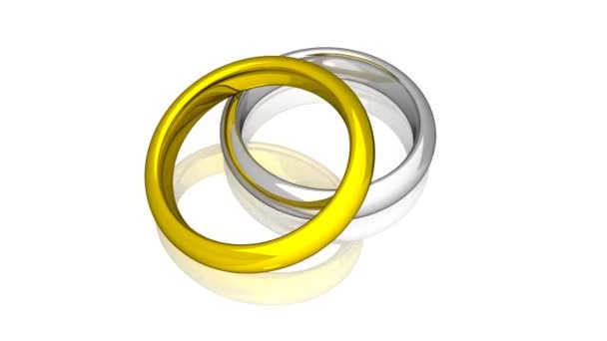
4 – When we compare 2 things or people using long adjectives
(three or more syllables), we add:
more + adjective + than
Example :
Gold is more expensive than silver
expensive
More expensive

Slide 15
5- There are a few exceptions:
Good
Better than
Worse than
bad
far
Farther than

Slide 16

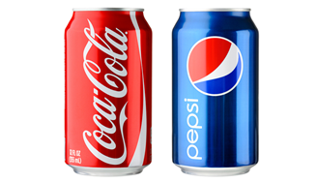
Example :
Coca Cola is better than Pepsi.
Good
Better than

Slide 17

Remember
when using a comparative you must always follow it with the word “than”.

Slide 18
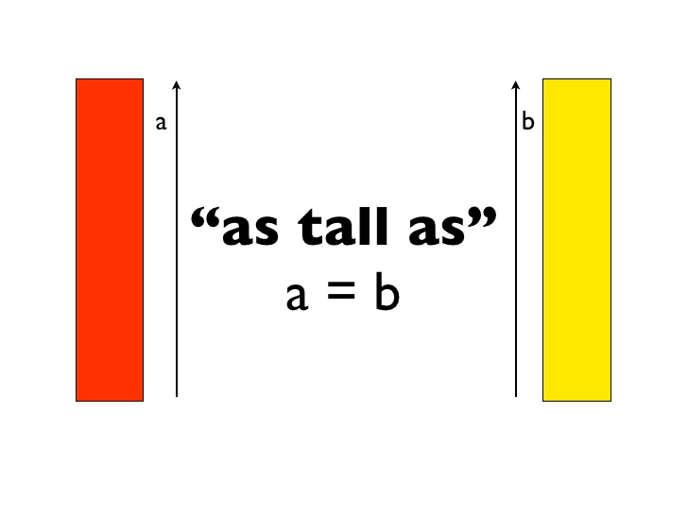
Rule
1- Use as + adjective + as to compare things that are equal or similar
Example :
Red building is as tall as Yellow one
as
adjective
as

Slide 19
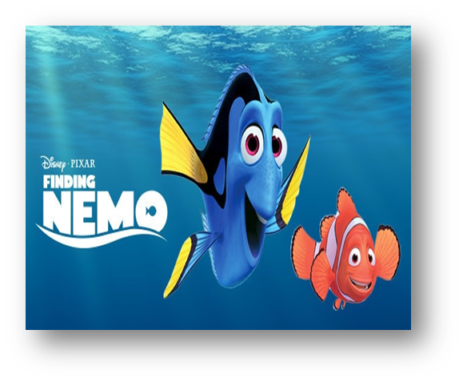
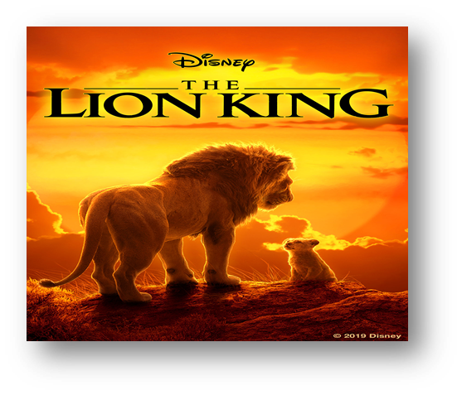
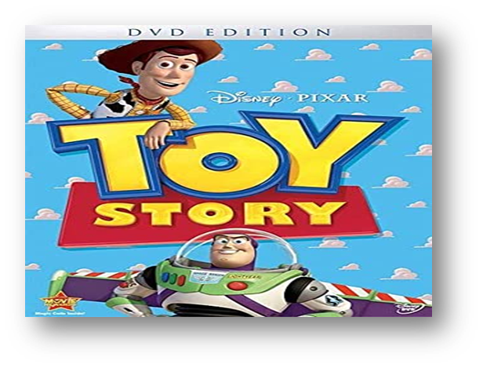
Rule
2- Use not as + adjective + as to compare things that are different
Example :
Finding Nemo & Toy Story are good films but not as good as The Lion King
Not as
adjective
as

Slide 20
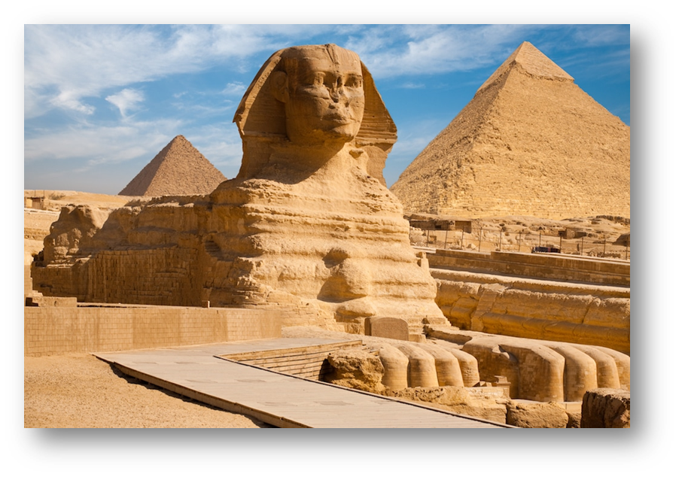
3- Use the + comparative , the + comparative to describe two actions
Example :
The more I hear about the Giza Pyramids , the more I want to know
the
comparative
the
comparative

Slide 21
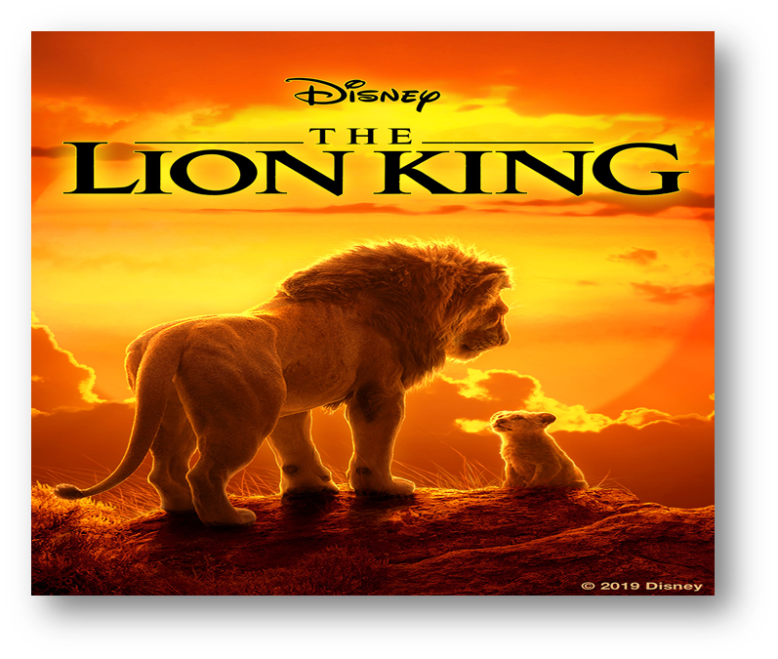
4 – We can use the expression by far to add emphasis
Example :
The lion King is by far The best TV film of all

Slide 22
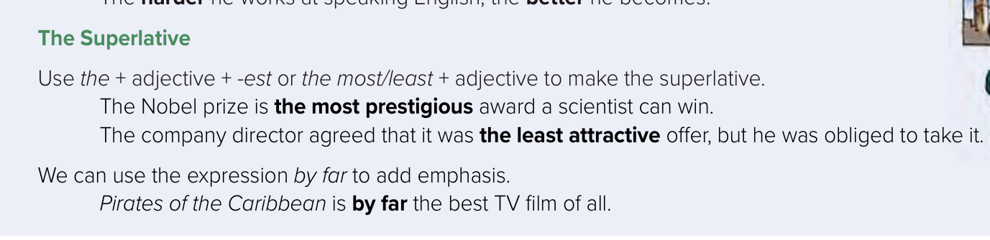

Slide 23
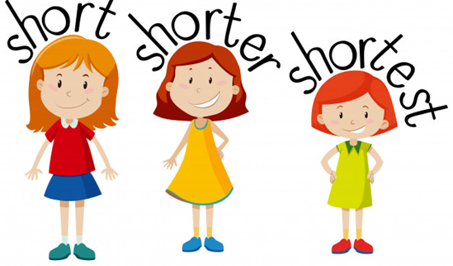
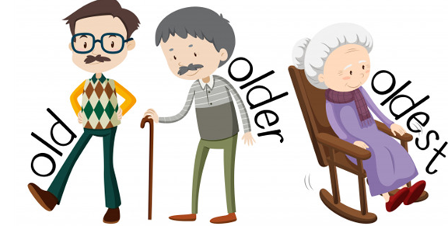
Rules
1- When we compare using short adjectives (one or two syllables), we add the + adjective + –est
Example :
Sara is the shortest
short
The shortest
She is the oldest
old
oldest

Slide 24
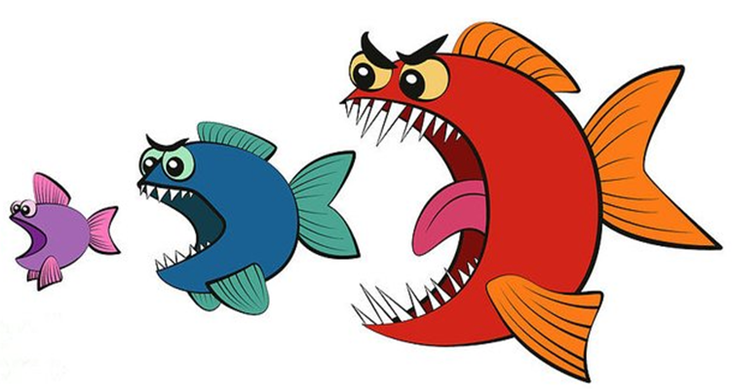
2- If an adjective ends in one vowel + consonant (a,e,i,o,u) (b,c,d,f,g,h,j,k,l,m....) ➔we double the consonant and add -est
Example :
The red fish is the biggest of all
big
The biggest

Slide 25
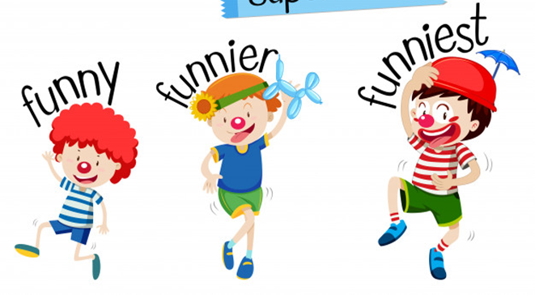
3- If and adjective ends with a –y, we change it to –i and add –est
Example :
The clown with red hat is the funniest of all
funny
funniest

Slide 26
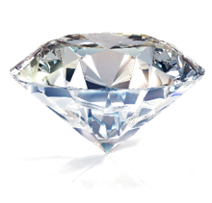
4 – When we compare using long adjectives ( three or more syllables) we add the most + adjective
Example :
Dimond is the most expensive of all
expensive
The most expensive

Slide 27
5- There are a few exceptions:
Good
The best
The worst
bad
far
The farthest

Slide 28
Open
Your student’s book
p. (65)

Slide 29
Words Connected with Space and the Planetary System

Slide 30
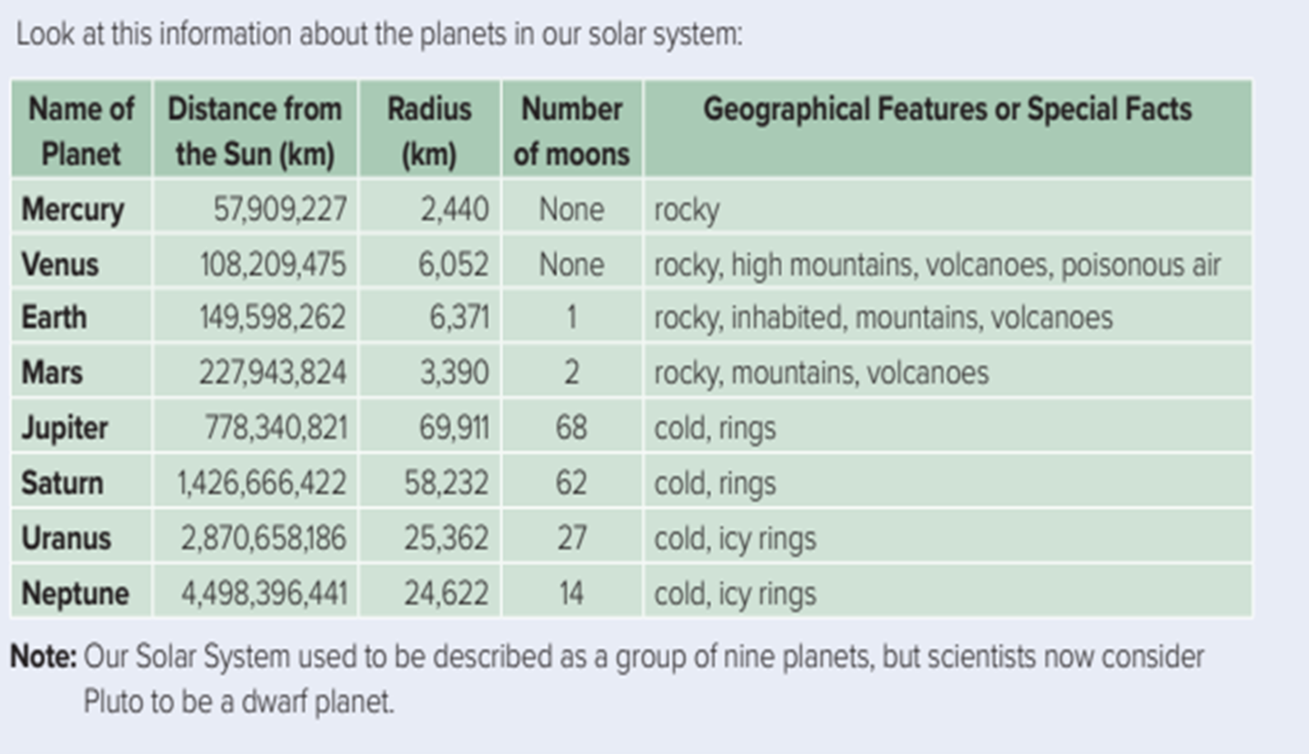

Slide 31
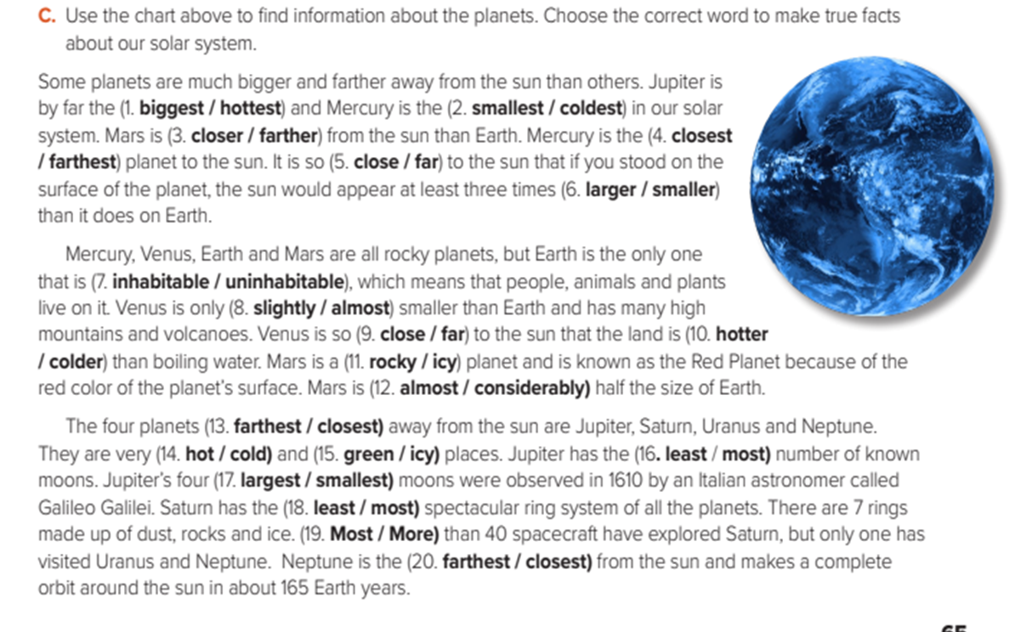

Slide 32
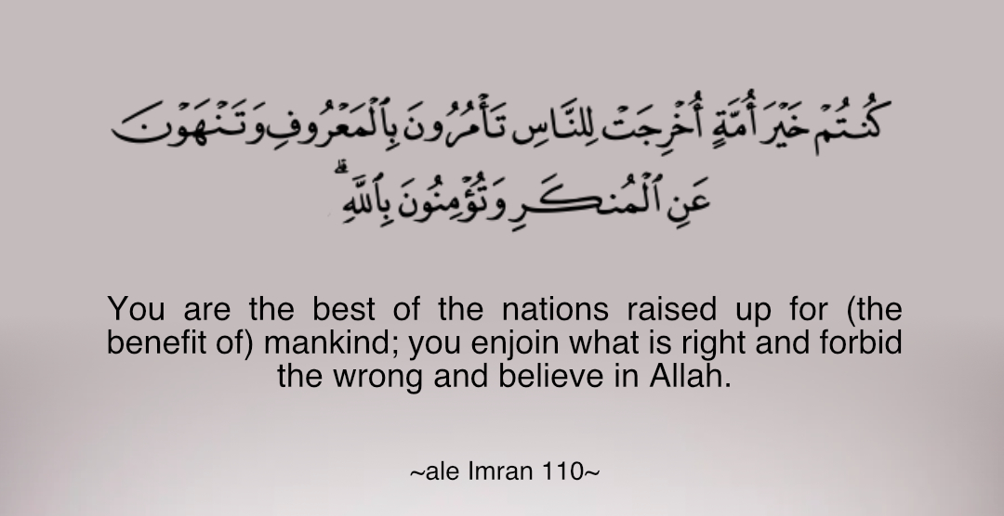

Slide 33
Homework
Workbook p.(252) ,
exercise ( D)

Slide 34


Thanks!

