Slide 1


Unit 4
The World of TV
Conversation + Listening
Mega Goal 3.1
Done by: Entisar AL-Obaidallah

Slide 2
Lesson Objectives
01
03
02
04
Answer
Listen
Some comprehension questions about the conversation
For specific information from a TV interview about office design
Practice
Deduce
agreeing and disagreeing with opinion
The meaning of the new words

Slide 3


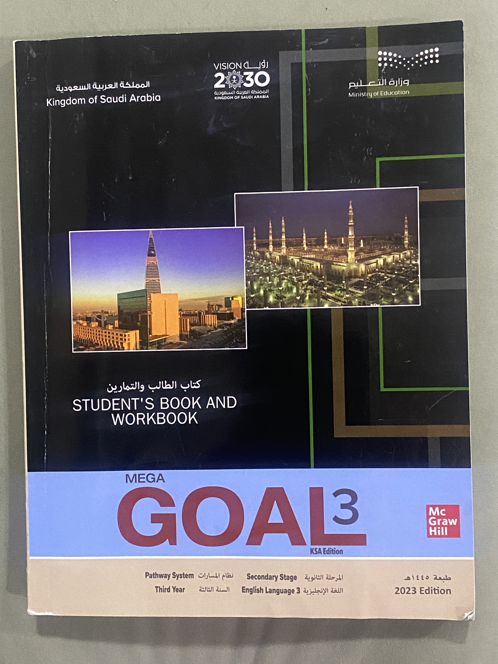
Open
Your student’s book , p.(58)

Slide 4
01
Conversation

Slide 5
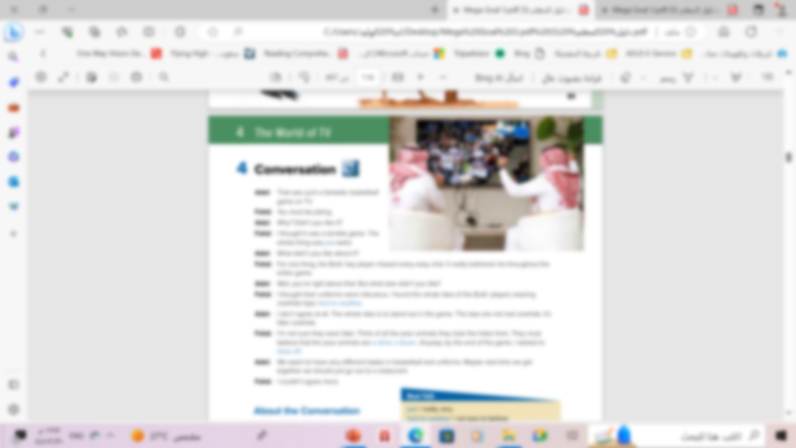


Read along as you listen

Slide 6

scanning
How many persons are there ?
Who are they?
20%
There are two persons : Fahed and Adel
What are they watching ?
10%
They are watching a basketball game

Slide 7
About the Conversation
1- What did Adel like about the game ?
He thought it was exciting
2- What did Fahd dislike about the players?
He thought the Bull’s key player didn’t play well and Bull’s cowhide tops were ridiculous.

Slide 8
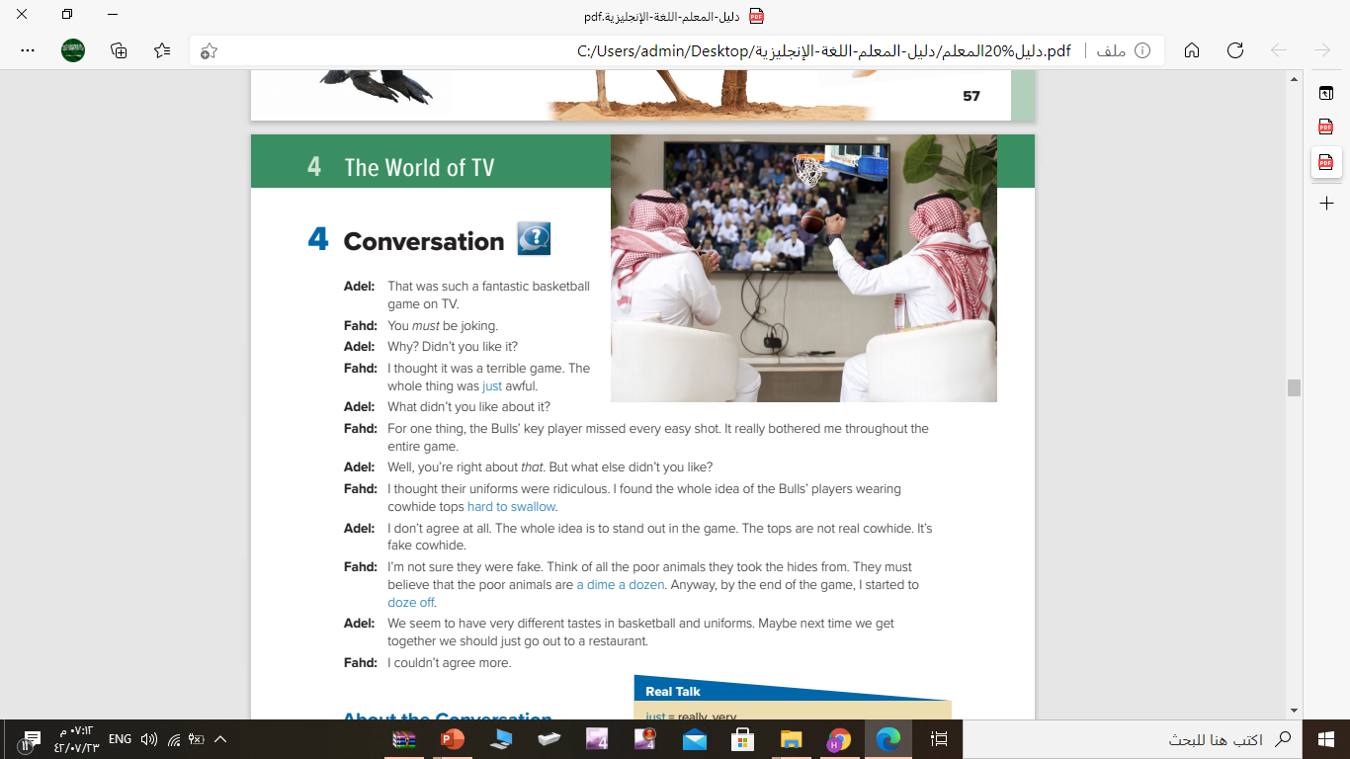

Listen to the conversation again
and underline the expressions
written in blue

Slide 9


Slide 10
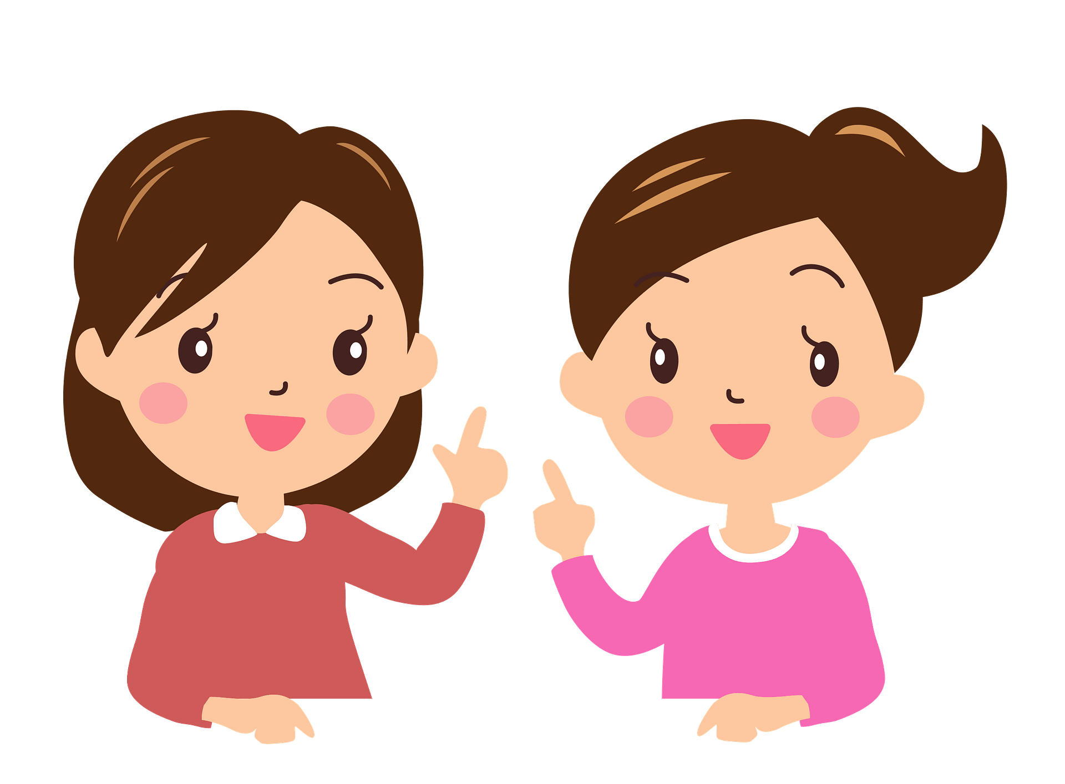
Who says
doze off…….
Who says
a dime dozen …….
Who says
hard to swallow …….
Who says
just…….
Fahd
Fahd
Fahd
Fahd

Slide 11
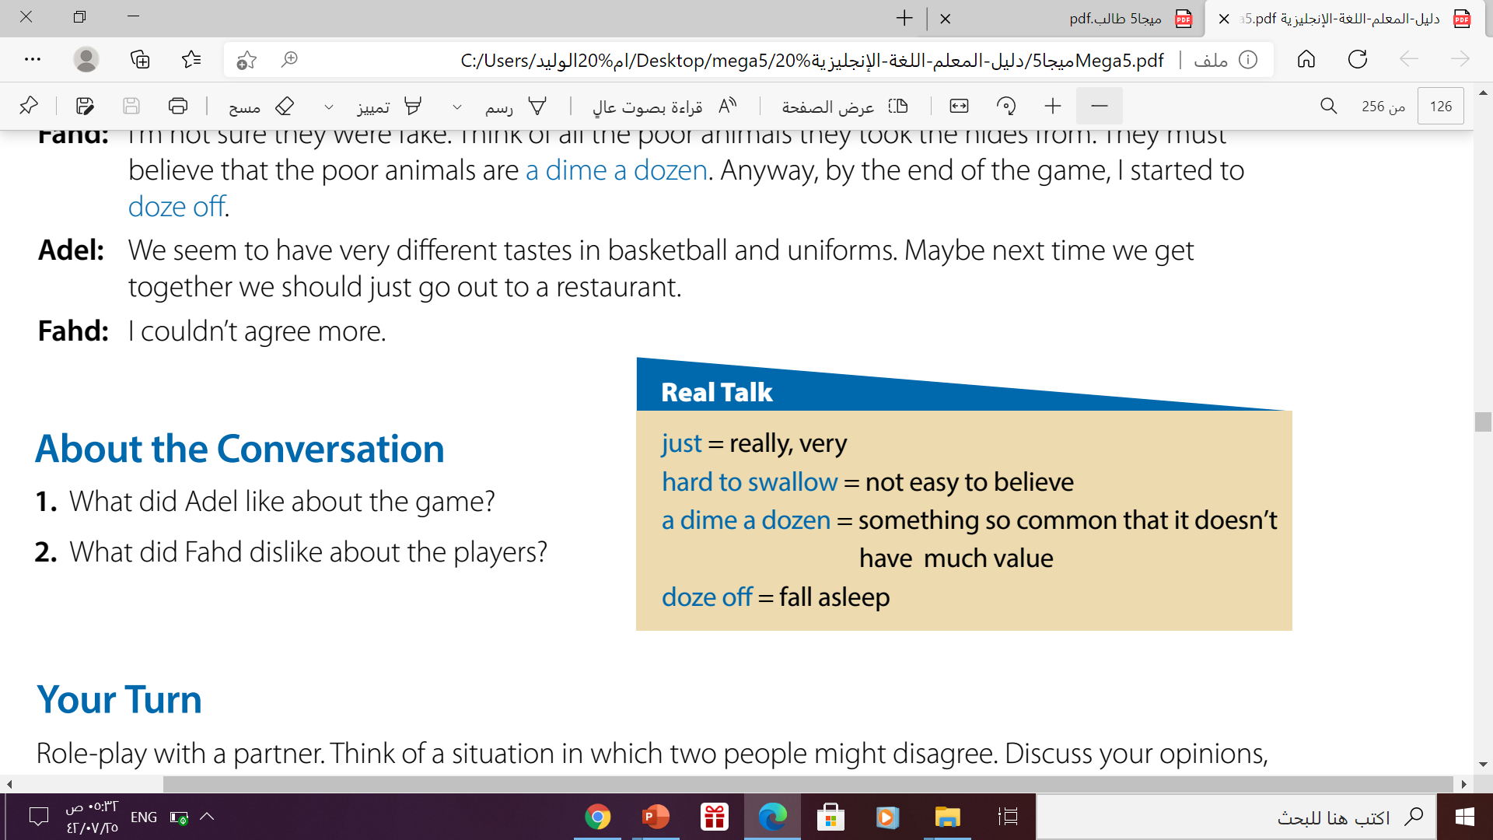
Read the phrases and their meaning:
Fahd is the one who uses
all of these expressions.

Slide 12
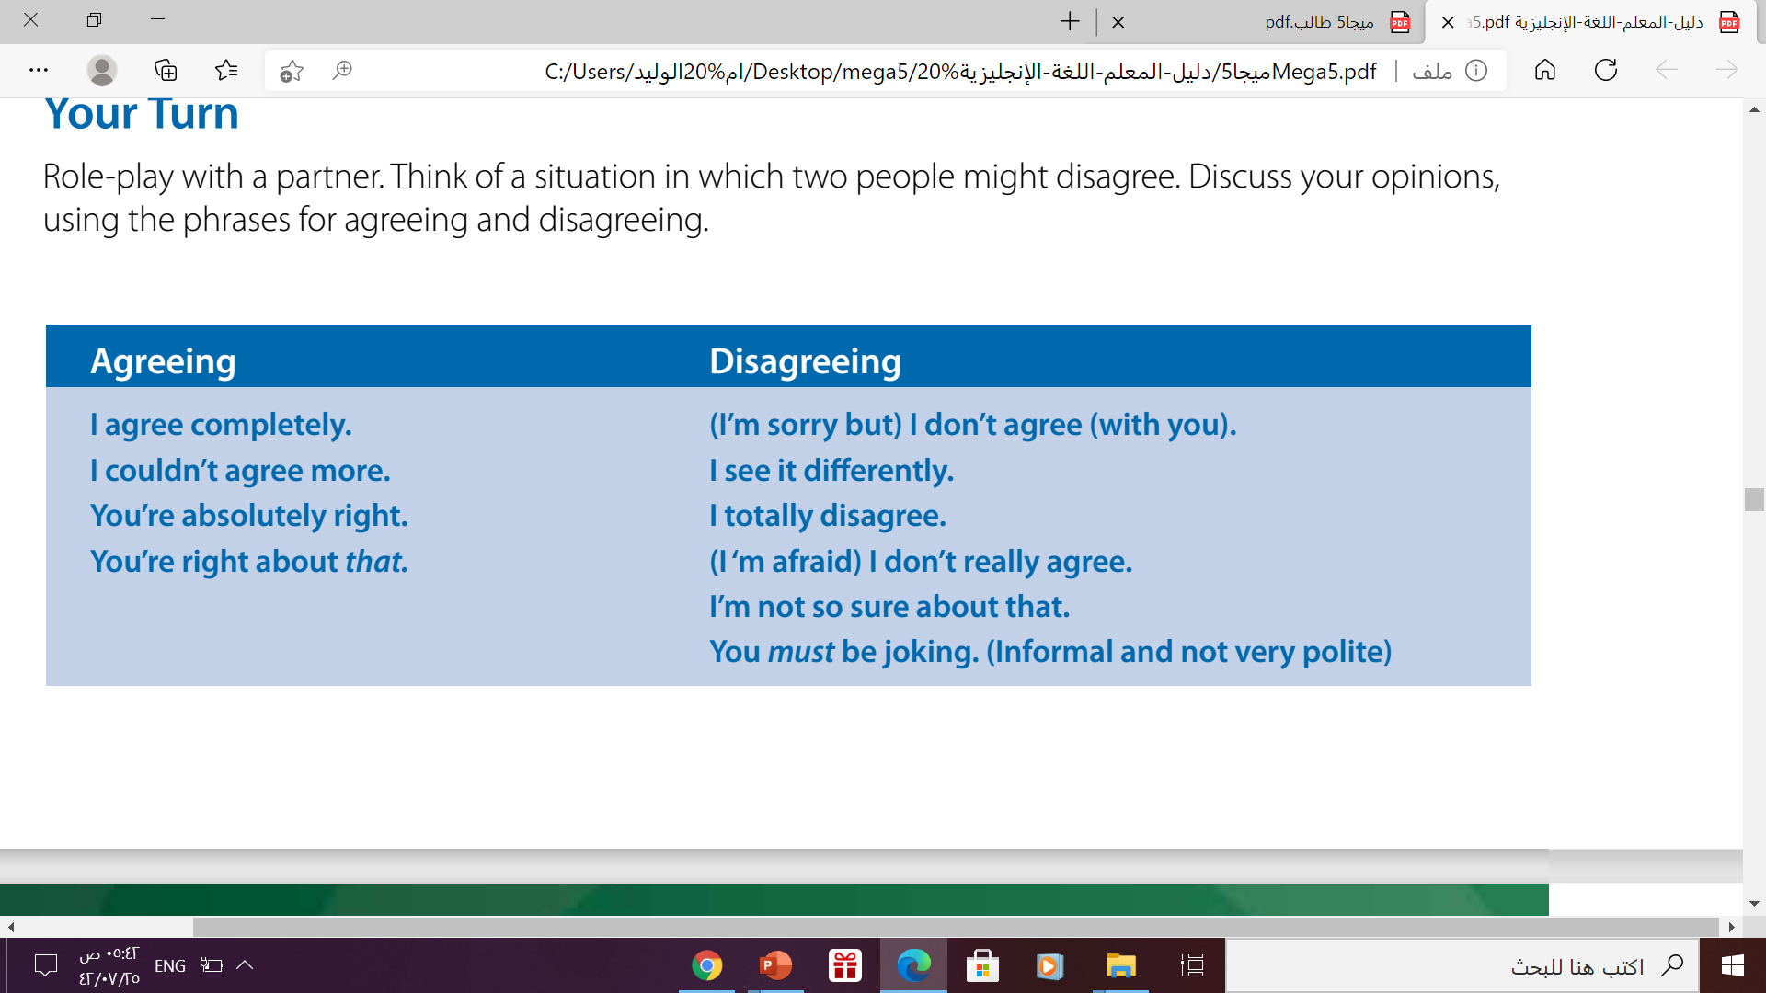
Your Turn

Slide 13
02
Listening

Slide 14
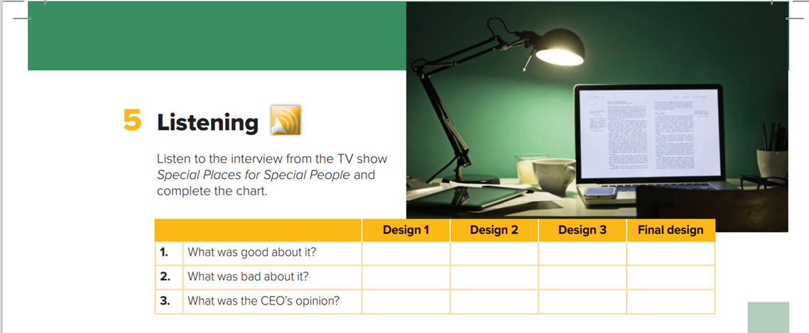

Listening

Slide 15
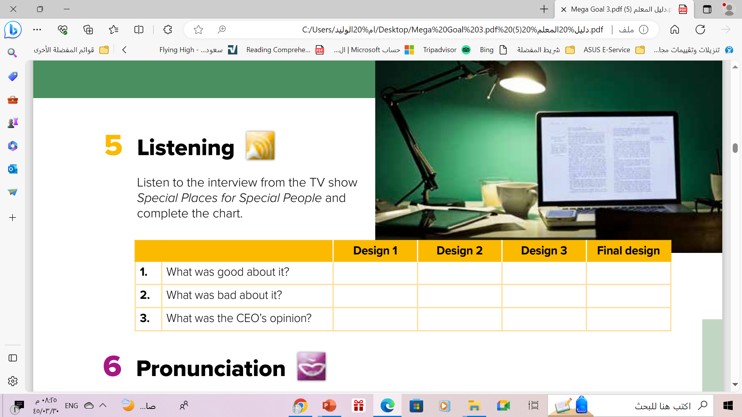
Listening
stylish
Aesthetically
suburb
What they
needed
Nothing good
Functional
problems
Staff isolated in cubicles
Not modern enough
Doesn’t meet need
Superb style but not functional
Neither stylish
nor functional-
disappointing
Satisfying

Slide 16
03
Pronunciation

Slide 17
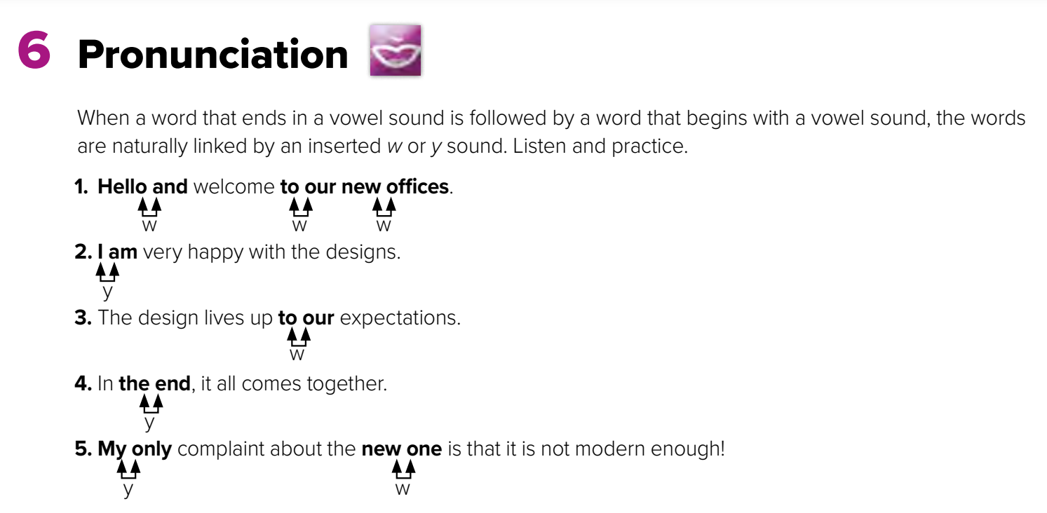


Slide 18
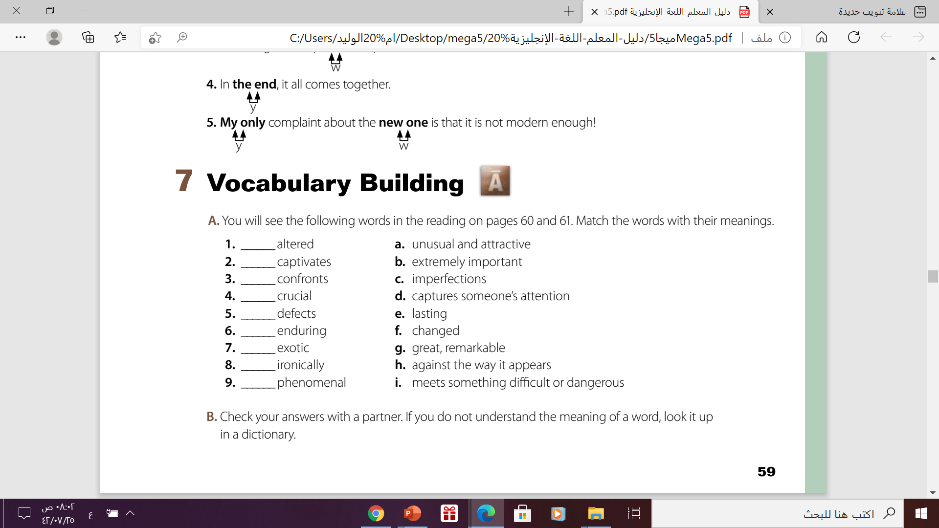
f
d
i
b
c
e
a
h
g

Slide 19

https://wordwall.net/play/12239/717/710

Slide 20


Thanks

