Slide 1

Skills Enhancement SG2
2nd intermediate

Slide 2

Goals(skills):
12-Discuss likes & dislikes by adjectives (-ed & -ing).
20- Describe daily activities and routines. Reading Comprehension: main idea, supporting detail, inference.
19- Talk about activities & express abilities
17- Get the main idea, supporting detail, inference
15- Talk about clothing & colors by using future: be + going to .

Slide 3




Adjectives
-ed / -ing

Slide 4


She was …….
excited
exciting

Slide 5
She was …………………….
excited
People
adj -ed

Slide 6


The movie was …………..
bored
boring

Slide 7
The movie was …………..
boring
Things
adj -ing

Slide 8


I was tiring
or
The book was amazing

Slide 9
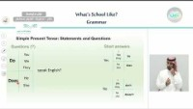
Watch here
Go to >
قنوات عين دروس
https://www.youtube.com/watch?v=5vJz7wTWPjs

Slide 10


Play here

Slide 11
Daily activities

Slide 12

Rearrange:
usually early sleep I
I usually sleep early.

Slide 13
Rearrange:
never She at night books reads
She never reads books at night

Slide 14

01
I always …………. on time
A
B
C
prays
pray
praying

Slide 15
02
Ahmad usually ……….. coffee
A
B
C
drinks
drink
drinking

Slide 16
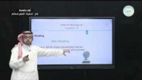
Watch here
Go to >
قنوات عين دروس
https://www.youtube.com/watch?v=zG9vdX-haE8

Slide 17
Play here

Slide 18
Activities abilities

Slide 19

He can ……………
plays football
play football

Slide 20
01
Can you …………. this ?
A
B
C
reads
read
reading

Slide 21
02
Wateen can’t …….. French
A
B
C
speak
speaks
speaking

Slide 22
I can cook Kabsa
or
She can’t comes

Slide 23
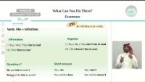
Watch here
Go to >
قنوات عين دروس
https://www.youtube.com/watch?v=43scTliwGBk

Slide 24
Play here

Slide 25
Main idea

Slide 26
01
I play for the team in …………. club
A
B
C
Computer
Science
football

Slide 27
02
I do experiments in …………. club
A
B
C
computer
science
football

Slide 28
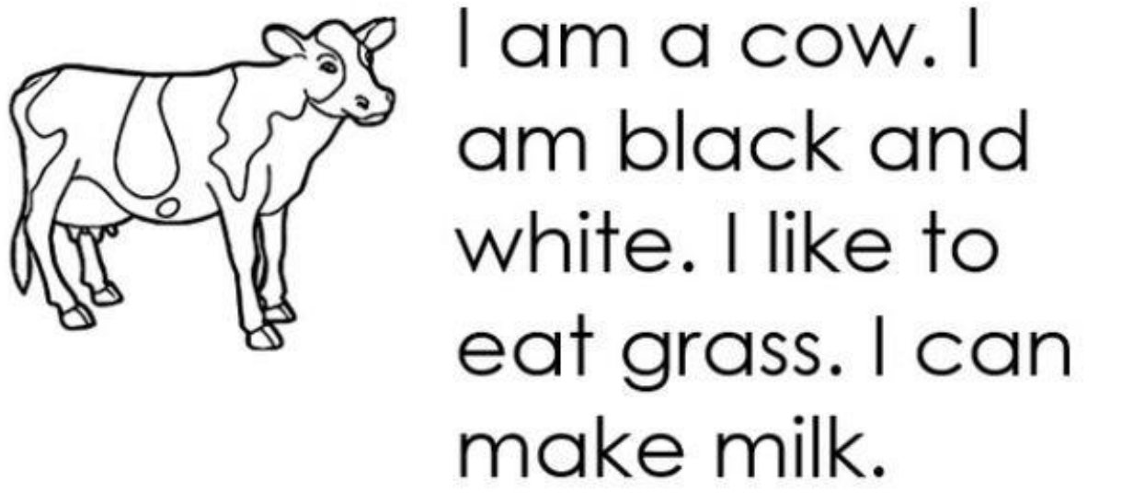

03
What is the color of the cow?
A
B
C
milk
Black & white
grass

Slide 29
03
What can the animal make?
A
B
C
milk
Black & white
grass

Slide 30
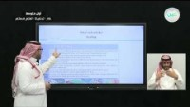
Watch here
Go to >
قنوات عين دروس
https://www.youtube.com/watch?v=EGWRkdFfQlg

Slide 31
Play here

Slide 32
Future : be – going to

Slide 33
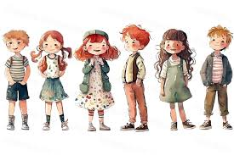
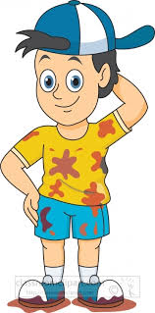



Match:
He’s wearing
a jacket
He’s wearing
a cap
He’s wearing
boots

Slide 34
What is she wearing?
She’s wearing …
She’s wears ….

Slide 35
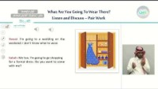
Watch here
Go to >
قنوات عين دروس
https://www.youtube.com/watch?v=wOoMCHAoP0Y

Slide 36
Play here

Slide 37

Prepared By
Dalal Al-Juaid
t.me/dalalforenglish

