Slide 1

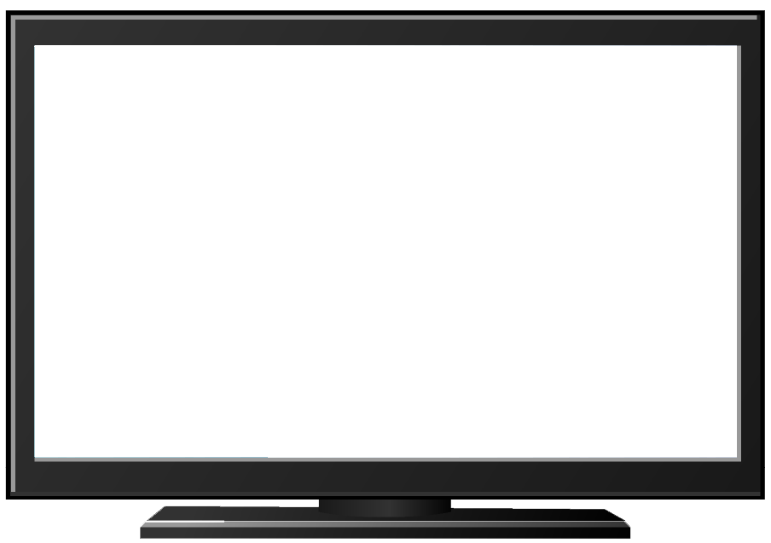


Mega Goal 3
U4 L4
Conversation
By: Essa Al Hussaini

Slide 2
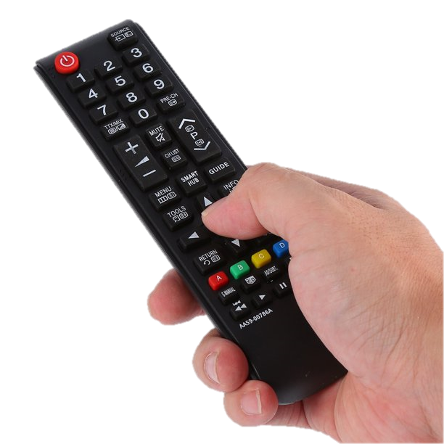
Lesson Goals & Outcomes
the meaning of new words in the conversation
the (real talk) phrases in new sentences
the program show you got its description
information about TV show through an audio text
use
Find
Name
4
certainty correctly
Find out
3
5
2
Express
1

Slide 3
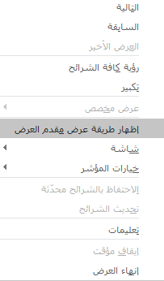
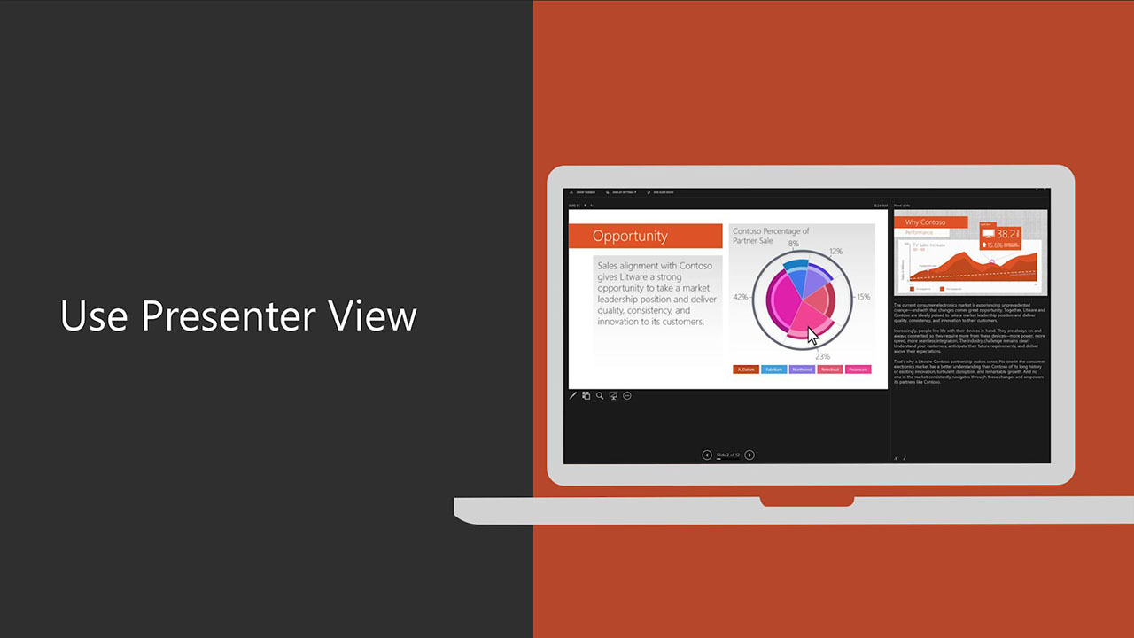
For better presentation

Slide 4

Guess
the kind of TV program we’re gonna introduce?
Reality Shows
Notes:
reality show:
a television program designed to be entertaining rather than informative.

Slide 5
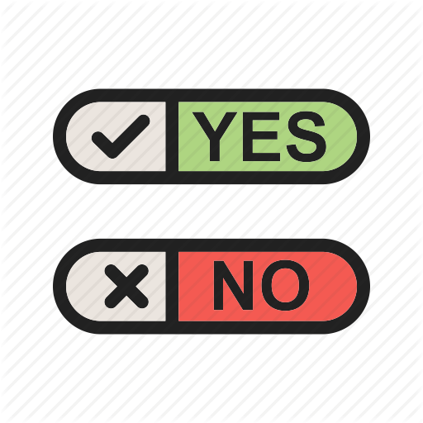
.. watch Reality Shows?

Slide 6
For those who say
Which
REALITY SHOWS do you watch?
Name
REALITY SHOWS you watch
What makes you enjoy
watching it?
Watch ..
too much?

Slide 7
For those who say
WHY?
boring?
annoys you?

Slide 8



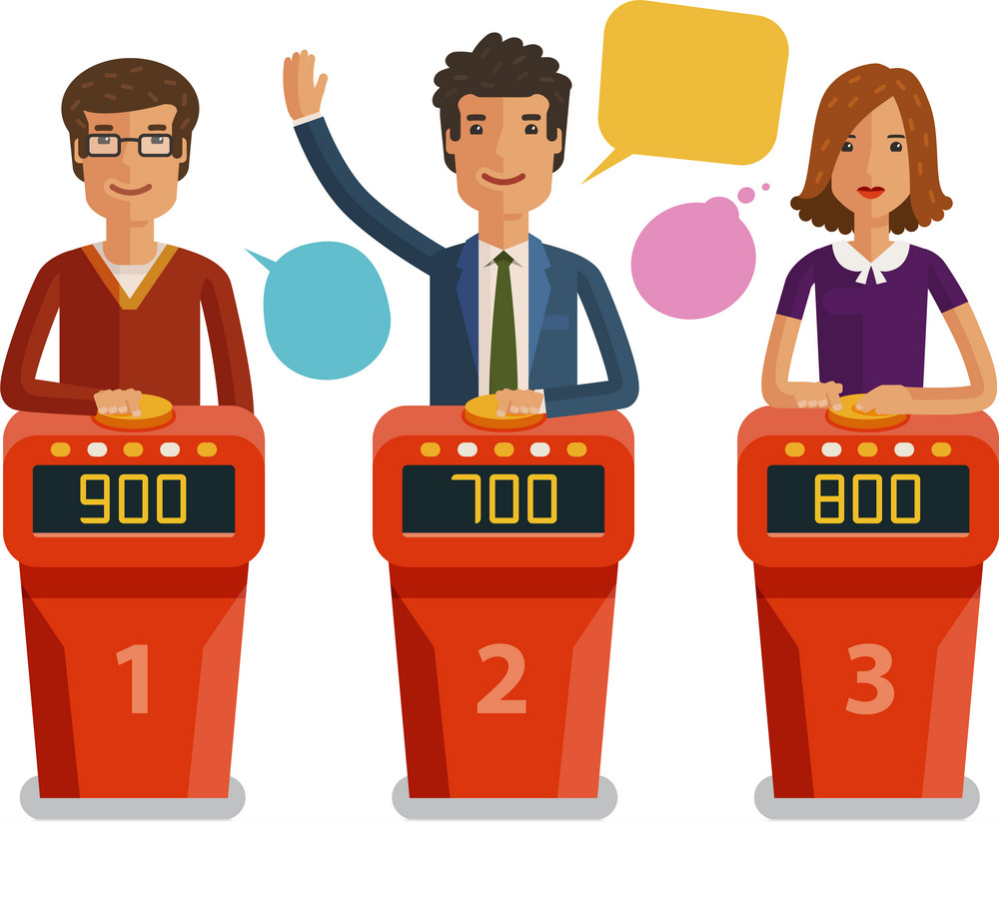
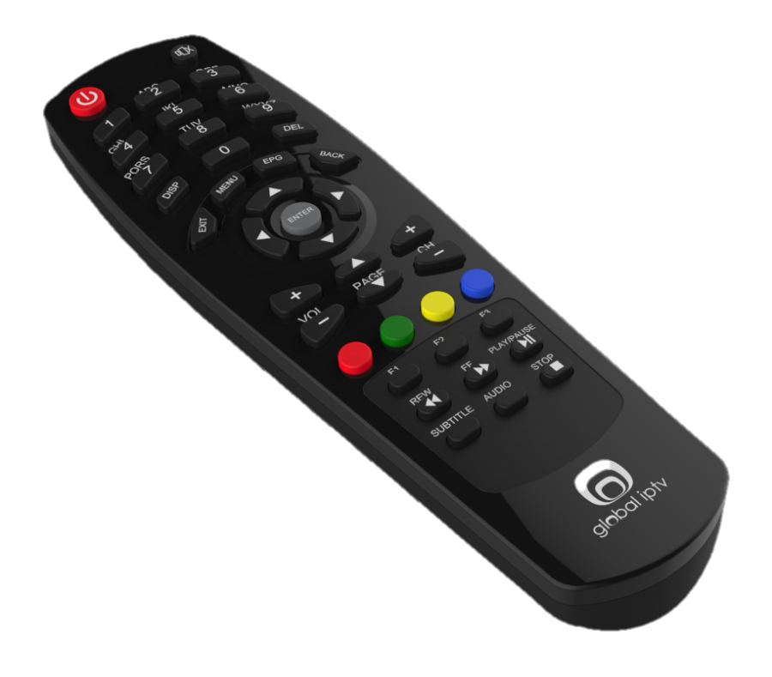
The Picture Shows ..
https://wordwall.net/ar/resource/5760426
Notes:
Remote control
Chef
Contestants / competitors

Slide 9

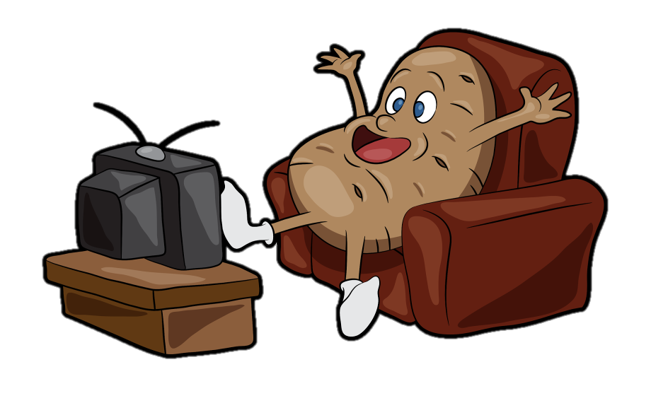
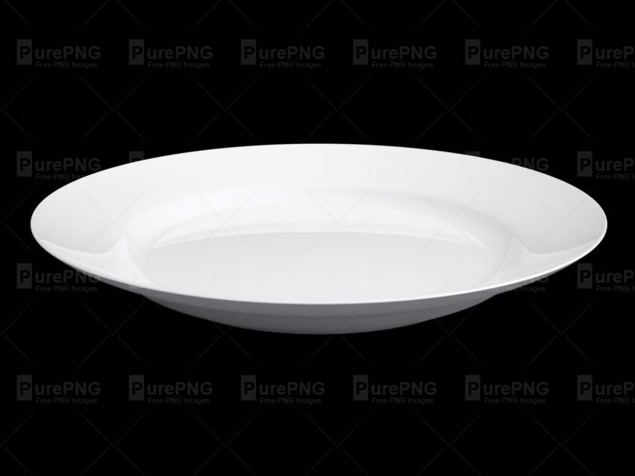
The Picture Shows ..
NAH
Notes:
Plate / dish
No
Couch potato ( someone who watches too much TV)

Slide 10

Books Closed
You’re gonna listen to
a conversation between Asma & Nura talking about a TV show.
Listening Time
What
TV SHOW are they watching?
Game
Cooking SHOW

Slide 11
Books Open
Listen &
follow along
58
Listening Time

Slide 12
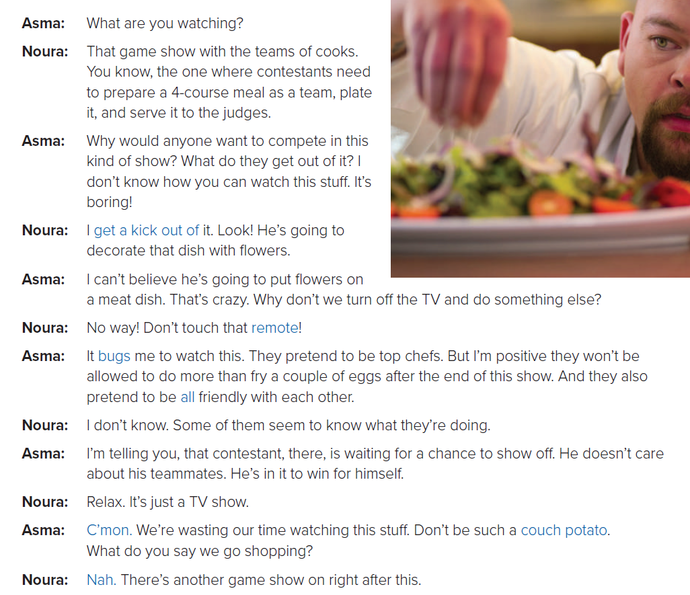

About the Conversation
Describe the TV show Noura is watching
Listen &
follow along
How does Asma feel about this program? Give examples
She doesn’t like it
Would you watch this program?
Why (not)?

Slide 13
Who are the contestants?
What … the contestants do?
What’s one of the contestants waiting for?

Slide 14

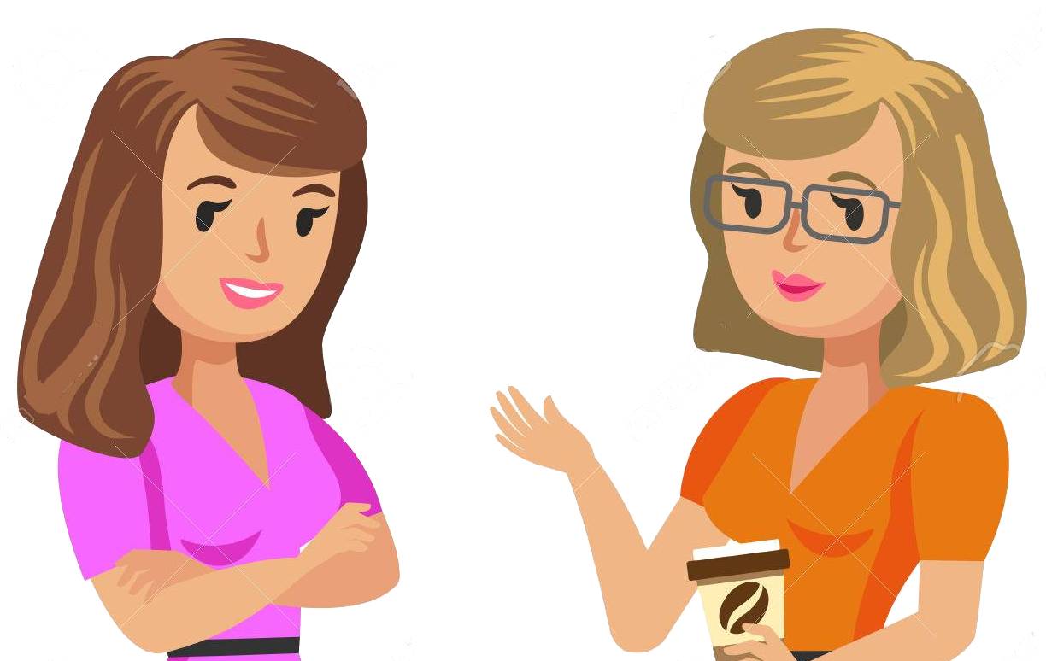
Who says? WHY?
get a kick out of
Notes:
get a kick out of
Noura says this
WHY?
meaning she has fun watching reality shows.)

Slide 15
Who says? WHY?
bugs
Notes:
bugs
Asma says this,
WHY?
meaning that the shows annoy her
The expression probably comes from the feeling you get when an insect is flying around you.

Slide 16
Who says? WHY?
Show off
Notes:
Show off
Asma says this,
WHY?
meaning that the contestant tries to show how clever or skilled he is so that other people will admire him.

Slide 17
Who says? WHY?
couch potato
Notes:
Couch potato
Asma says this,
WHY?
meaning that
Noura spends too much time watching TV.
The expression compares the person to a vegetable, sitting on a couch and doing nothing.

Slide 18

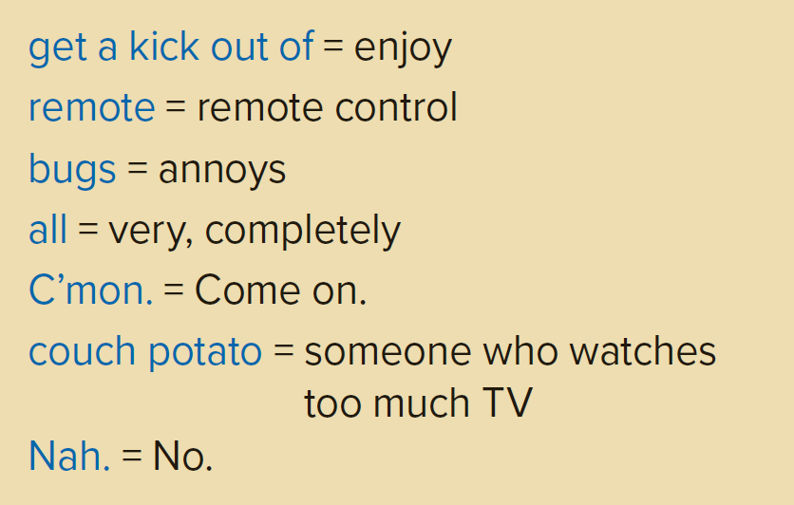

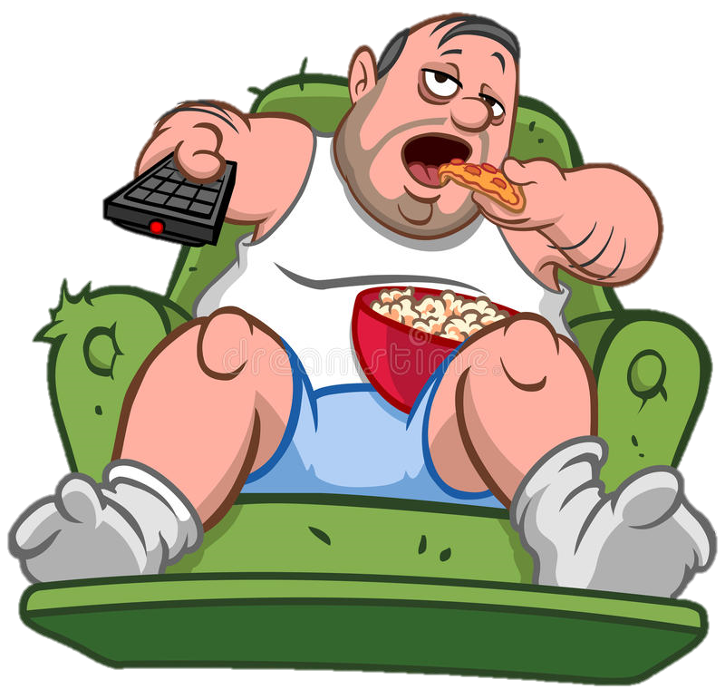
Real Talk

Slide 19

get a kick out of
bugs
show off
couch potato
informal expressions
shouldn't use them in formal situations

Slide 20
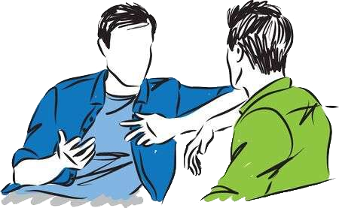
Practice Makes Perfect
What do you get a kick out of?
What bugs you?
Have you met anyone who likes showing off?
Are you a couch potato?

Slide 21
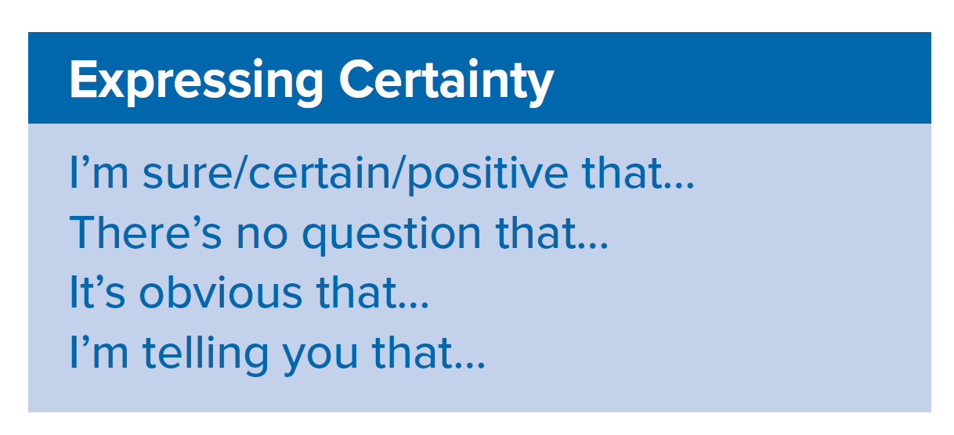

Expressing Certainty
What Expression Asma uses ..?
use these phrases when you are very sure about something

Slide 22
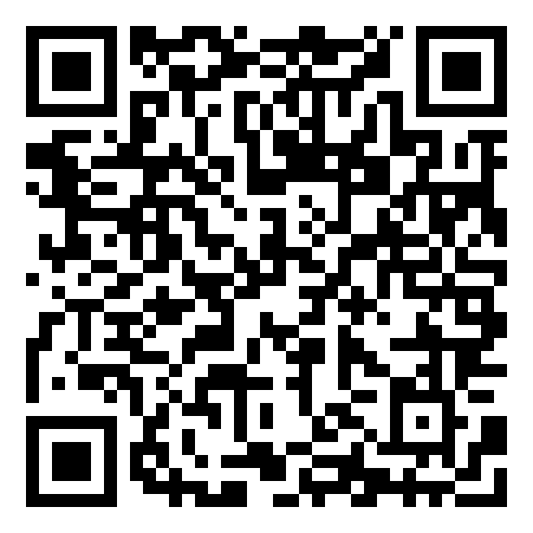
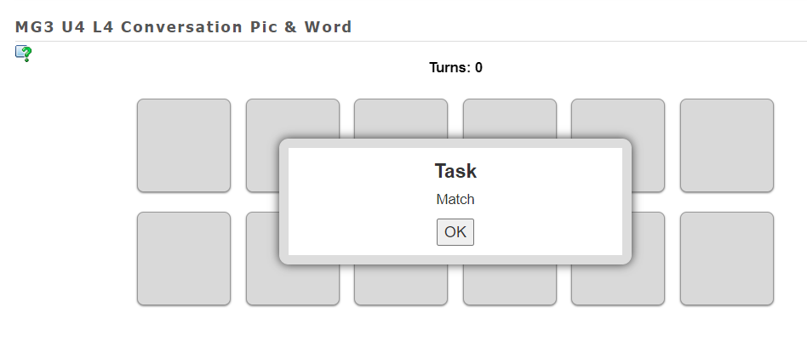
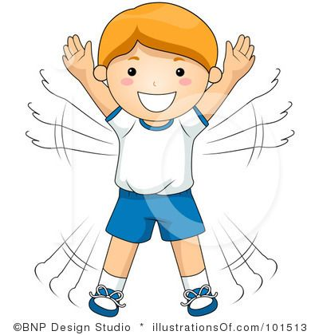

Quick
Check
https://learningapps.org/watch?v=pj5qpn0yj20

Slide 23
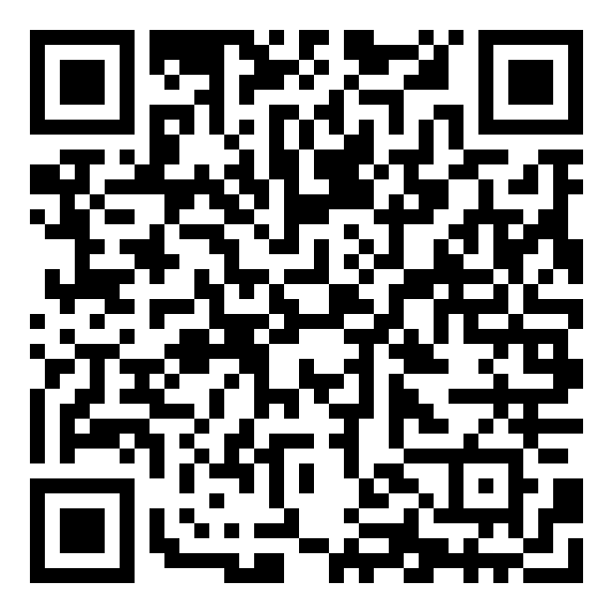
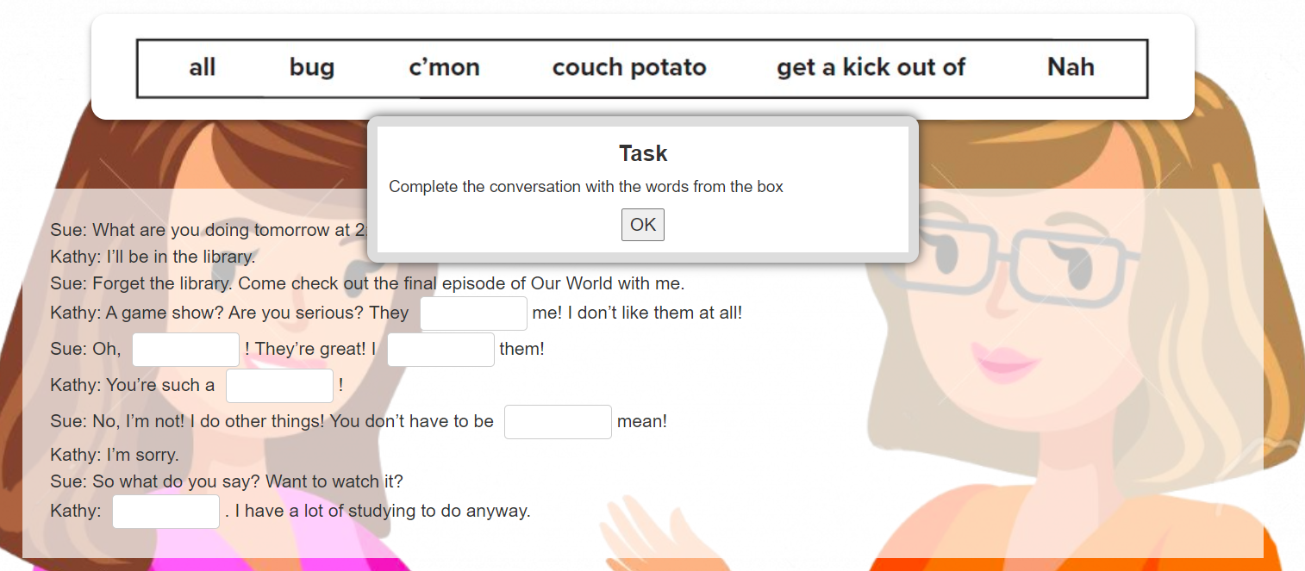
Quick
Check
https://learningapps.org/watch?v=pr2r2b8an20

Slide 24
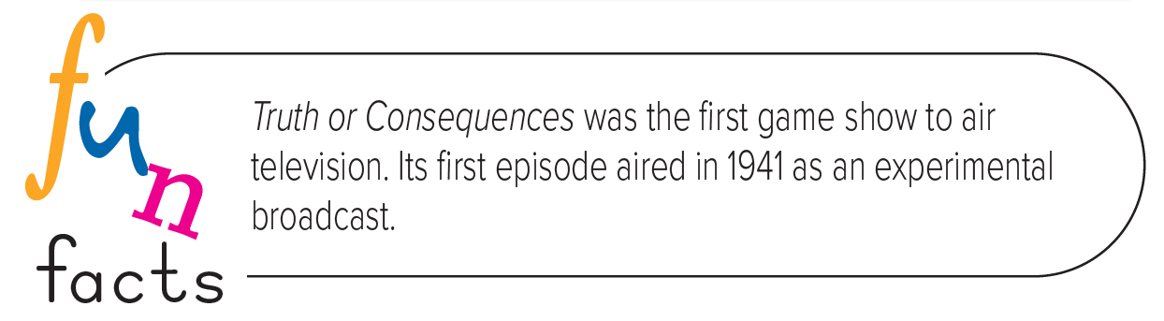



Slide 25


HOMEWORK
https://forms.office.com/Pages/ShareFormPage.aspx?id=b4OQU5QpqkK9sELnf3f9C0tUDGzPRYpDjgbnhRSJpRlURThTSFNGSzk1VVE4TE5PS1ZZWU1CNUk5Ni4u&sharetoken=3Fb937dliX5wEl3SnyCP

Slide 26
THANK
YOU
Lesson done by: Essa Al Hussaini

