Slide 1

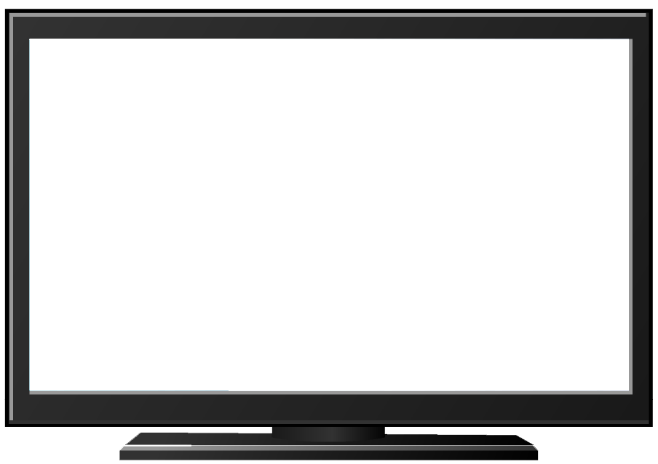
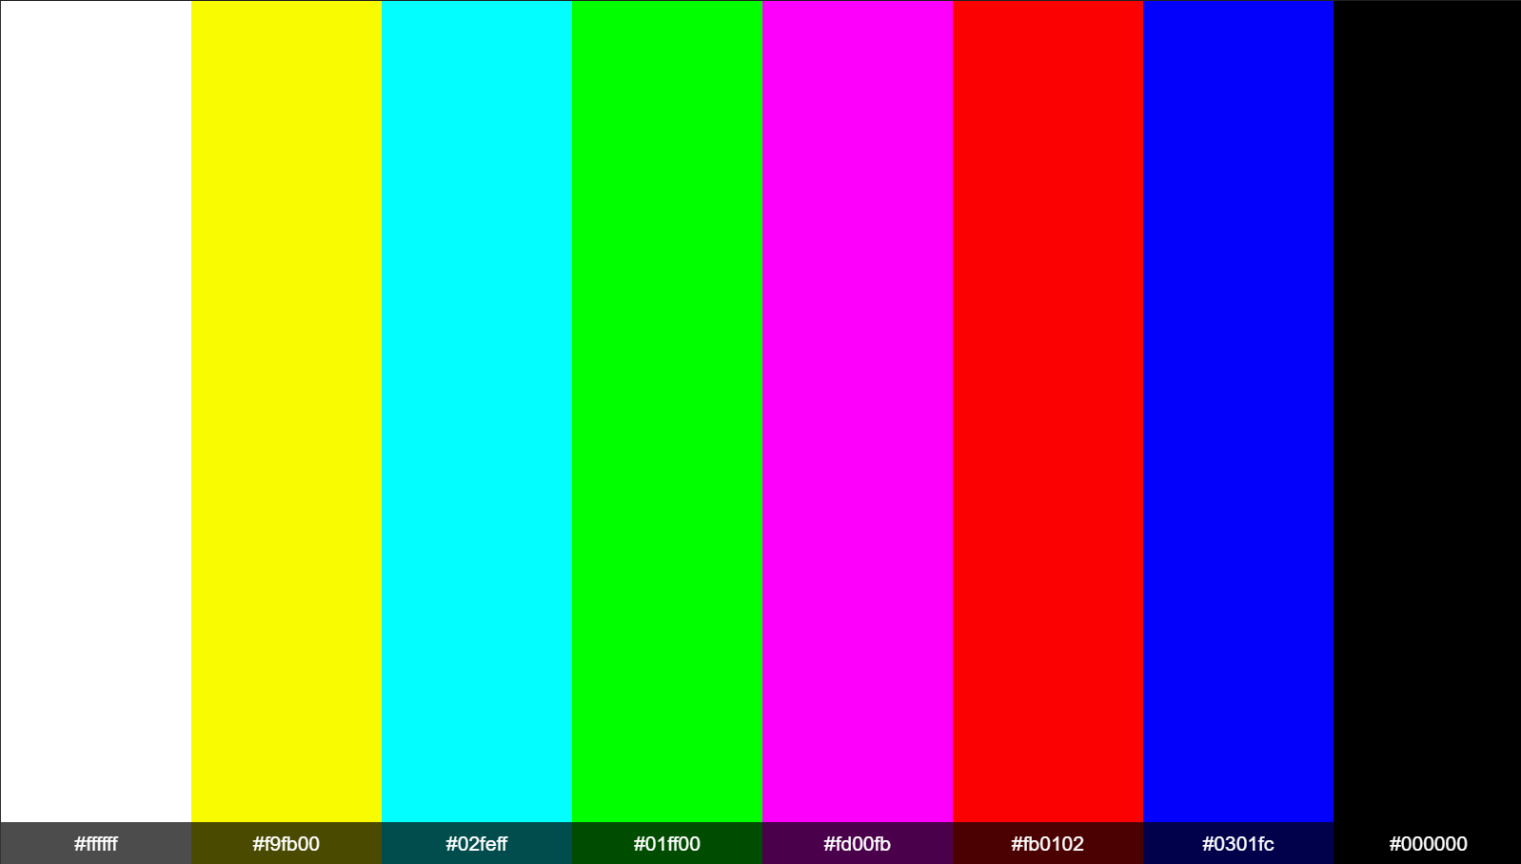
Mega Goal 3
U4 L1
Listen & Discuss
By: Essa Al Hussaini

Slide 2



Replace the pictures with words
to catch the unit title
The lesson is about?
TV around the world

Slide 3
Lesson Goals & Outcomes
the sentences with the new words
types of Tv programs
meaning of new words
TV programs that SS like or dislike.
Complete
Determining
Find
TV program with its description
4
Listing
3
5
2
Matching
1

Slide 4

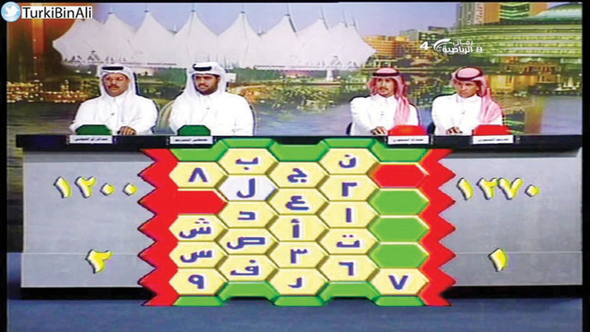
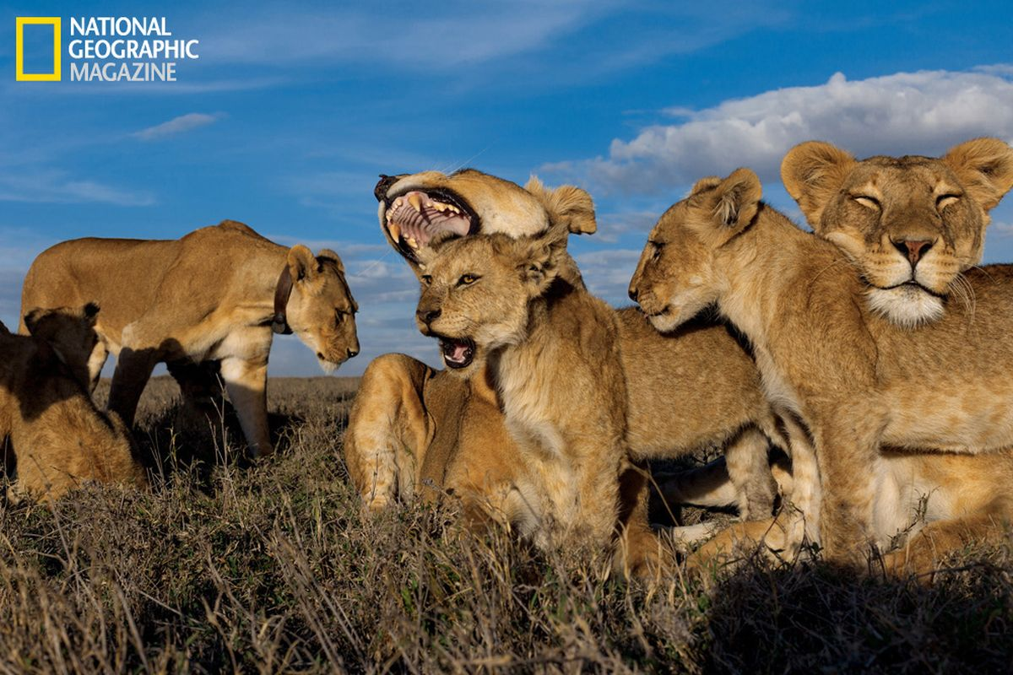
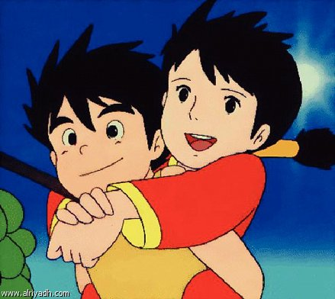
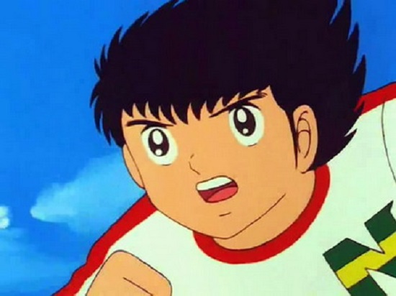

Once upon time ..
I liked watching..

Slide 5
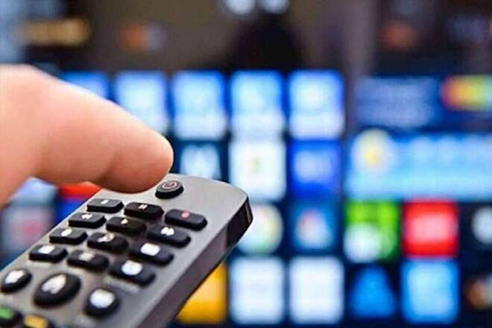

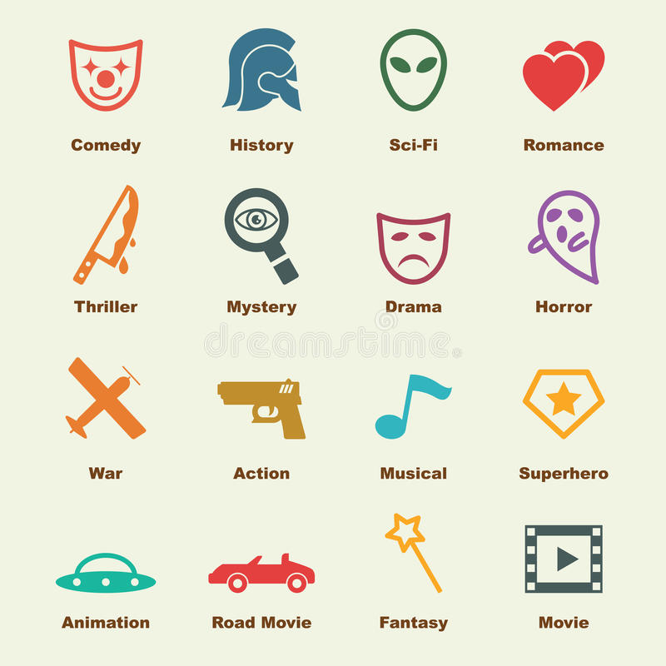
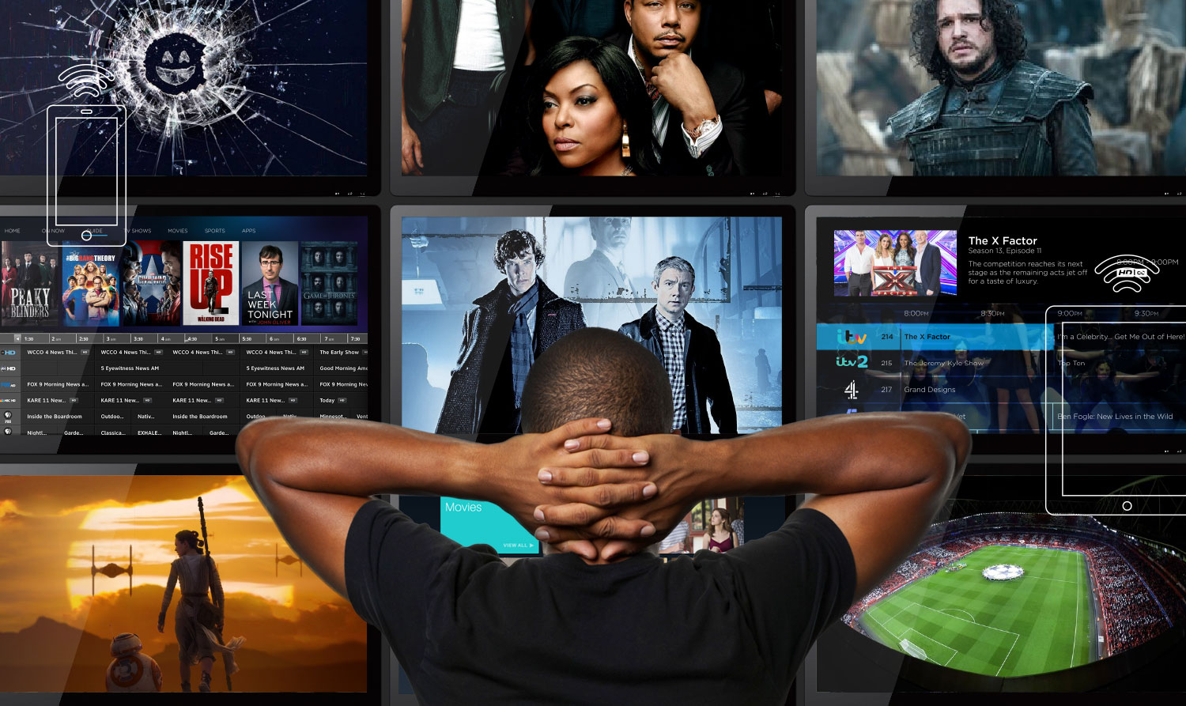
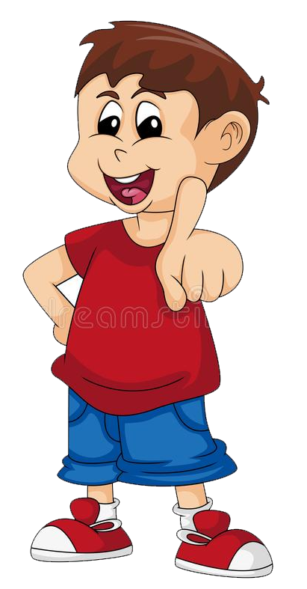
Nowadays
Kind of
TV programs you
Like / dislike?

Slide 6




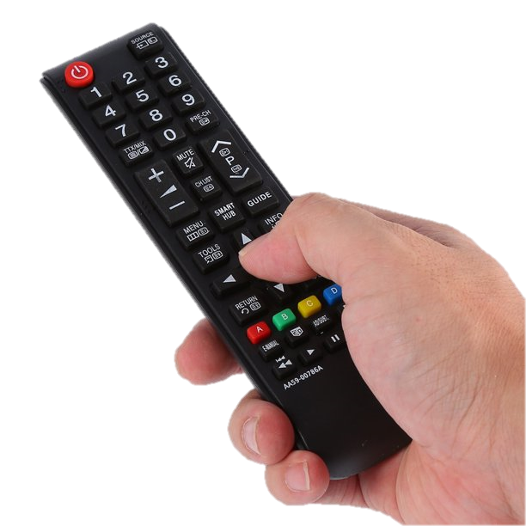
You tell
Quizizz Break
https://quizizz.com/admin/quiz/5f8a1e562096a7001bed3008?studentShare=true
By: Tr. Fatimah Jaber

Slide 7
Books OPEN
Pages: 54 - 55

Slide 8
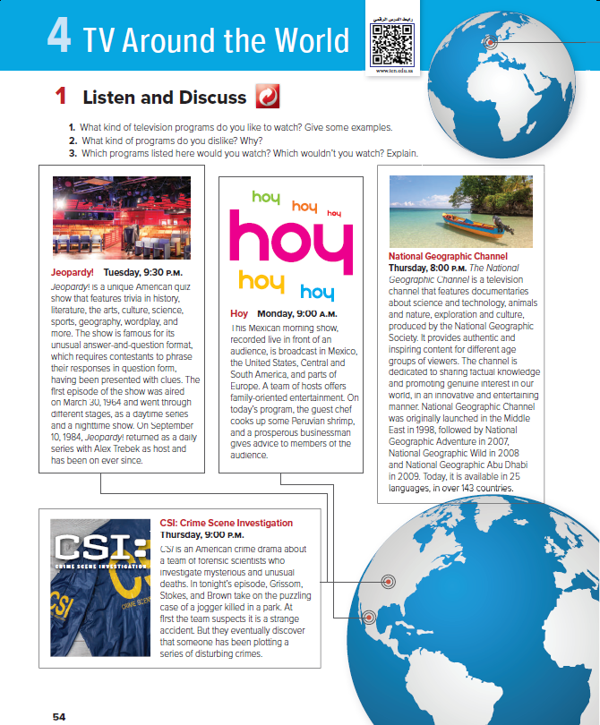
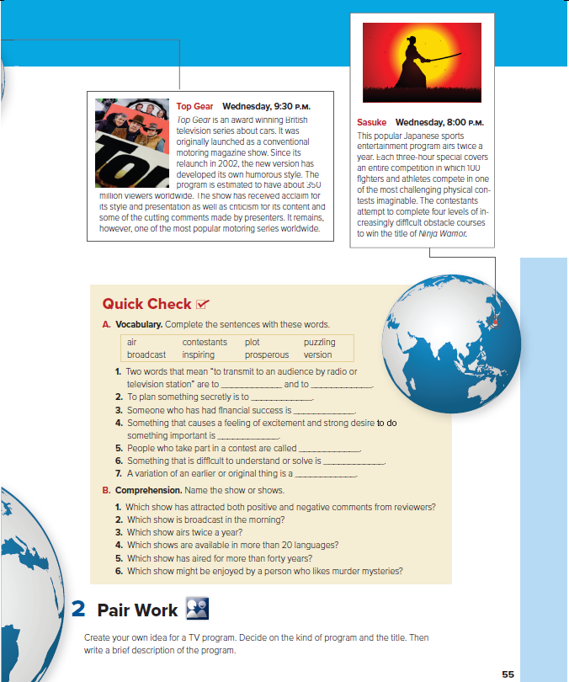
Theses are ..?
# of
Tv programs?

Slide 9
Which program is
good for family viewing?
about
cars?
a
documentary?
a sports program?
from the U.S.?
a quiz show?

Slide 10
the Earth indicates to?
What countries indicated?

Slide 11

Read along
as you listen

Slide 12
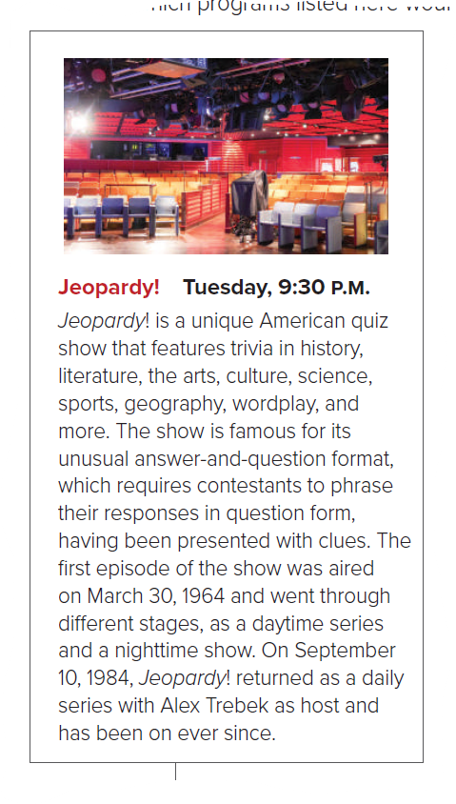

1st aired in 1984?
What kind of Program?
What Day shown?
a food program?
Saudi program?

Slide 13
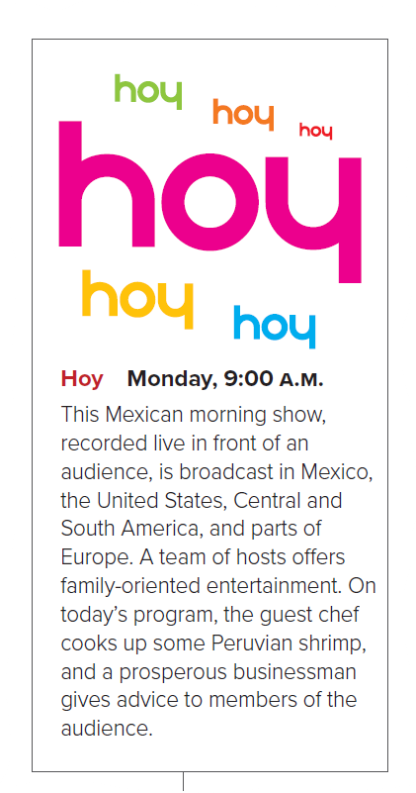
the guest
only cooks?
What else
the guests do?
What Time shown?

Slide 14
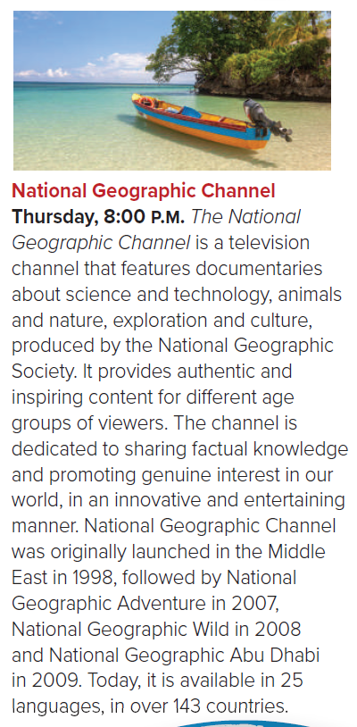
Sharing true knowledge?
For children only?
Animals Channel?
a TV Program?

Slide 15
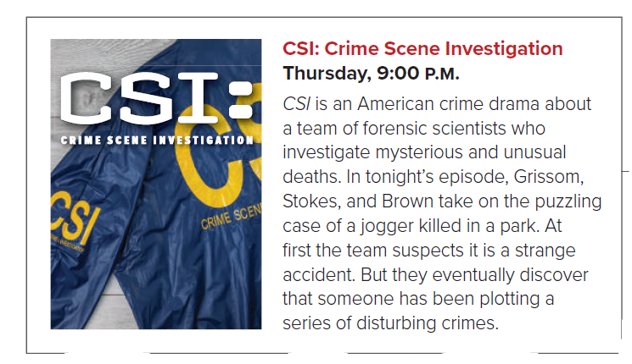
deals with all types of crime?
What Types of crime?

Slide 16

started as
a magazine show?
# of viewers?
WHY
viewers like it?
a famous motoring show?

Slide 17

Program airs 3 times yearly?
How long
show takes?
What Kind of sport?

Slide 18
Programs you would (not) watch?
Have you
seen similar programs?

Slide 19
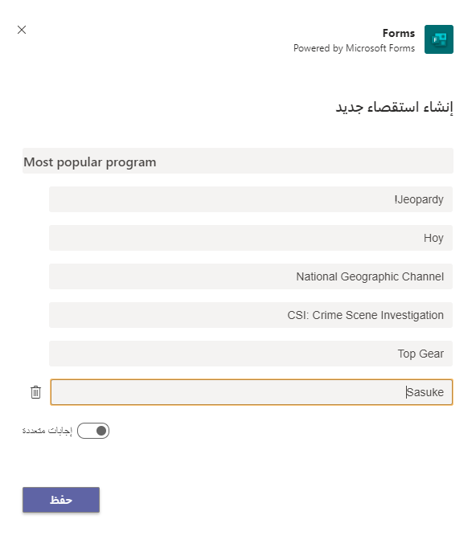

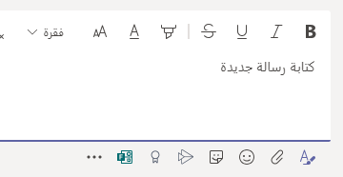
Create
a poll

Slide 20
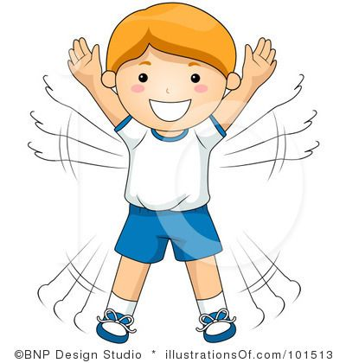
Quick
Check

Slide 21
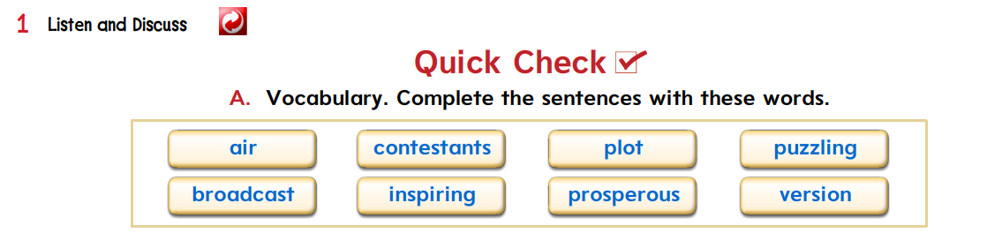
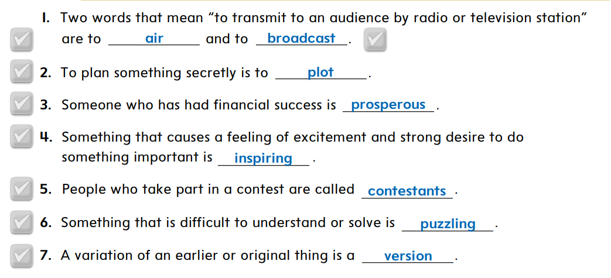


Slide 22
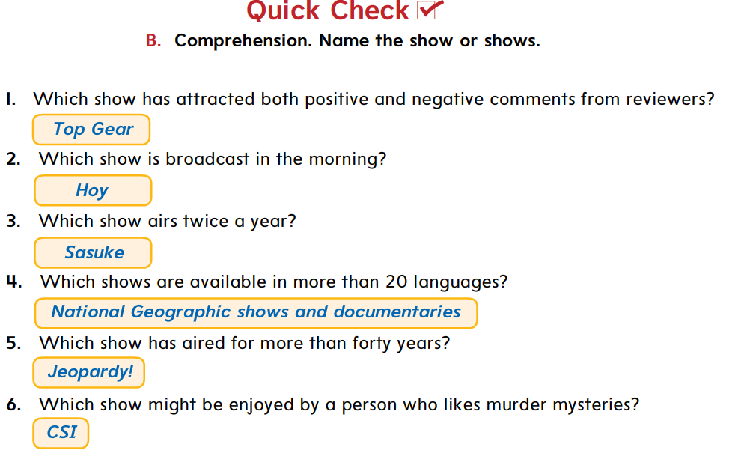

Slide 23

https://wordwall.net/play/5503/216/862

Slide 24
THANK
YOU
Lesson done by: Essa Al Hussaini

