Slide 1
Mega Goal 3
Conversation
Unit : 4 Page : 58 Lesson : 4
Talal Alhazmi

Slide 2
Our Lesson Goals
Listen To the Conversation
01
Learn the New Words
Listening
02
Listen and answer the questions
Pronunciation
03
Some of Casual Speech

Slide 3
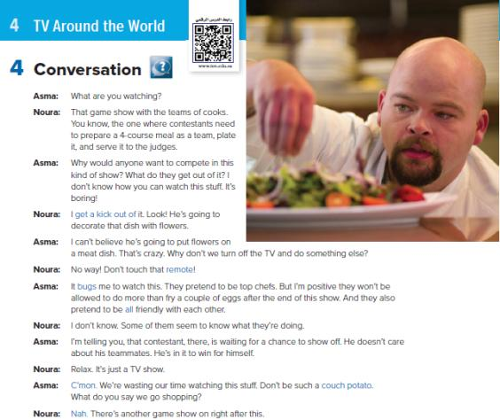


Conversation

Slide 4
Words Meaning
Remote
Get a Kick Out Of
Remote Control
Enjoy
Bugs
Annoys
Couch Potato
Real
Talk
Someone Who Watches Too Much TV
all
Very, Completely

Slide 5
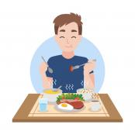

Word and the Opposite
Enjoy
Word and The Opposite
Suffer

Slide 6
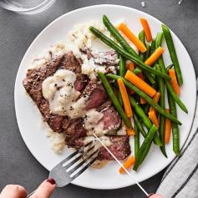
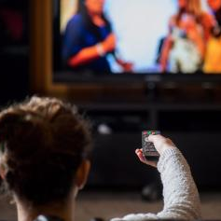
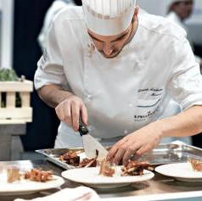

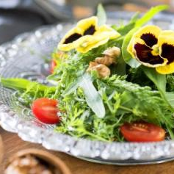
Questions
Q) Describe the TV Show Noura is watching.
Q) Would you watch this program?
Why or Why not ?

Slide 7
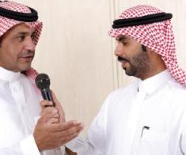
Listening

Slide 8
After Listening
1 – Fantastic trainer
1 – A broken toe
2 – In the best physical and mental shape
Things have positive impact on Imad’s performance
Things have negative impact on Imad’s performance
2 – Father in the hospital
3 – Wonderful, supportive family
3 – A cold

Slide 9

going to and want to
In casual speech, going to is often reduced to /gonna/.
And want to is often reduced to /wanna/.

Slide 10


Practice: Read the following sentences.
I’m not going to let any of that stop me.
I want to congratulate you .
I want to take a minute to say thank you.

Slide 11

Read
You’re going to be answering questions.
There’s no question in my mind that you’re going to overcome
all your problems.
We want to prove that hard work pays off.

Slide 12
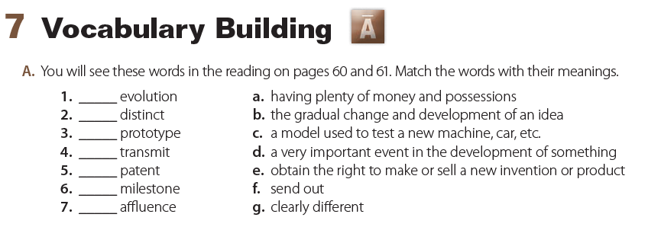
b
g
c
f
e
d
a

Slide 13

https://quizizz.com/admin/quiz/5f88b82999dd11001ba92ca9/alaa-quiz

Slide 14
The End
I Hope You Enjoy It.
Have a nice weekend!
Edited by: Talal Alhazmi

