Slide 1
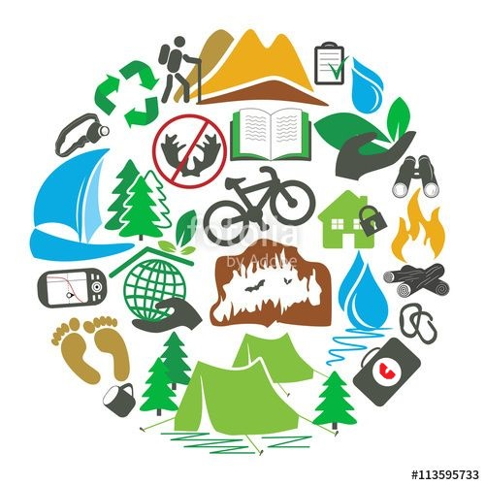
Mega Goal 3
Reading
U: 3 L:8
By: Essa Al Hussaini

Slide 2
Lesson Goals & Outcomes
1
2
3
4
5
FINDING
Making
MAKING
COMPLETING
FINDING
the meaning of ecotourism
questions by using the text topic
phrases related to the word (ecotourism)
sentences about the text
the meaning of new words in the text

Slide 3

Warm Up (Book Closed)
Replace the number by 3 letters
abbreviating the way they sound
2
Eco rism

Slide 4



Warm Up (Book Closed)
https://www.youtube-nocookie.com/embed/RDIfFTs9V1A?autoplay=1&iv_load_policy=3&loop=1&modestbranding=1&playlist=RDIfFTs9V1A
Ecotourism

Slide 5

Warm Up (Book Closed)
Eco- means?
related
to the earth
to the environment
Ecotourism
Eco

Slide 6

Warm Up (Book Closed)
your ideas
about the meaning of
Ecotourism

Slide 7
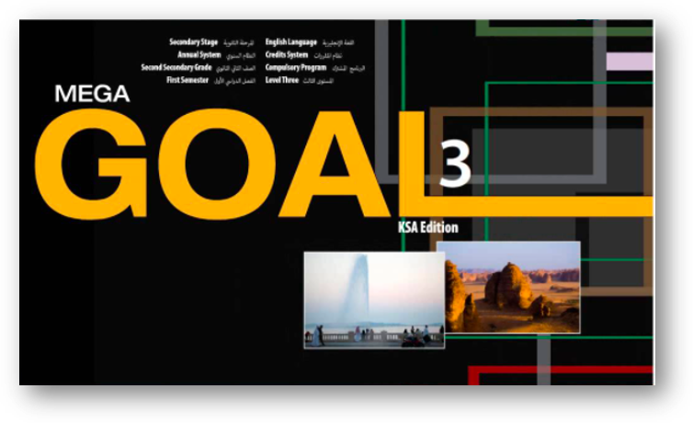

Revising what you did
Vocabulary Building
https://www.liveworksheets.com/id1242917gs

Slide 8
Page: 40

Slide 9
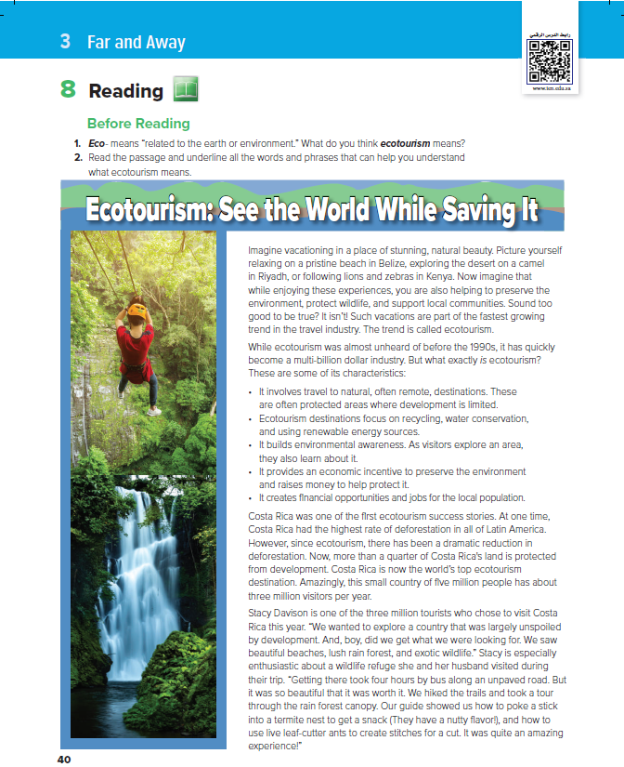
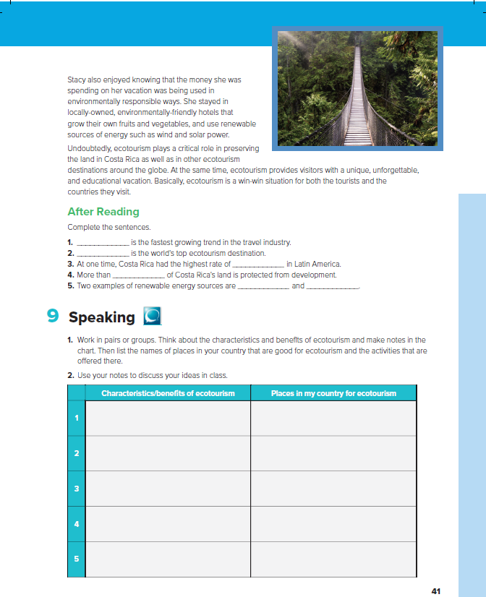
.. the title?
.. # of pics?
like the places?
Have you ever experienced?
Places have services or facilities?

Slide 10
Stacy also
5
Ecotourism plays
Imagine vacationing
6
1
While ecotourism
.. the title?
2
.. # of pics?
.. # of paragraphs?
Costa Rica
3
1st two words of each paragraph?
Stacy Davison
4

Slide 11
Pics & title
.. the main idea of the article?
?
Saving water
Saving Money
Enjoying your time
responsible traveling to natural area
Having fun around the world?
Going on an adventures

Slide 12
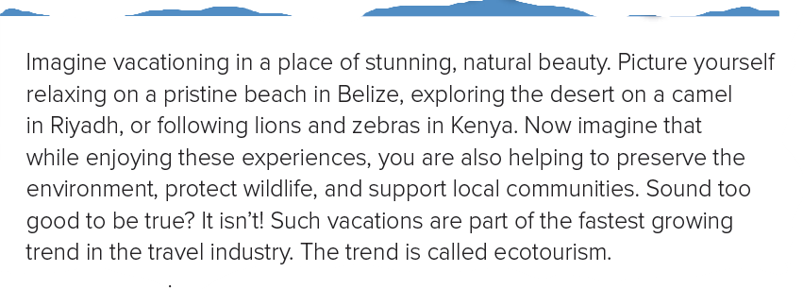
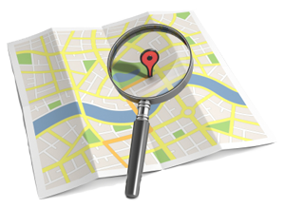
1
Places to travel for relaxing?

Slide 13
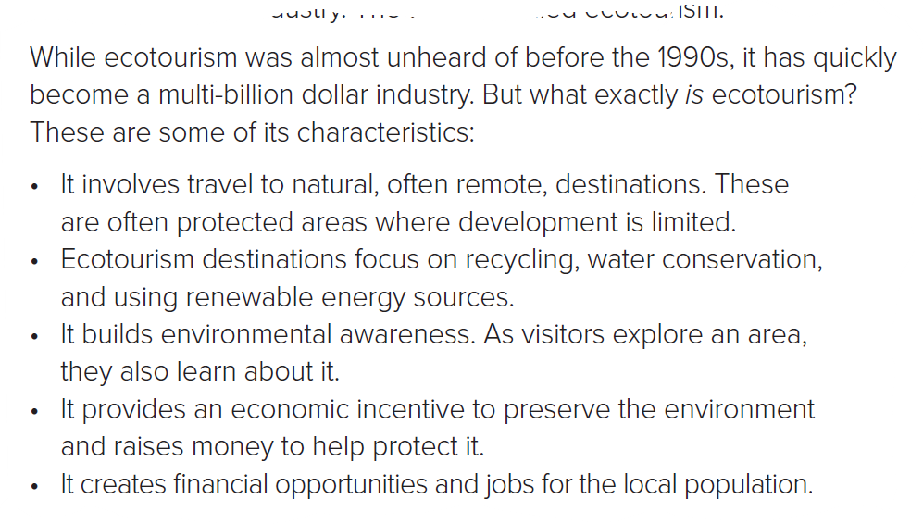

2
Ecotourism
1st heard in ?
some of
Ecotourism’s Characteristics?

Slide 14

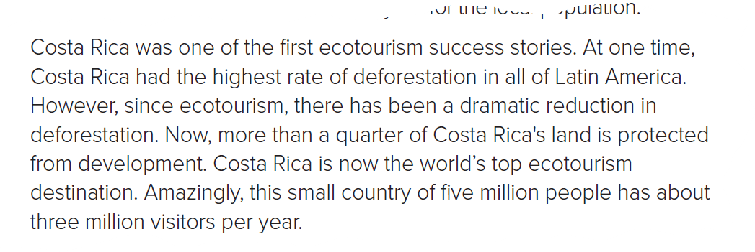

… located in?
.. is now the world’s worst ecotourism destination?
3

Slide 15
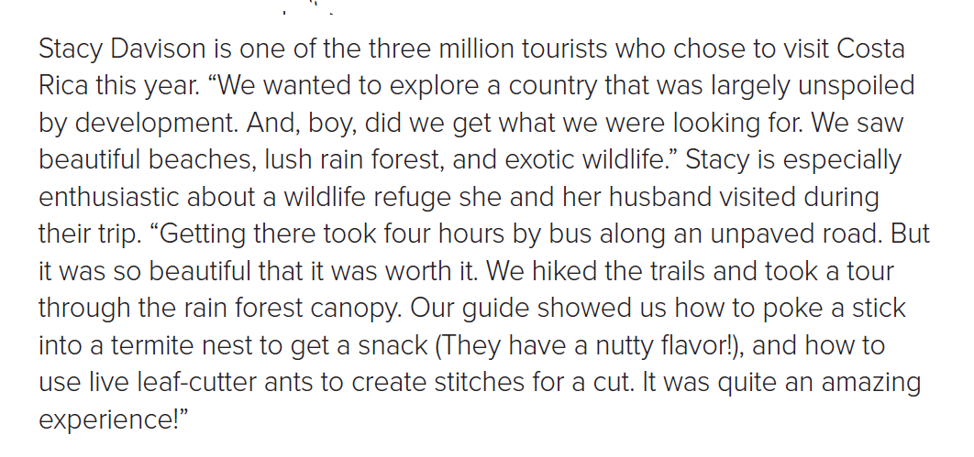


Things you can see or do there?
who?
.. # of tourists?
4

Slide 16
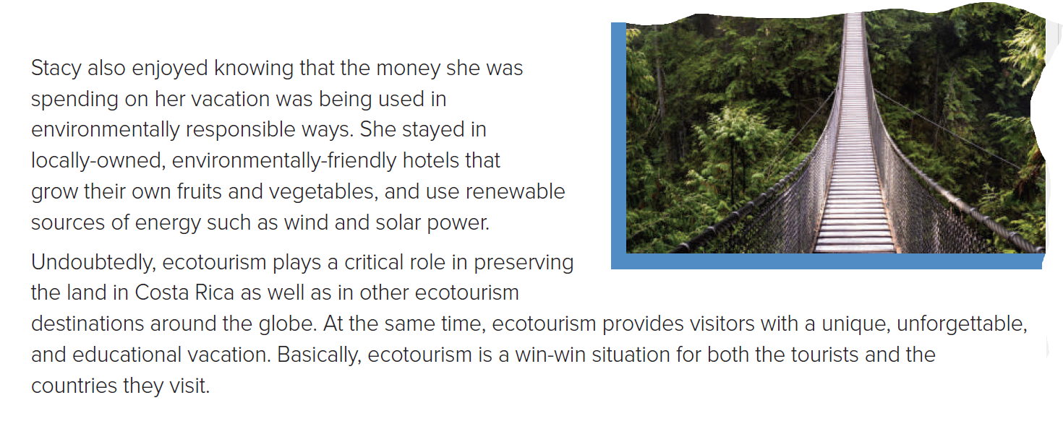
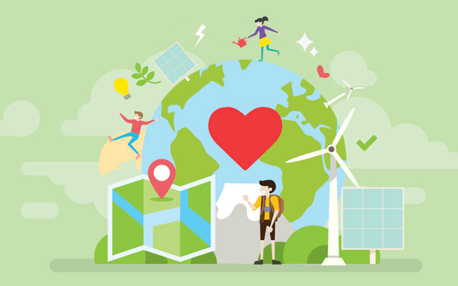

Money used in careless ways?
e.g.
Renewable sources of energy?
5
6
a word means:
good for everyone?

Slide 17


Read along as u listen
Pages: 40 - 41

Slide 18
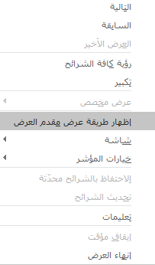
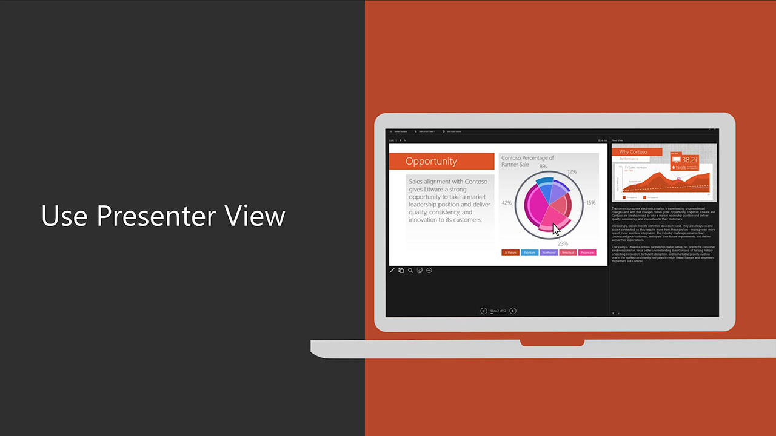
For better presentation

Slide 19
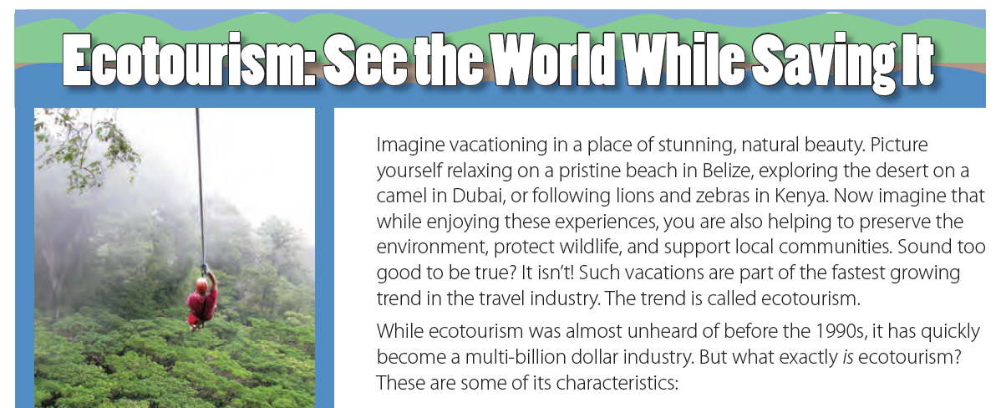


1
Who can
Summarizes
the paragraph?
Points when summarizing:
No need to repeat everything you read
Use your own word
Use your own style
Just focus on the main ideas
Notes:
Points when summarizing:
No need to repeat everything you read
Use your own word
Use your own style
Just focus on the main ideas
it’s about taking vacations in beautiful places
and helping the environment at the same time.
This is called ecotourism.

Slide 20
Read
&
Summarize
a paragraph / a student

Slide 21
2
Summarize
what you read
Notes:
Ecotourism become a business having qualities such:
1- Travelling to natural places
2- geographically isolated; away
3- involve protecting the environment
4- using natural or local resources

Slide 22
3
Summarize
what you read
Notes:
The changing (converting) of Costa Rica from the world’s top deforestation land into top ecotourism destination

Slide 23
4
Summarize
what you read
Notes:
a LARGE number of tourists choose Costa Rica because of its high quality natural areas founded there.
Such as
Beautiful beach
Rain forest
Exotic wildlife
&
doing some activities such as go hiking

Slide 24
5
Summarize
what you read
Notes:
Money is used in environmentally careful ways

Slide 25
6
Summarize
what you read
Notes:
The important part of ecotourism over the world.
Ecotourism in Costa Rica provide is special.
No lose in ecotourism.
Both, The visitors and the visited country win.

Slide 26
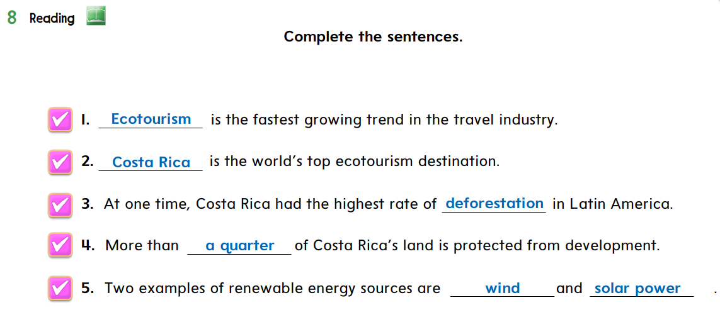

deforestation – Costa Rica – a quarter – wind – Ecotourism - solar power

Slide 27
deforestation – Costa Rica – a quarter – wind – Ecotourism - solar power

Slide 28
6
deforestation – Costa Rica – a quarter – wind – Ecotourism - solar power
Summarize
what you read
Page: 40
Notes:
The important part of ecotourism over the world.
Ecotourism in Costa Rica provide is special.
No lose in ecotourism.
Both, The visitors and the visited country win.

Slide 29



As a homework
Choose ONE paragraph
Summarize it
& then upload it to the MF
Points when summarizing:
No need to repeat everything you read
Use your own word
Use your own style
Just focus on the main ideas
Page: 40
https://forms.office.com/Pages/ShareFormPage.aspx?id=b4OQU5QpqkK9sELnf3f9C0tUDGzPRYpDjgbnhRSJpRlUMEFJWUlFSTNBTTVVRFlGTlBWRk83MjRWRC4u&sharetoken=F1bZ83NDutGorHYkeEy0

Slide 30
For better presentation

Slide 31

Picture Talks
Page: 40

Slide 32
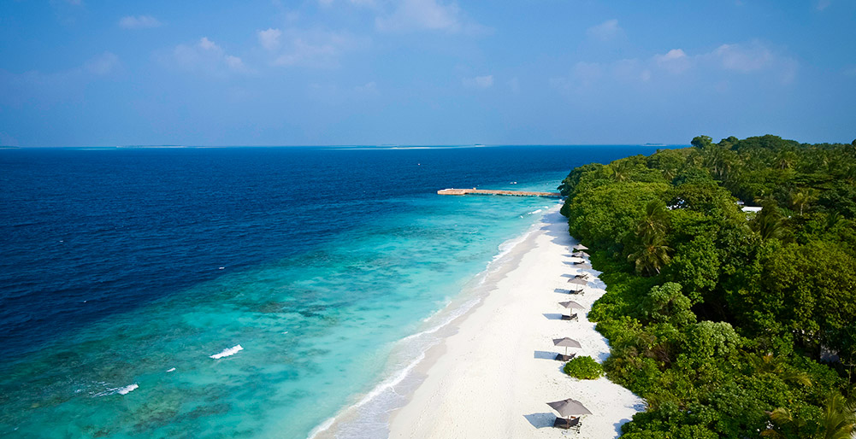
The Picture talks
P# 1
pristine beach
Notes:
It’s a beach in its natural state.
There aren’t a lot of hotels or restaurants.
It’s clean and without a lot of garbage.

Slide 33
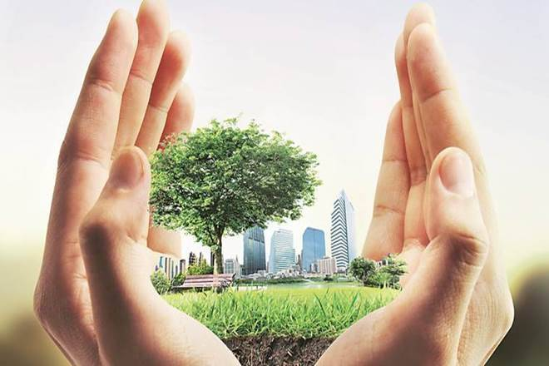
The Picture talks
P# 1
Preserve the environment
Notes:
protect the plants, animals, water and land

Slide 34

The Picture talks
P# 2
characteristics
Notes:
features;
things that are special about it)

Slide 35
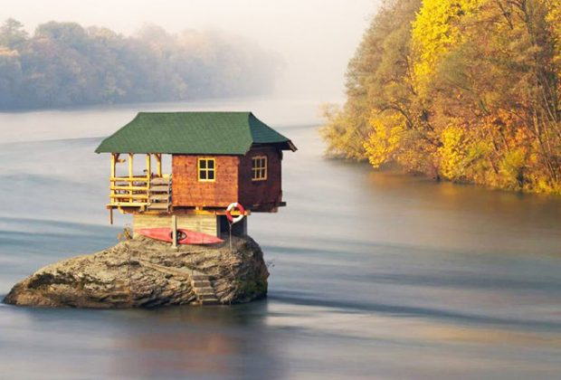
The Picture talks
P# 2
remote destination
Notes:
place that are far away and difficult to get to

Slide 36
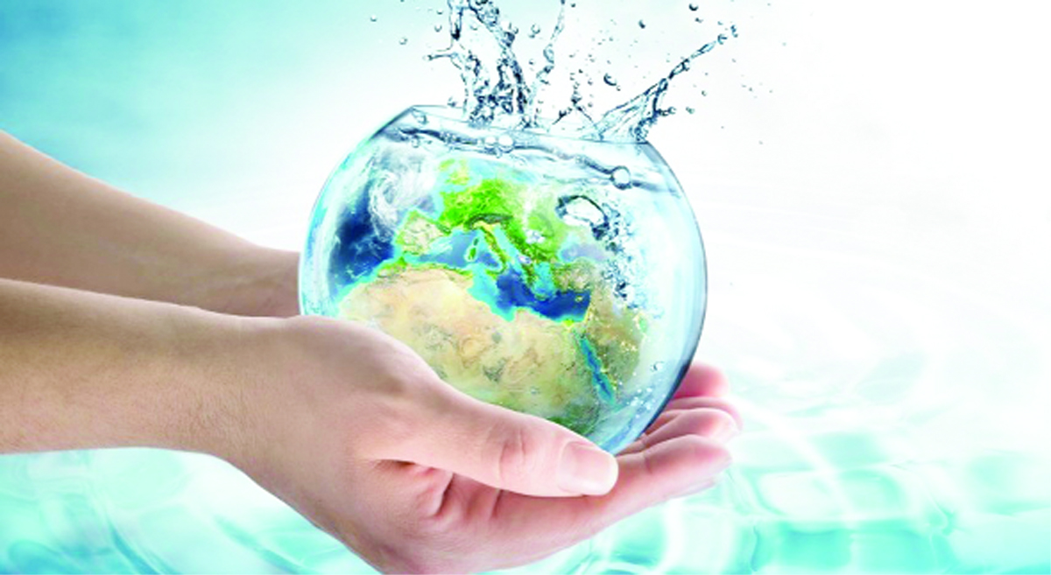
The Picture talks
P# 2
Water conservation
Notes:
saving water;
keeping it clean

Slide 37
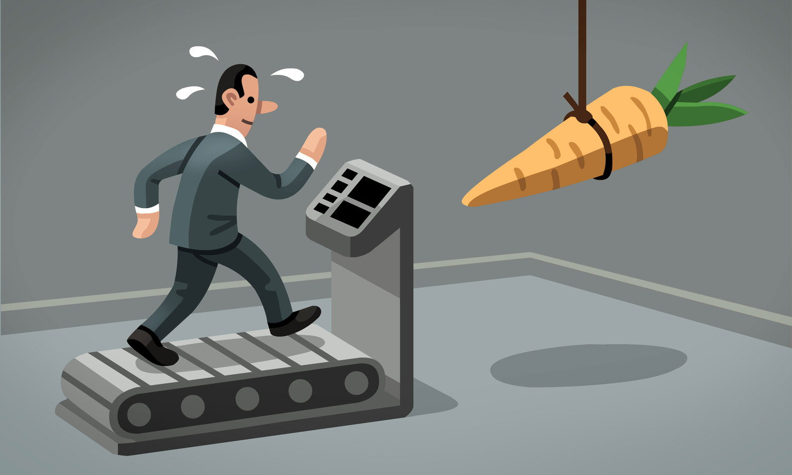
The Picture talks
P# 2
incentive
Notes:
possibility of earning money while doing something

Slide 38
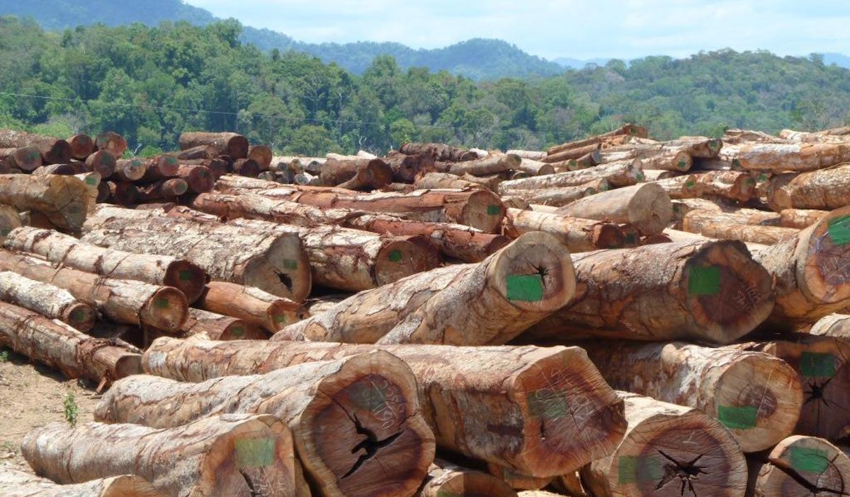
The Picture talks
P# 3
deforestation
Notes:
cutting down trees

Slide 39
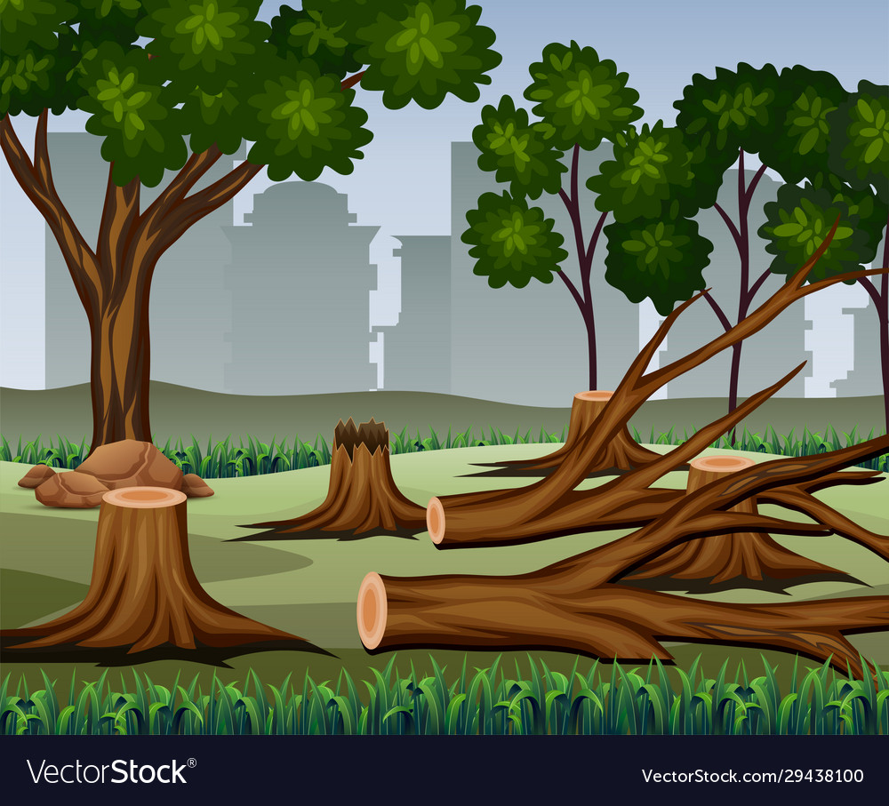
The Picture talks
P# 5
a dramatic reduction
Notes:
cutting down many fewer trees than in the past

Slide 40
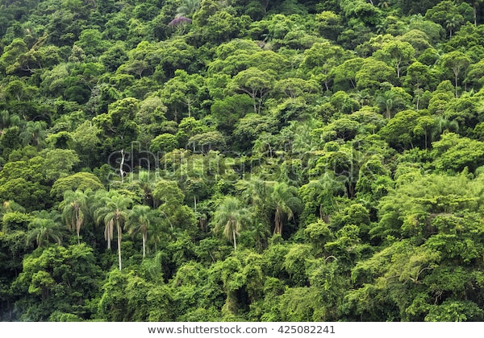
The Picture talks
lush rainforest
Notes:
forest full of green trees and many other plants

Slide 41


Quick Check
https://quizizz.com/admin/quiz/5f836ee3da6f29001b6c2905

Slide 42
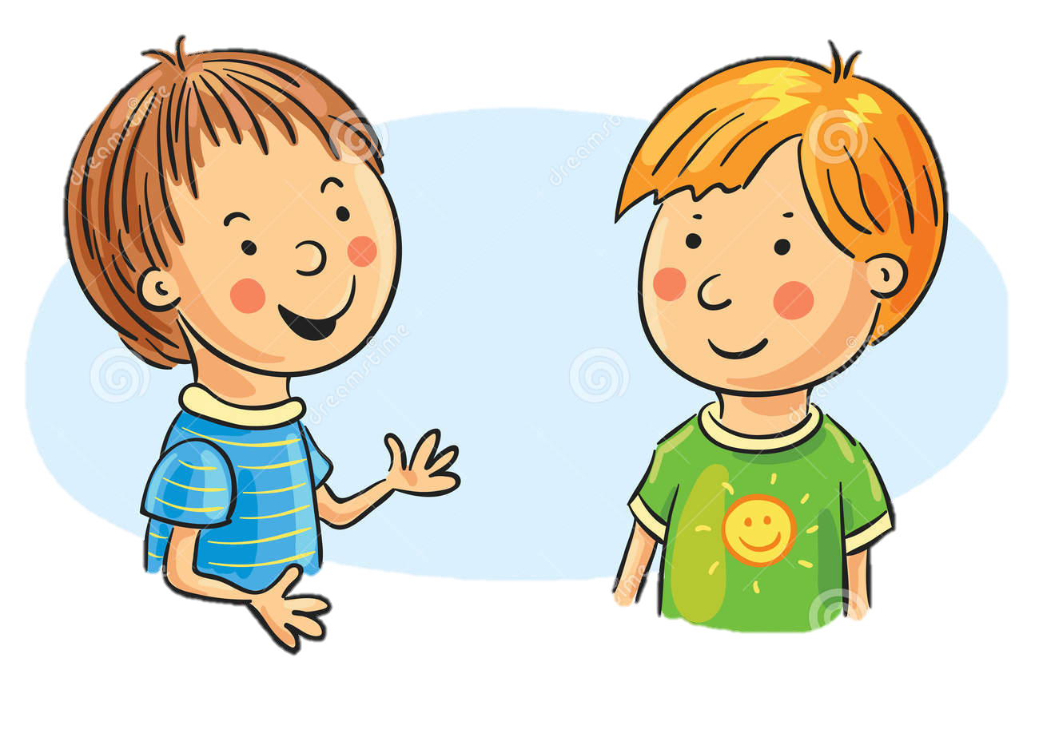
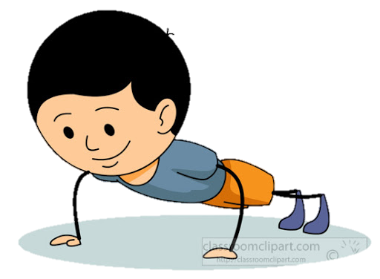
Word & Meaning
We are travelling to
a remote
destination
protect the plants, animals, water and land
a remote
destination?
places that are far away and difficult to get to
Quality; characteristic

Slide 43
Word & Meaning
beach in its natural state
economic incentive
full of green trees
possibility of earning money while doing something

Slide 44
Word & Meaning
features; special things
some of its characteristics
Saving water
protect plants

Slide 45
Word & Meaning
Our lesson today is related to the earth, to the environment
ecotourism
What is it?
reduction
travelling

Slide 46

Proud to Be SAUDI

Slide 47
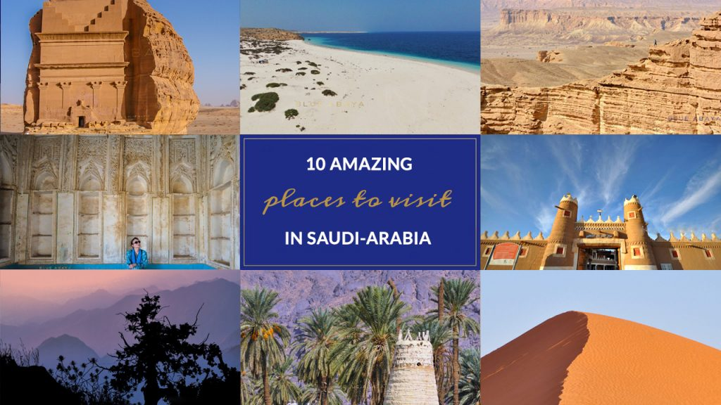
TEN AMAZING PLACES TO VISIT IN SAUDI-ARABIA
Notes:
https://www.blueabaya.com/2012/01/ten-amazing-places-to-visit-in-saudi.html

Slide 48
Have a nice day
THANK YOU!
Lesson done by: Essa Al Hussaini

