Slide 1

U4 – The Art of Advertising
P. 52-53
Language in context
Listening
Pronunciation
Conversation

Slide 2
Objectives:
1- Test previous general knowledge
2- Link the product with its description in the radio advertisement.
3- Pronounce Consonant + vowel & Consonant + Consonant correctly.
4- Guess the content of the conversation.
5- Extract information from the conmversation.

Slide 3

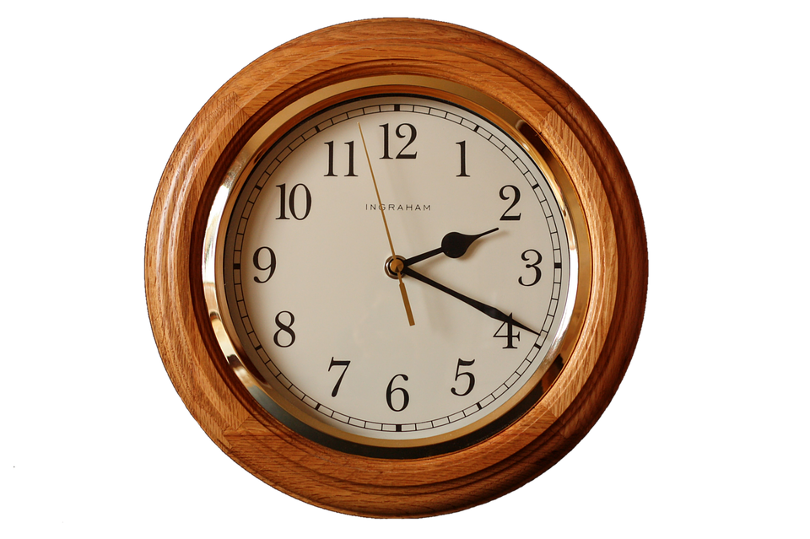


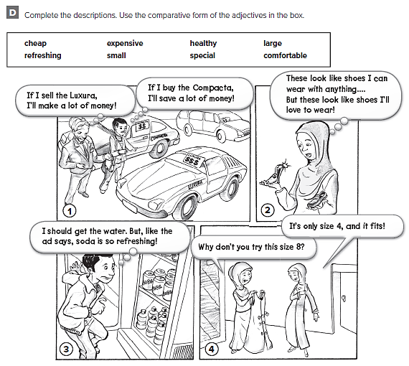
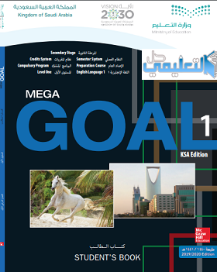

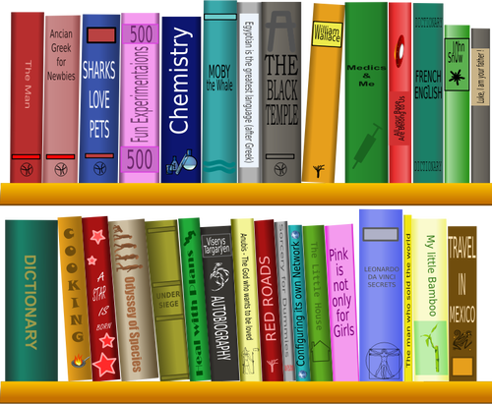




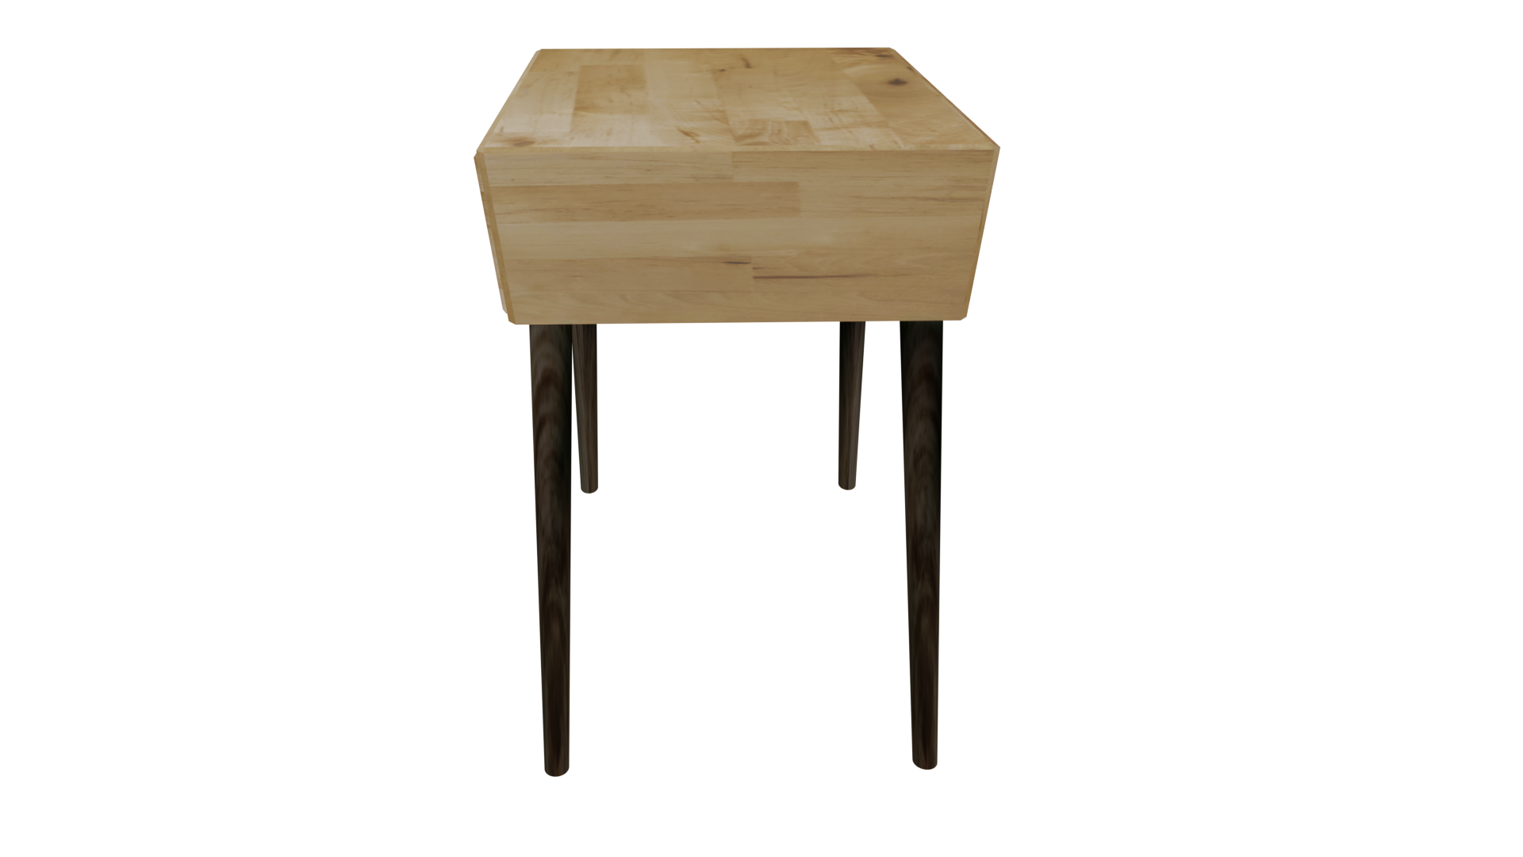

I love English
Mega Goal 1 WB (111)

Slide 4
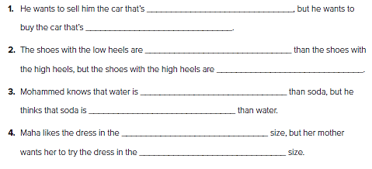
I love English
more expensive
cheaper
more comfortable
Mega Goal 1..WB (111)
more special
healthier
more refreshing
smaller
larger

Slide 5
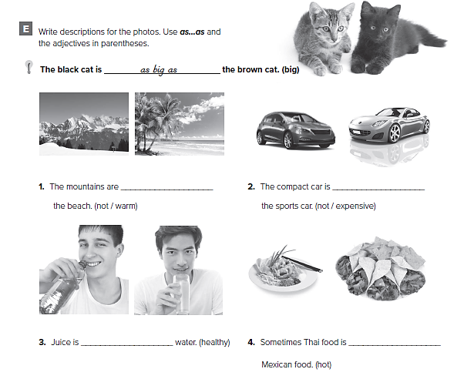

I love English
Mega Goal 1..WB (112)
not as expensive as
not as warm as
as healthy as
as hot as

Slide 6
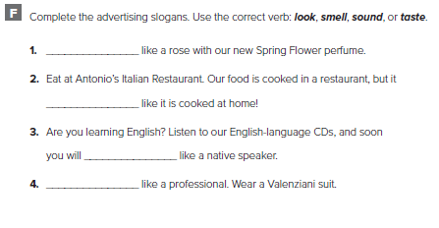
I love English
smell
Mega Goal 1..WB (112)
tastes
sound
look

Slide 7
Choose the correct answer:
1-Prophet Mohammed is the [best – better – good] person in the world.
2-The motorbike is [fast – faster – fastest] than the bike.
3-Hamed is as [tall – taller – tallest] as Ahamd.
4-He has spoken English for 10 years, and he [smells – tastes – sounds] like a native speaker.

Slide 8
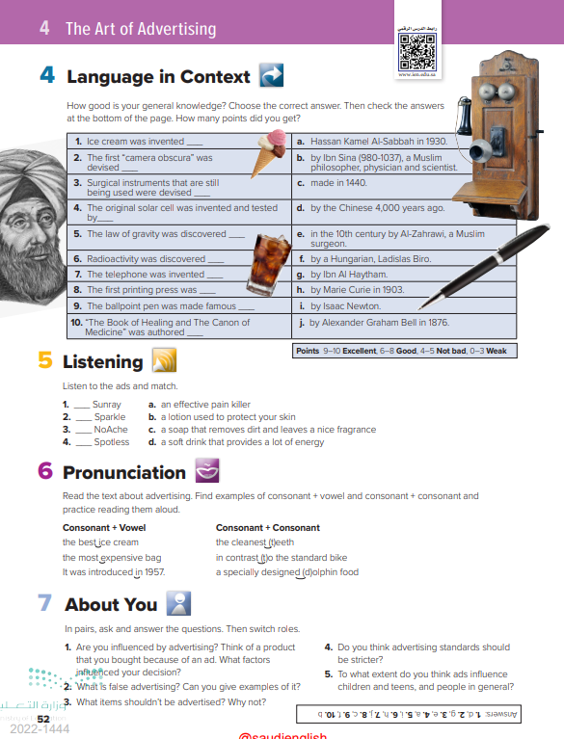
52

Slide 9
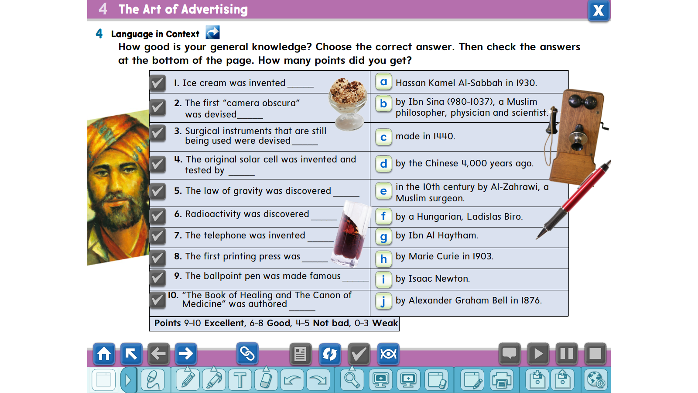
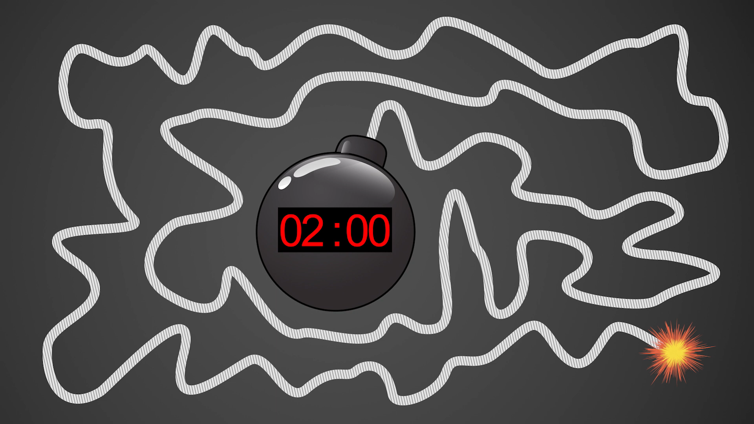
d
g
e
a
i
h
j
c
f
b

Slide 10
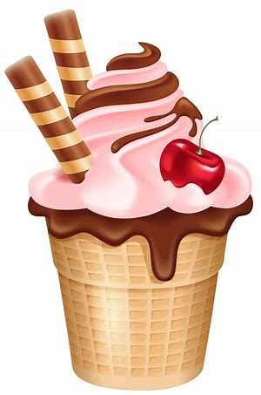
Ice cream was invented by the Chinese 4,000 years ago.

Slide 11
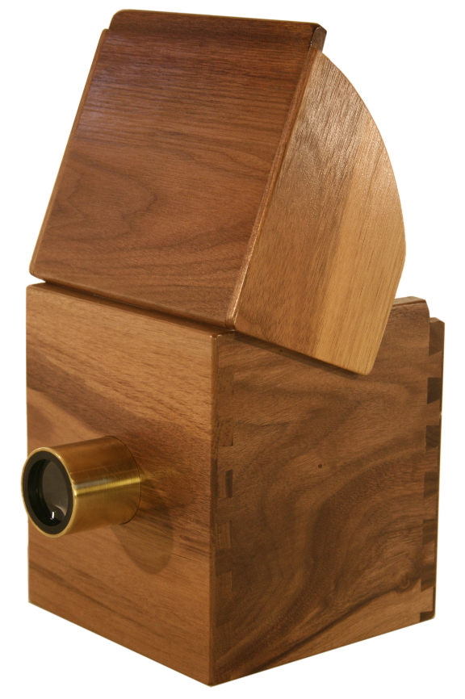
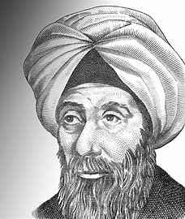
The first “camera obscura” was devised by Ibn Al Haytham.

Slide 12
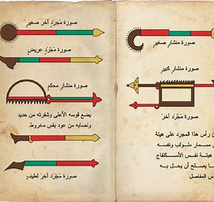
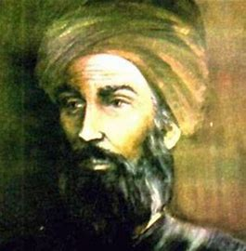
Surgical instruments that are still being used were devised in the 10th century by Al-Zahrawi, a Muslim surgeon.

Slide 13
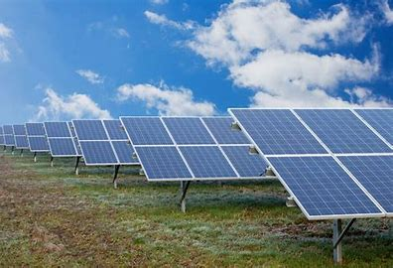
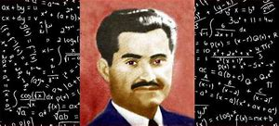
The original solar cell was invented and tested by Hassan Kamel Al-Sabbah in 1930.

Slide 14
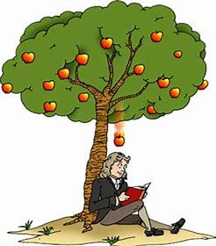
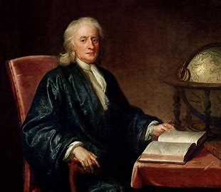
The law of gravity was discovered by Isaac Newton.

Slide 15
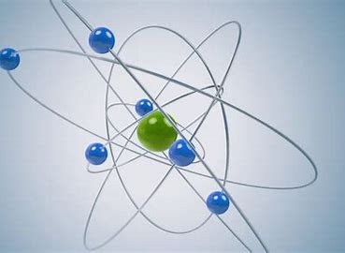
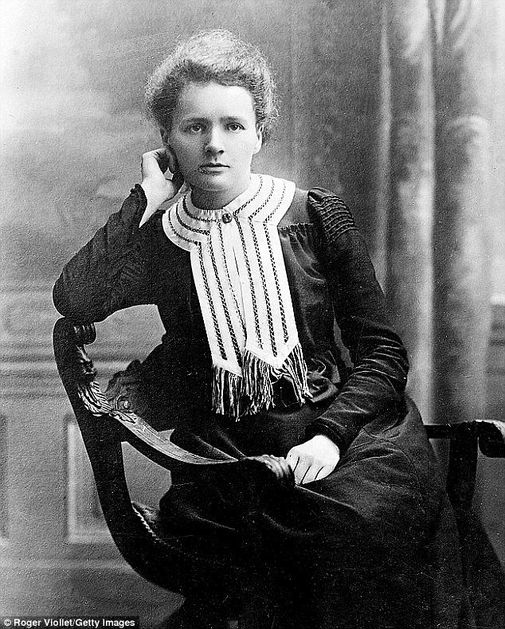
Radioactivity was discovered by Marie Curie in 1903.

Slide 16
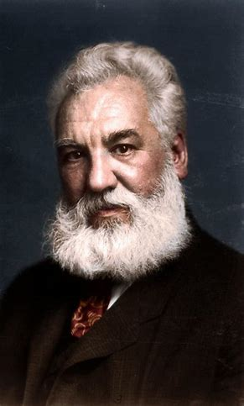
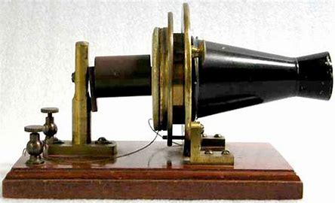
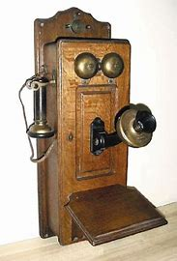
The telephone was invented by Alexander Graham Bell in 1876.

Slide 17
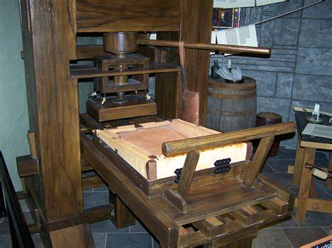
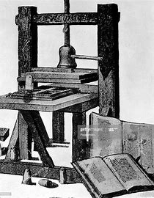
The first printing press was made in 1440.

Slide 18
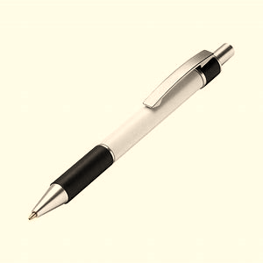
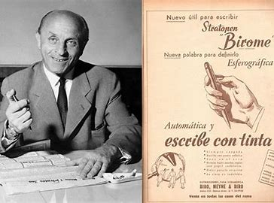
The ballpoint pen was made famous by a Hungarian, Ladislas Biro.

Slide 19
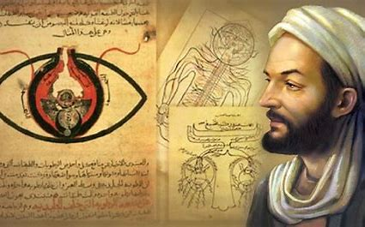
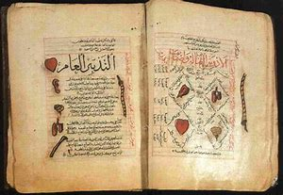
“The Book of Healing and The Canon of
Medicine” was authored by Ibn Sina (980-1037), a Muslim philosopher, physician and scientist.

Slide 21
52

Slide 22
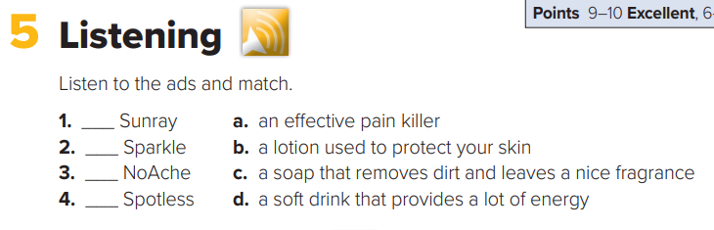

Name:…………………………………………………………………
4

Slide 23
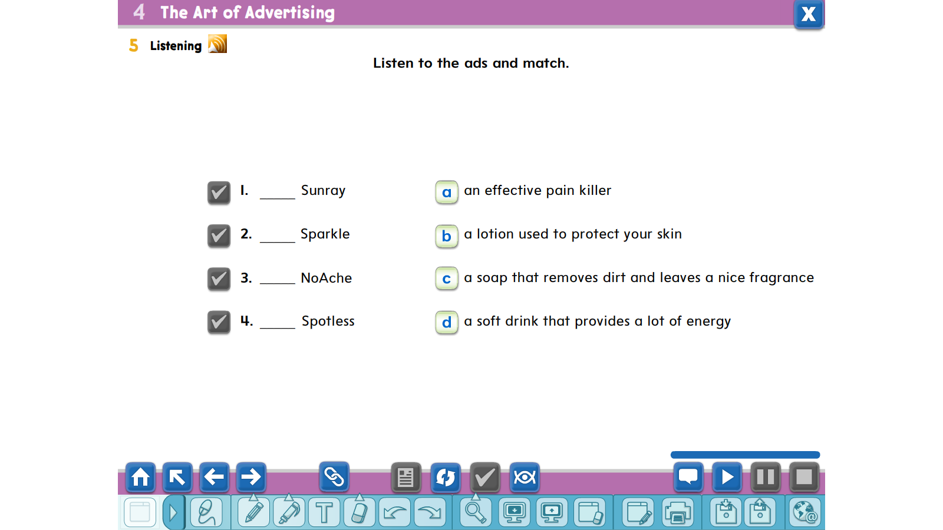
b
d
a
c

Slide 24
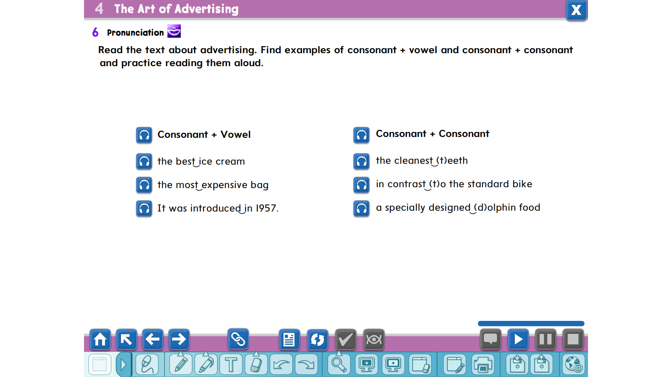

Slide 25
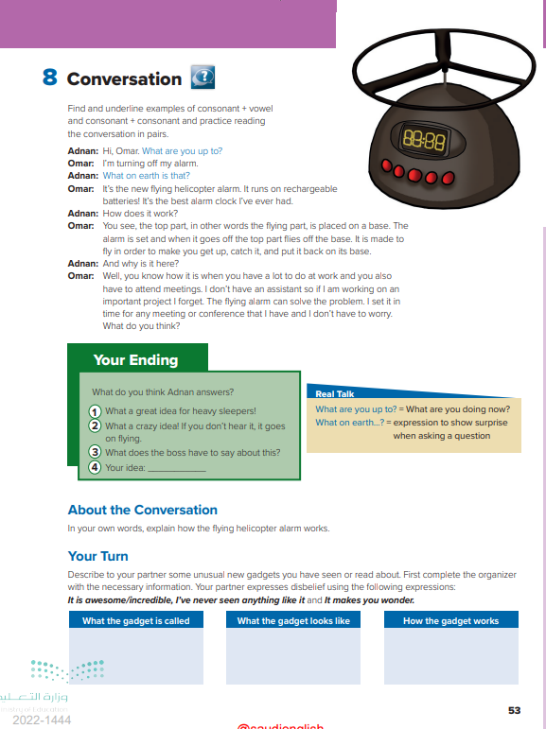
53

Slide 26
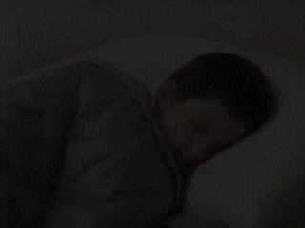

Slide 27
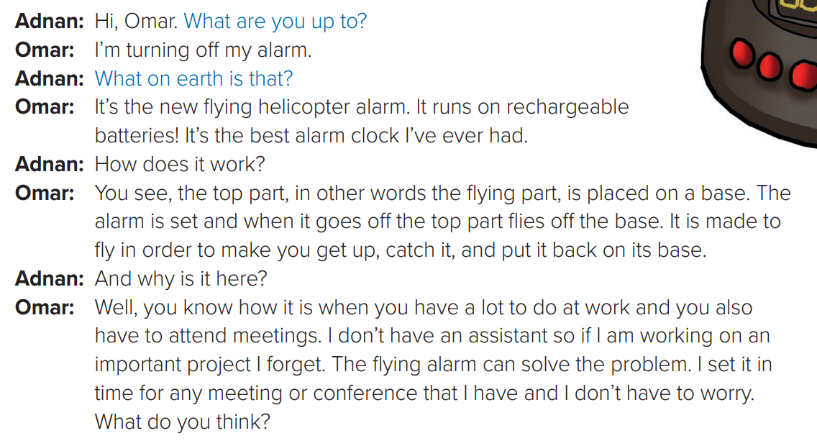
Preview the text:
Who are the speakers?
How does it work?
How is this alarm different than any other alarms?
Would you buy a similar one?

Slide 28
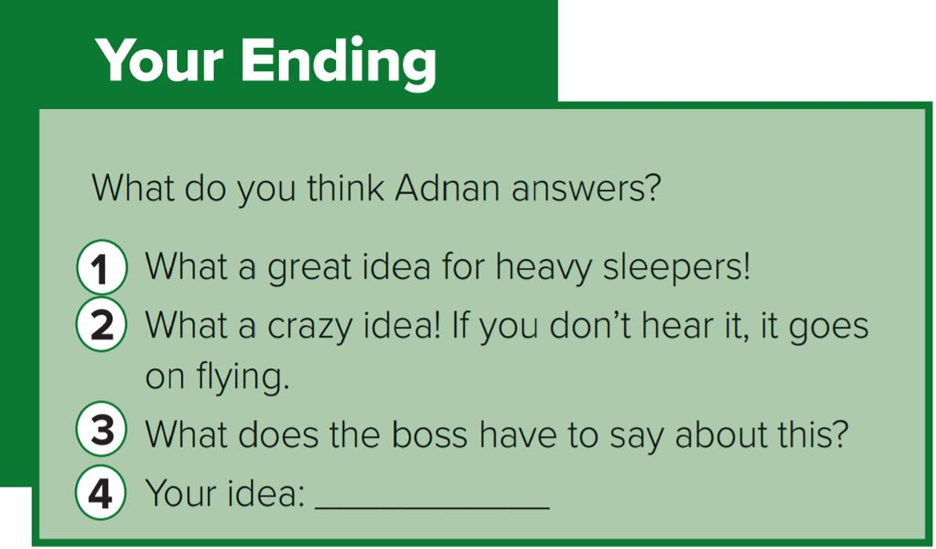
Listen and follow

Slide 29
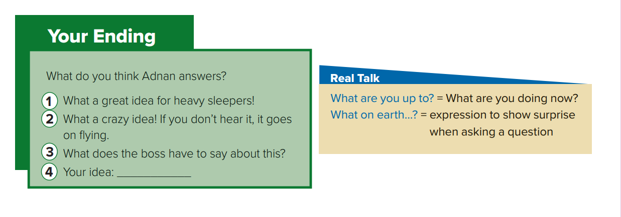
Who said..?

Slide 30
Role play

Slide 31
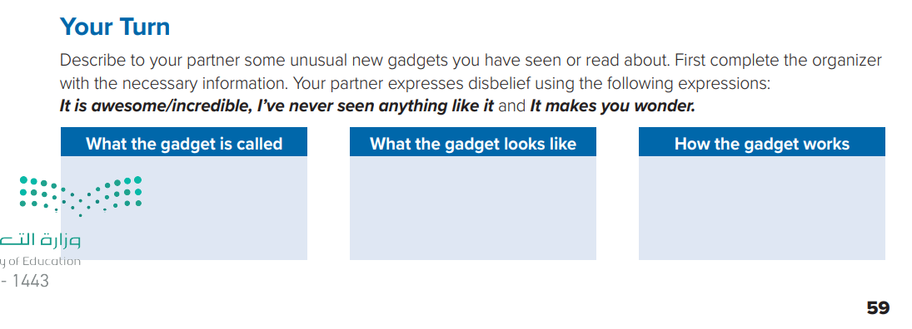

Slide 32
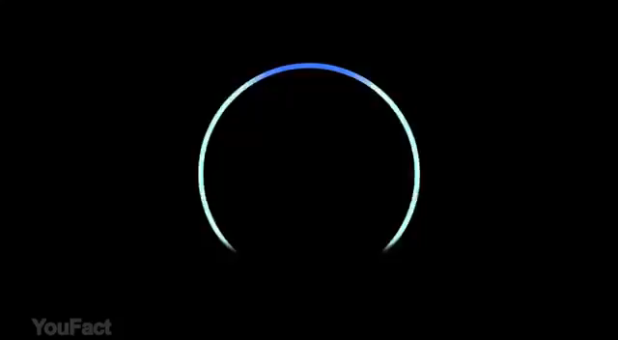
Mega Goal 1 .. SB (53)

Slide 33
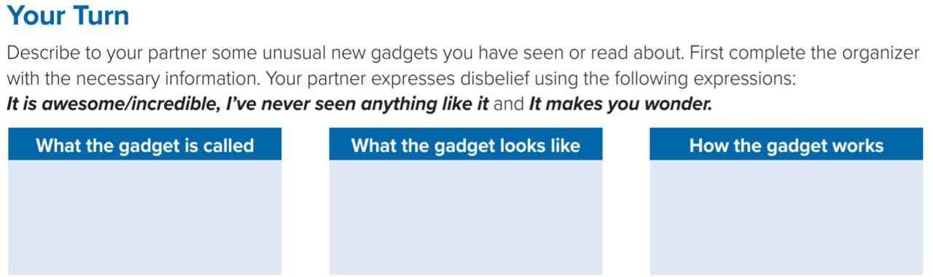
Mega Goal 1 .. SB (53)
It uses sensors and image mapping to create usable layouts of your home which allows to clean effectively
Robot Vacuum
It’s small
and round

