Slide 1

Mega Goal 1
U: 4
Grammar
By: Yousef Hilal Alyazedi

Slide 2
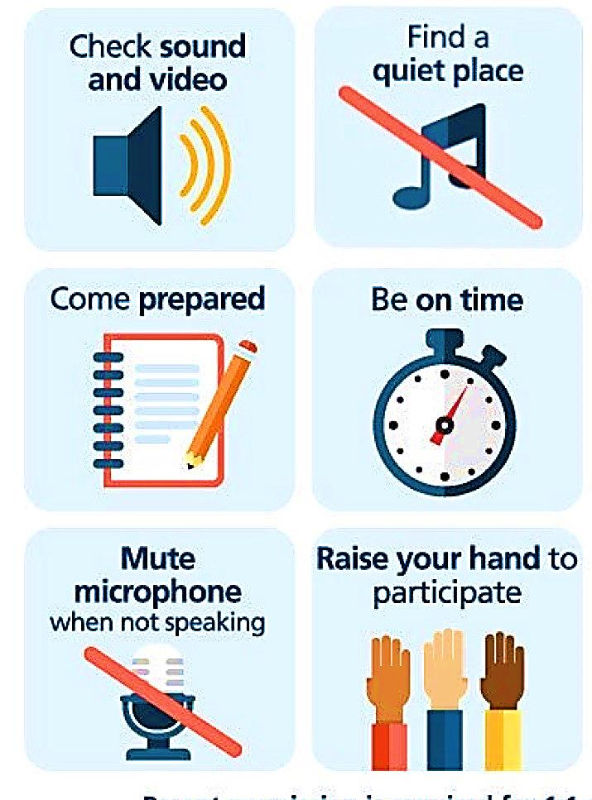
Online Classroom Rules

Slide 3
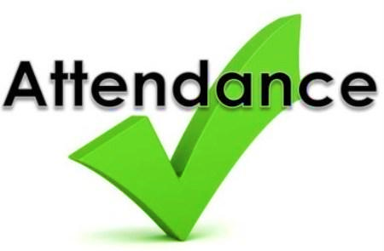
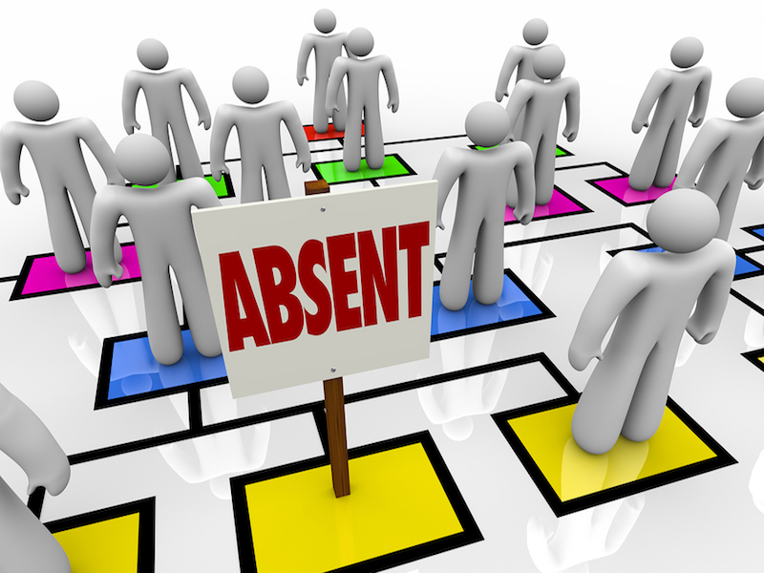

Slide 4

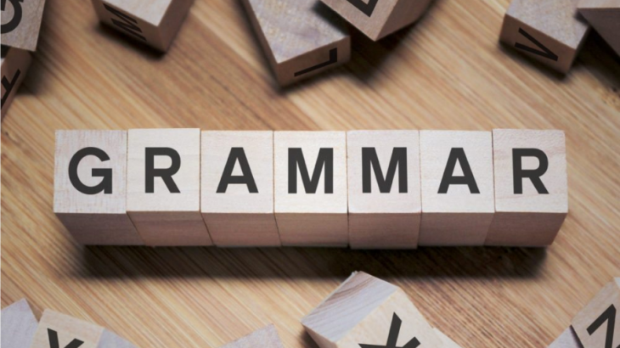


Lesson Objectives
The students will be able to :
1 – use passive voice with different tenses .
2 – make a comparative and superlative for adjectives .
3 – use as … as to show two items are the same .
4 – use verbs “ look, smell, sound, taste ” with like + noun.

Slide 5


Open your Student’s book at page: 56

Slide 6
Look at these sentences
The lesson is explained by the teacher .
The lesson was explained by the teacher .
The squirrel has been chased by the dog .
The squirrel will be chased by the dog .

Slide 7
General Structure
Object
Be
p.p ( v-ed / v3 )
They broke the window .
The window was broken .
We only use “ by + agent “ when it is important to say who or what is responsible for something .

Slide 8
Tense
Active
Passive
Present simple
The students clean the classroom .
The classroom is cleaned
Simple past
The students cleaned the classroom .
The classroom was cleaned
Present perfect
The students have cleaned the classroom .
The classroom has been cleaned
Future
The students will clean the classroom .
The classroom will be cleaned

Slide 9
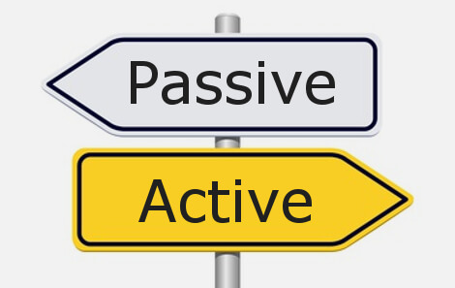
Active Voice ?
We use active voice when the subject is doing the action .
Passive Voice ?
We use Passive voice when the focus on the action
We use Passive to emphasize what was done instead of who did it .

Slide 10
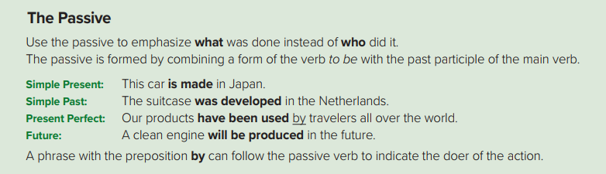

Slide 11

Change into passive
Sami receives a letter .
A letter is received by Sami .
Amazon will release a new tablet .
Change into passive
A new tablet will be released by Amazon .

Slide 12
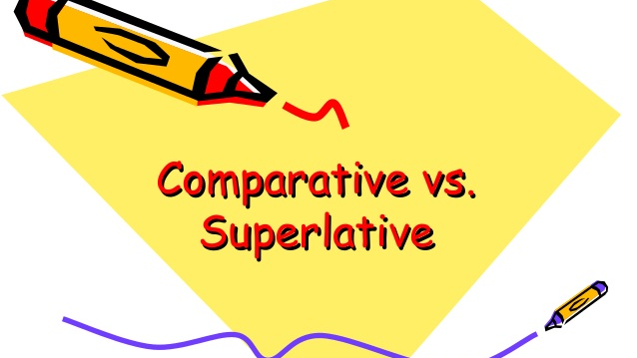

Slide 13
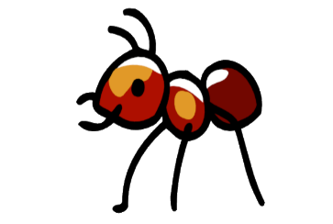

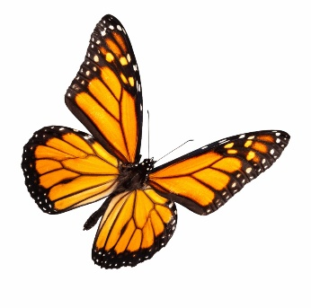
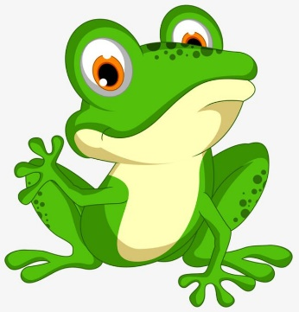
Comparative
Normally used if we want to compare two things, people,etc
The ant is smaller than the hippo .
Butterfly is more beautiful than frog .

Slide 14
1 – We add er to one-syllable words .
old
older than
2 – If an adjective ends in ( e ), we add ( r ) only .
nice
nicer than
3 – If an adjective ends in a vowel + consonant, we double the consonant and add ( er ) .
big
bigger than

Slide 15
4 – If an adjective ends in with ( y ) , we change ( y ) to ( i ) and add ( er ) .
happy
happier than
5 – If an adjective has two syllables or more, we add ( more ) before
expensive
more expensive than
6 – We have few exceptions :
good
better than
bad
worse than
far
farther than / further than

Slide 16

Remember
We must follow the comparative by the word ( than )

Slide 17
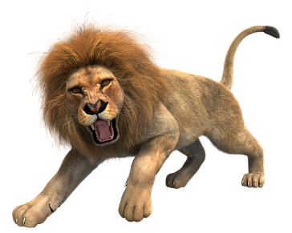
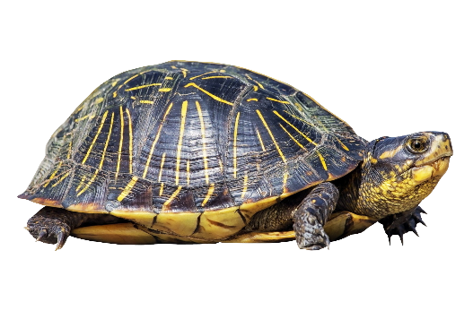
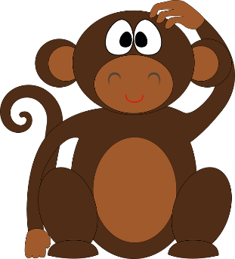
Superlative
we use it if we want to compare three or more things, people , etc
The ant is the smallest .
Butterfly is the most beautiful .

Slide 18

1 – We add est to one-syllable words .
long
the longest
2 – If an adjective ends in ( e ), we add ( st ) only .
large
the largest
3 – If an adjective ends in a vowel + consonant, we double the consonant and add ( est ) .
fat
the fattest

Slide 19
4 – If an adjective ends in with ( y ) , we change ( y ) to ( i ) and add ( est ) .
silly
the silliest
5 – If an adjective has two syllables or more, we add ( the most) before
careful
the most careful
6 – We have few exceptions :
good
the best
bad
the worst
far
the farthest / the furthest

Slide 20

Remember
In the superlative, we must precede the short adjective by the word ( the ) .

Slide 21
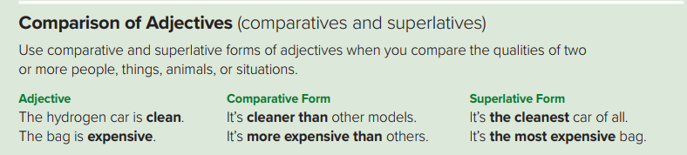

Slide 22
Compare
Saudi Arabia is ( large ) Bahrain .
Saudi Arabia is larger than Bahrain .
Compare
Winter is the ( cold ) season .
Winter is the coldest season .

Slide 23
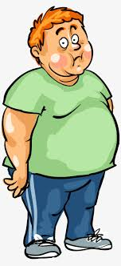
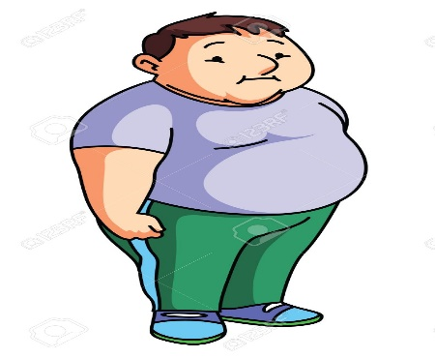
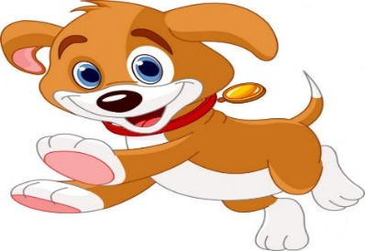
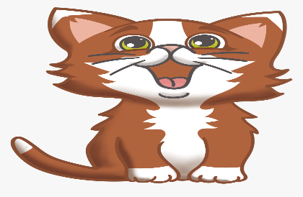
as + adjective + as
We use as … as to express that two parts of comparison are equal or the same in some ways .
John is as fat as Mark .
The cat is as happy as the dog .

Slide 24
as…as
Abha ( cold ) Taif .
Abha is as cold as Taif .
Jassim is ( tall ) Fahad .
not as …… as
Jassim is not as tall as Fahad .

Slide 25
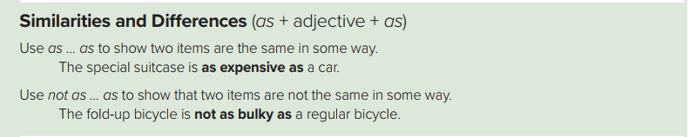

Slide 26


They look like old men .
It sounds like a storm .
It smells like coffee .
We use sense verbs + like + noun in descriptions .

Slide 27
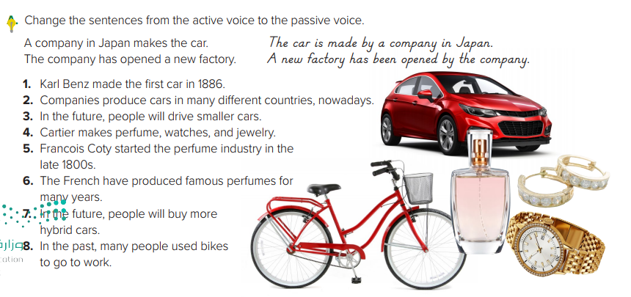

Slide 28

Answers
1 – The first car was made by Karl Benz in 1886 .
2 – Cars are produced ( by companies ) all over the world nowadays .
3 – In the future, smaller and smaller cars will be driven ( by people ) .
4 – Perfume , watches and jewelry are made by Cartier .
5 – The perfume industry was started by Francois Coty in he late 1800s .
6 – Famous perfumes have been produced by the French for many years .
7 – In the future, more and more hybrid cars will be bought ( by people ) .
8 – In the past , bikes were used by many people to go o work .

Slide 29
Open your Student’s book at page: 57

Slide 30
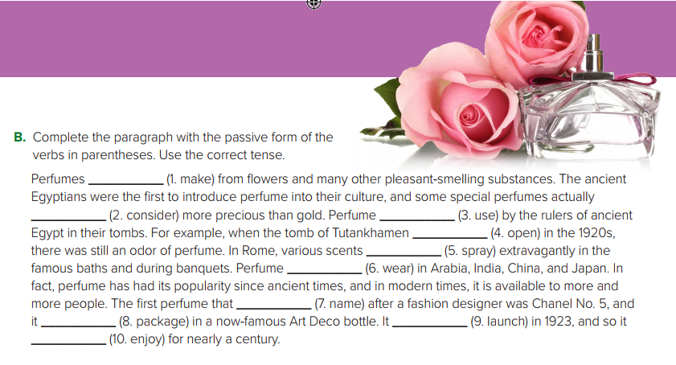
are made
Were considered
Was used
Was opened
Were sprayed
Was worn
Was named
Was packaged
was launched
has been enjoyed

Slide 31
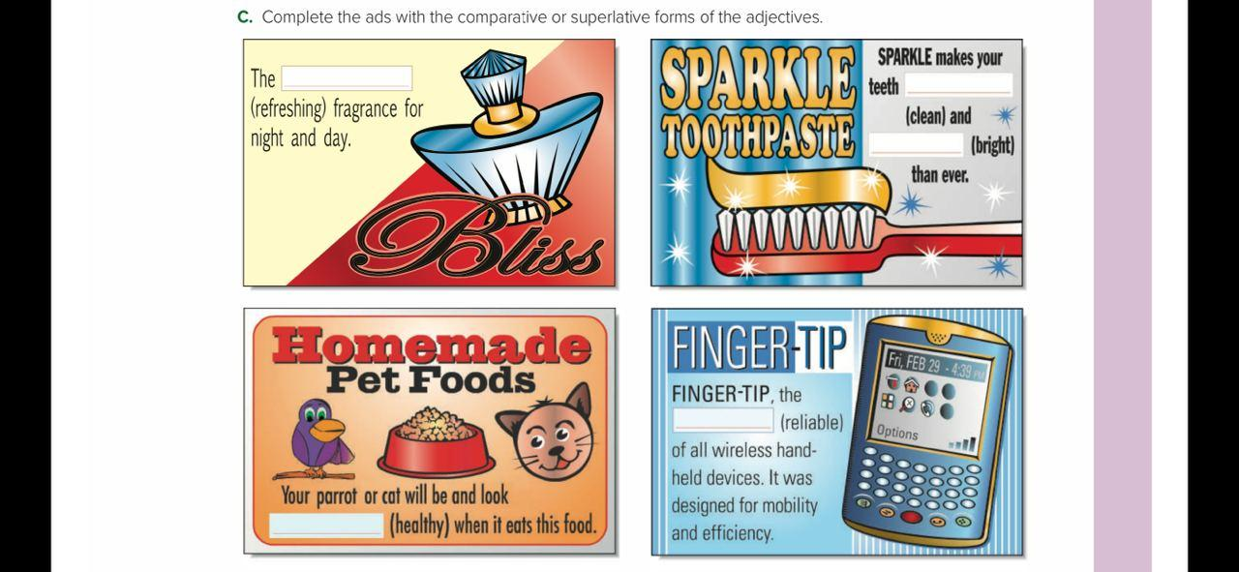
Most refreshing
cleaner
brighter
Most reliable
healthier

Slide 32
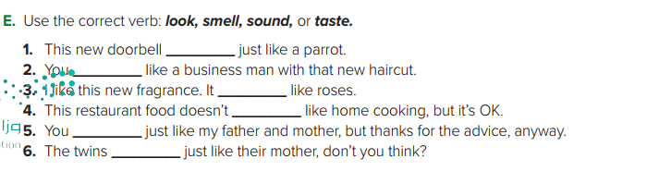
Sounds/look
look
smell
taste
sound
look

Slide 33

Workbook P. 38 + 40

Slide 34



