Slide 1
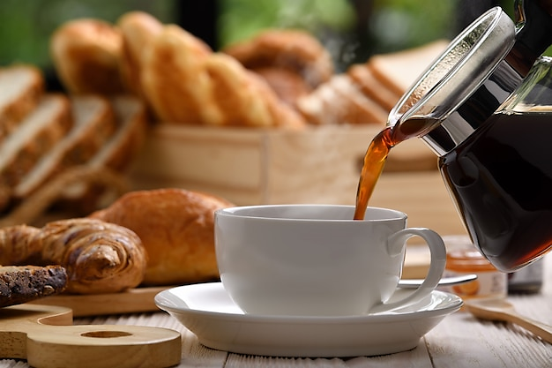
Good Morning

Slide 2

Let’s take a quick “Revision” for the previous lesson.

Slide 3
Match
A. Arranges trips. |  | 1. Customer service
B. Takes care of sick people. |  | 2. Salesperson
C. Sells things to customers. |  | 3. nurse
D. Helps customers on the phone. |  | 4. Travel agent
D
C
B
A

Slide 4

Let’s start our new lesson, shall we?

Slide 5

Objectives
Study “Simple present tense”.
Wh- Questions in the Simple Present.
Verb Want + Infinitive.

Slide 6
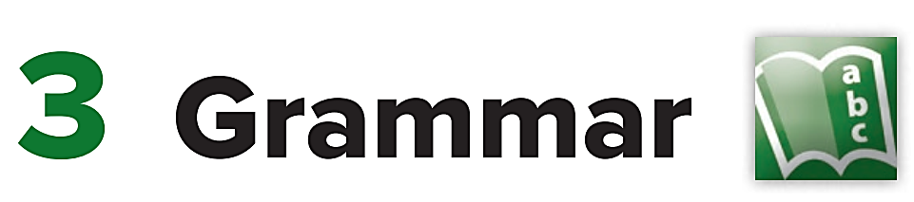

Slide 7
Simple Present Tense
When do we use it?
Use the simple present to talk about things that are true in general or that happen all the time.

Slide 8



Examples
I live in Saudi Arabia.
General truth
My brother lives in America.
General truth
I cook dinner every night.
Happens all the time

Slide 9
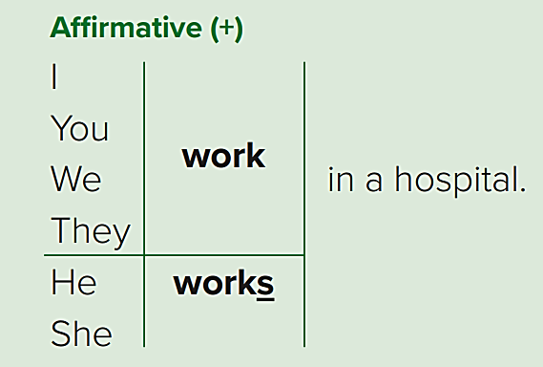
Simple present form

Slide 10
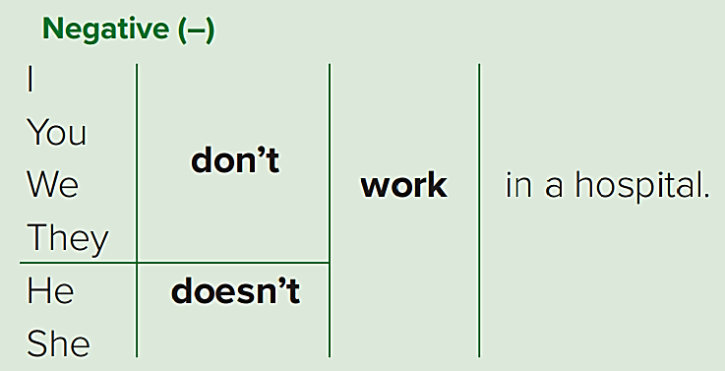
Simple present form

Slide 11
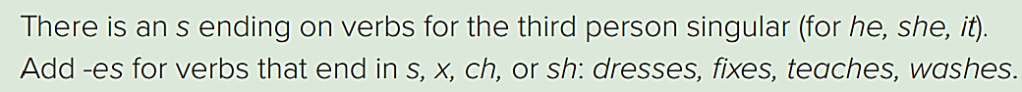
He
She
it
Works

Slide 12
dresses
He
She
it
fixes
teaches
washes

Slide 13
Names
Ahmad works in a hospital.
Sarah likes to draw.
Khalid plays football every day.
Norah teaches at a high school.
Names will take the verb ending with (– s) in affirmative forms.

Slide 14
Pay attention
Ahmad works in a hospital.
1 name takes verb with - s
Ahmad and Fahad work in a hospital.
2 or more names take verb without - s

Slide 15
Names
Ahmad doesn’t work in a hospital.
Sarah doesn’t like to draw.
Khalid doesn’t play football every day.
Norah doesn’t teach at a high school.
Names will take “doesn’t” in negative forms.
The verb after “doesn’t” must be without - s

Slide 16
Pay attention
Ahmad doesn’t work in a hospital.
1 name takes “doesn’t”
Ahmad and Fahad don’t work in a hospital.
2 or more names take “don’t”

Slide 17
Summary

Slide 18
(Affirmative)
He works
She works
it works
(one Name) works
I work
We work
You work
They work
(2 or more Names) work

Slide 19
(Negative)
I don’t work
We don’t work
You don’t work
They don’t work
(2 or more Names) don’t work
He doesn’t work
She doesn’t work
it doesn’t work
(One Name) doesn’t work

Slide 20

Very Good Class !
Now, let’s play a game, shall we?
Start

Slide 21
Simple Present Tense
(Questions)
How to form a Question in the simple present?
Let’s see…

Slide 22
To form a question in the present, we use 2 words:
Do
Does
Do
I
We
You
they
He
She
it
Does

Slide 23
Let’s try and make some questions!
they drink coffee. (make a question)
How can you make a question from this sentence?
add ( Do or Does ).
Which one?
If the pronoun in the sentence is ( I, we, you, they) then choose “Do”.
If the pronoun is ( he, she, it) choose “Does”.
Got it?

Slide 24
Let’s try it!
The sentence: They drink coffee.
The question: Do they drink coffee?
the pronoun in this sentence is they, so we choose “Do”.

Slide 25
Examples!
Question | sentence
1. Does he drink tea? | 1. He drinks tea.
2. Does martin work very hard? | 2. Martin works very hard.
3. Do you work in Riyadh? | 3.I work in Riyadh.

Slide 26
(Wh- Questions)
Wh- Questions are (what, where, when, why)
They come in the beginning of the Question:
Does she work?
Where does she work?

Slide 27
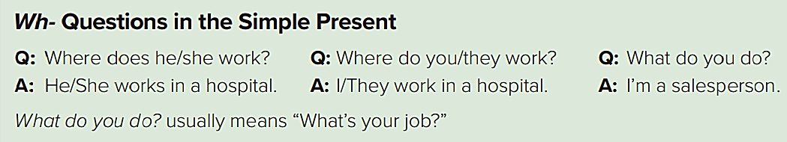

Slide 28
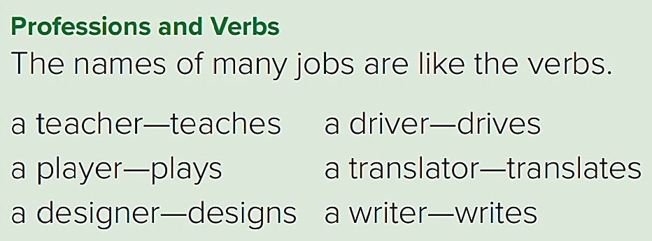

Slide 29
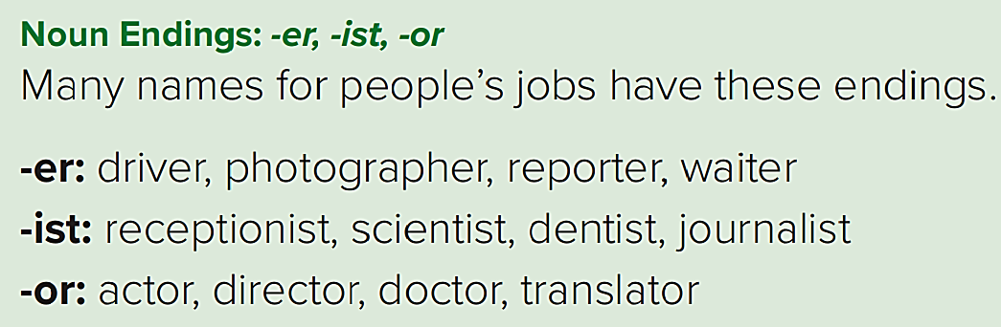

Slide 30
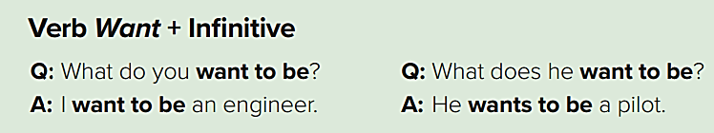


I want to be (a doctor)
I want being (a doctor)

Slide 31

Now, Let’s answer the exercises in the book

Slide 32
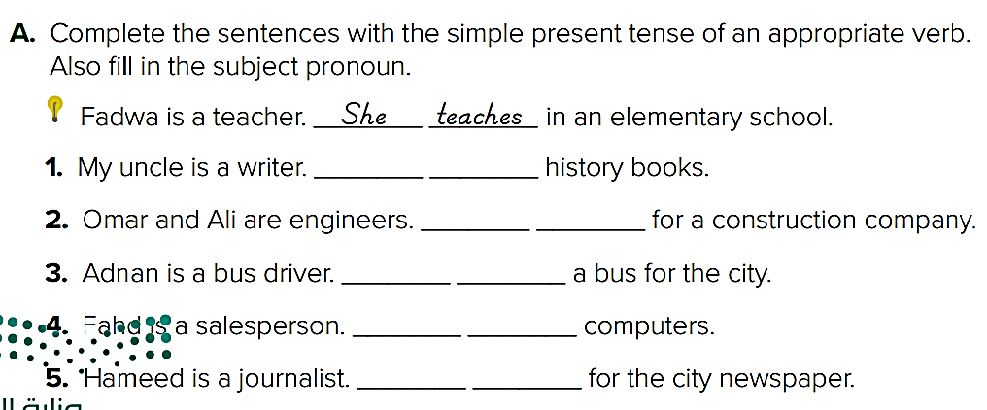
He
writes
They
work
He
drives
He
sells
He
works

Slide 33
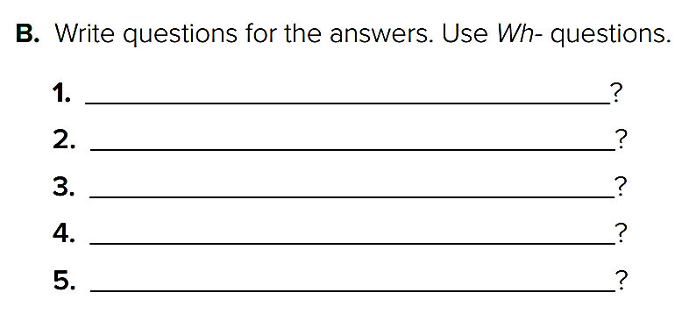
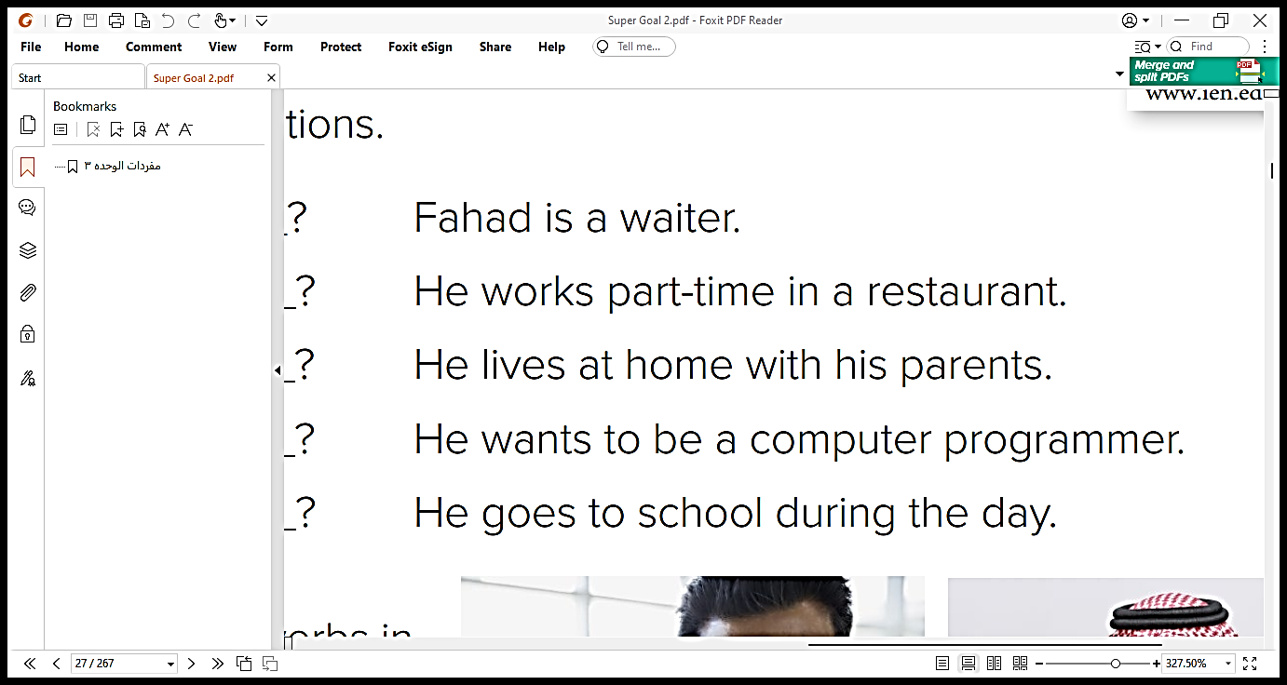
What does Fahad do
Where does he work
Where does he live
What does he want to be
What does he do during the day

Slide 34
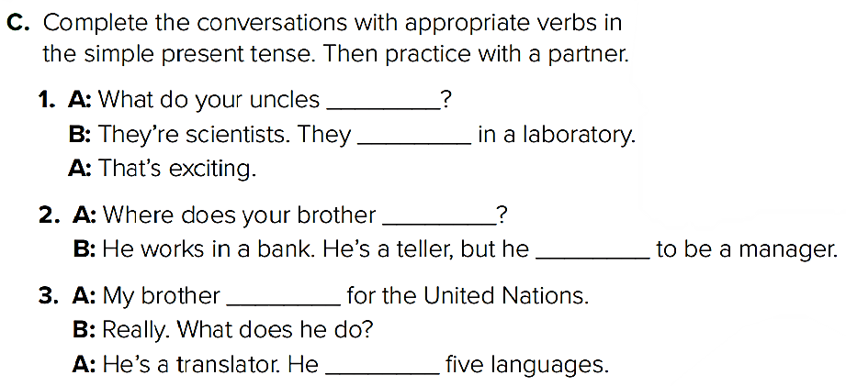
do
work
work
wants
works
speaks

Slide 35

End Of Class

Slide 36

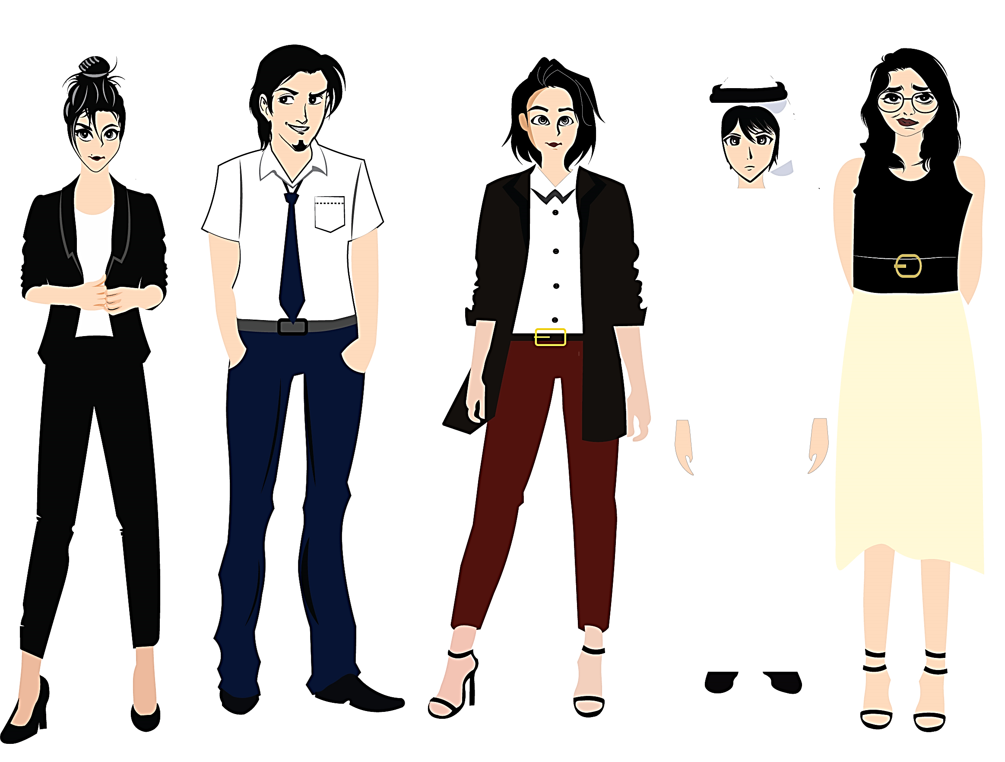


Pictures by:
www.freepik.com
تم تصميم هذا العرض من قبل: فريق عمل البوابة الإنجليزية ، وهو مجاني لكي يستفيد منه معلمي اللغة الإنجليزية.
هذه الشريحة تعتبر كـ"حفظ حقوق" نتمنى عدم حذفها حال مشاركة العرض مع معلمين آخرين.
نسمح بحذف الحقوق في حالة واحدة فقط: اذا أراد معلم الإنجليزي إضافة هذا العرض كـ انتاج معرفي خاص فيه.

