Slide 1


Slide 2
What Will They Think of Next?
Listen & Discuss
Pair work

Slide 3
Listen & Discuss

Slide 4
Goals:
List things that we take for granted today
1
Match each word to its definition.
2
Answer some questions about the text
3
List the predictions the author made about the English language
4
Name an invention they can’t live without
5
6
Discuss the predictions mentioned in the magazine that we take for granted today
Predict life events in the year 2100
7

Slide 5

Read the colour

Slide 6

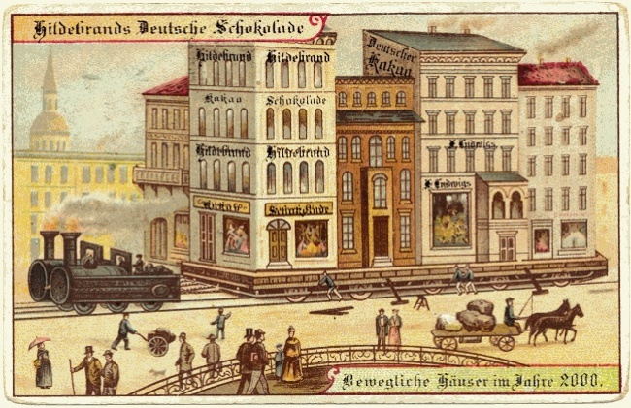
1-What things that we take for granted today did people not have 100 years ago?
.2. Name a discovery or development that you think people will have (or use) 100 years from now.

Slide 7
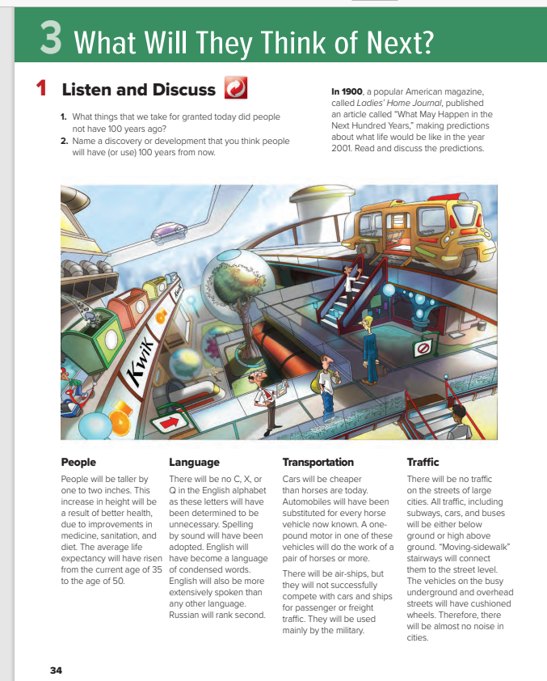
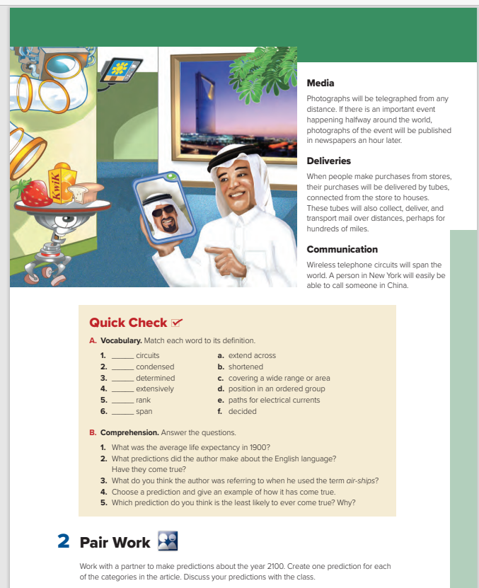

Students Book
P.34-35

Slide 8
…..Sections are there?
……..Title for each section?
……….Pictures?

Slide 9



Book Closed & Listen
What topics were discussed?

Slide 10
Listen & Read along

Slide 11
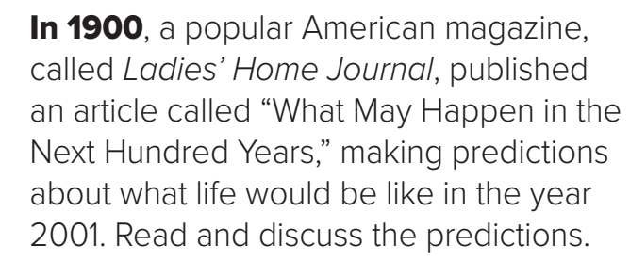
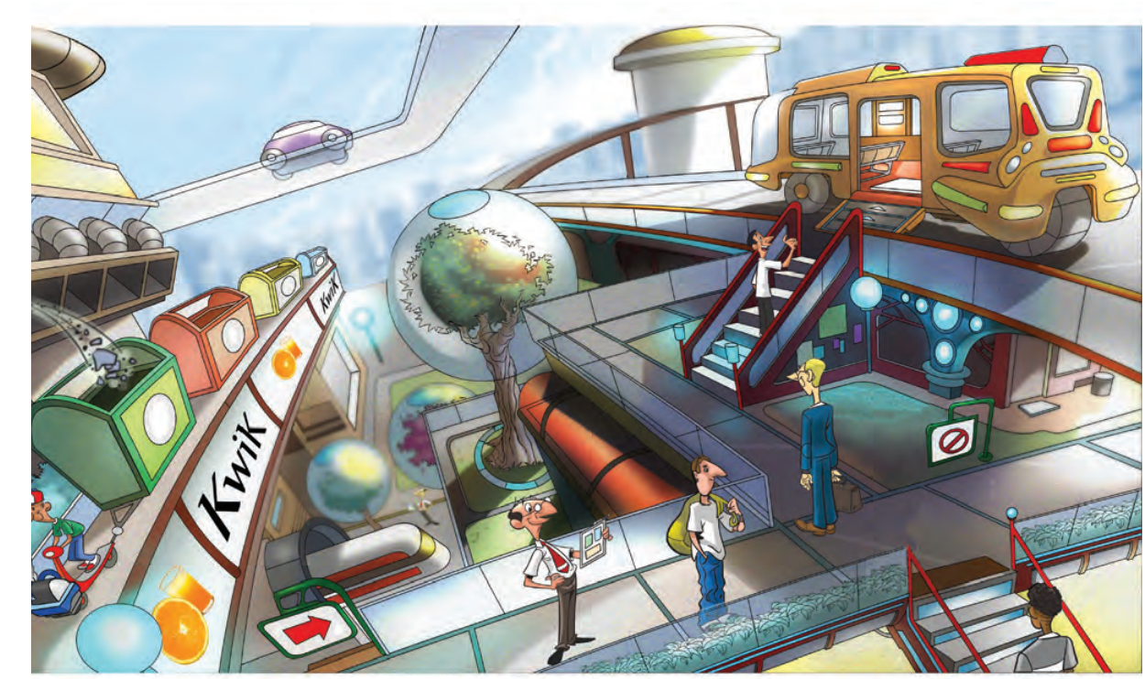
What predictions does the picture on page 34 illustrate?
Does this look like a modern city?
(the predictions about transportation and traffic)
Automobiles have replaced all horse vehicles.
Subways and tunnels allow people to move underground.
There are elevated trains and roadways that allow people to travel overhead as well.
Escalators and moving sidewalks are used to transport people

Slide 12
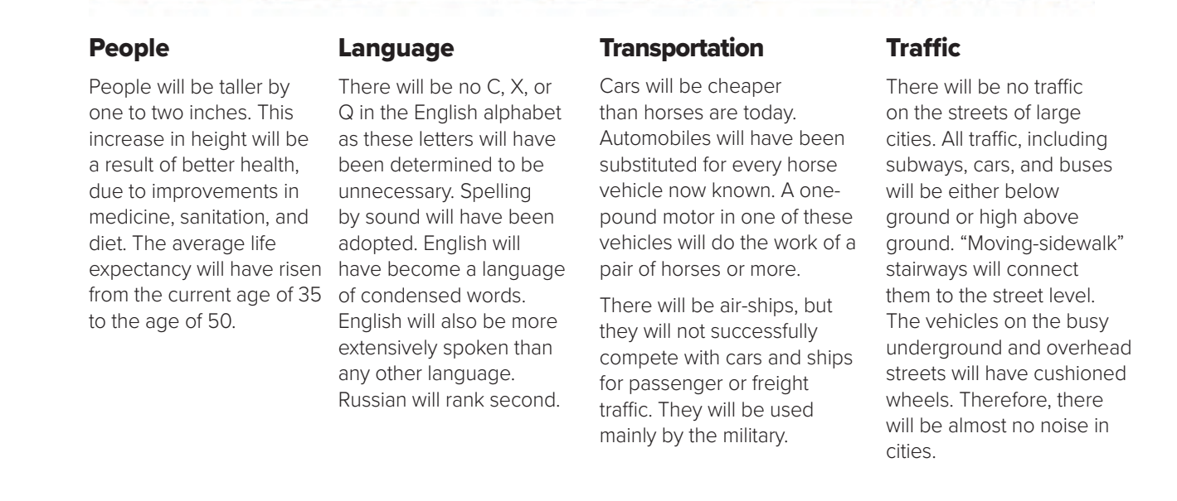
What predictions about transportation and traffic have not come true?
Vehicles do not have cushioned wheels, although modern tires are probably quieter than tires in 1900. Cities are still noisy.

Slide 13
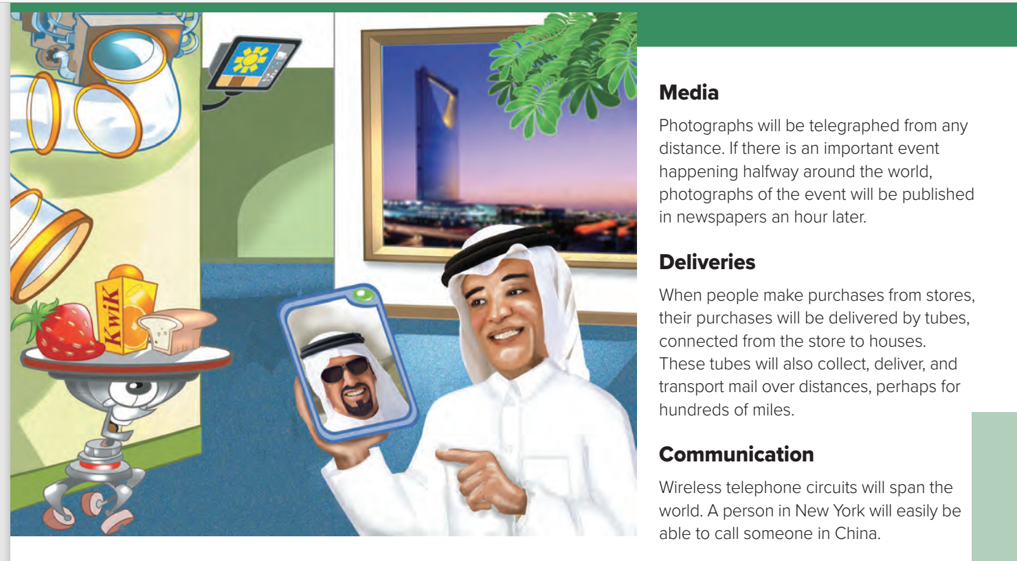
What predictions does the picture on page 35 illustrate?
Which predictions have come true?
Which predictions shown in the picture have not come true?
(It is easy for a person in New York to speak to someone in China wirelessly.
the predictions about media, deliveries, and communication
Tubes are not able to deliver goods to homes from stores

Slide 14
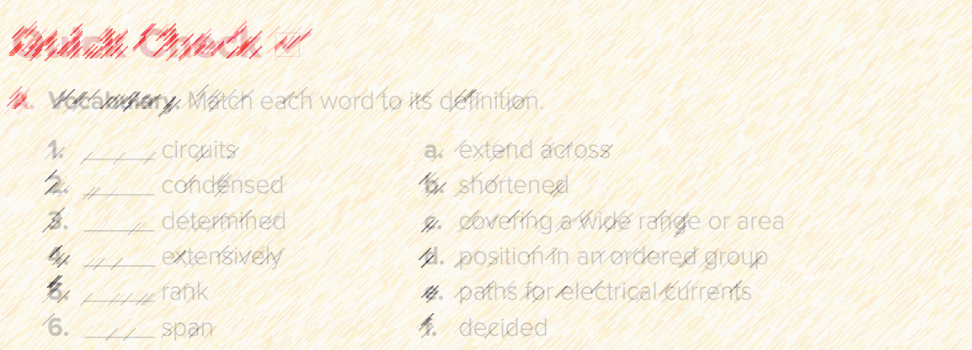
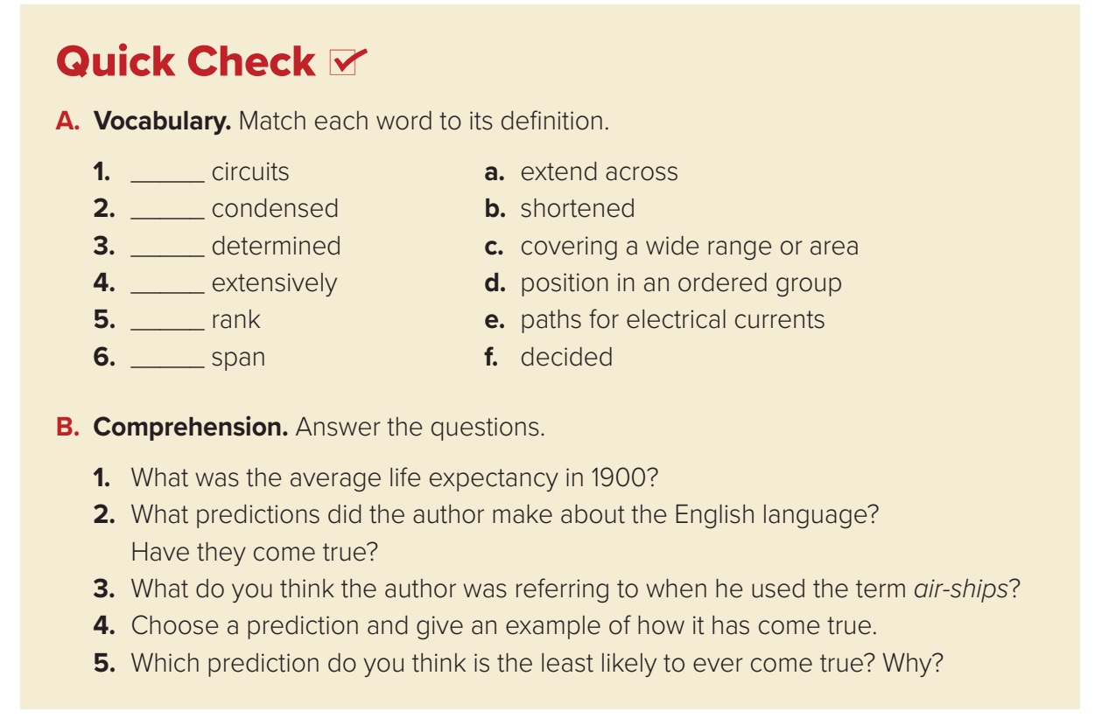
e
b
f
c
d
a

Slide 15
1. The average life expectancy in 1900 was 35 years.
2. He thought there would be no C, X, or Q; spelling would be by sound; the language would be condensed; and English would be the most widely spoken language. The prediction about English being the most widely spoken language came true.
3. He was probably thinking about airplanes.
4. Automobiles have replaced all horse-drawn vehicles.
5. There will never be tubes connecting houses to a store. This is impossible

Slide 16

Pair work

Slide 17

Work with a partner to make predictions about the year 2100.
Create one prediction for each of the categories in the article.
Discuss your predictions with the class.

Slide 18


Slide 19


