Slide 1

Mega Goal 2 (2.1)
Unit 3
L12: Project
By Talal Alhazmi

Slide 2
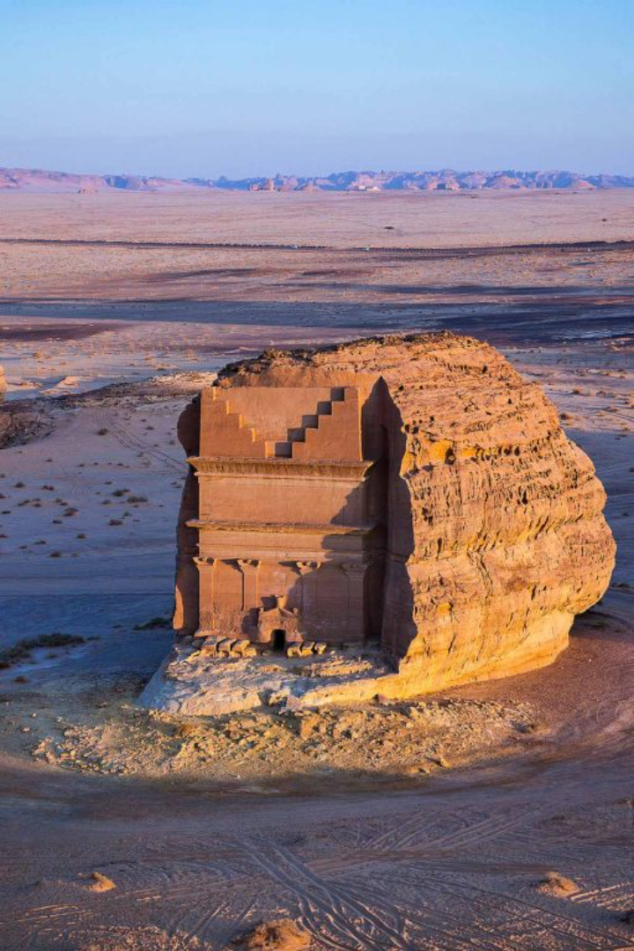
An Area for Ecotourism in Saudi Arabia
Discover the hidden gem of AlUla, nestled amidst dramatic landscapes, ancient ruins, and rich biodiversity, offering a unique experience for ecotourists.
by Talal Alhazmi

Slide 3
Location and Geography of the Area
Located in northwestern Saudi Arabia, AlUla boasts stunning natural landscapes, including majestic sandstone formations and expansive deserts.

Slide 4

Local Flora and Fauna
AlUla is home to diverse plant species such as acacia trees and endemic herbs. Wildlife enthusiasts can spot Arabian leopards, caracals, and over 130 bird species.

Slide 5
Traditional Activities and Culture
1
Cultural Excursions
Explore AlUla's cultural heritage through visits to ancient tombs, rock art sites, and traditional mud-brick villages.
2
Outdoor Adventures
Engage in thrilling activities like hiking, rock climbing, and off-road expeditions in the mesmerizing desert landscapes.
3
Local Cuisine
Indulge in authentic Arabian dishes, such as lamb mandi, at traditional Bedouin camps and local restaurants.

Slide 6

Plans for Ecotourism Development
With an emphasis on preservation, AlUla aims to develop sustainable infrastructure, including eco-friendly resorts and responsible tourism practices.

Slide 7
Sustainable Tourism Practices
Renewable Energy
Conservation Efforts
Community Involvement
AlUla is committed to harnessing renewable energy sources, such as solar power, to reduce its ecological footprint.
Efforts are in place to protect the natural habitats and archaeological sites, implementing strict conservation measures.
AlUla actively engages and empowers local communities to ensure the sustainable development of ecotourism.

Slide 8
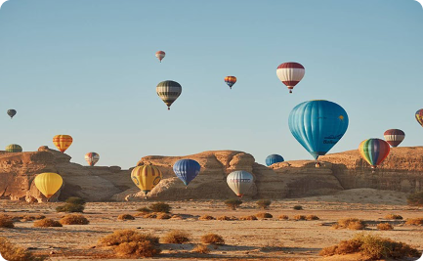
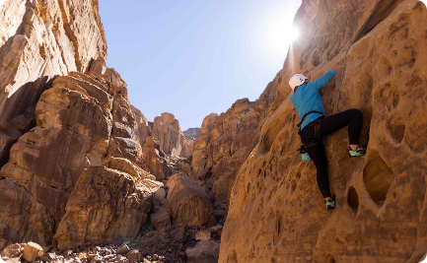
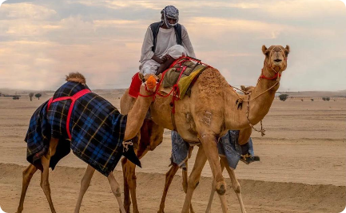
Opportunities for Visitors
Hot Air Balloon Rides
Rock Climbing Adventure
Camel Riding Tours
Soar above AlUla's landscapes and marvel at the breathtaking views during a serene hot air balloon ride.
Challenge yourself with thrilling rock climbing excursions led by experienced guides in AlUla's unique rock formations.
Embark on a traditional camel riding tour and enjoy the tranquility of the desert while exploring hidden gems.

Slide 9

Conclusion and Call to Action
Plan your ecotourism adventure in AlUla to experience the untouched beauty of nature, embrace local culture, and contribute to sustainable tourism practices.

