Slide 1

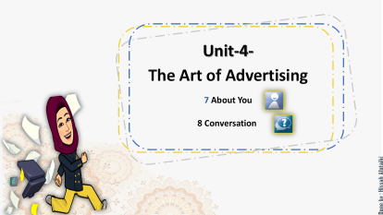
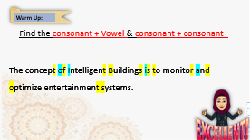
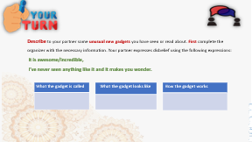
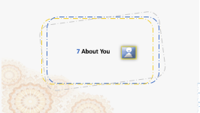
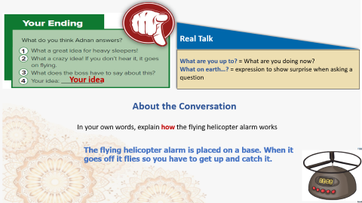


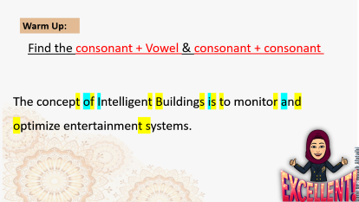

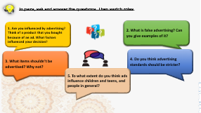
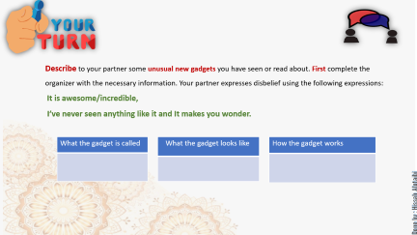


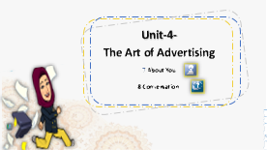
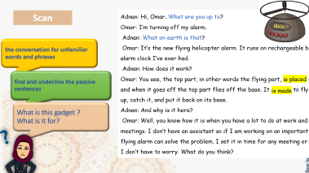
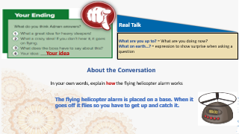
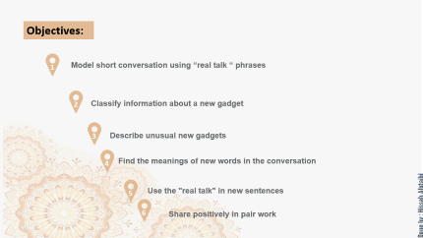
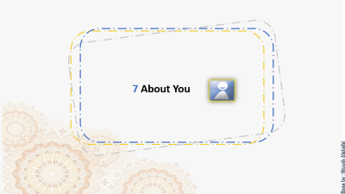
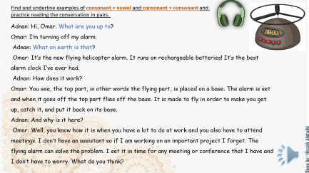


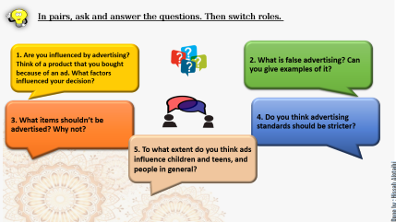
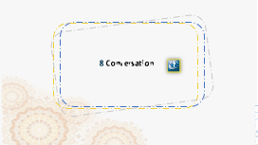
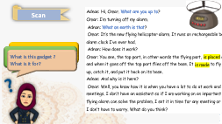

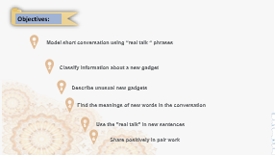
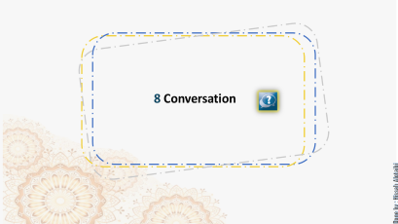
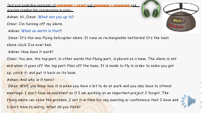
Notes:
شش

Slide 2


Slide 3

Good Morning

Slide 4

Objectives:
1
Model short conversation using “real talk “ phrases
2
Classify information about a new gadget
3
Describe unusual new gadgets
4
Find the meanings of new words in the conversation
5
Use the "real talk" in new sentences
6
Share positively in pair work

Slide 5

Unit-4-
The Art of Advertising
7 About You
8 Conversation

Slide 6

Warm Up:
Find the consonant + Vowel & consonant + consonant
The concept of Intelligent Buildings is to monitor and
optimize entertainment systems.
The concept of Intelligent Buildings is to monitor and
optimize entertainment systems.

Slide 7
7 About You

Slide 8



In pairs, ask and answer the questions. Then switch roles.
1. Are you influenced by advertising? Think of a product that you bought because of an ad. What factors influenced your decision?
2. What is false advertising? Can you give examples of it?
3. What items shouldn’t be advertised? Why not?
4. Do you think advertising standards should be stricter?
5. To what extent do you think ads influence children and teens, and people in general?

Slide 9
8 Conversation

Slide 10

Scan
Adnan: Hi, Omar. What are you up to?
Omar: I’m turning off my alarm.
Adnan: What on earth is that?
Omar: It’s the new flying helicopter alarm. It runs on rechargeable batteries! It’s the best alarm clock I’ve ever had.
Adnan: How does it work?
Omar: You see, the top part, in other words the flying part, is placed on a base. The alarm is set and when it goes off the top part flies off the base. It is made to fly in order to make you get up, catch it, and put it back on its base.
Adnan: And why is it here?
Omar: Well, you know how it is when you have a lot to do at work and you also have to attend meetings. I don’t have an assistant so if I am working on an important project I forget. The flying alarm can solve the problem. I set it in time for any meeting or conference that I have and I don’t have to worry. What do you think?
the conversation for unfamiliar words and phrases.
find and underline the passive sentences
is placed
is made
What is this gadget ?
What is it for?

Slide 11
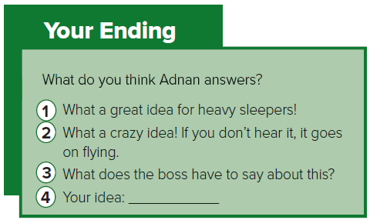


Real Talk
What are you up to? = What are you doing now?
What on earth…? = expression to show surprise when asking a question
Find and underline examples of consonant + vowel and consonant + consonant and practice reading the conversation in pairs.
Adnan: Hi, Omar. What are you up to?
Omar: I’m turning off my alarm.
Adnan: What on earth is that?
Omar: It’s the new flying helicopter alarm. It runs on rechargeable batteries! It’s the best alarm clock I’ve ever had.
Adnan: How does it work?
Omar: You see, the top part, in other words the flying part, is placed on a base. The alarm is set and when it goes off the top part flies off the base. It is made to fly in order to make you get up, catch it, and put it back on its base.
Adnan: And why is it here?
Omar: Well, you know how it is when you have a lot to do at work and you also have to attend meetings. I don’t have an assistant so if I am working on an important project I forget. The flying alarm can solve the problem. I set it in time for any meeting or conference that I have and I don’t have to worry. What do you think?

Slide 12

Real Talk
What are you up to? = What are you doing now?
What on earth…? = expression to show surprise when asking a question
Your idea
About the Conversation
In your own words, explain how the flying helicopter alarm works
The flying helicopter alarm is placed on a base. When it goes off it flies so you have to get up and catch it.

Slide 13

Describe to your partner some unusual new gadgets you have seen or read about. First complete the organizer with the necessary information. Your partner expresses disbelief using the following expressions:
It is awesome/incredible,
I’ve never seen anything like it and It makes you wonder.
What the gadget is called
What the gadget looks like
How the gadget works

Slide 14


Slide 15


