Slide 1
We can 5

Slide 2


Slide 3
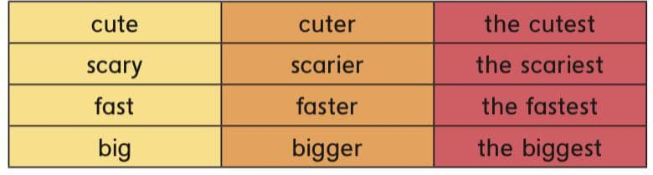






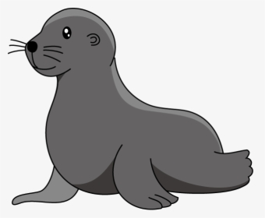

Slide 4



Slide 5
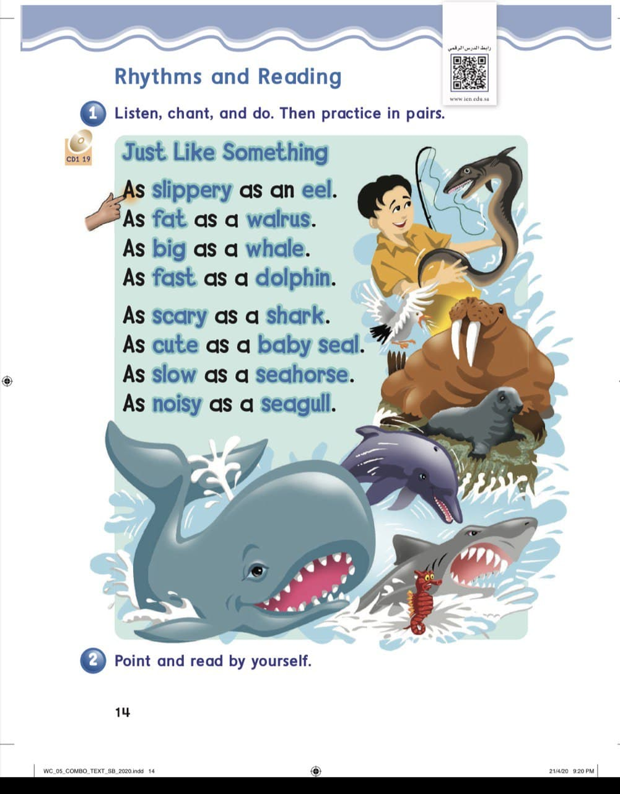
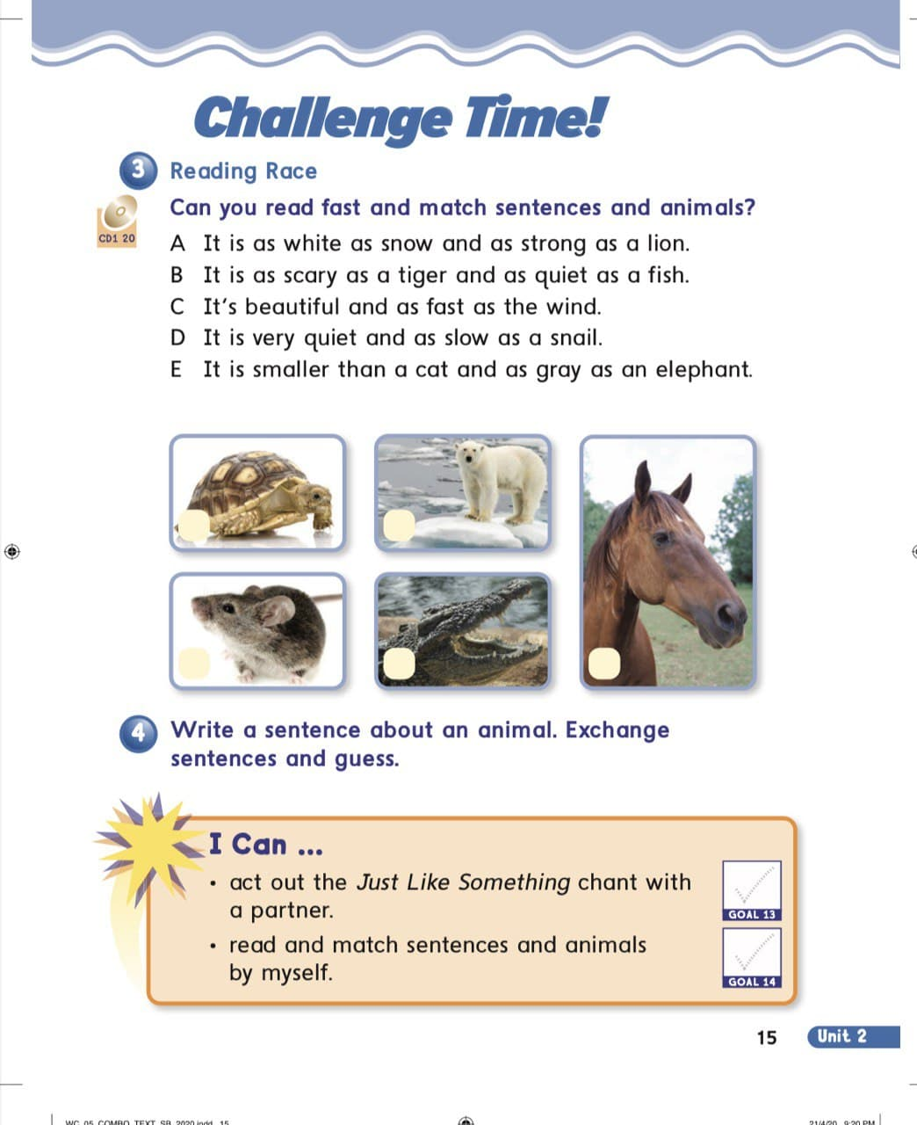

Slide 6
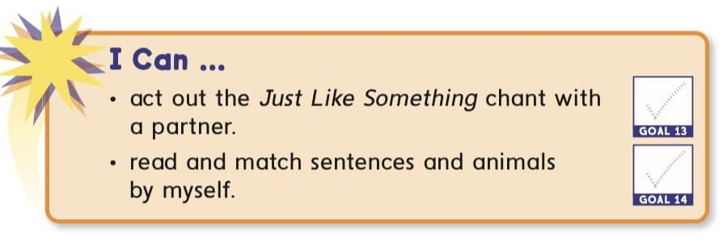
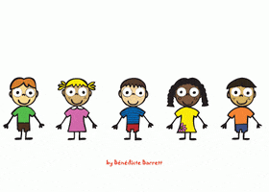

Slide 7
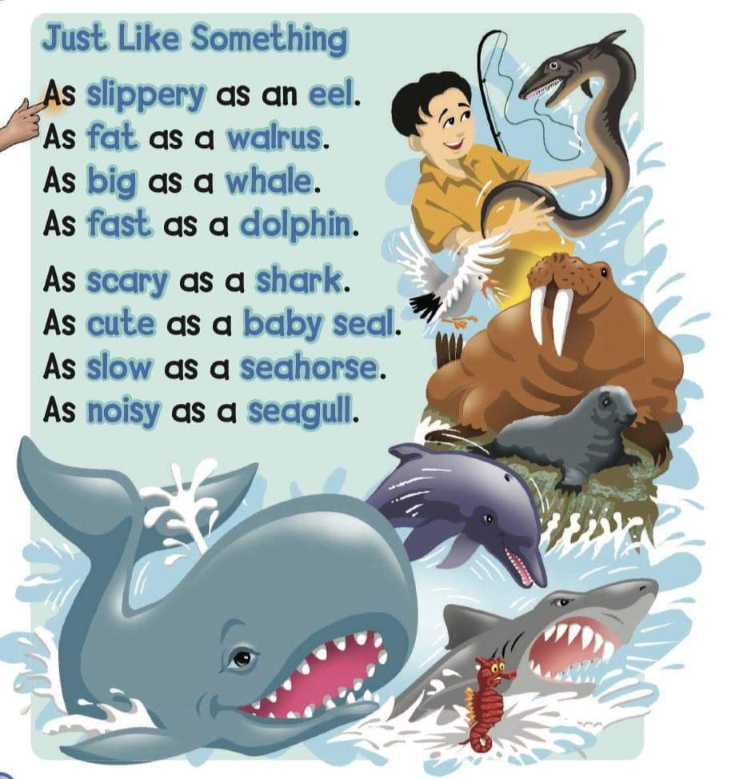


Slide 8

as slippery as

Slide 9

an eel

Slide 10
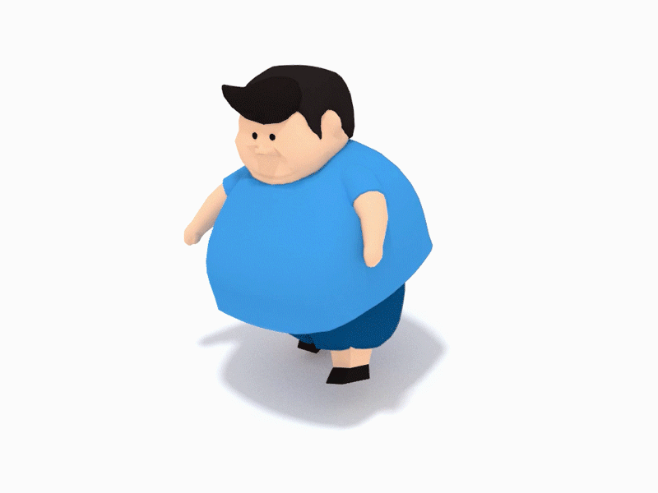
as fat as

Slide 11
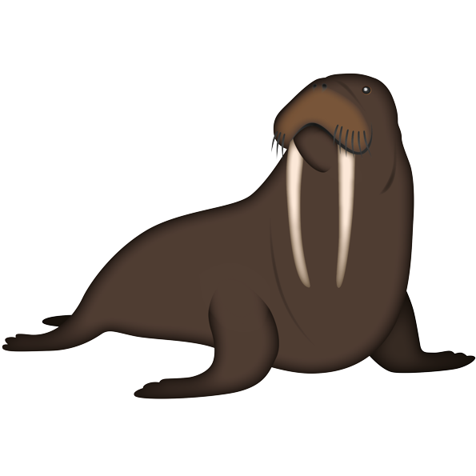
a walrus

Slide 12

as as

Slide 13

a whale

Slide 14
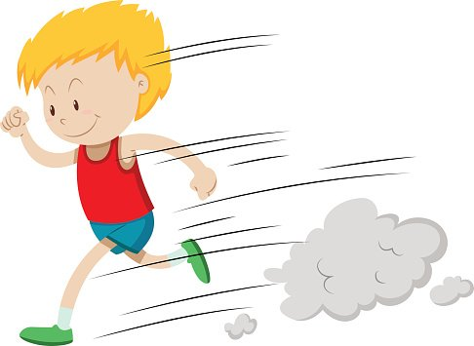
fast
as as

Slide 15

a dolphin

Slide 16

As scary as

Slide 17

a shark

Slide 18

As cute as

Slide 19
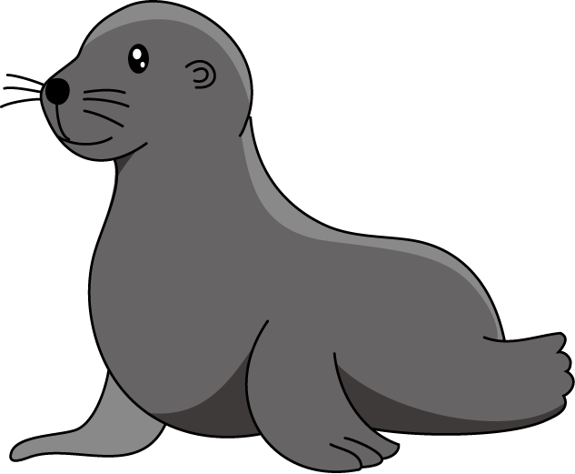
a seal

Slide 20
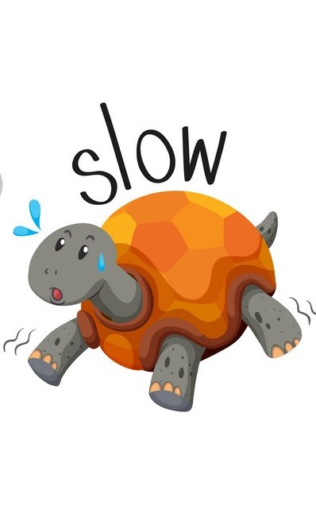
As as

Slide 21

a seahorse

Slide 22

As noisy as

Slide 23

a seagull

Slide 25


Slide 26
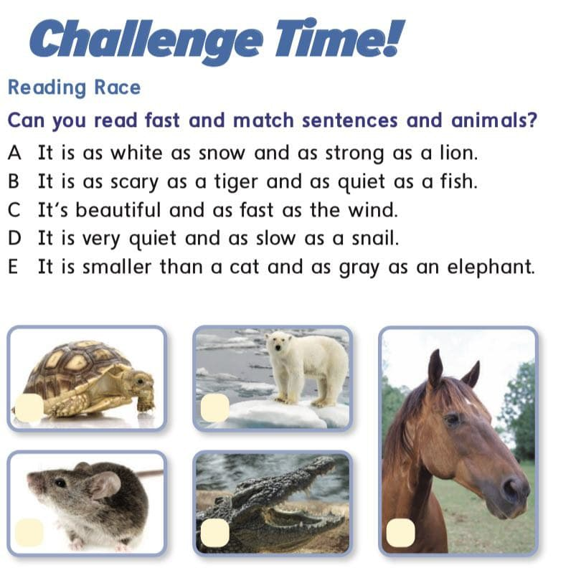

Slide 27

it is as white as snow and as strong as a lion.

Slide 28
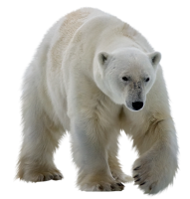


Slide 29
It is as scary as a tiger and as quite as a fish.

Slide 30


Slide 31
it is beautiful and as fast as the wind.

Slide 32
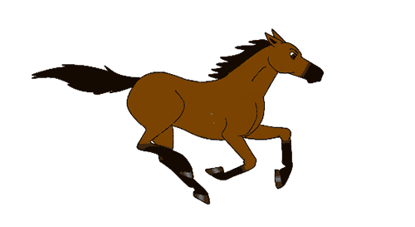

Slide 33
it is very quite and
as slow as a snail .

Slide 34
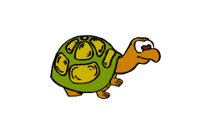

Slide 35
it is smaller than a cat
and as gray as an elephant.

Slide 36
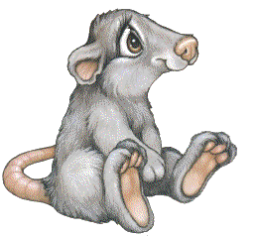

Slide 37



Slide 38

HOMEWORK

Slide 39


Goodbye

