Slide 1


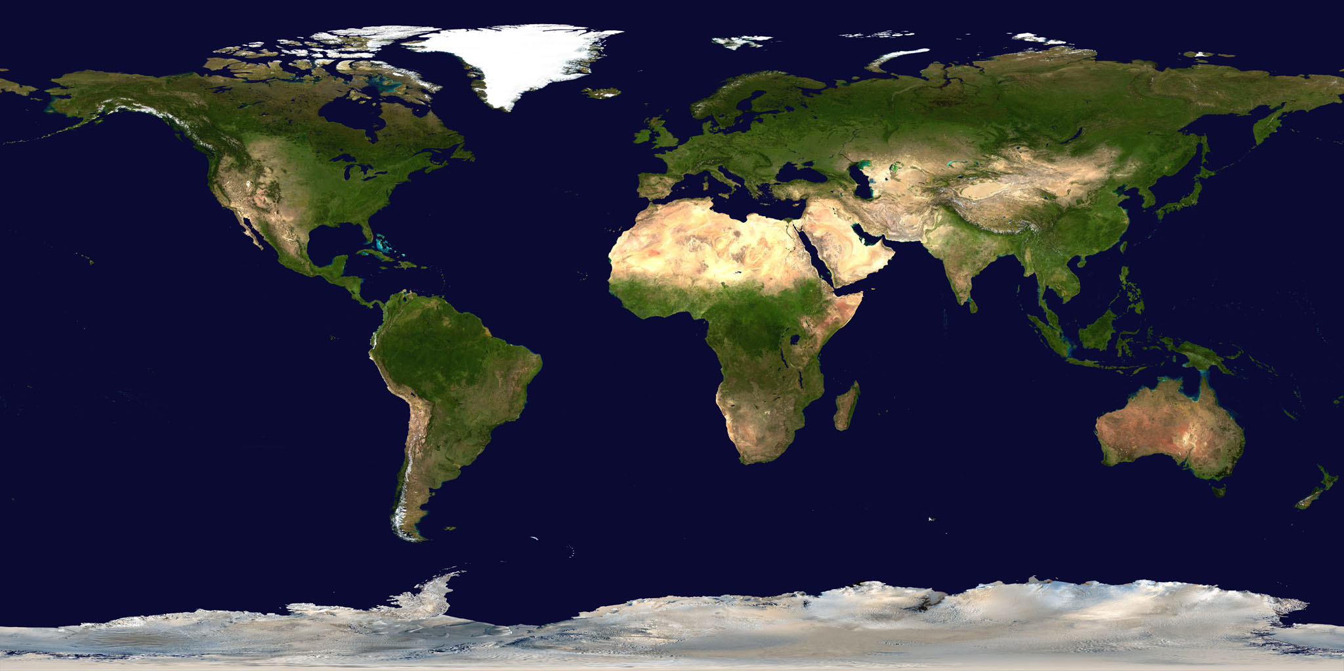
Super goal 1
Unit 4
Lesoon 1 (26)(27)
Listen & Discuss
Done BY: Haya B.

Slide 2
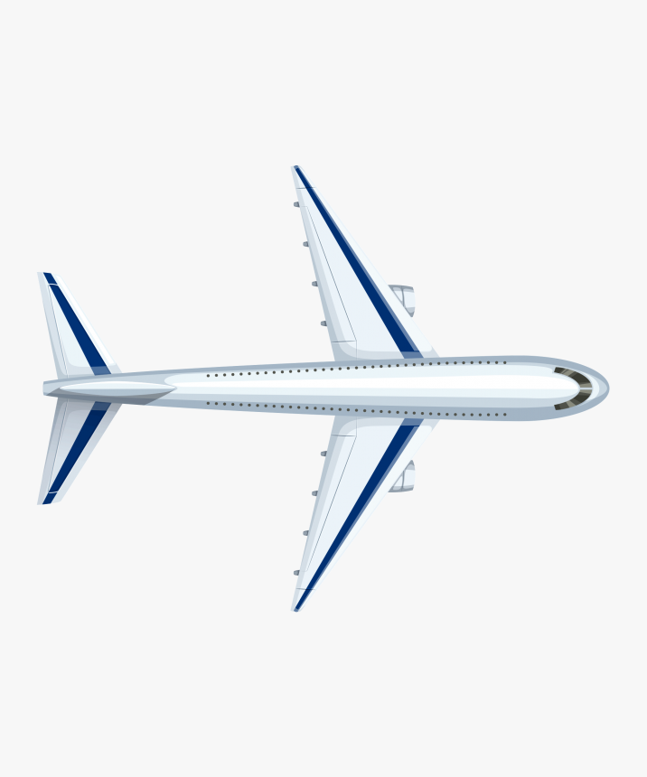
Around the world

Slide 3


Check homework

Slide 4
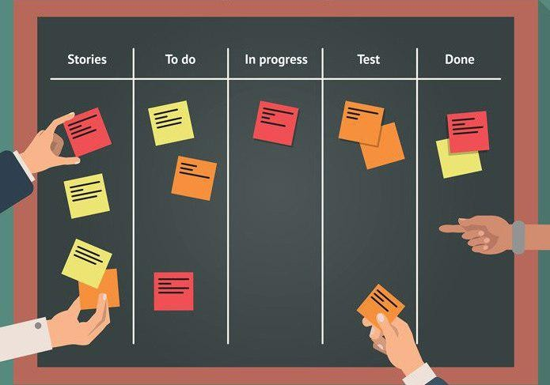
Check students’ tasks

Slide 5


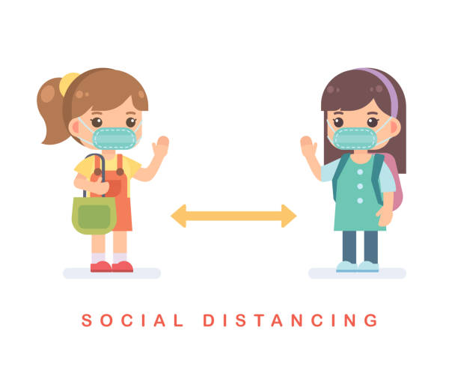
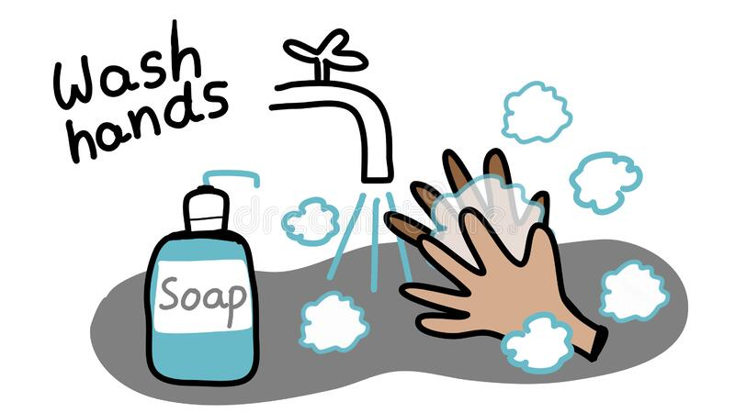

Rules of the classroom
1- avoid gathering.
2- we must wear mask.
3- speak English .
4- Wash hands.
5- If you want to answer or ask, please, raise your hand

Slide 6

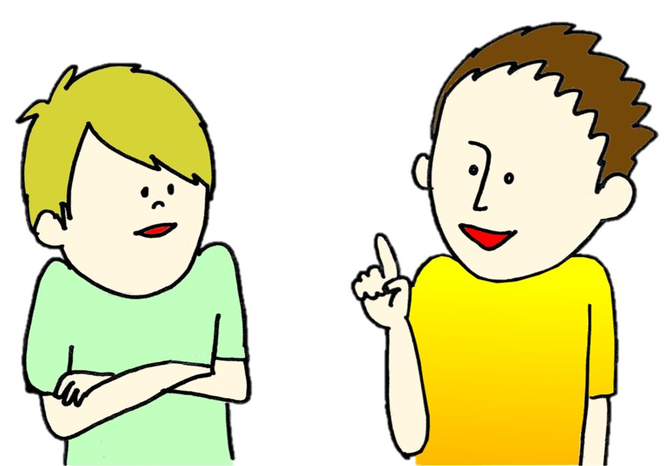





1
2
⇒
3
4
5
tekhnologic
I eat (a-an-the) orange
She has (a-an -the) eraser
This is a book.(a-an-the) book is new
(this-these) is a pen
This is ………

Slide 7

Objectives:
open your book on (26)
1- read the conversation.
2- learn new words.
3- ask about countries and nationalities
3- answer the questions.

Slide 8
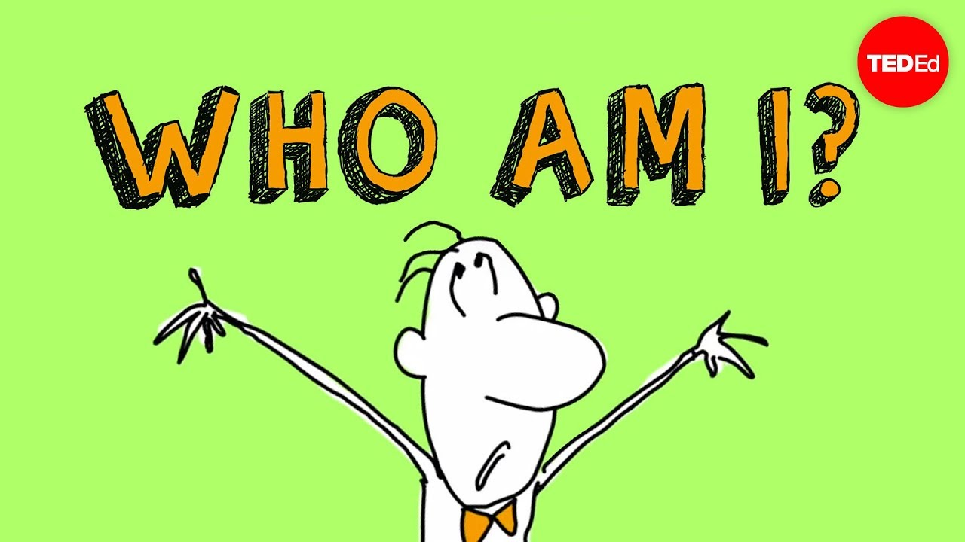
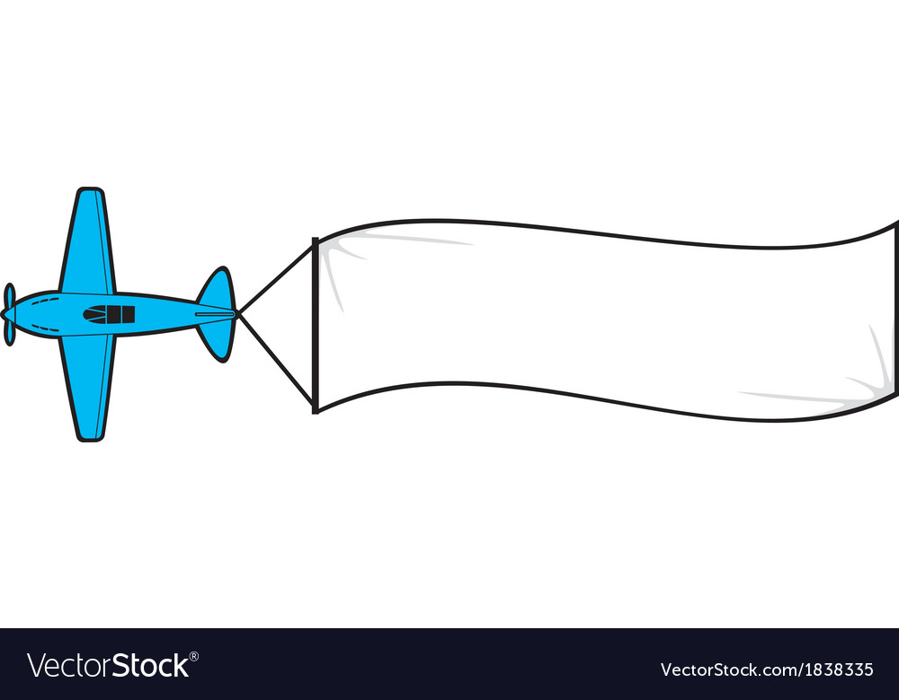

Warm up:
By using who am I strategy,
guess the country by clues

Slide 9

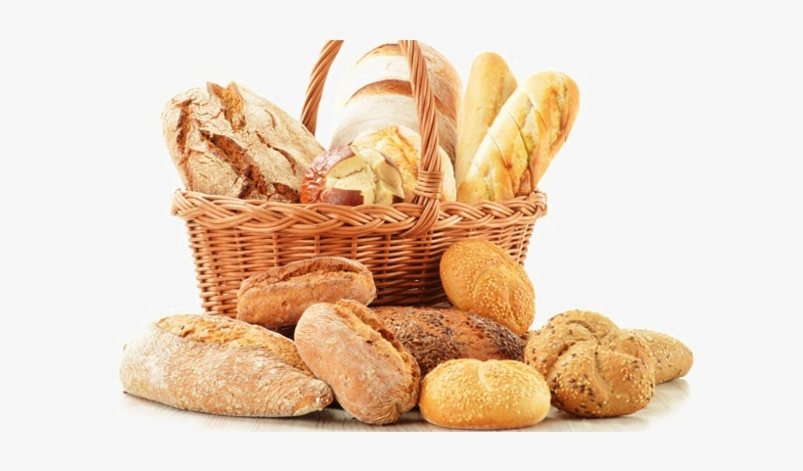
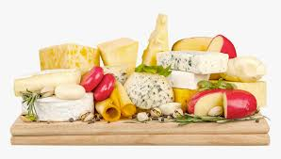

Warm up:
bread
cheese
France
Eiffel tower

Slide 10
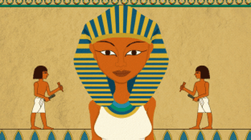

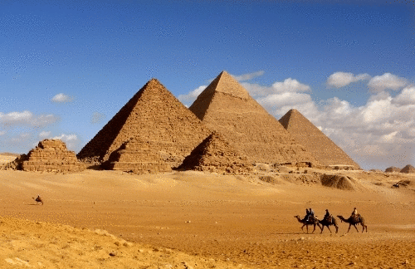
Warm up:
cleopatra
Egypt
pyramids

Slide 11

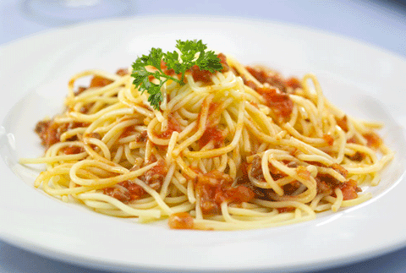

Warm up:
pasta
Italy
Pizza

Slide 12



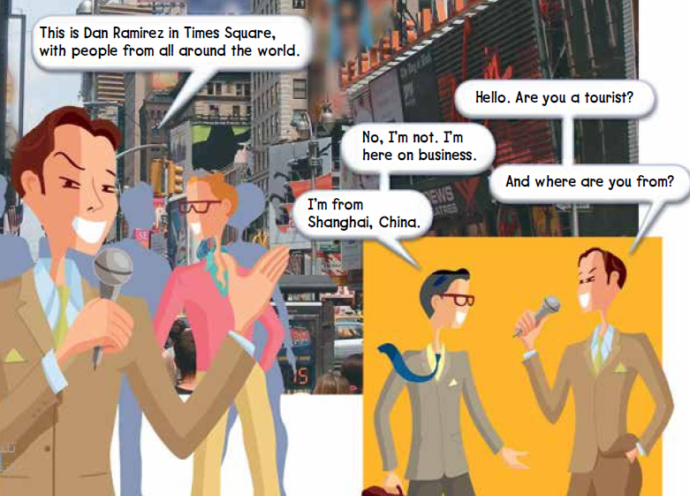
Listen and discuss:
Before listening
Sq3r strategy
26
How many people in the picture?
Four people.
Where is this?
It’s New York
Have you ever been in New York?
What is the name of the man?
He is Dan Ramirez

Slide 13

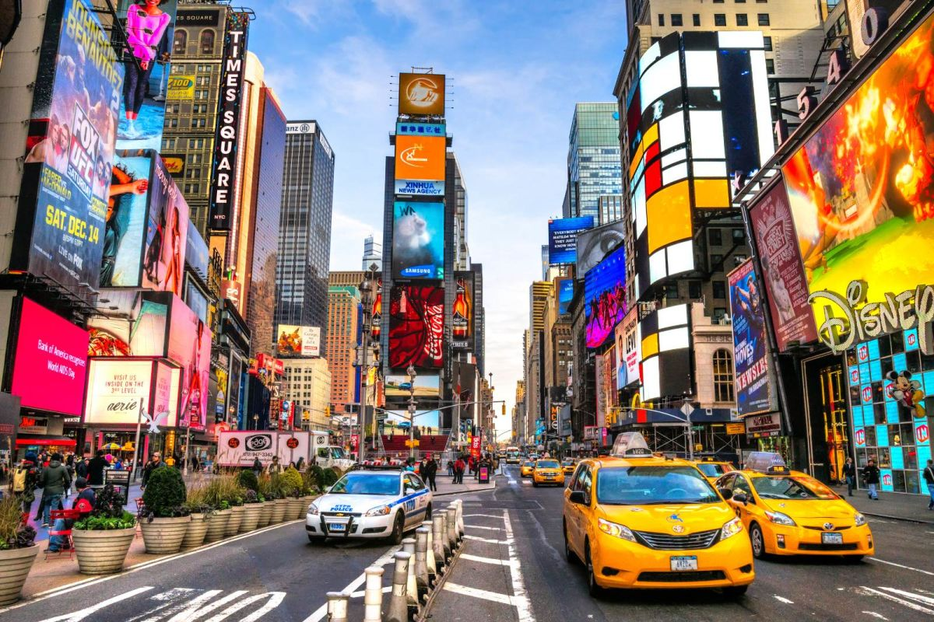
Listen and discuss:
during listening
Sq3r strategy
26
He’s a reporter from a television station.
He’s talking to people in Times Square in New York City
.
☺ Times Square is a popular tourist destination.
There are a lot of stores and restaurants there.

Slide 14



New words:
viewers = the people who are watching the television program.
tourist = someone traveling on vacation
on business = refers to someone traveling for work

Slide 15
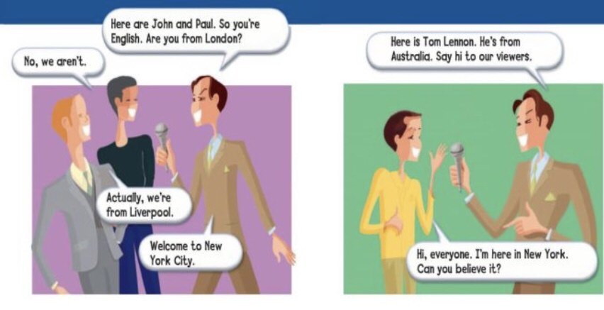
Listen and discuss:
during listening
Sq3r strategy
27
What are their names?
John and Paul.
Where are they from?
They are from England
What is their nationality?
They are English

Slide 16
Listen and discuss:
during listening
Sq3r strategy
27
Where is Tom from?
He is from Australia .
what is his nationality?
He is Australian.

Slide 17
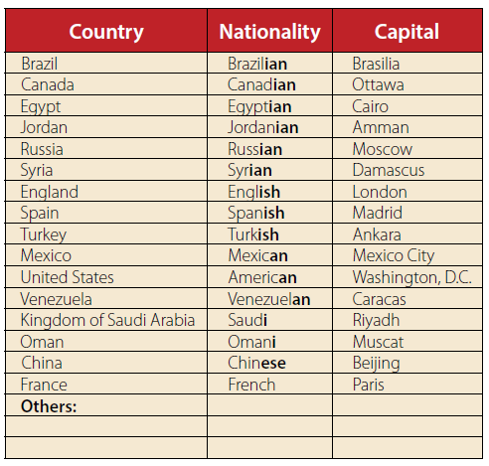

Listen and discuss:
27
Is your our country in the chart?

Slide 18
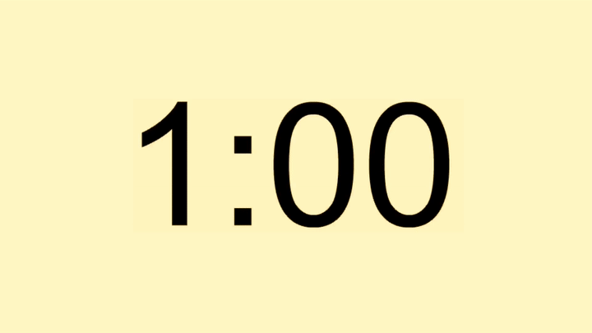

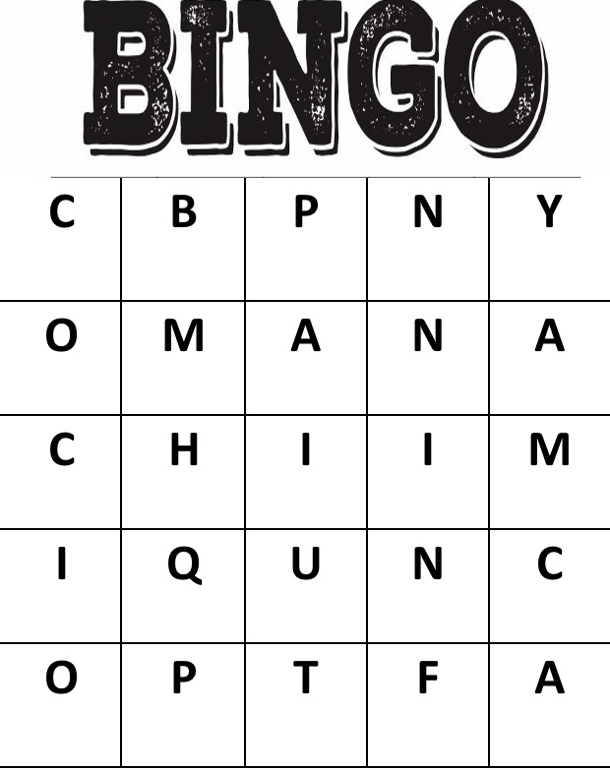
This is my flag.
Lets play:
By using one minute strategy,
Guess the name of the falg.
Oman

Slide 19

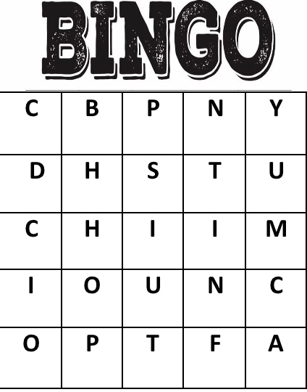
Lets play:
By using one minute strategy,
Guess the name of the falg.
This is my flag.
China

Slide 20
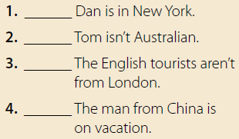
Quick check:
27
By using one minute strategy,
Answer the question.
yes
no
Tom is Australian.
yes
no
He’s on business.

Slide 21

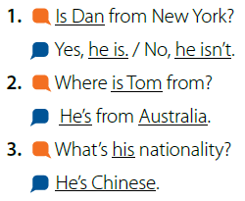
Pair work:
By using role-play strategy,
Ask and answer .

Slide 22

قال تعالى“وَمِنْ آَيَاتِهِ خَلْقُ السَّمَاوَاتِ وَالْأَرْضِ وَاخْتِلَافُ أَلْسِنَتِكُمْ وَأَلْوَانِكُمْ
إِنَّ فِي ذَلِكَ لَآَيَاتٍ لِلْعَالِمِينَ
سورة الروم(٢٢)
And of His signs is the creation of the heavens and the earth and the diversity of your languages and your colors. Indeed in that are signs for those of knowledge

Slide 23


Patriotic aim:
I am proud to be Saudi

Slide 24
Task :
Write four countries with nationalities

Slide 25
homework :
Page (101) Exercise (B)

Slide 26


