Slide 1




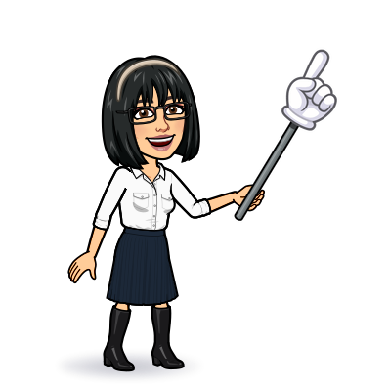

4 pronunciation 5 listening 7 About you
Today:
Date:
- -1445
Page 29
By: Dalal Al-Juaid

Slide 2


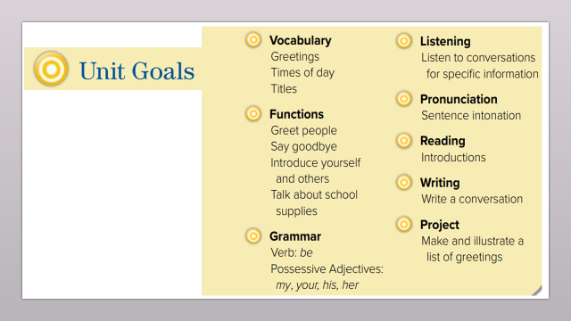
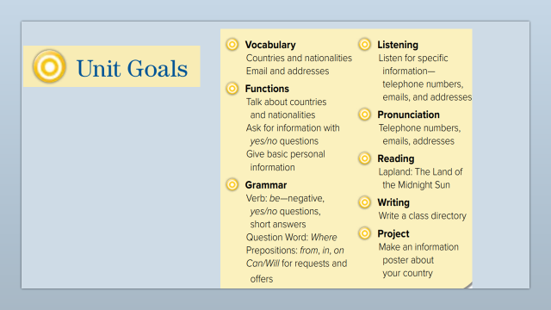
recognize international telephone codes
answer questions about address
Warm up
lesson
read telephone numbers
summative

Slide 3
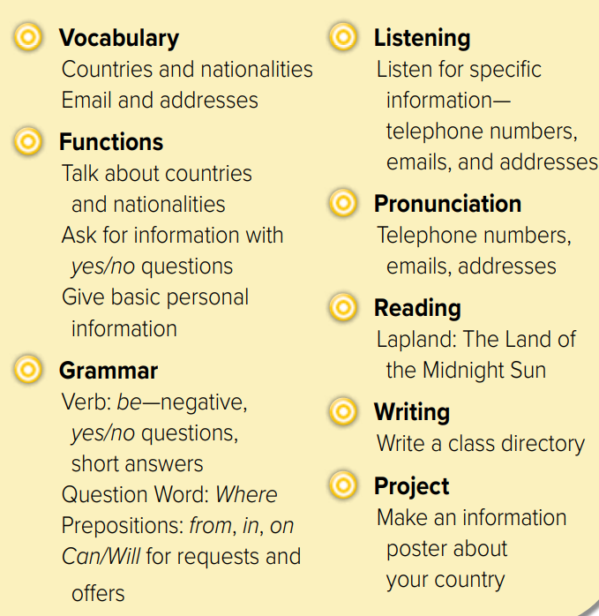
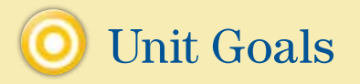

Slide 4




Telephone GAME
What is Lujain’s phone number?
Warm up
lesson
056666666
summative

Slide 5

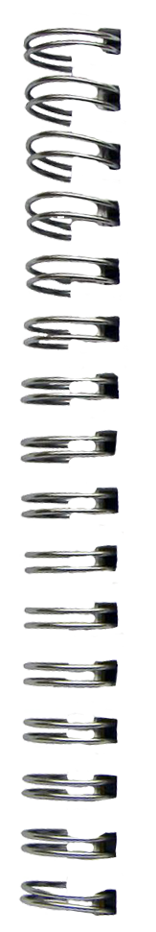
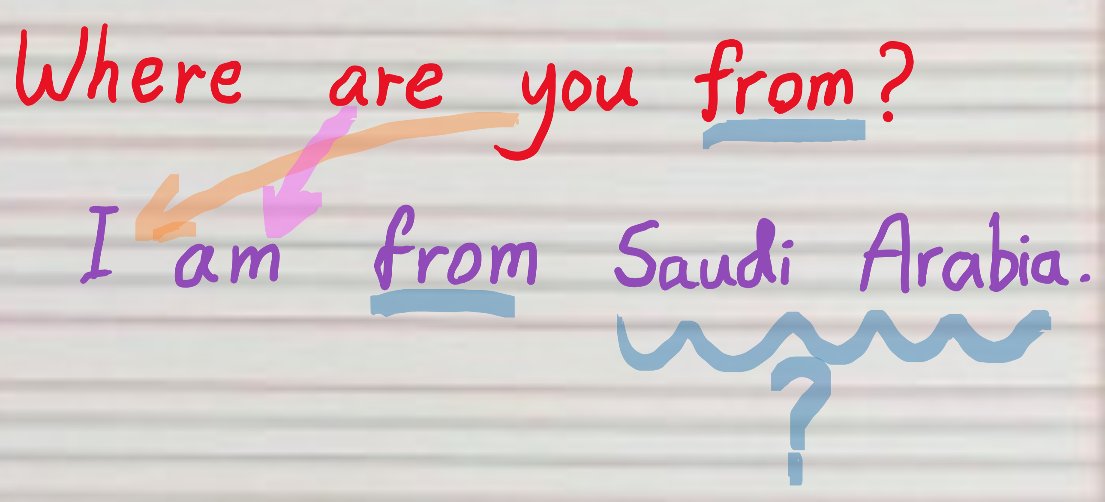


What’s this?
Revision
country
England
nationality
capital
Correct the mistake
Haneen is from vacation

Slide 6

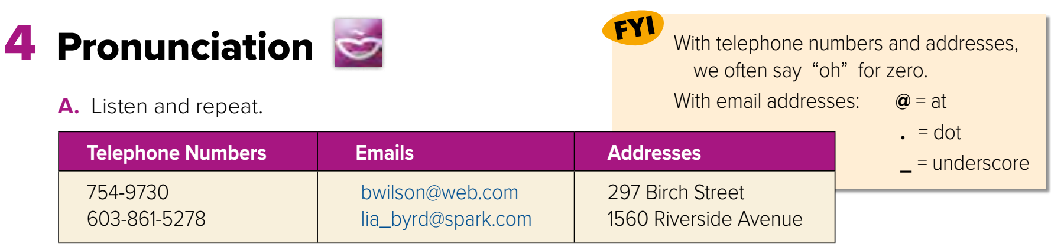


Page 29
Warm up
lesson
summative

Slide 7
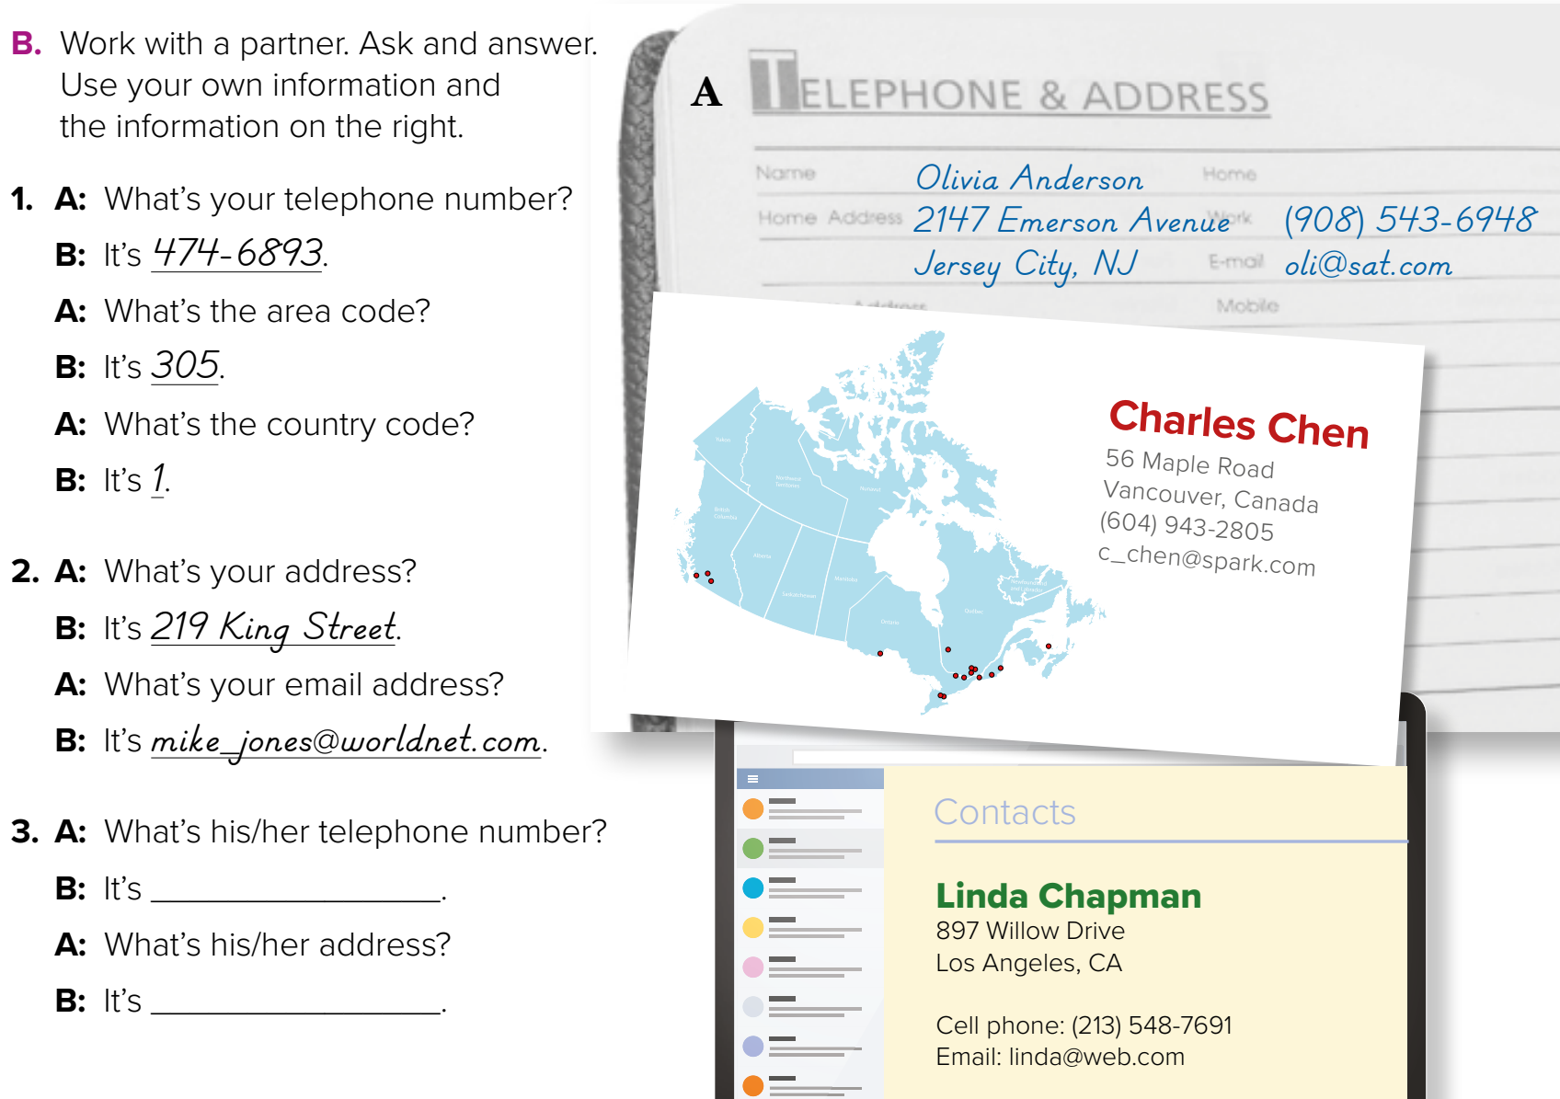
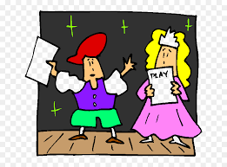
Role paly
Warm up
lesson
summative

Slide 8
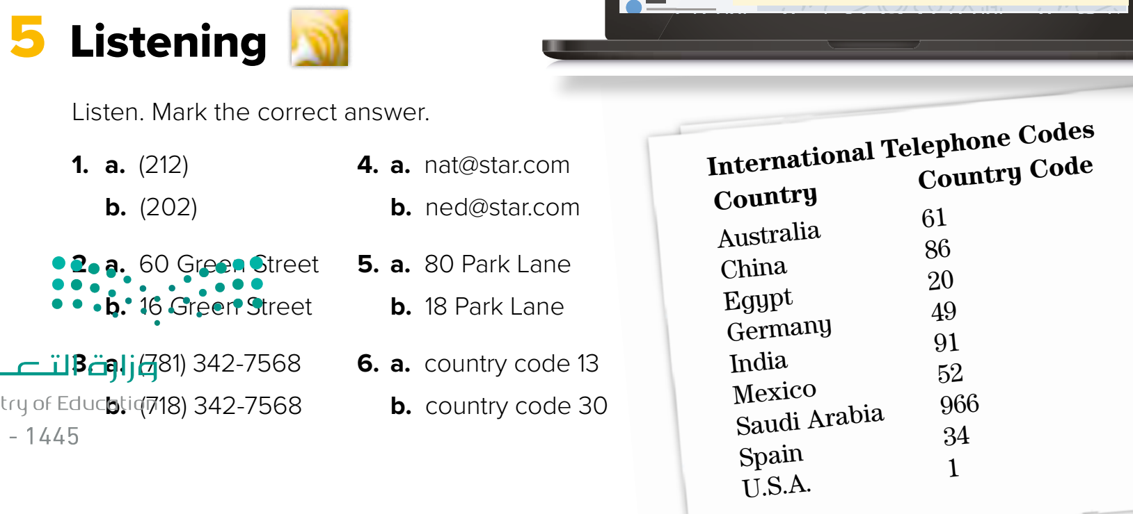
Warm up
lesson
summative

Slide 9


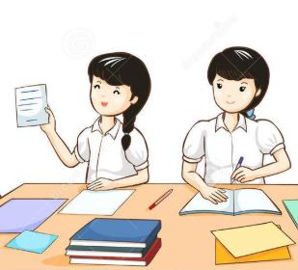

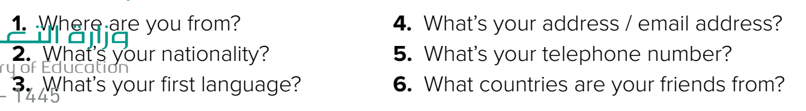
Think pair share
Warm up
lesson
summative

Slide 10



Lets play
Warm up
lesson
summative

Slide 11





page 201 Ex(E)
for practice grammar
Warm up
lesson
summative

Slide 12
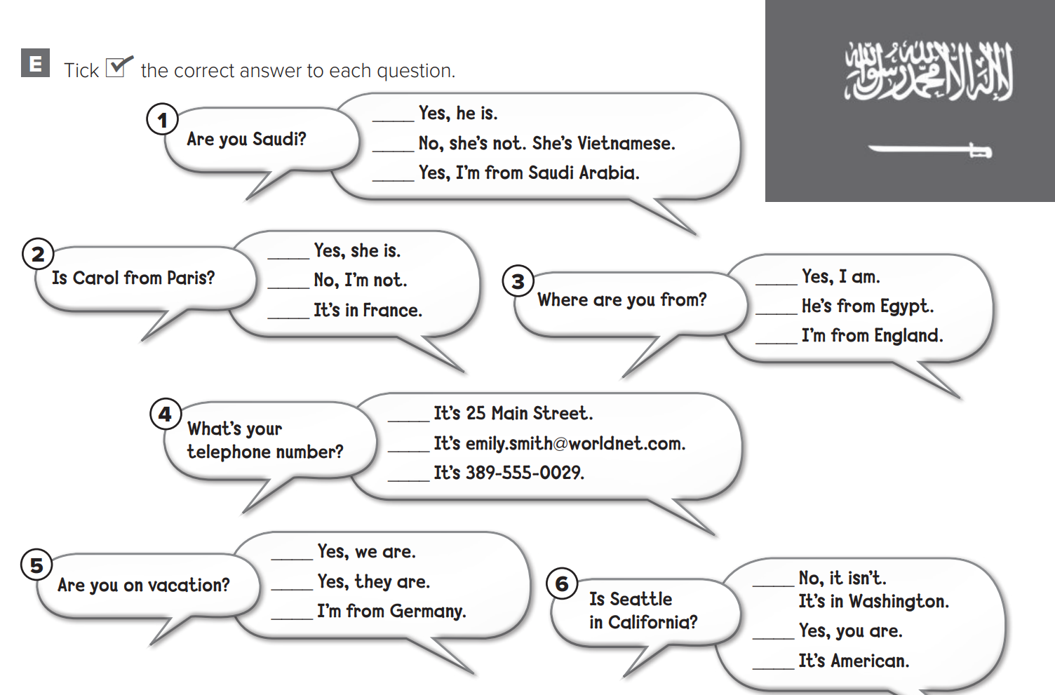

p.201
Warm up
lesson
summative

