Slide 1






11 form , meaning & function
Today:
Date:
- -1445
Page 25
By: Dalal Al-Juaid

Slide 2


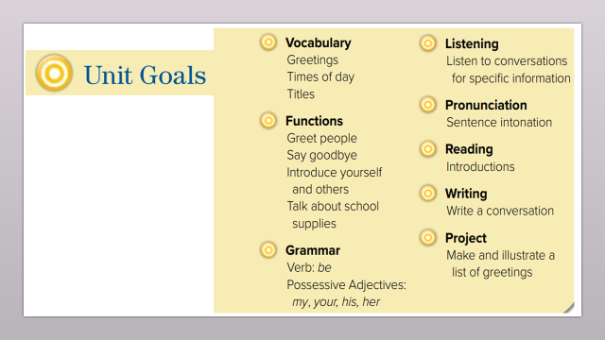
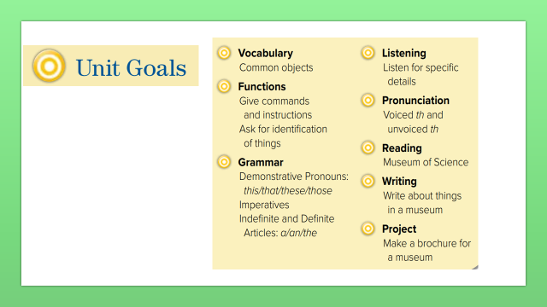
Use the definite article (the).
Differentiate between ( a- an – the ).
Warm up
lesson
summative
2-Pair work

Slide 3
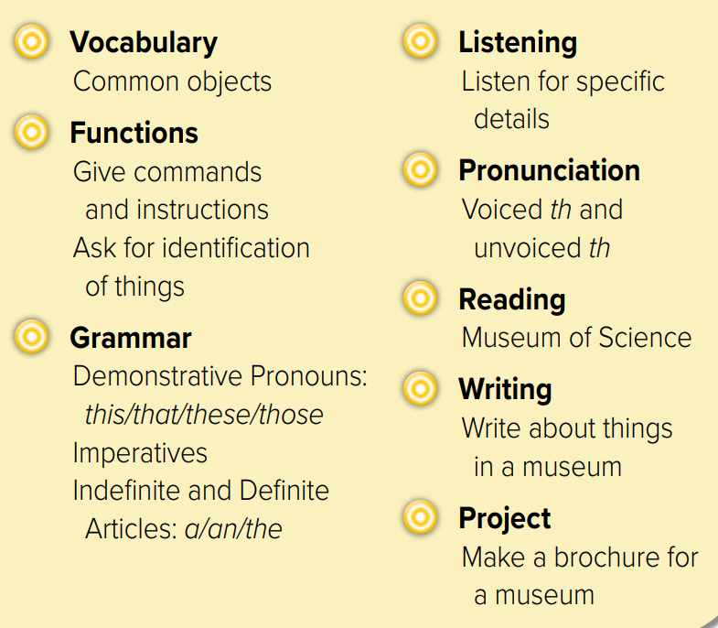
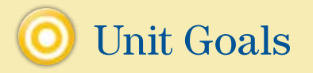

Slide 4
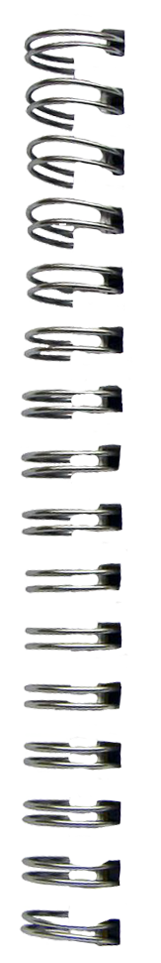






What’s this?
Revision
a
an
1st time
singular & plural
the

Slide 5





This is a classroom.
The classroom is big
Warm up
lesson
summative
2-Pair work

Slide 6
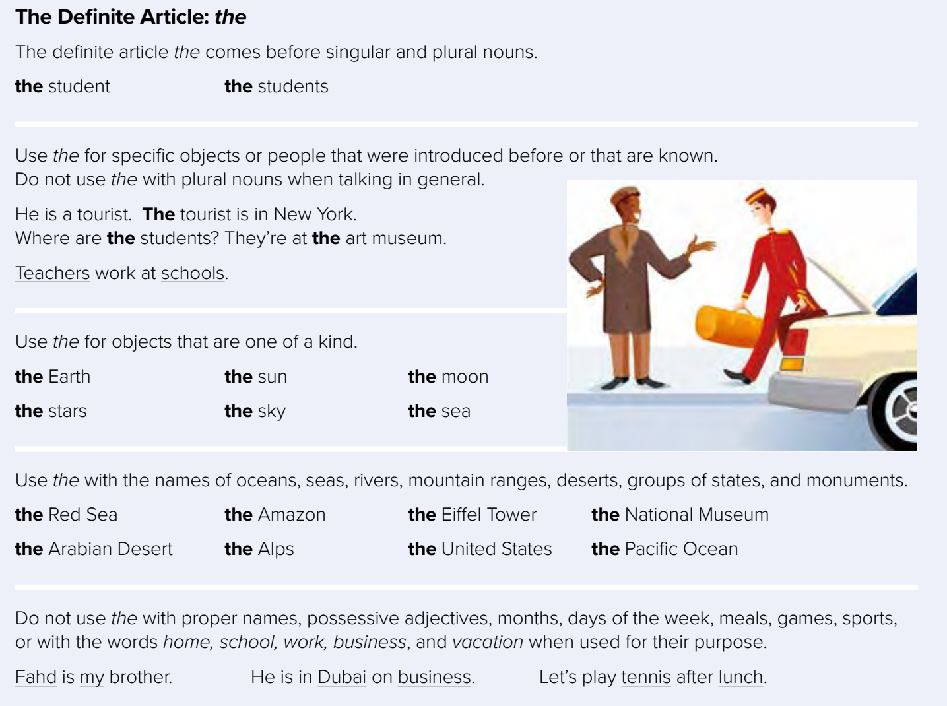

Page 25
a
an
singular only
1st time
the
singular & plural
2nd time
Warm up
lesson
This is a book.
These are books.
summative
The book is old
The books are new
2-Pair work

Slide 7





















read
Warm up
lesson
summative
2-Pair work

Slide 8
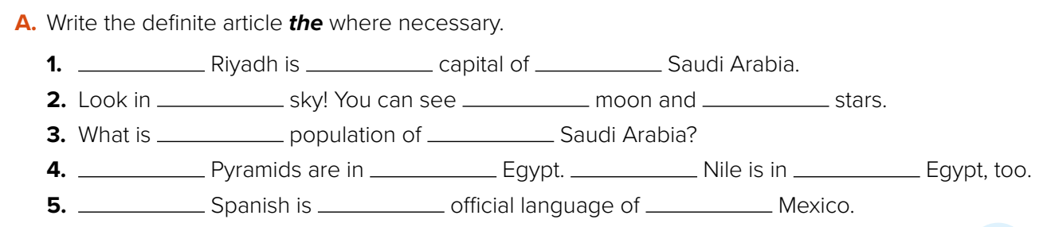



-
the
the
the
the
the
the
-
The
-
The
-
-
the
-
Warm up
Think pair share
lesson
summative
2-Pair work

Slide 9
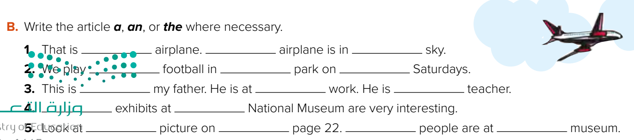
an
The
the
-
the
-
-
-
a
The
the
the
-
The
a / the
Warm up
lesson
Think pair share
summative
2-Pair work

Slide 10


Lets play
Think pair share
Warm up
lesson
summative
2-Pair work

Slide 11



How is the world looking at KSA
Warm up
lesson
summative
2-Pair work

Slide 12





Write a sentence in your notebook
Warm up

