Slide 1



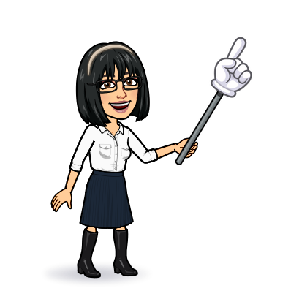


8 reading
Today:
Date:
- -1445
Page 23
By: Dalal Al-Juaid

Slide 2


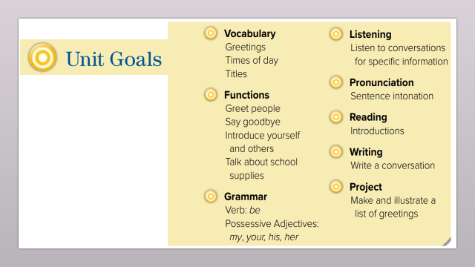
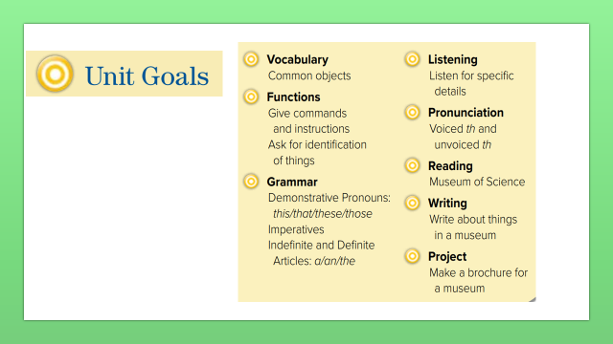
answer some questions from a reading text.
Complete sentences from a reading text.
Warm up
lesson
Find out the meaning of the new words.
New words
summative
2-Pair work

Slide 3
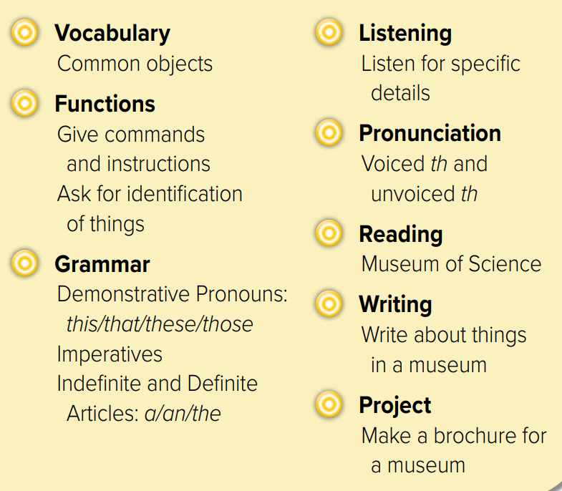
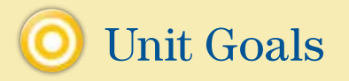

Slide 4
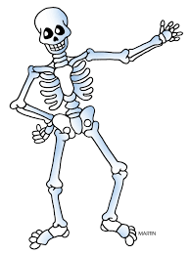
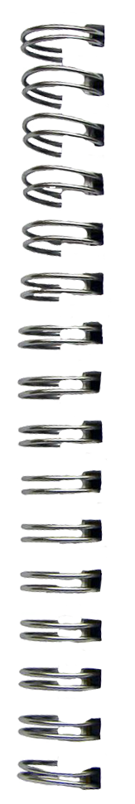
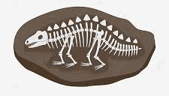




What’s this?
Revision
……………. #
#
small

Slide 5

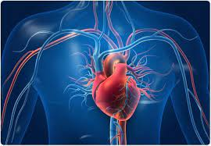

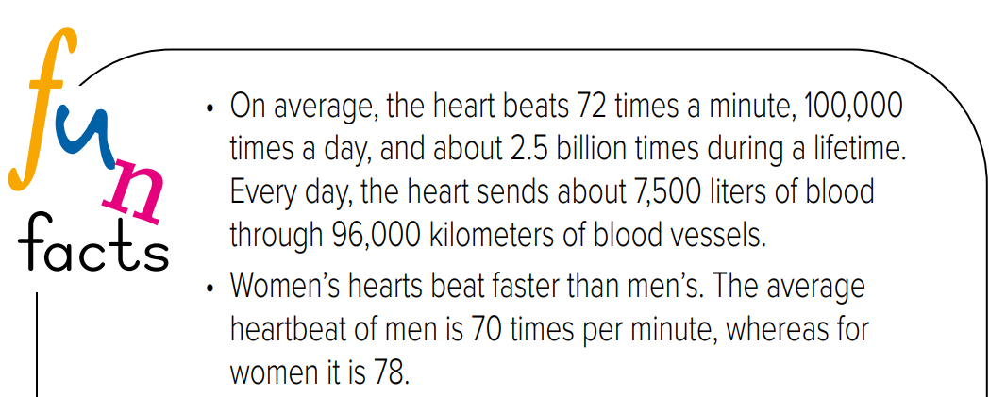
What is this ? What do you know about it ?
Warm up
lesson
New words
summative
2-Pair work

Slide 6





What kind of things do you see in the museum?
Can you see a film in the museum?
Warm up
lesson
New words
What do you think reading is about?
summative
2-Pair work

Slide 7
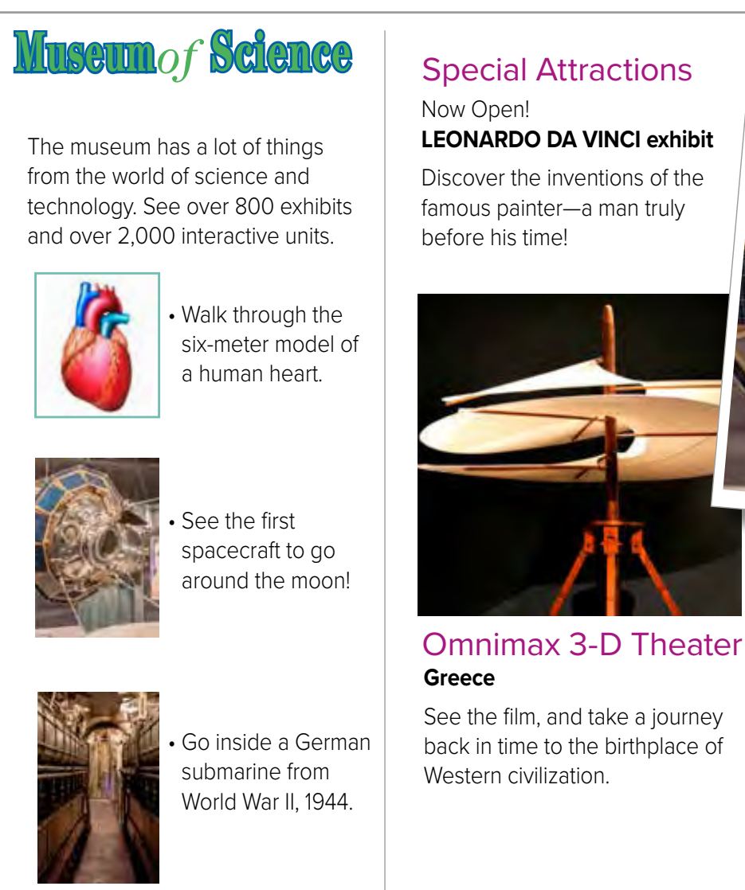
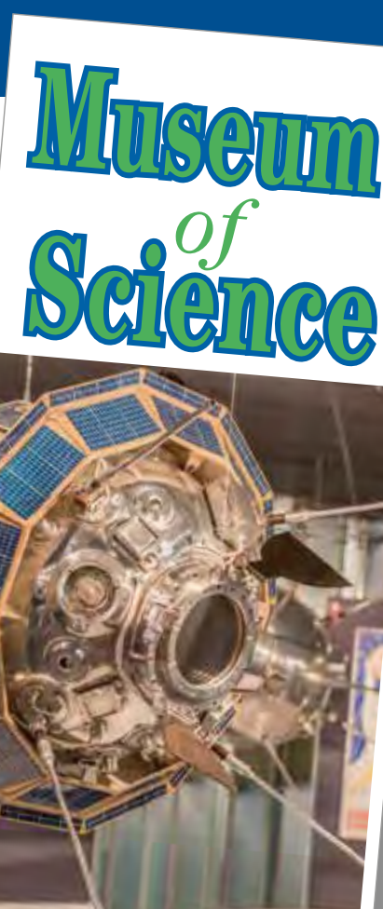



Page 23
Listen
What is the special exhibit?
Warm up
lesson
New words
How many exhibits?
summative
2-Pair work

Slide 8
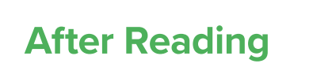

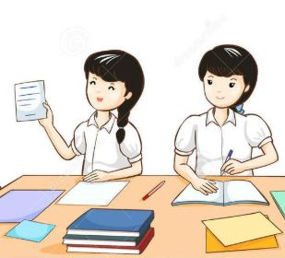

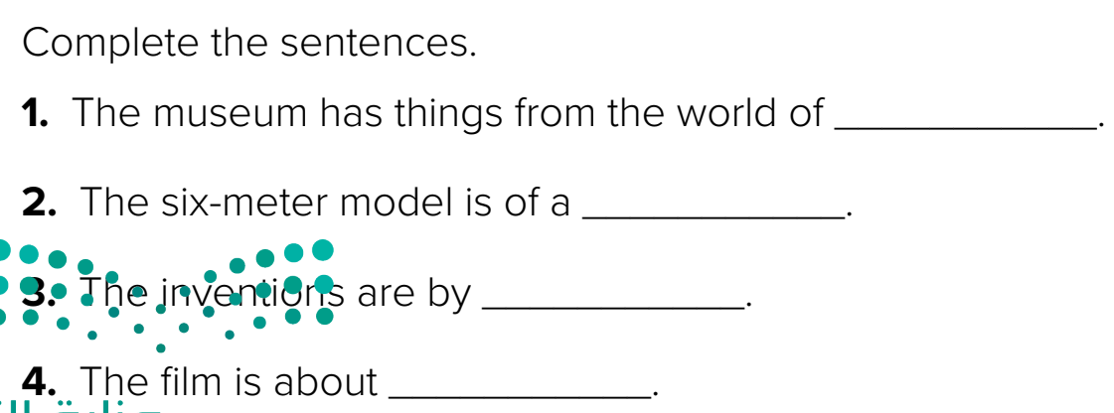
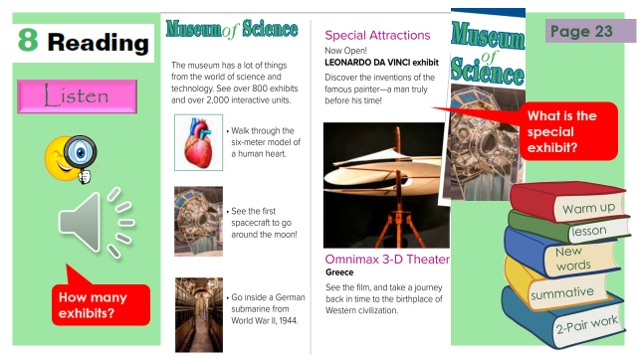
Think pair share
science and technology
human heart
Leonardo da Vinci
Warm up
Greece
lesson
New words
summative
2-Pair work

Slide 9
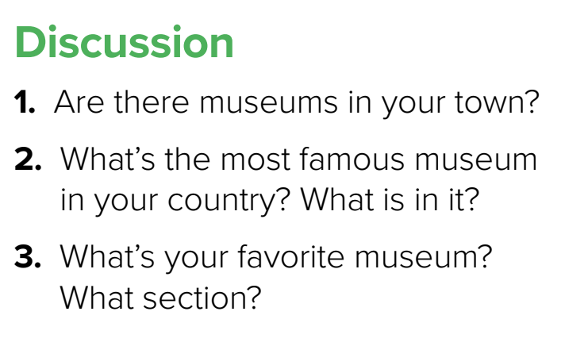
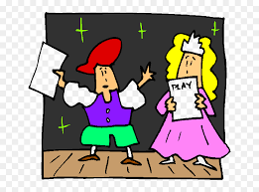
Role paly
Warm up
lesson
New words
summative
2-Pair work

Slide 10



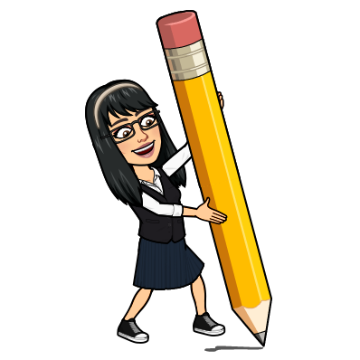
science
New Words
technology
exhibits
shows
تفاعلي
interactive
model
spacecraft
invention
new

Slide 11


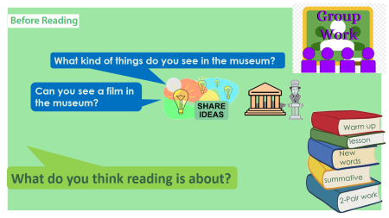
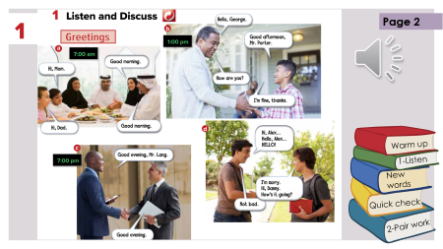
Lets play
Think pair share
Warm up
lesson
New words
summative
2-Pair work

Slide 12


Make a question
Warm up
lesson
New words
summative
2-Pair work

Slide 13





page 198 Ex(F-G)
for practice grammar
Warm up
New words

Slide 14
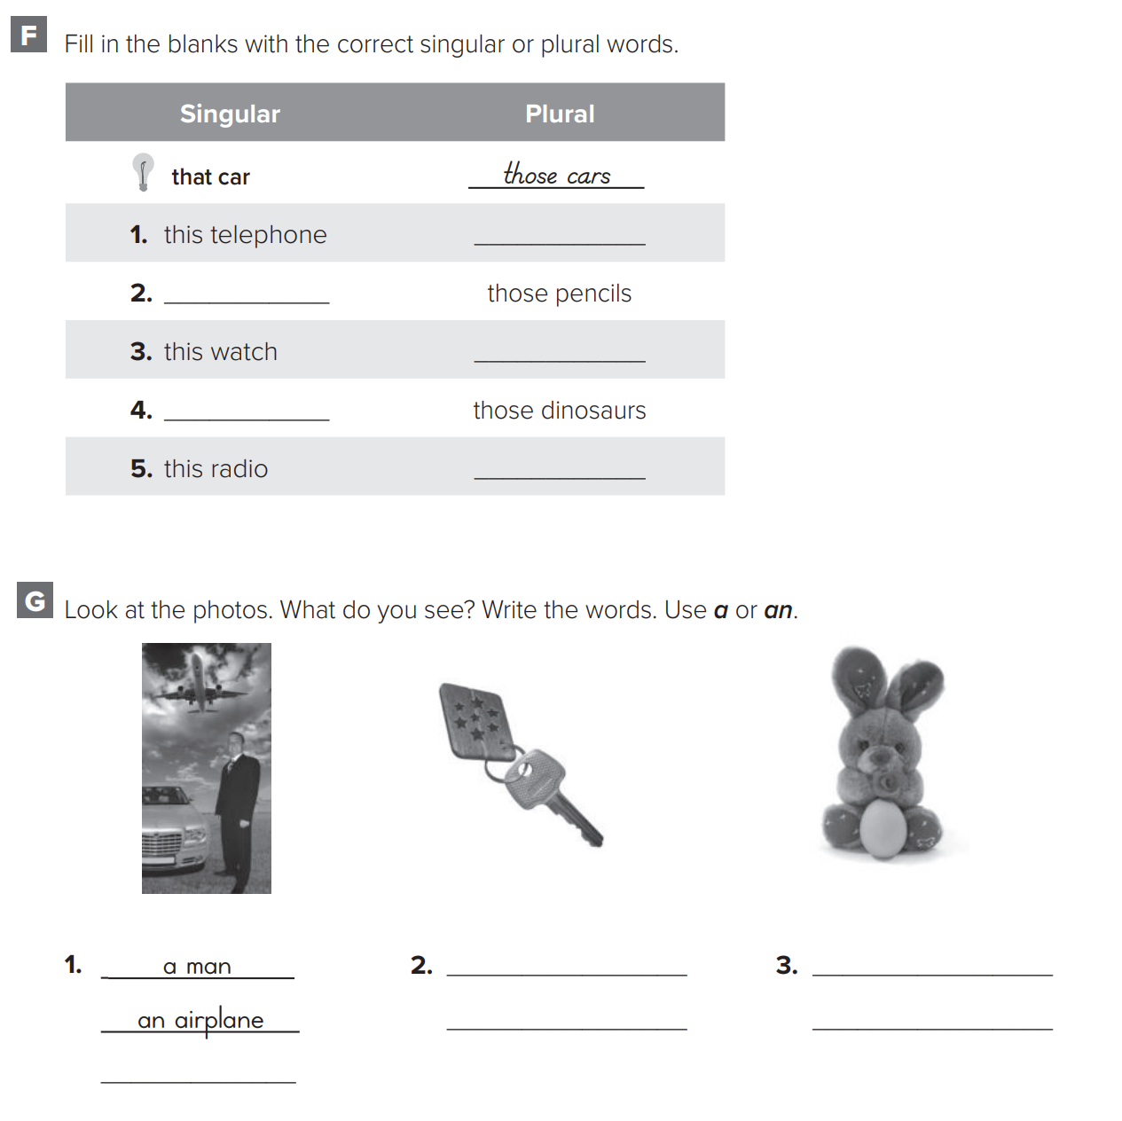
p.198
These telephones
That pencil
These watches
Warm up
That dinosaur
New words
These radios

Slide 15
p.198
Warm up
a key
a toy
a keychain
an egg
New words
a car

