Slide 1
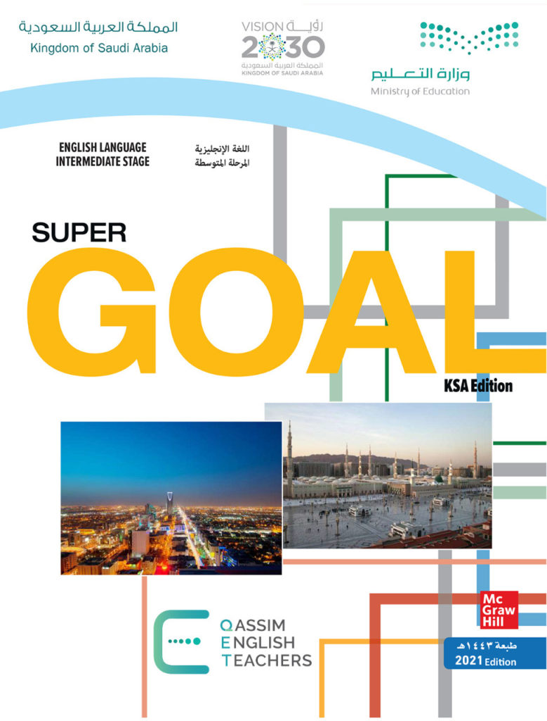
Unit 3
When Are You Travelling?
Reading

Slide 2
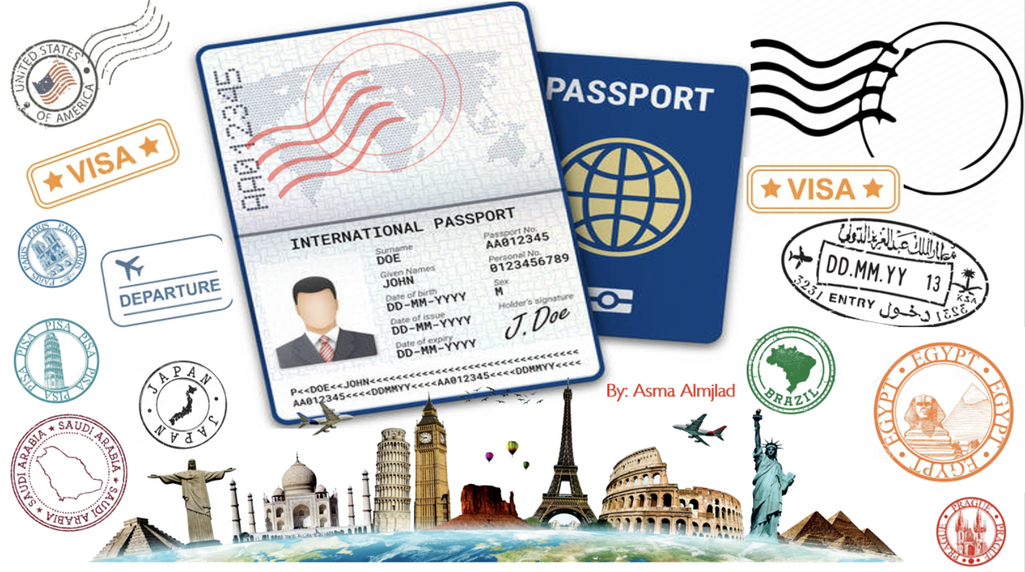

Slide 3
بسم الله الرحمن الرحيم
Day:
Date:

Slide 4


Learning Objectives
Identify the main idea of reading
answer questions about the reading
Design Arabic language study program for foreigners
Recognize the benefits of learning Arabic
Give meaning of the new words

Slide 5

Vocabulary
brochure

Slide 6
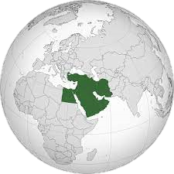
Vocabulary
Middle East

Slide 7
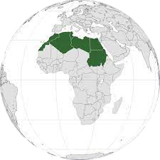
Vocabulary
North Africa

Slide 8
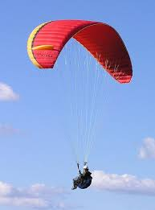
Vocabulary
paragliding

Slide 9
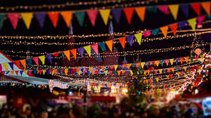
Vocabulary
festival

Slide 10

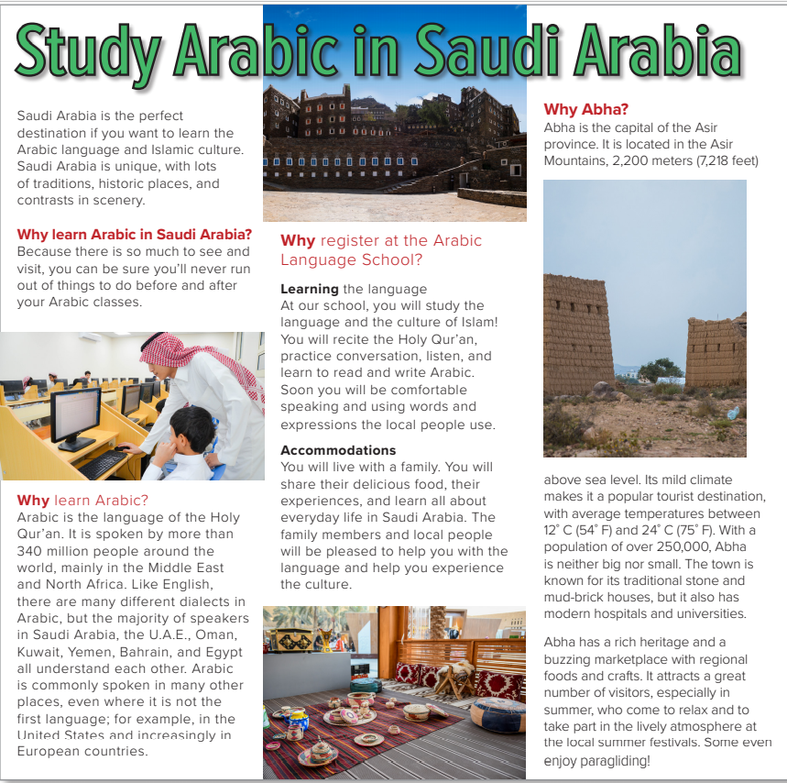
Pages:28 & 29
Who is the man?
What country do you think the pictures are of?
Is it a magazine article or a brochure?
(a brochure)
What is the brochure for?
What are good places in Saudi Arabia to visit?
(the Arabic Language School)
What is the climate like in Saudi Arabia?
Will the brochure give all the facts or just some of the facts?
Do you think Saudi Arabia is a good place to study Arabic?
Will the brochure have any negative information?
Why not?

Slide 11
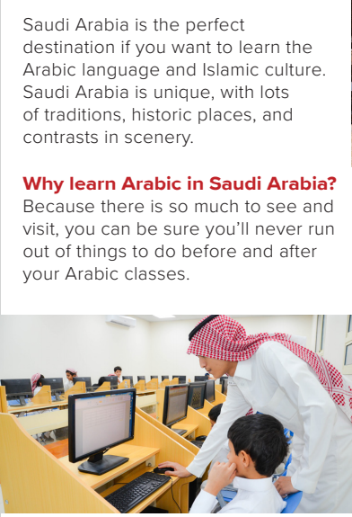
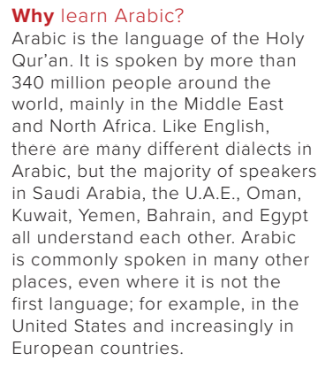
Pages:28 & 29
What makes Saudi Arabia special?
(its traditions, historic places, and contrasts in scenery)
What makes Saudi Arabia a good place to learn Arabic?
(There are a lot of things to do outside of class.)
How many people speak Arabic?
(more than 340 million people)
Where do people speak Arabic?
(in the Middle East and North Africa, in the US and in European countries)

Slide 12
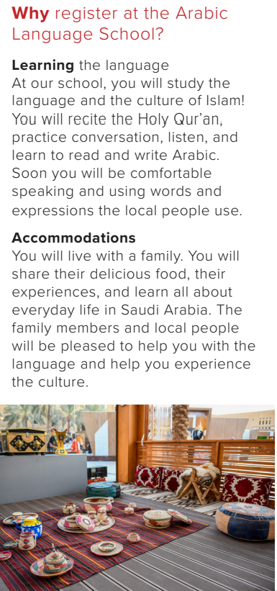
Pages:28 & 29
What will you study at the school?
(the language and culture of Islam, the Holy Qur’an)
Why will it be good to live with a family?
(You will share their food, experiences, and learn about everyday life in Saudi Arabia.)

Slide 13
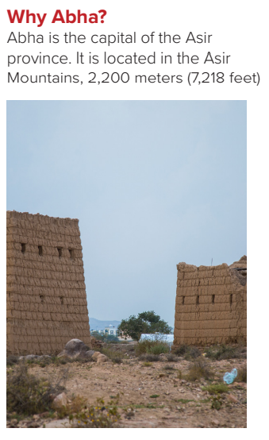
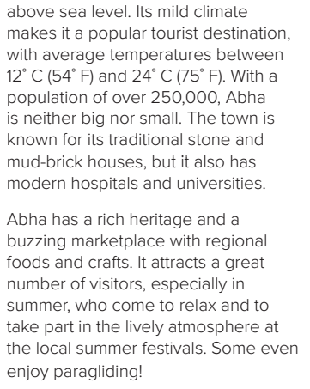
Pages:28 & 29
Is Abha in the mountains or by the sea?
(in the mountains)
What is the climate in Abha like?
(It has a mild climate with temperatures between 12°C and 24°C.)
Is Abha an old city or a modern city?
(both)
What is the population of Abha?
(over 250,000)
What attractions are there in Abha?
(rich heritage, marketplace, summer festivals, paragliding)

Slide 14
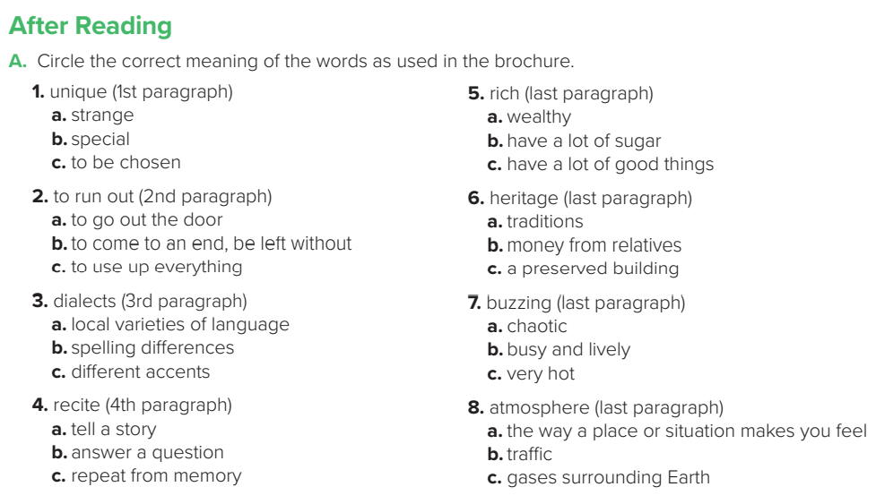
Pages:28 & 29

Slide 15
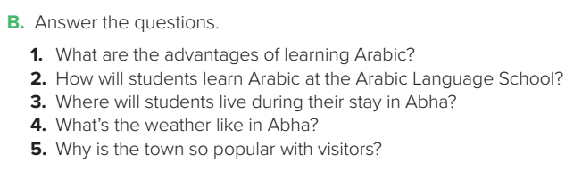
1.Arabic is spoken by more than 340 million people, so it can help you communicate with lots of people.
2. Students will recite the Holy Qur’an, practice conversation, listen, and learn to read and write Arabic.
3. Students will live with a family.
4. Abha has a mild climate with temperatures between 12°C and 24°C.
5. The climate is good, and Abha has a rich heritage, a buzzing marketplace, a lively atmosphere, summer festivals, and even paragliding.

Slide 16
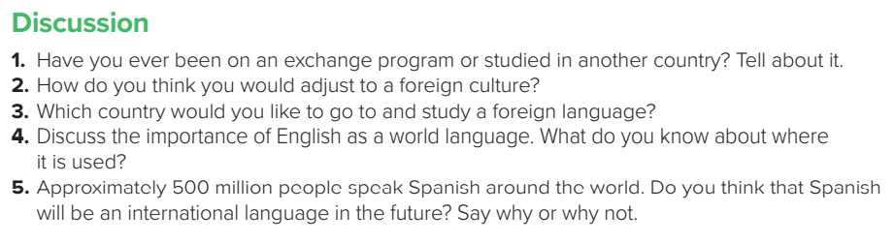

Slide 17
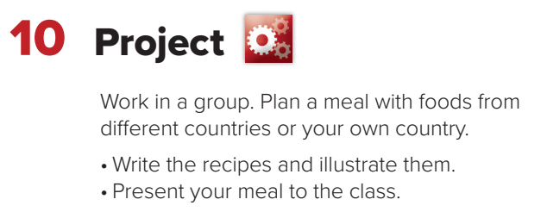

Slide 18

Homework
Workbook
Page
183
( SINGLE LARGE HEADER )

Slide 19
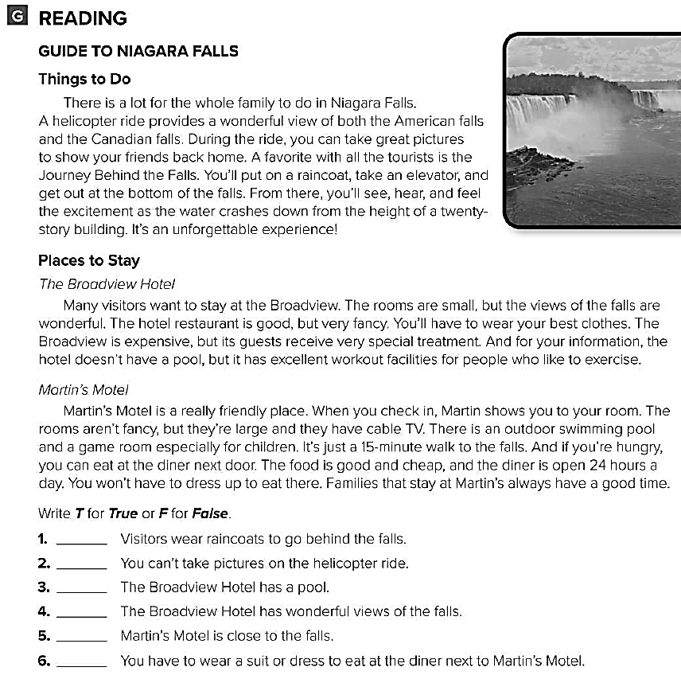
T
F
F
T
T
F

Slide 20
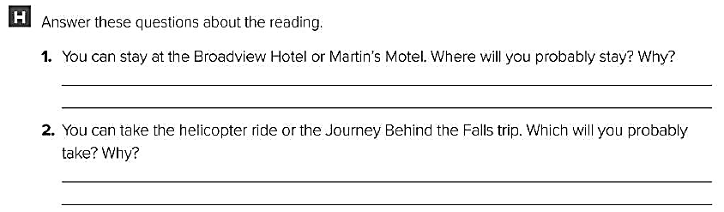
I probably will stay at the Broadview Hotel. I want to see the falls from my room .
I probably will take the helicopter ride. I want to get some good photos of the falls .

