Slide 1

Unit 4
What do I need to buy?
Listen & Discuss
PRESENTATION BY: SLIDECORE

Slide 2

بسم الله الرحمن الرحيم
Day
Date

Slide 3
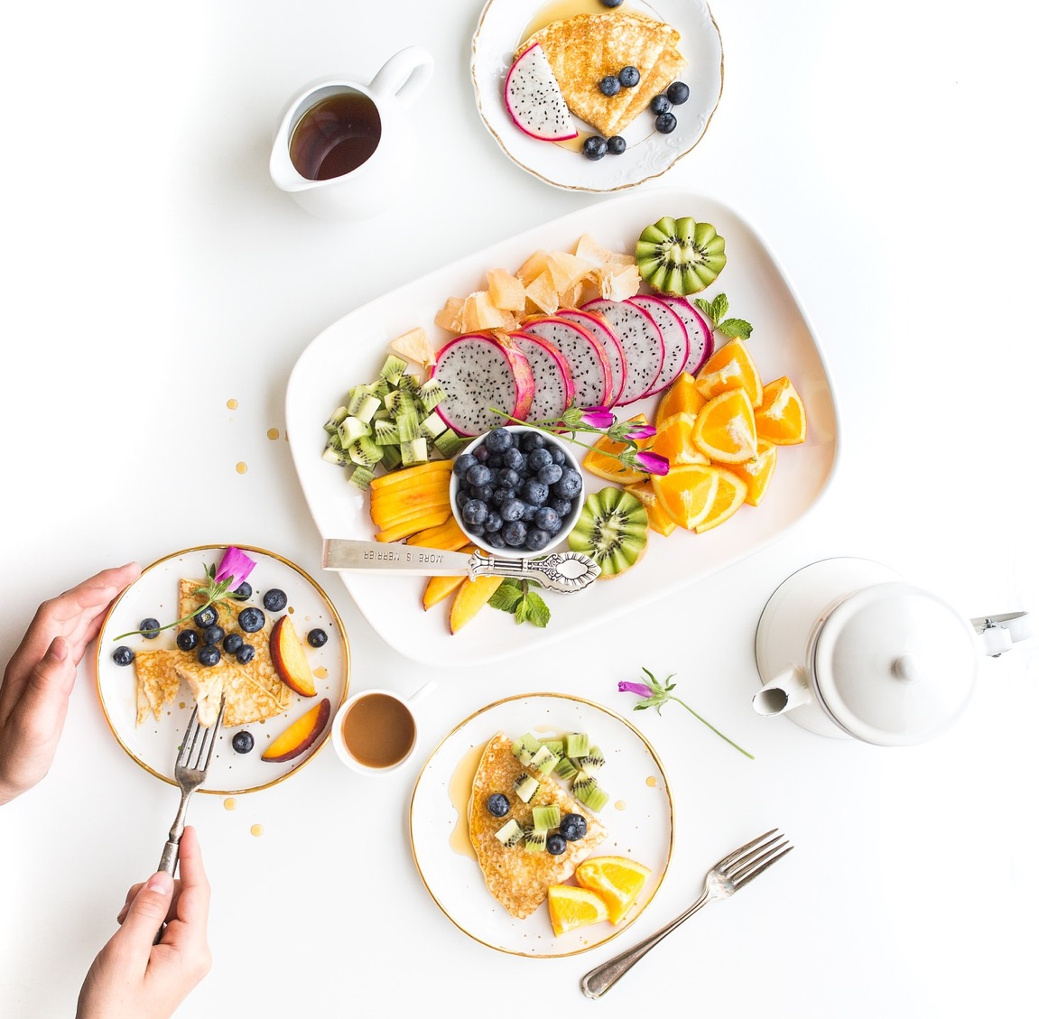

PRESENTATION BY: SLIDECORE

Slide 4
Learning Objectives
discuss buying food habits
02
classify food into categories (Food groups)
01
express attitude towards types of food
04
value the blessing of having various types of food.
03
05
talk about prices and quantities

Slide 5
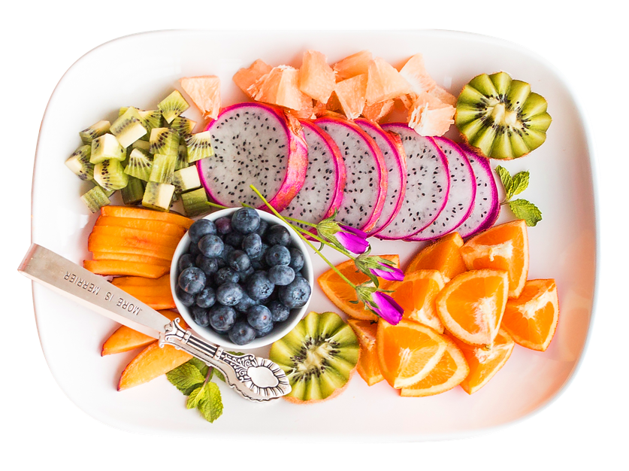
Vocabulary
appetizer

Slide 6
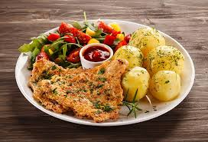
Vocabulary
Main dish

Slide 7
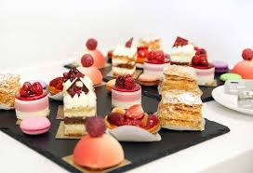
Vocabulary
dessert

Slide 8
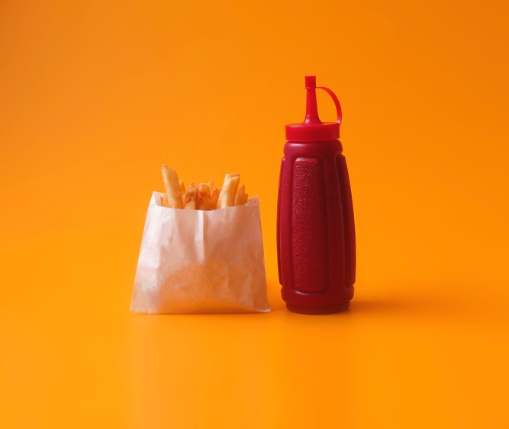
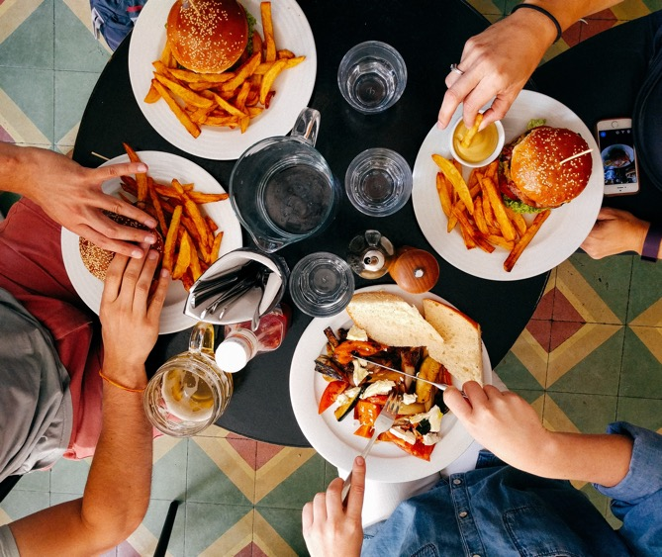
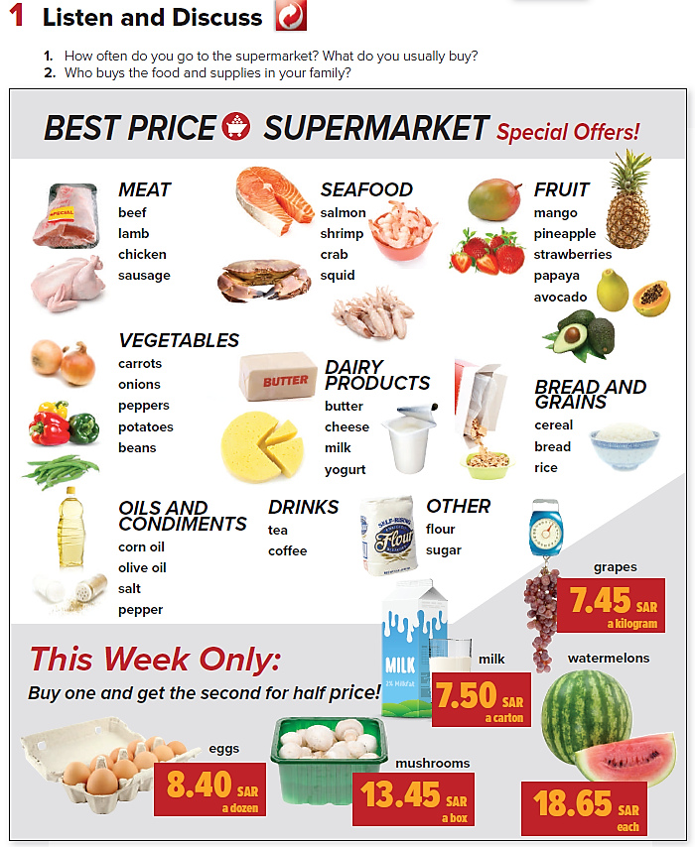

Page:38

Slide 9

PRESENTATION BY: SLIDECORE

Slide 10

Practice

Slide 11
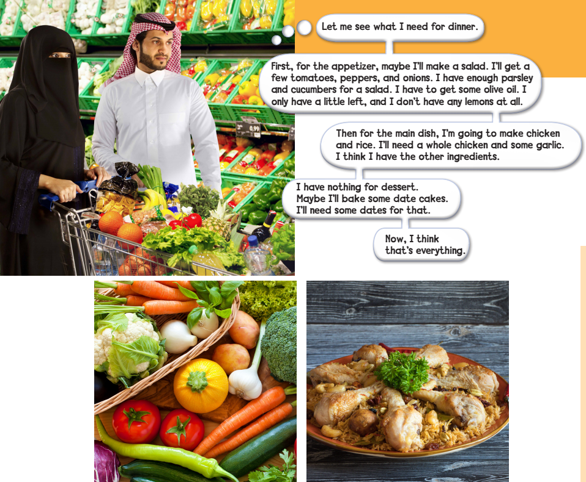
Page:39
PRESENTATION BY: SLIDECORE

Slide 12
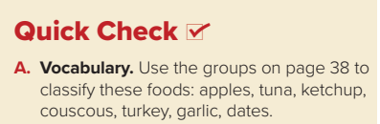
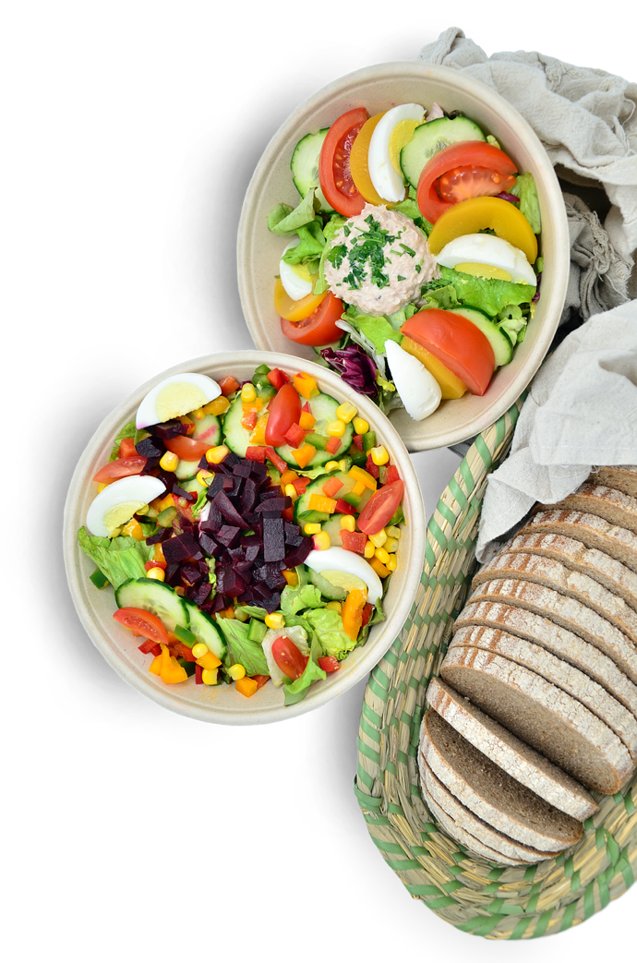
Fruit | Seafood | Oils and Condiments | Meat | Vegetables | Bread and Grains
apples | tuna | ketchup | turkey | garlic | couscous
dates

Slide 13
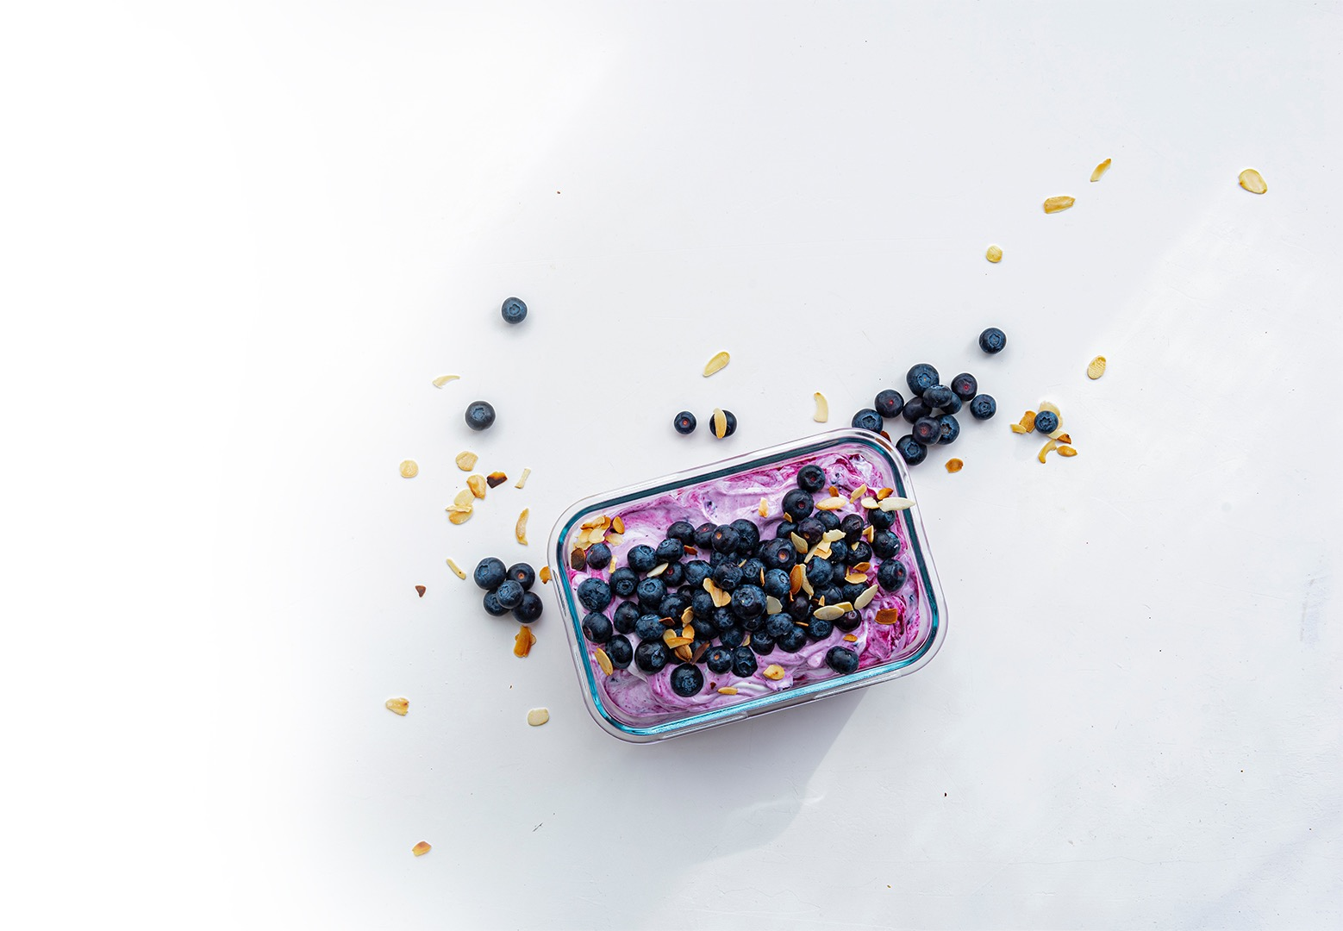
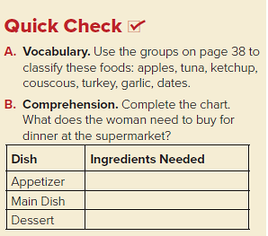
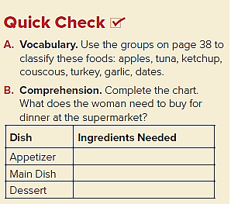
tomatoes, peppers, onions, olive oil, lemons
a whole chicken, some garlic
dates

Slide 14
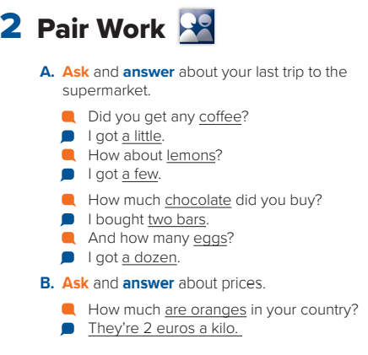
PRESENTATION BY: SLIDECORE

Slide 15
Homework
Workbook page 185

Slide 16
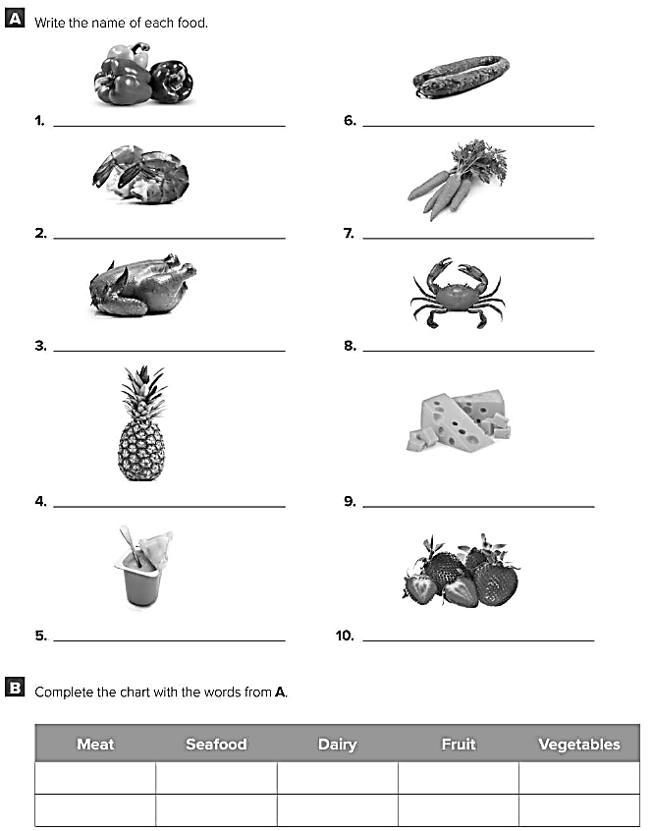
Peppers
Sausage
Shrimp
Carrots
Chicken
Crab
Pineapple
Cheese
Yoghurt
Strawberries
Chicken
Shrimp
Yoghurt
Pineapple
Peppers
Sausage
Crab
Cheese
Strawberries
Carrots

Slide 17
Healthy life Flaticon icon pack
Icons by Manthana Chaiwong

Slide 18
Colored Food & Drink Icons
Icons by Icons8

Slide 19
Editable Icon Set
Things you can do:
Resize the icon
Change fill color and opacity
Add stroke
Add dash lines

