Slide 1
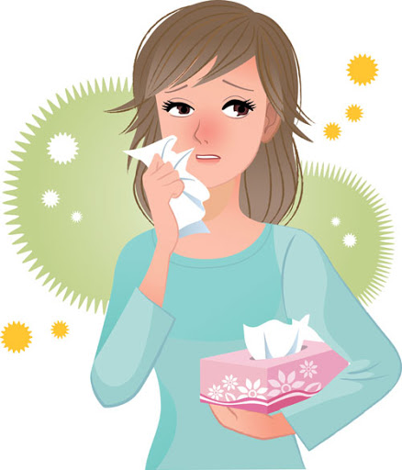
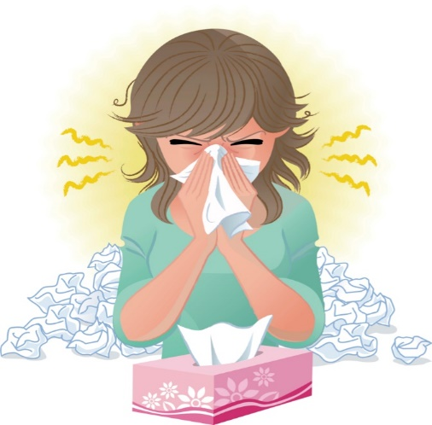
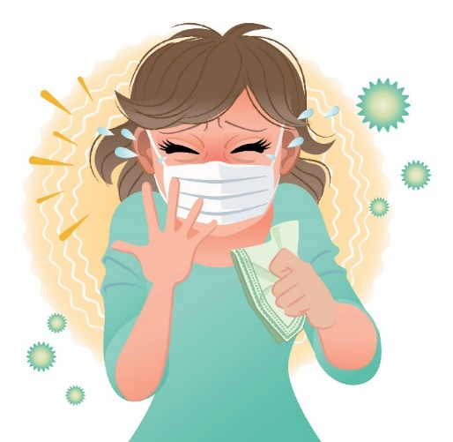
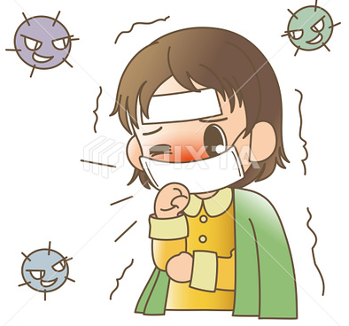

☺Avoid gathering !
Covid 19
☺wear a mask before going out.
☺Social distancing is not a choice, it is a must!
☺Keep a distance of 2 meters to avoid accountability
☺wash hands constantly.

Slide 2
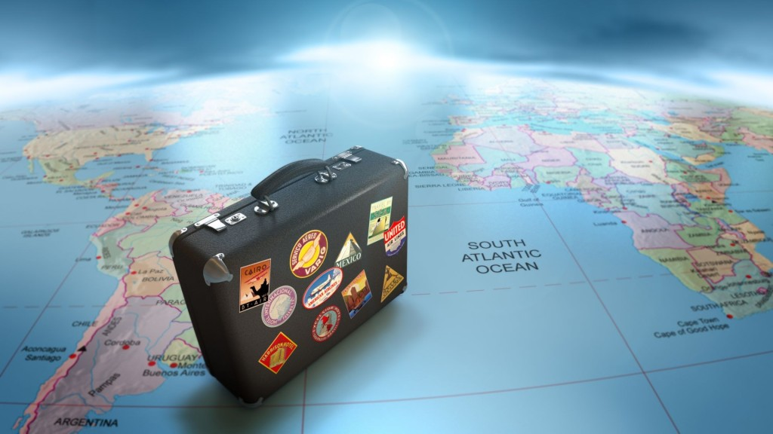
3-When Are You Traveling?
Reading
Page 28&29

Slide 3
objectives
Identify the main idea of reading
Answer questions about the reading
Recognize the benefits of learning Arabic
Design Arabic language study program for foreigners

Slide 4

remember
What did you have study in the previous lessons?

Slide 5


We can do it
https://wordwall.net/play/4905/404/177

Slide 6

Warm up
https://im-a-puzzle.com/look_i_m_a_quiz_puzzle_3v2qi7wru.puzzle

Slide 7
Study Arabic Language in Saudi Arabia
Page 28 & 29

Slide 8

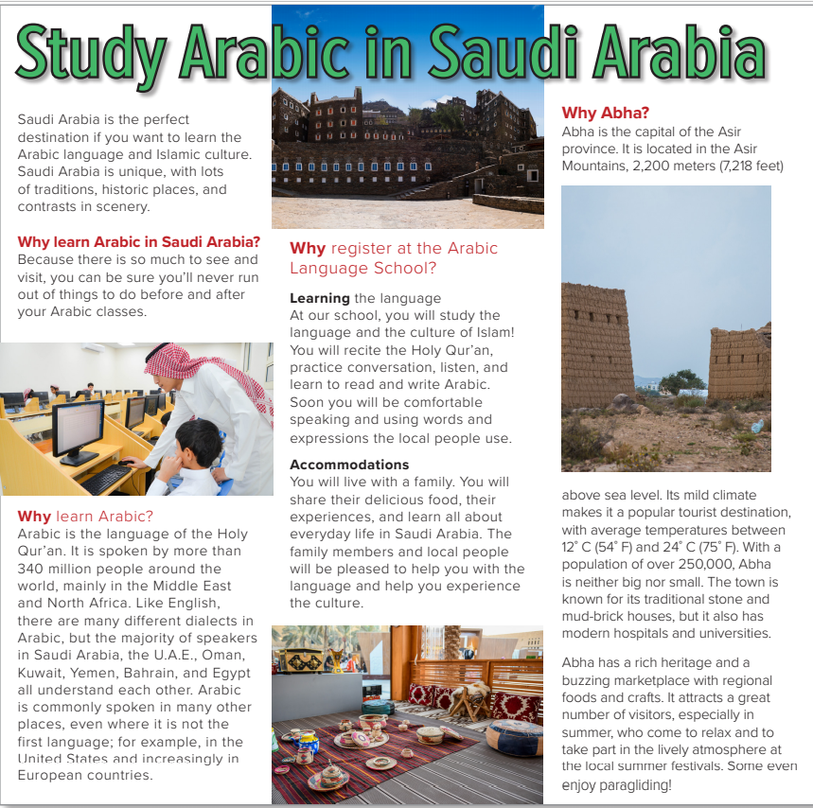
Page:28
Who is the man?
What country do you think the pictures are of?
Is it a magazine article or a brochure?
(a brochure)
What is the brochure for?
What are good places in Saudi Arabia to visit?
(the Arabic Language School)
What is the climate like in Saudi Arabia?
Will the brochure give all the facts or just some of the facts?
Do you think Saudi Arabia is a good place to study Arabic?

Slide 9
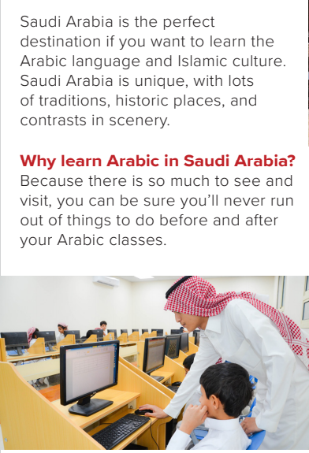
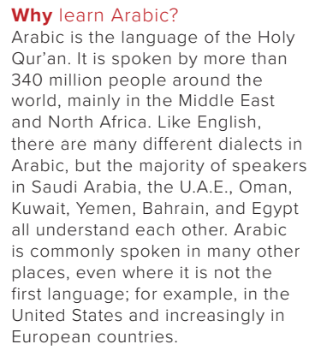
What makes Saudi Arabia special?
(its traditions, historic places, and contrasts in scenery)
What makes Saudi Arabia a good place to learn Arabic?
(There are a lot of things to do outside of class.)
How many people speak Arabic?
(more than 340 million people)
Where do people speak Arabic?
(in the Middle East and North Africa, in the US and in European countries)

Slide 10
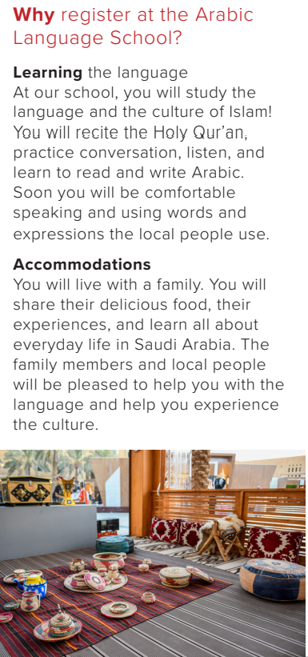

→ Make a comprehension question about this paragraph then ask your friends.

Slide 11
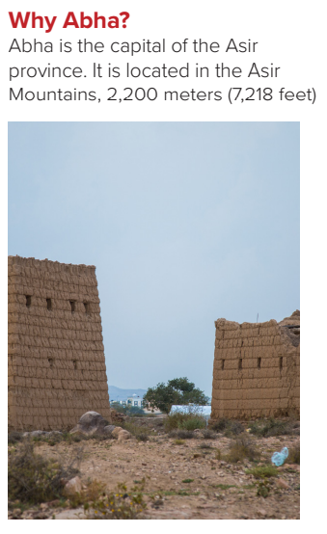
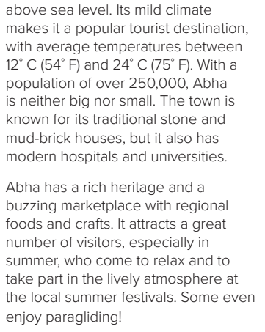
Is Abha in the mountains or by the sea?
(in the mountains)
What is the climate in Abha like?
(It has a mild climate with temperatures between 12°C and 24°C.)
Is Abha an old city or a modern city?
(both)
What is the population of Abha?
(over 250,000)
What attractions are there in Abha?
(rich heritage, marketplace, summer festivals, paragliding)

Slide 12
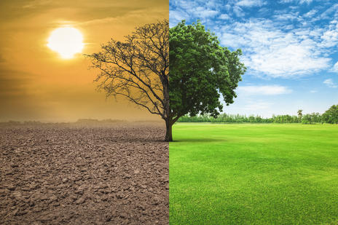
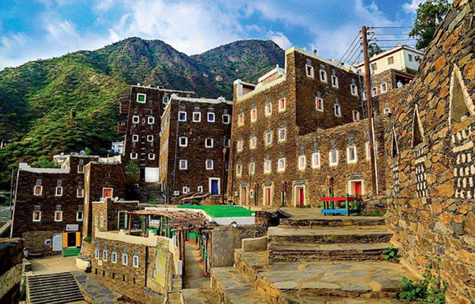
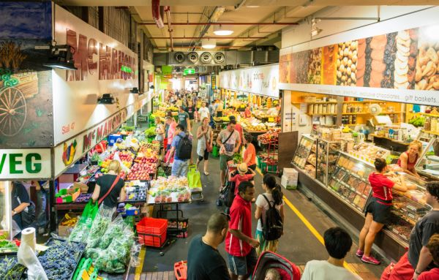
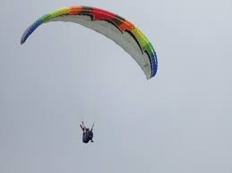
Match the words with pictures
Heritage
Paragliding
Buzzing marketplace
climate

Slide 13

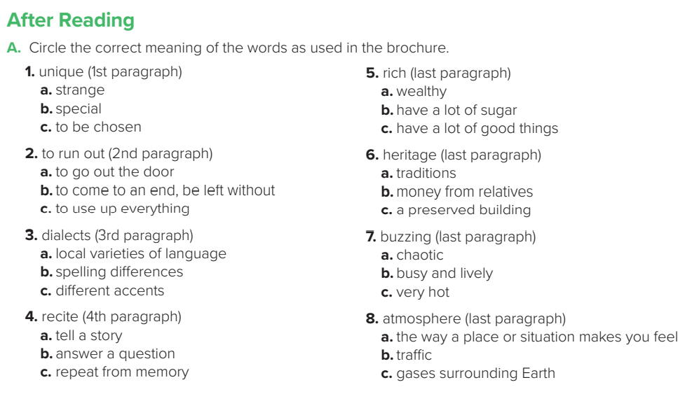

Slide 14
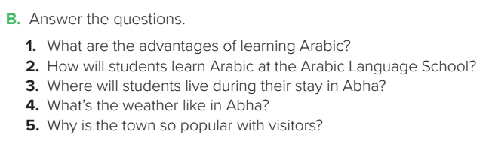
1.Arabic is spoken by more than 340 million people, so it can help you communicate with lots of people.
2. Students will recite the Holy Qur’an, practice conversation, listen, and learn to read and write Arabic.
3. Students will live with a family.
4. Abha has a mild climate with temperatures between 12°C and 24°C.
5. The climate is good, and Abha has a rich heritage, a buzzing marketplace, a lively atmosphere, summer festivals, and even paragliding.

Slide 15


Let’s do some exrcises

Slide 16



“Create a dialogue about study Arabic laungage in Saudi Arabia.”
-pair work

Slide 17
Homework
workbook
Page 105

Slide 18


“You’re braver than you believe, and stronger than you seem, and smarter than you think.”
-A.A. Mine
Author/Poet
Have a nice day
Miss. Bashaier Alkhathami

