Slide 1
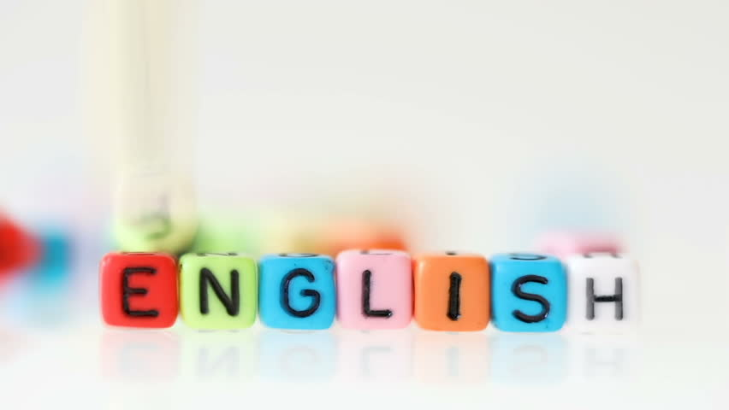

Super goal 1
Unit 4
Lesson 4 reading
اعداد المعلم / يحيى المنقري متوسطة المأمون بالهفوف

Slide 2
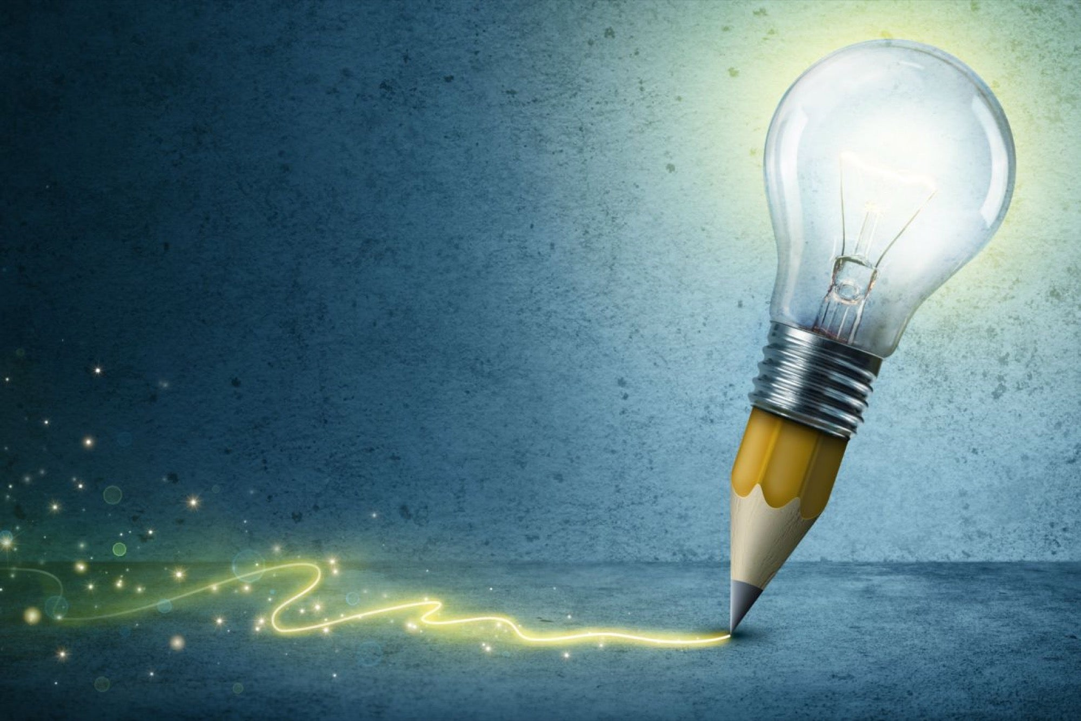
Learning Objectives
*By the end of this lesson, Ss will be able to:
1- complete the chart from the passage .
2- Read about Lapland .

Slide 3
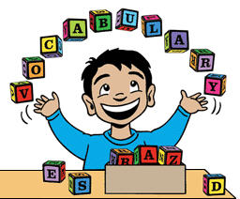

Slide 4
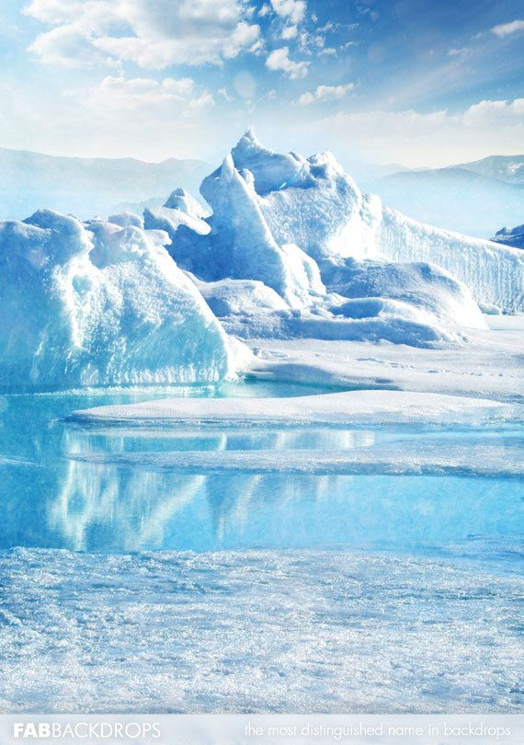
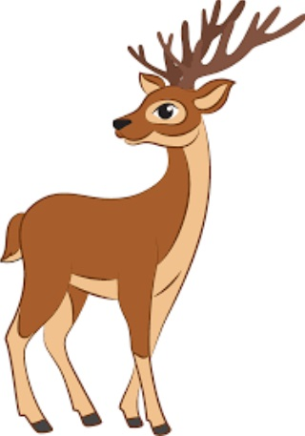
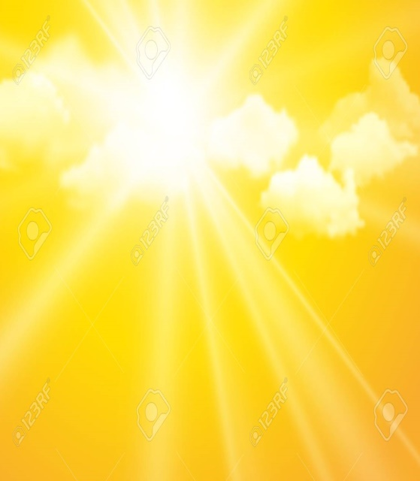
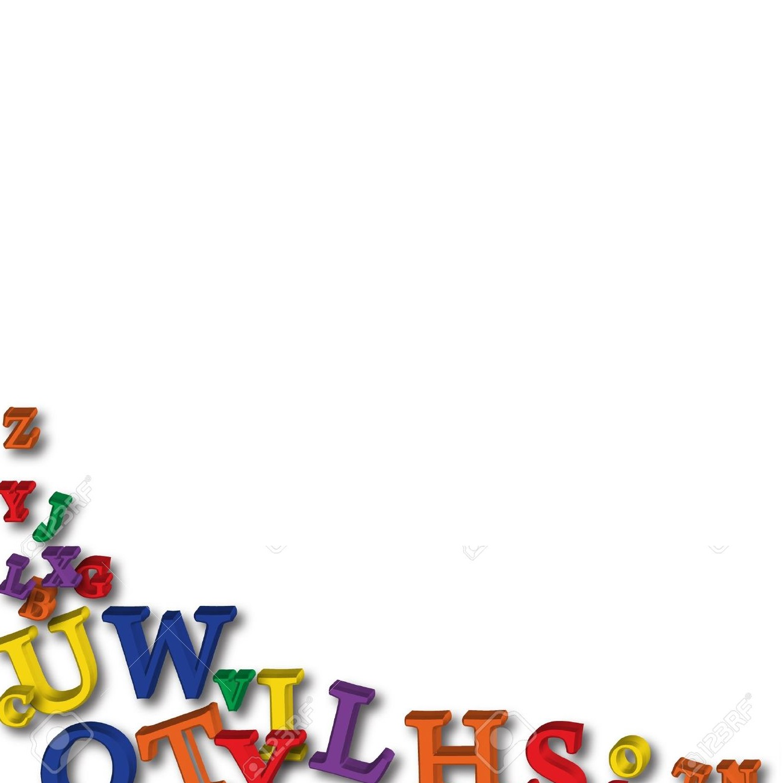

Arctic
Reindeer
Sunlight

Slide 5
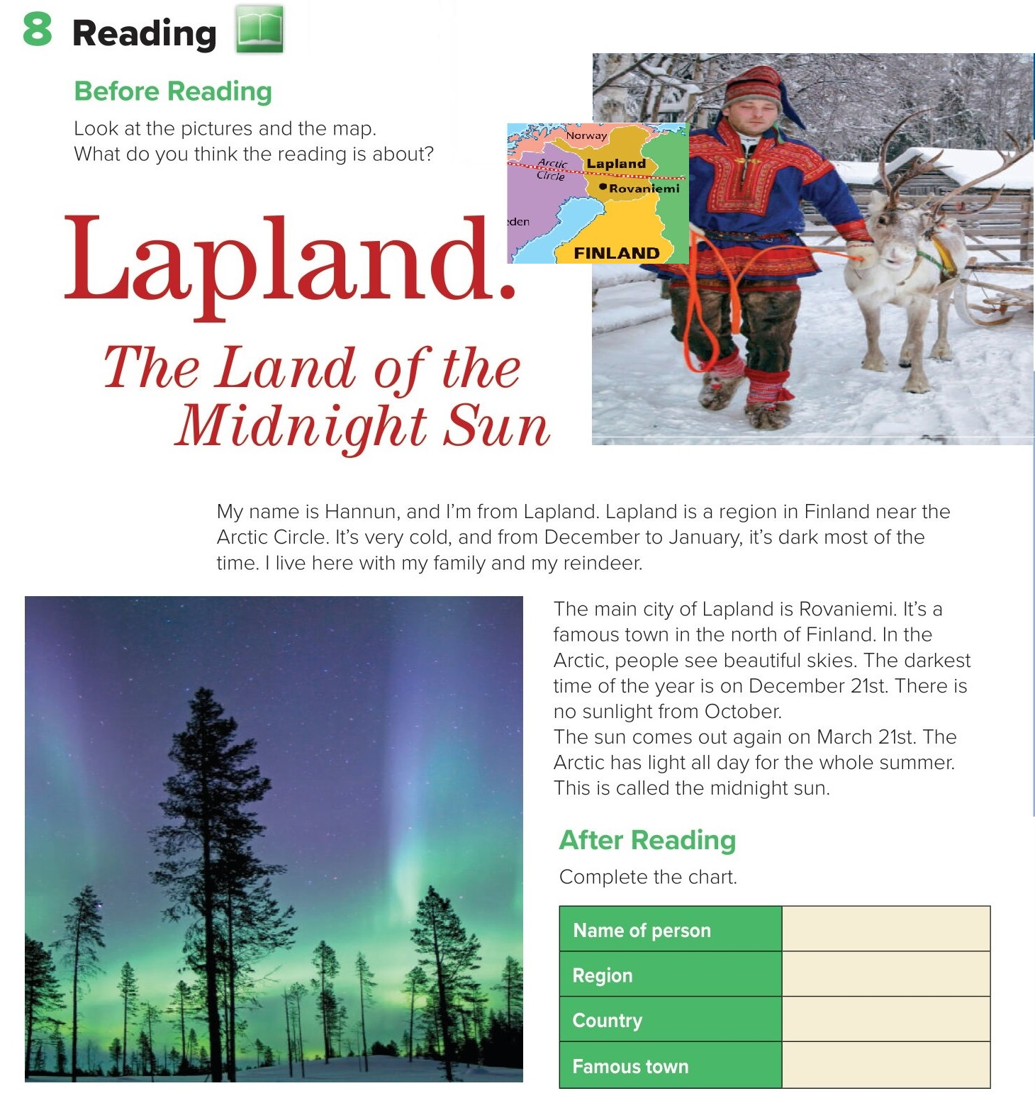
I think it is about Lapland next to Finland.
Hannun
Lapland.
Finland
Rovaniemi.

Slide 6
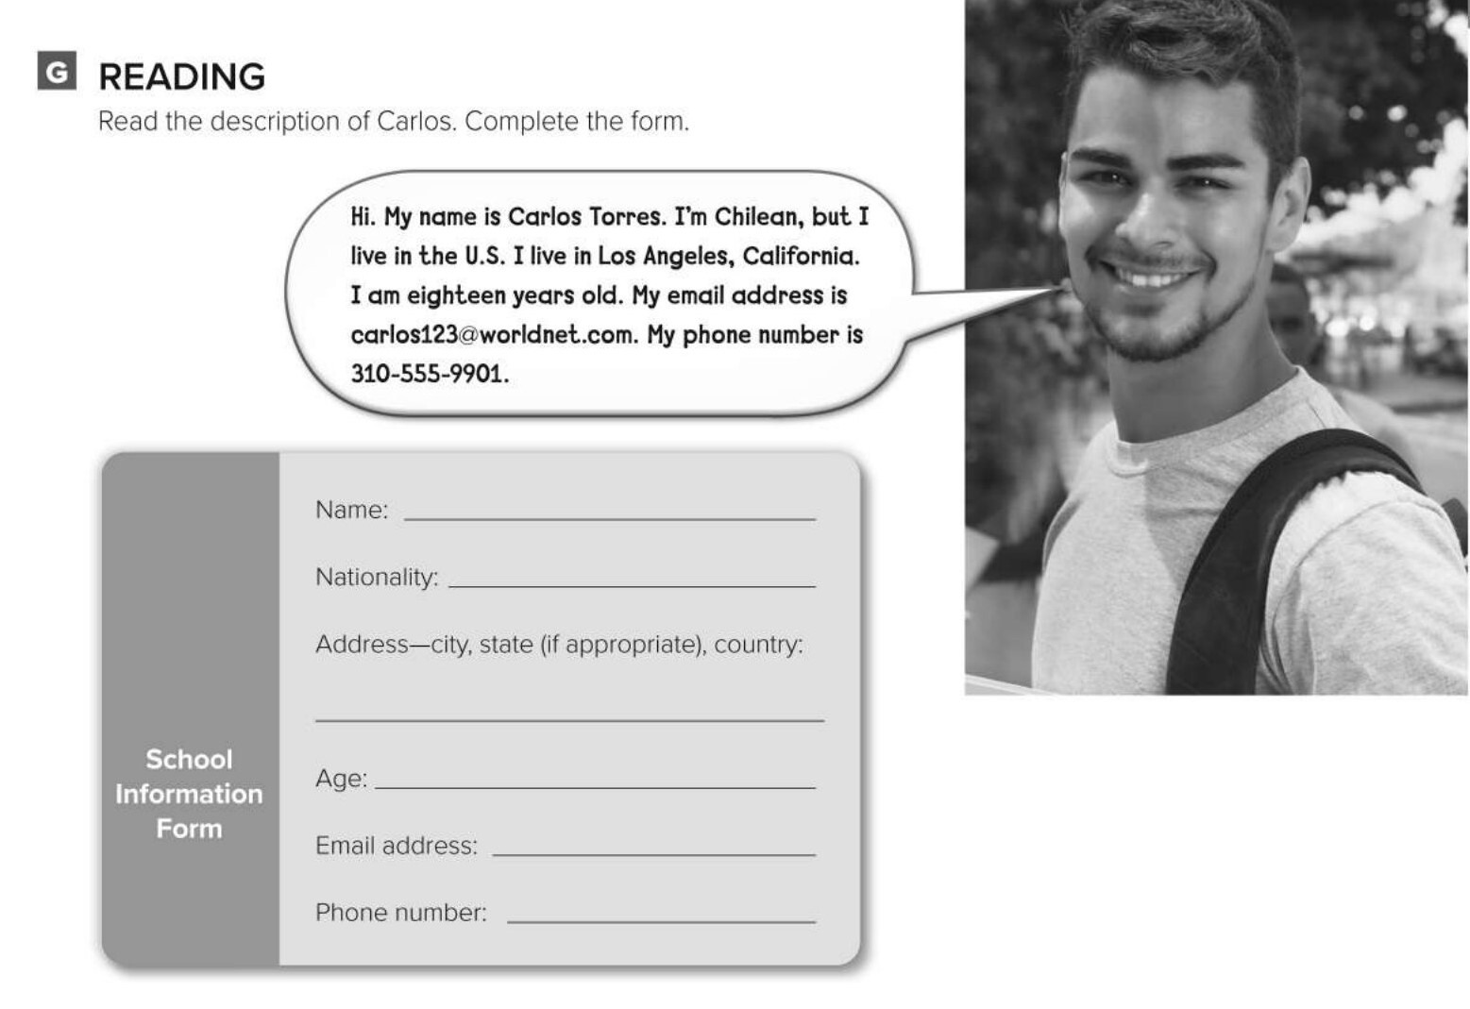
Carlos Torres
Chilean
Los Angeles, California, U.S.
18
carlos123@worldnet.com
301-555-9901

Slide 7

Choose the correct answer :
1-
Lapland is very ……..
Hot
Cold
2-
Lapland is a region in Finland .
TRUE.
FALSE
3-
4-
Reindeer
Sunset
sheep
Sunlight

Slide 8


Slide 9

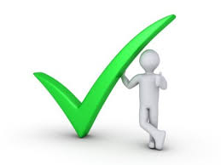
Back

Slide 10
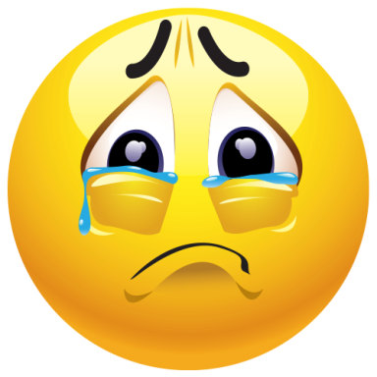

Back

