Slide 1


Slide 2


Good Morning

Slide 3
Mega Goal3.1
Influential People

Slide 4
Conversation
Listening
Pronunciation
Vocabulary Building

Slide 5
Goals:
Answer questions about the conversation
Recognize the new phrases in the conversation
Use “Real Talk” expressions correctly
Match new vocabulary with sentences to achieve correct meaning
Arrange numbers' sequence according to an audio
Determine the "ed" sound in given words
Select the right meaning of the words according to the text

Slide 6
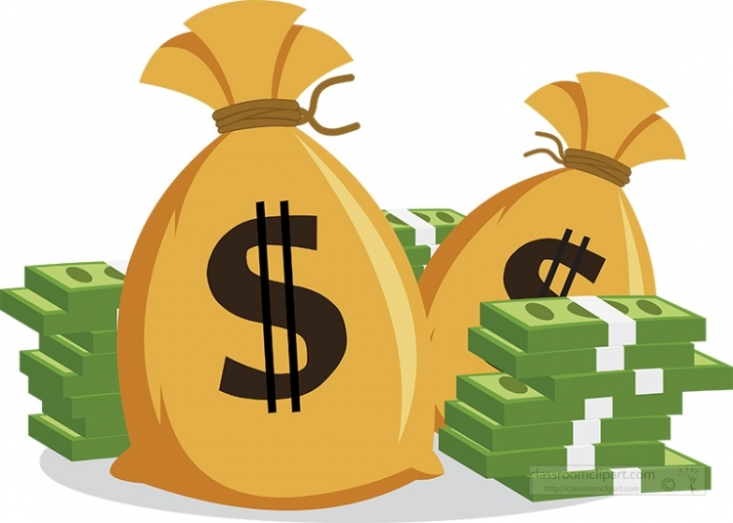

Conversation

Slide 7
What will you do with it?
You won SAR 30,000!

Slide 8
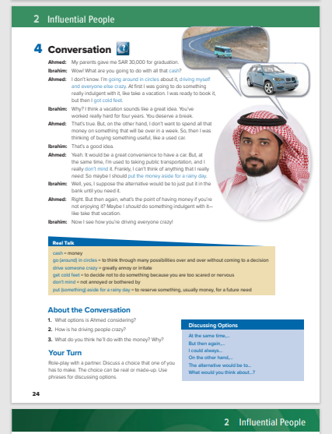
Students Book
P.24

Slide 9
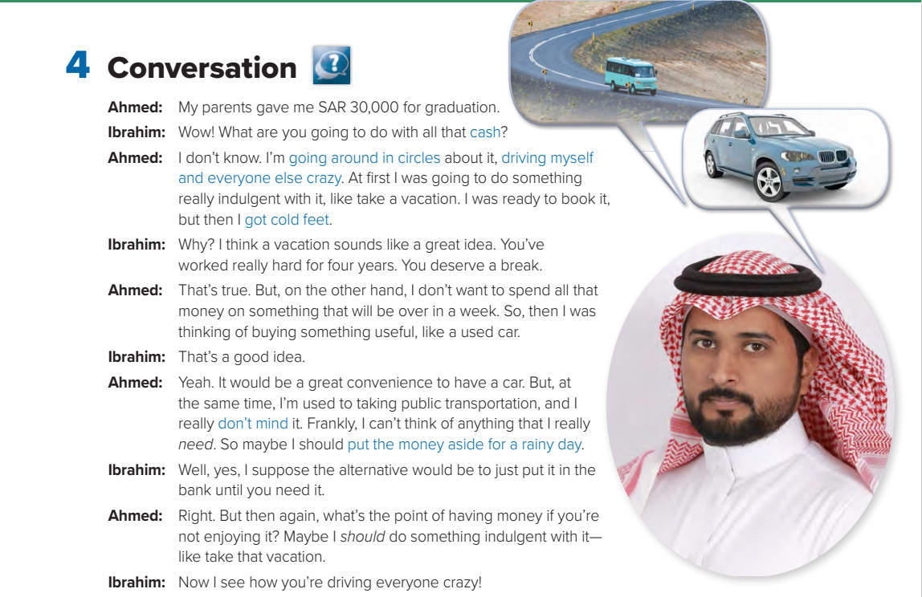
What is the young man thinking about?
He is deciding whether to spend his money on a car or a vacation.
Who are the people talking?

Slide 10

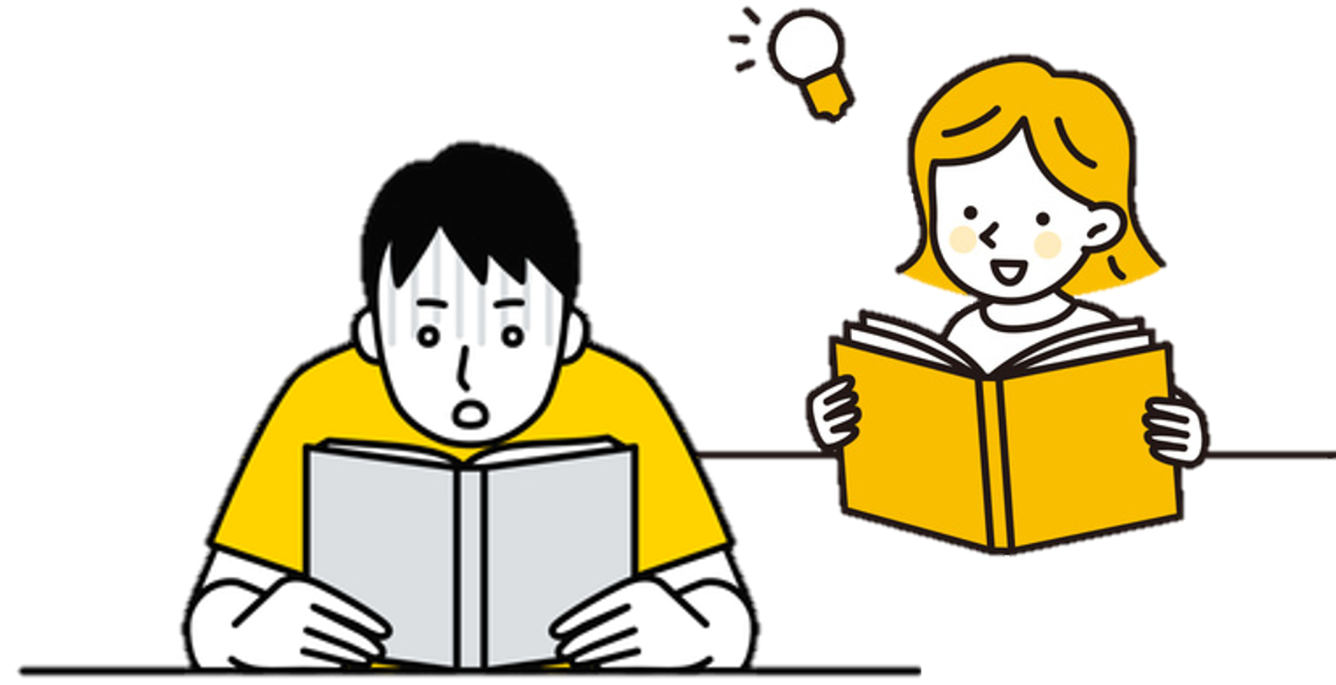

Listen

Slide 11

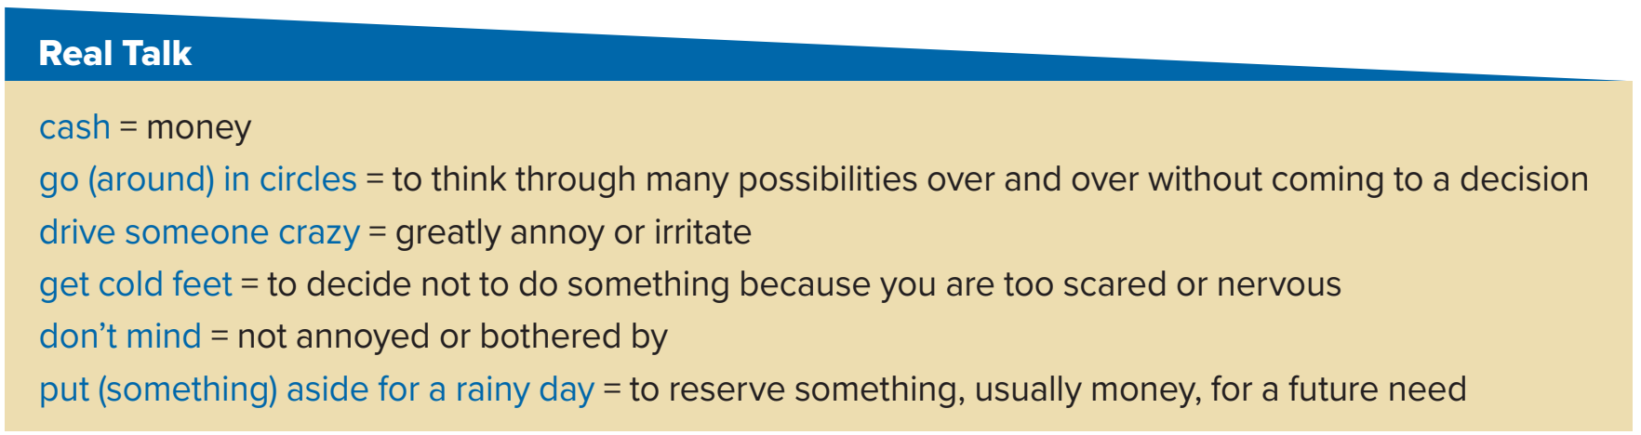
Read as long as you Listen

Slide 13
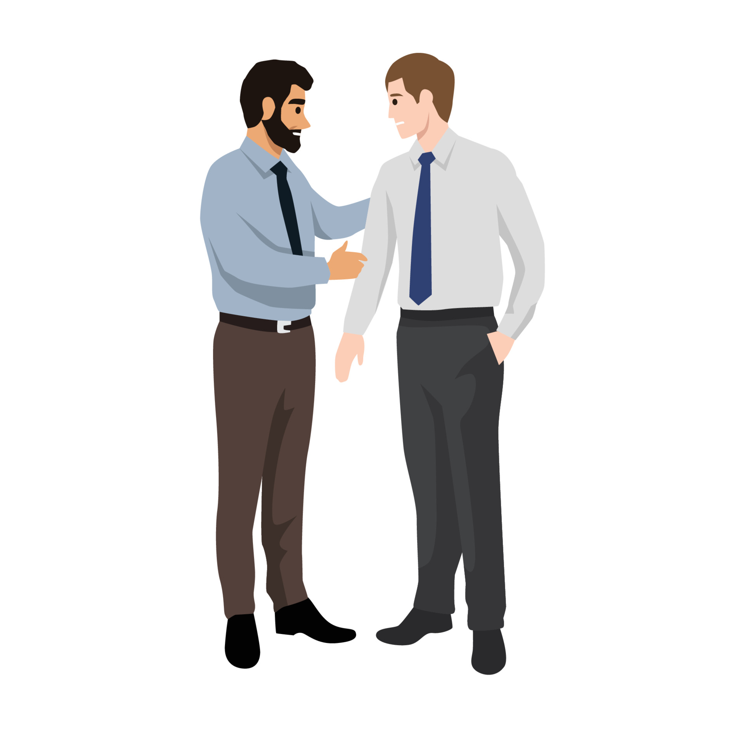
I only carry the amount of cash that I need to buy lunch for the day. I bring my check book or ATM card if I need more money
How much cash do you usually carry with you?
I went around in circles about what to buy my brother for his graduation. I just didn’t know what he would like
Have you ever had to make a decision that you went around in circles about?
What is something that drives you crazy?
It drives me crazy when people talk on their cell phones when waiting in line to pay at stores. I think it is rude

Slide 14
Once while skiing I was going to ski down a difficult trail, but I got cold feet and took the easy way down instead
Have you ever gotten cold feet?
I don’t mind doing laundry. Although many people don’t like it, I think it is relaxing
What is something you don’t mind doing that others don’t like to do?
I like to put my money aside for a rainy day. You never know when you might need it!
Are you the kind of person who spends your money or puts it aside for a rainy day?

Slide 15
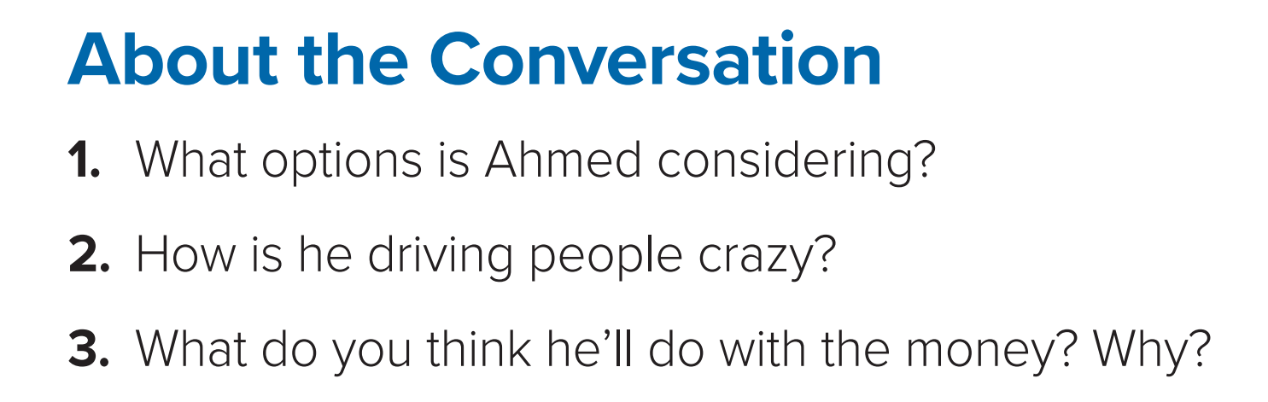
He is considering buying a car, going on vacation, and putting the money in the bank.
He can’t make up his mind.
3. I think he will buy a used car, because that is what I would do.

Slide 16

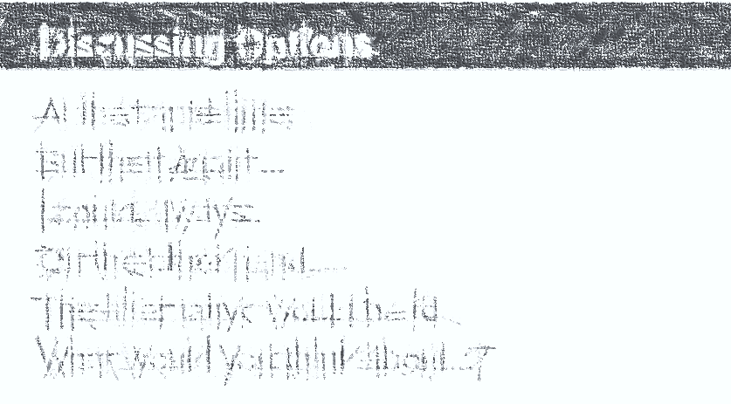
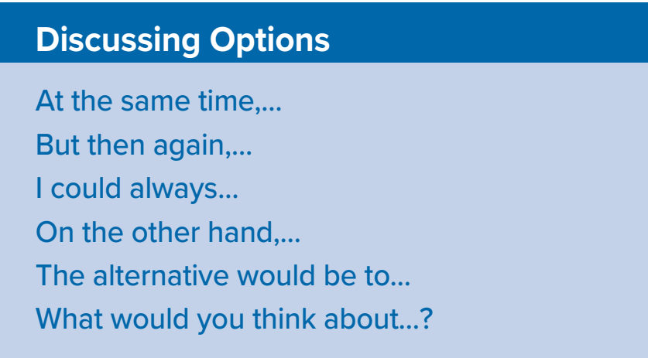

Slide 17
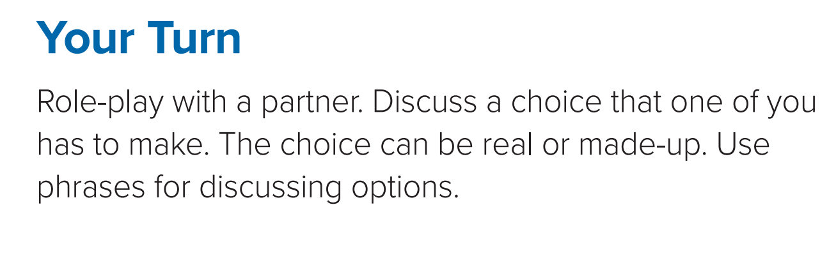

Slide 18
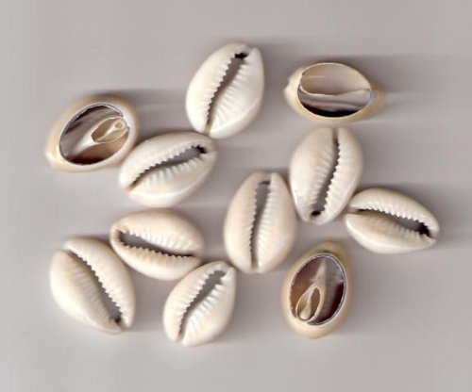
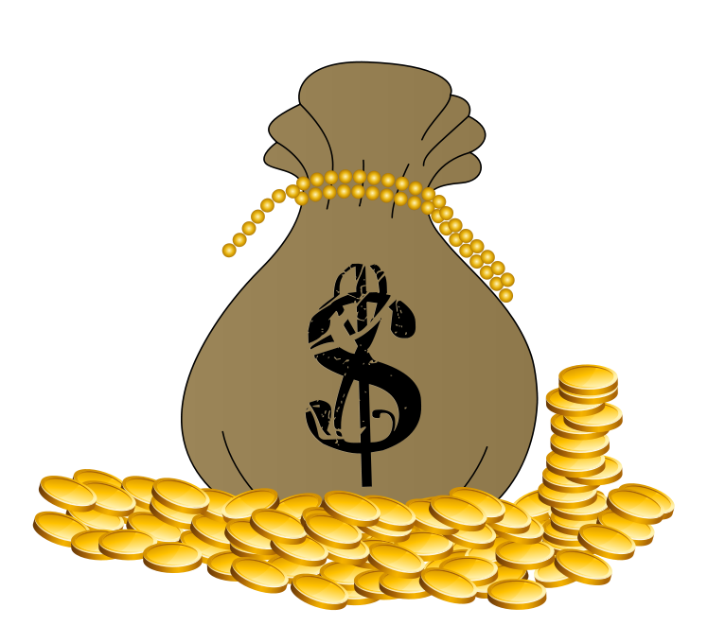
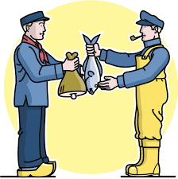
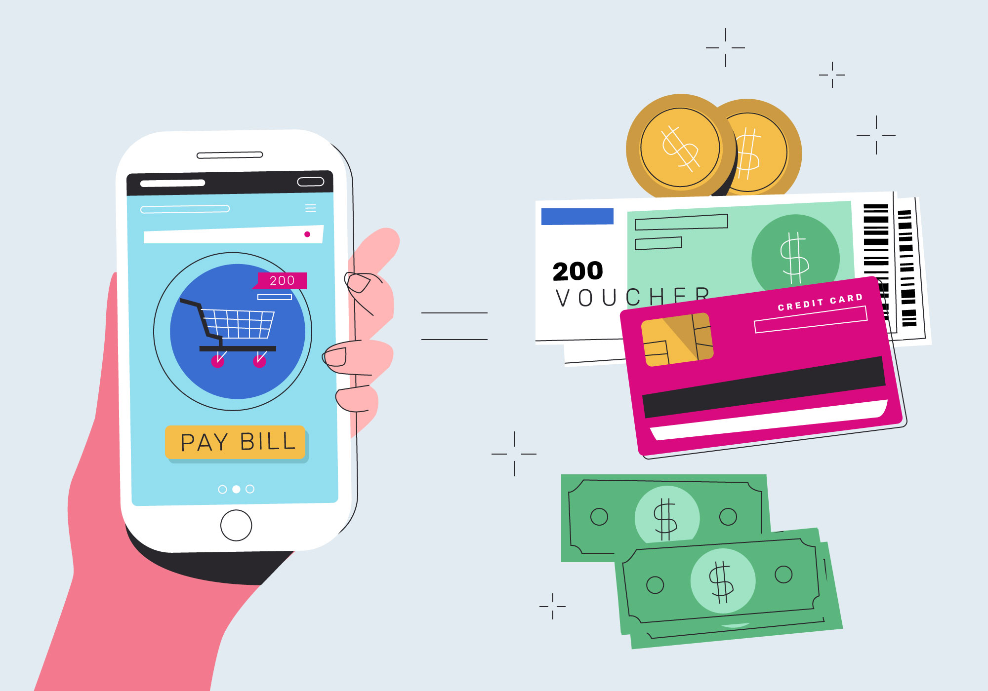
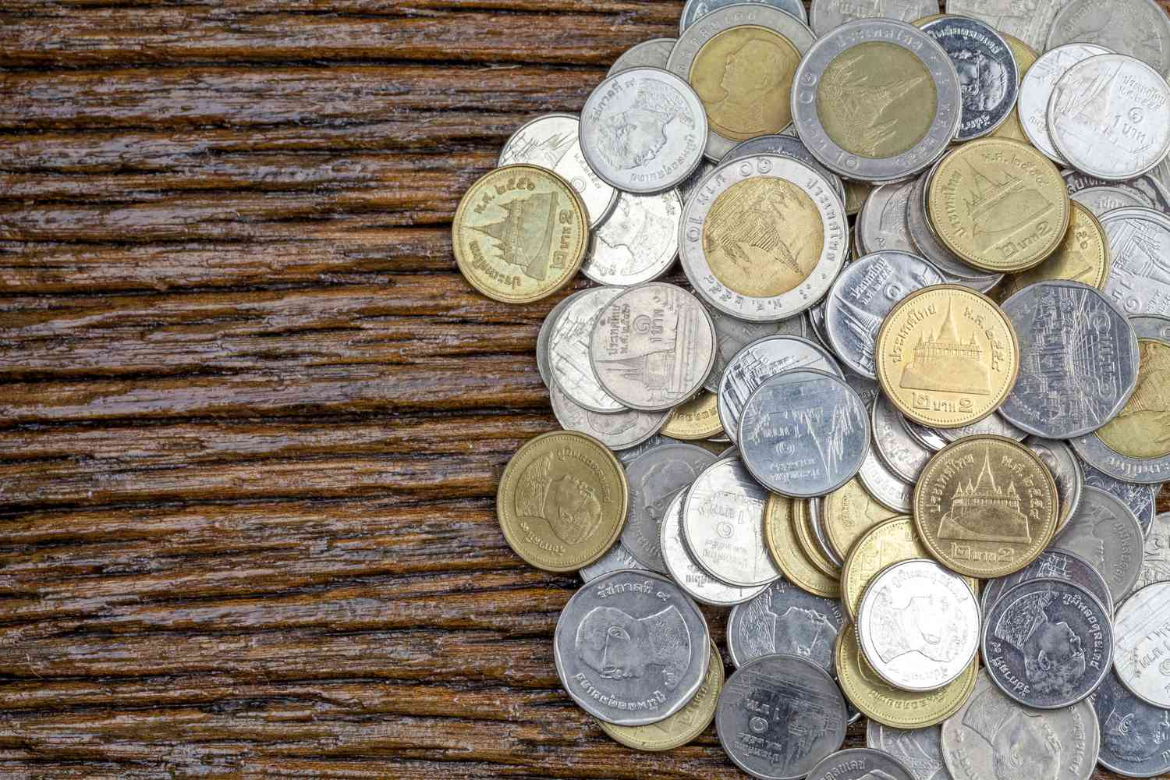
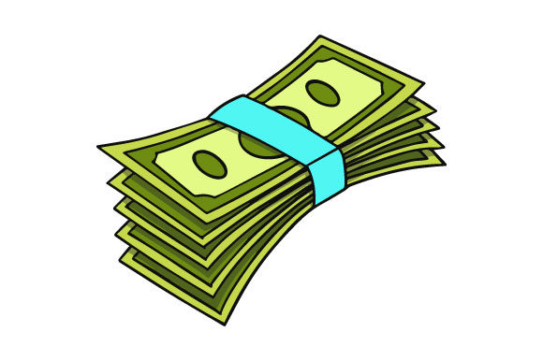
Listening

Slide 19
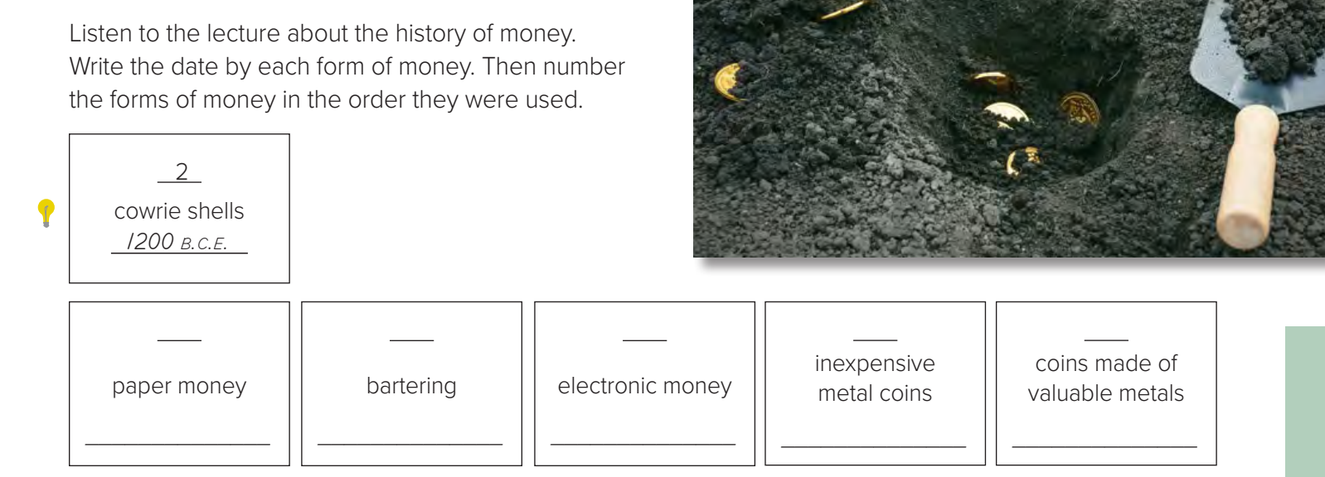
bartering
inexpensive metal coins
cowrie shells
paper money
electronic money
coins made of valuable metals

Slide 20

5
1
6
3
4
800 c.e
9000 b.c.e.
today
1000 b.c.e
500 b.c.e

Slide 21
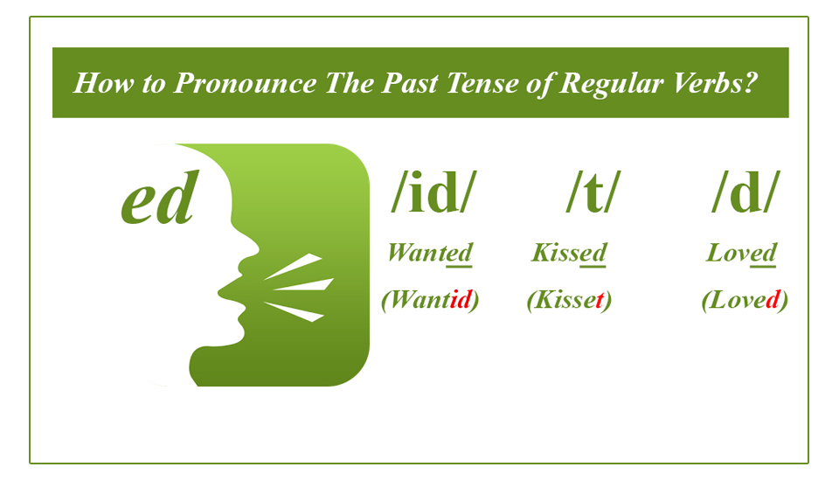
Pronunciation

Slide 23
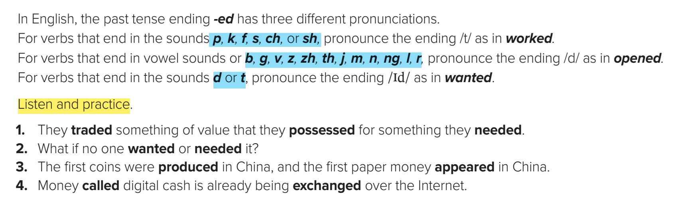

Slide 24
Vocabulary Building

Slide 25
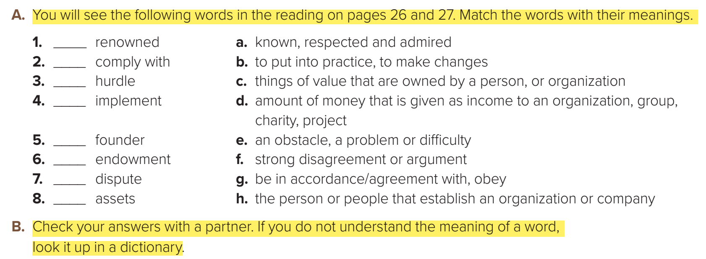

a
g
e
b
h
d
f
c

Slide 26
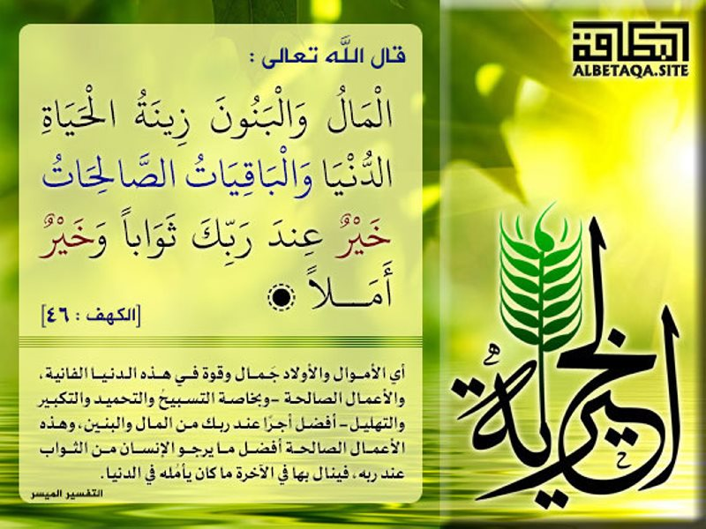

Slide 27


Slide 28
