Slide 1

اعداد
أ: عبير العنزي

Slide 2

The Definite Article: the
Page: 25

Slide 3

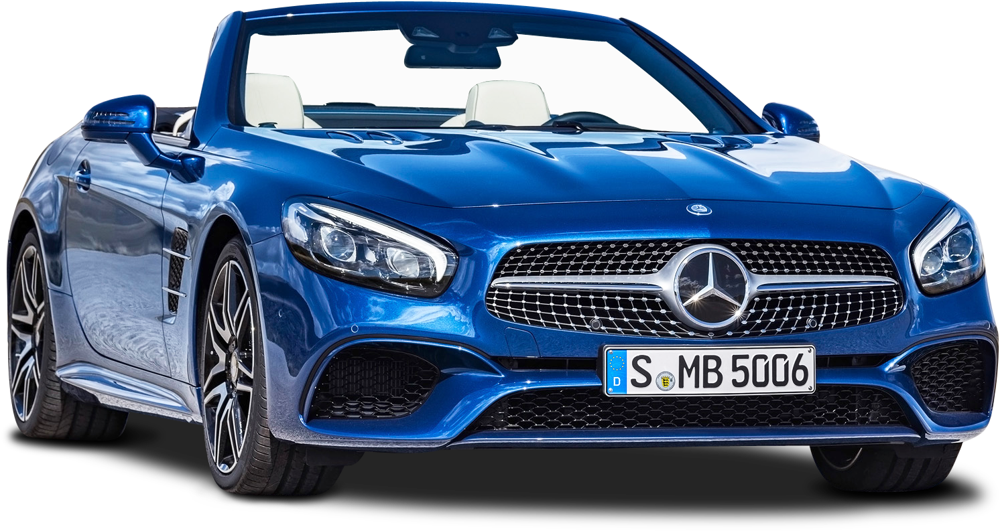

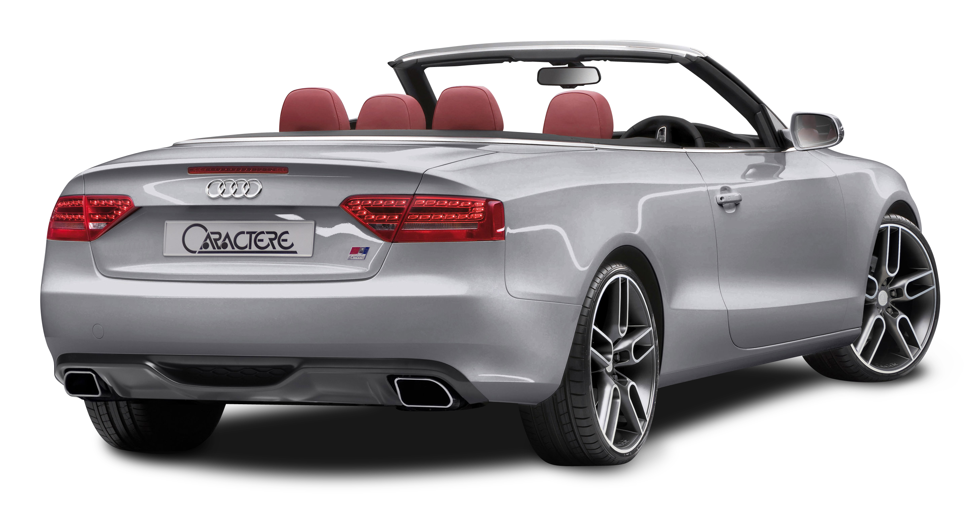
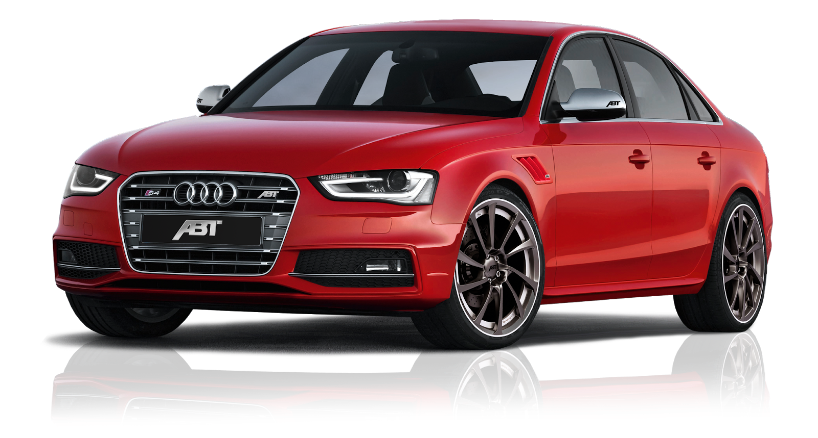
The definite article the comes before singular and plural nouns.
Sigular
Plural
The car….
The
Can I borrow the car?
The cars
The cars are new

Slide 4
The Definite Article: the
We use the definite article in front of a noun when we believe the listener/reader knows exactly what we are referring to

Slide 5
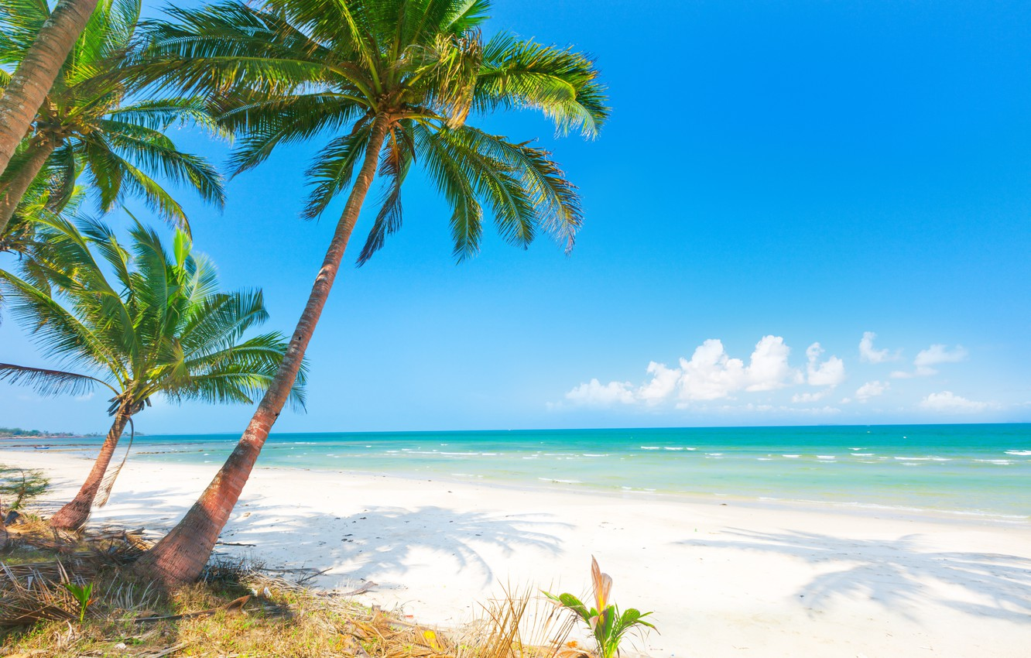
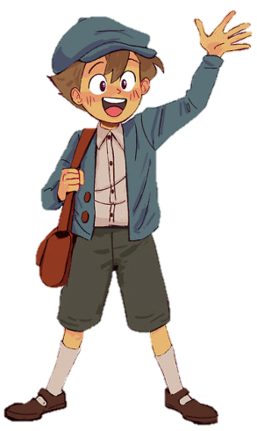
we went to the beach every day
Look at the boy over there

Slide 6
The Definite Article: the
Use the for objects that are one of a kind

Slide 7






1
The Earth
The stars
2
4
The moon
The sea
6
The sky
3
The sun
5

Slide 8
Use the with the names of …..
Seas
monuments
Mountains
2
4
6
1
3
5
oceans
Reviers
deserts

Slide 9
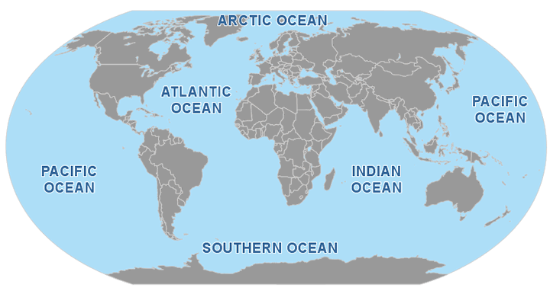
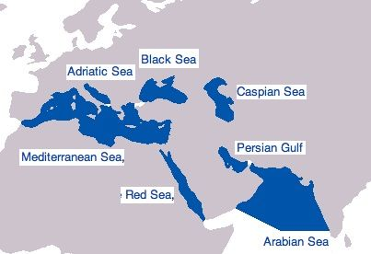
1
Seas
2
oceans

Slide 10
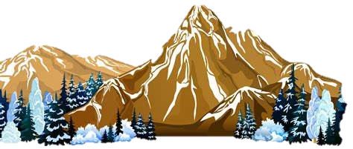

Mountains
3
4
Reviers

Slide 11

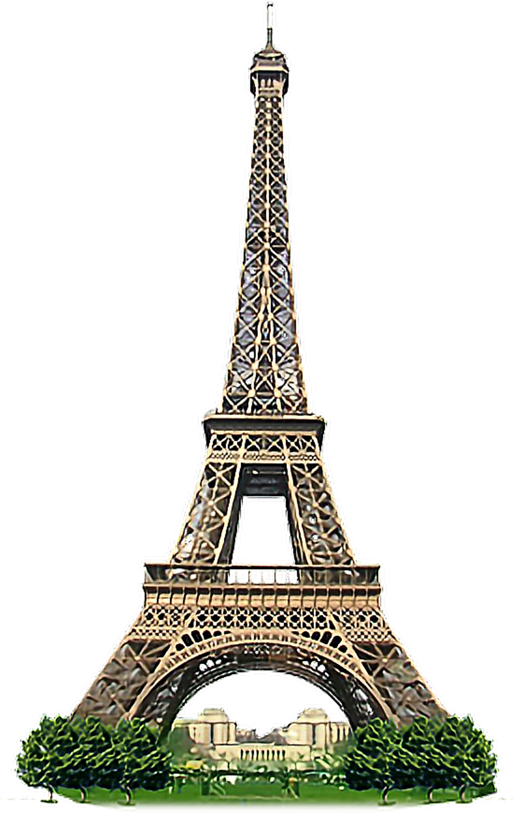
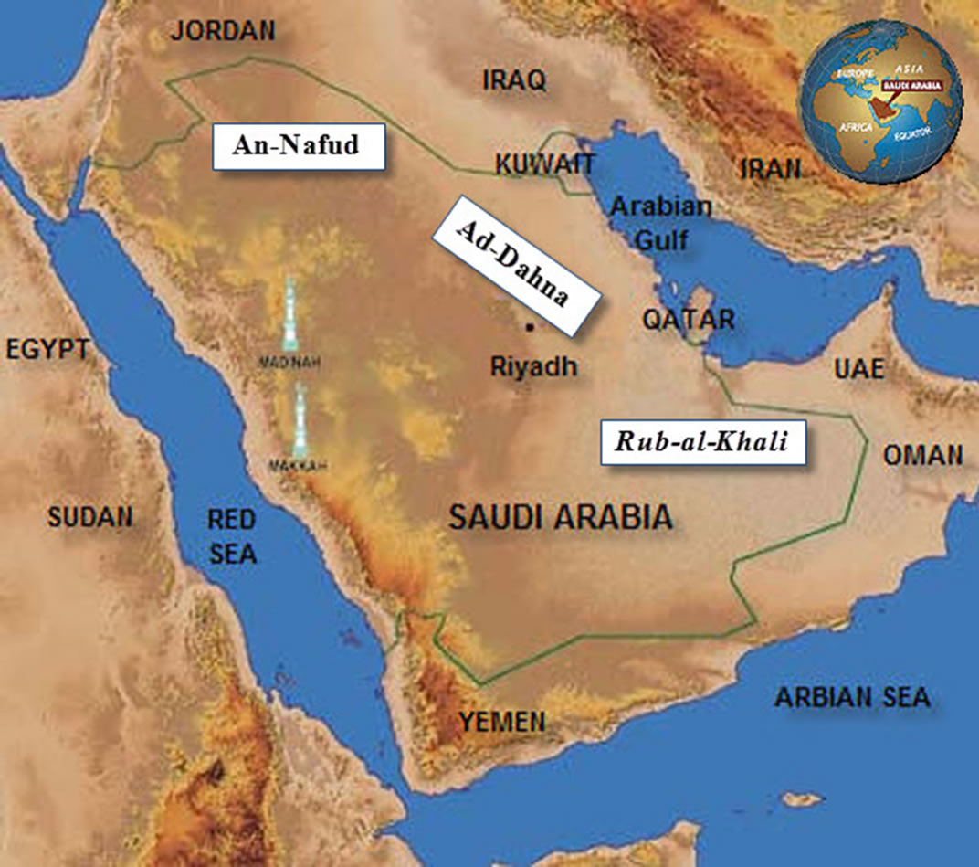
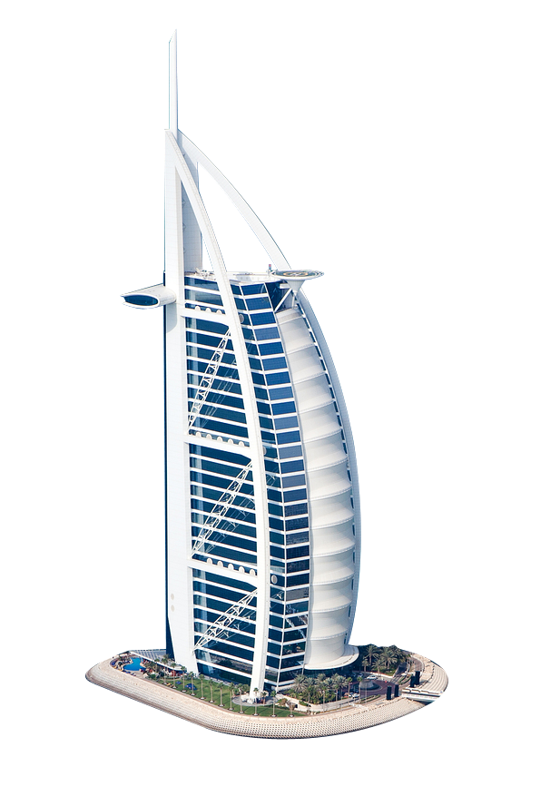
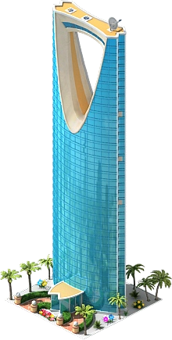
monuments
5
6
deserts

Slide 12

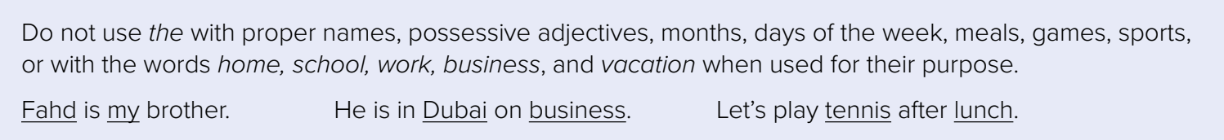

Slide 13


the
Games
Hide and seek
Proper names
Ahmad ,Dubai,Sara,Sony,Twitter
Months
September,October ,November
Days
Saturday,Sunday, Monday
Meals
Breakfast, lunch , dinner
sports
Football, jogging ,swimming ,hocky
T.BUSHRA ALSWAILEM

Slide 14
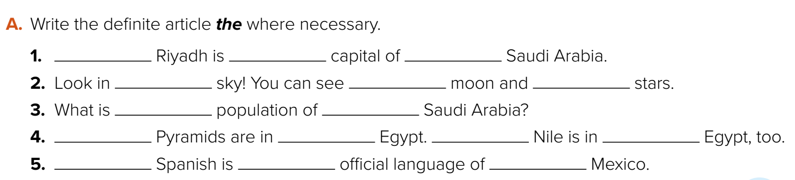
×
×
the
the
the
the
×
the
×
×
The
the
×
×
the

Slide 15
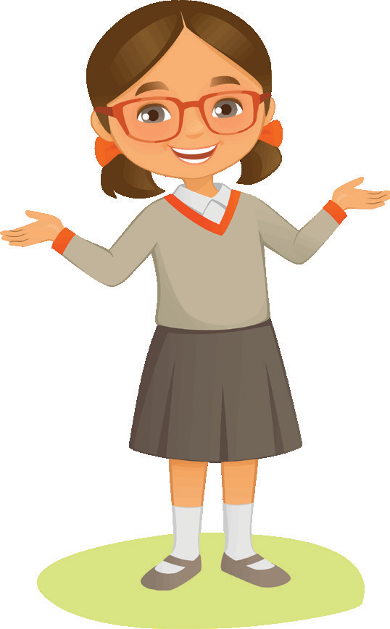
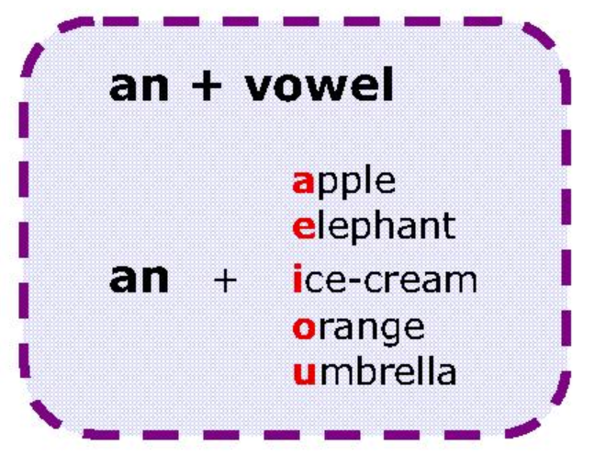
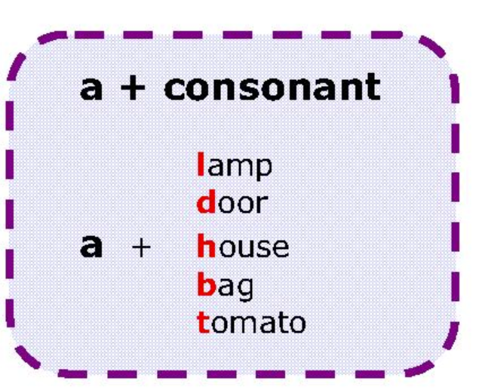
the article a, an
a
an

Slide 16
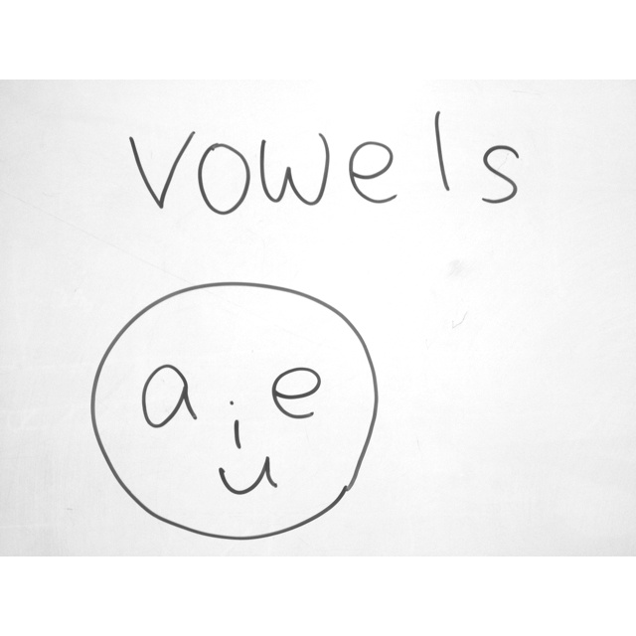
the article, an
an

Slide 17
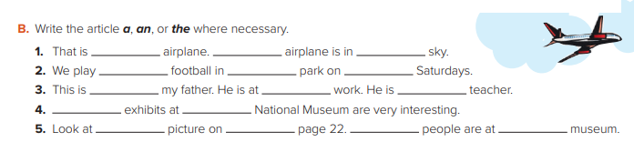
an
the
the
×
×
the
×
×
a
The
the
×
the
the
the

