Slide 1


Unit 5
Families, Families
Lesson 1

Slide 2
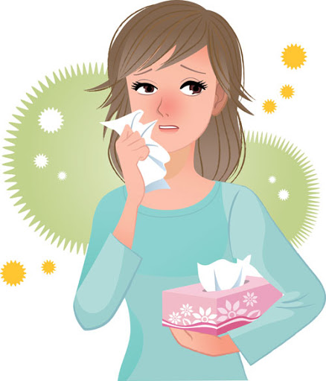
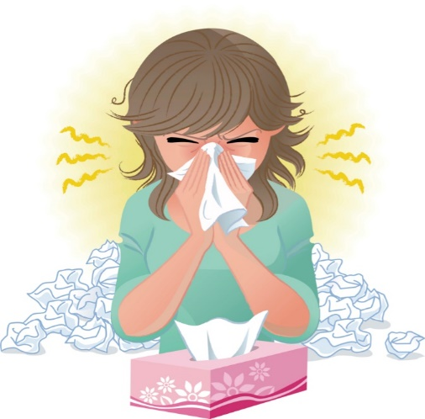
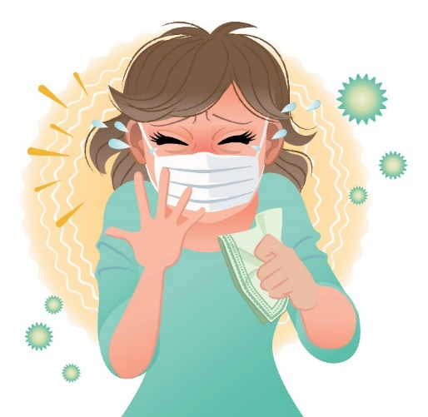
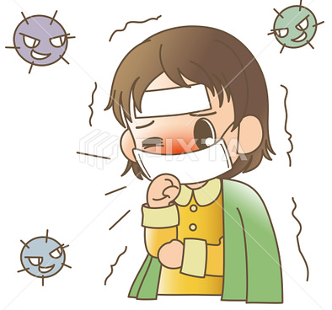
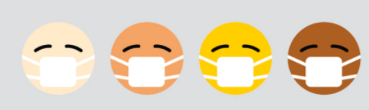
☺Avoid gathering !
Covid 19
☺wear a mask before going out.
☺Social distancing is not a choice, it is a must!
☺Keep a distance of 2 meters to avoid accountability
☺wash hands constantly.

Slide 3






Learning Objectives
identify family relationships
name family’s members
answer personal questions about their families
describe families correctly
praise the blessing of having a family.

Slide 4
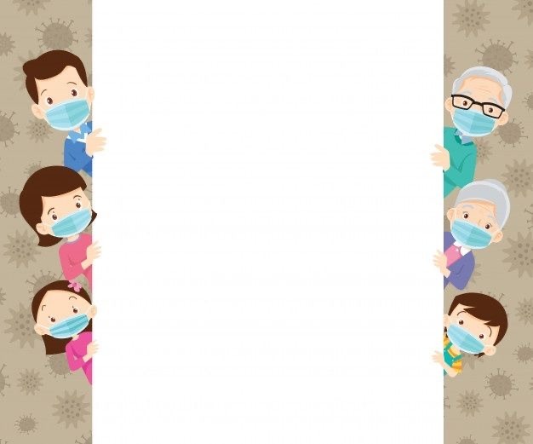
بسم الله الرحمن الرحيم
Day:
Date:

Slide 5
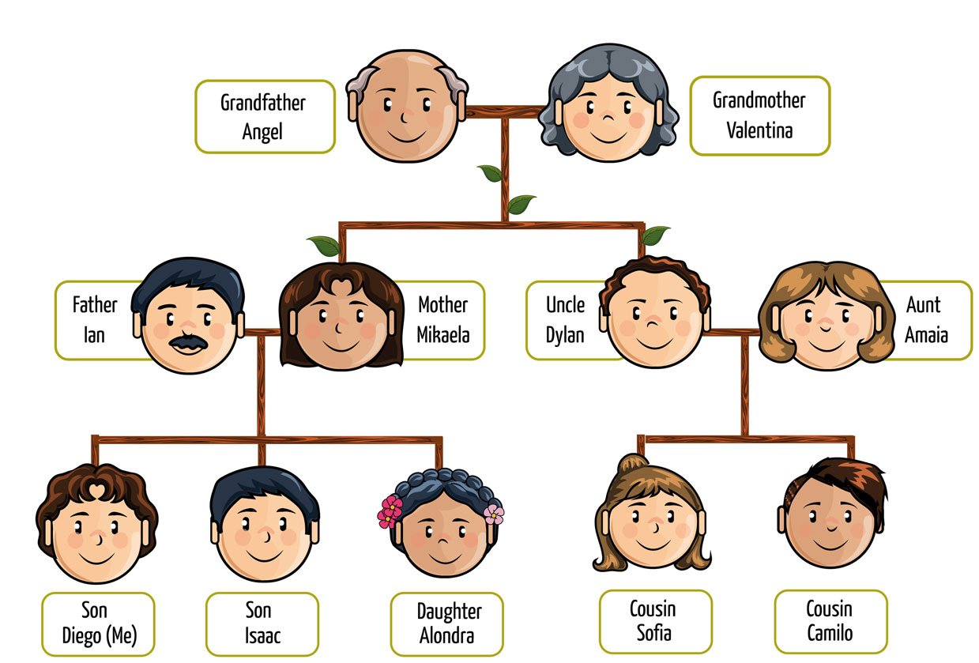

Slide 6


Slide 7

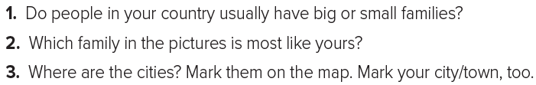
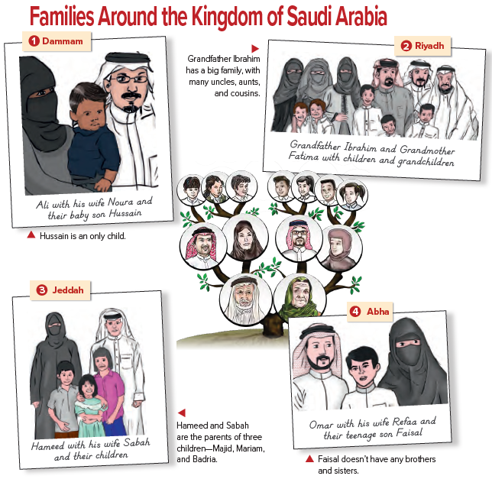

Slide 8


Slide 9
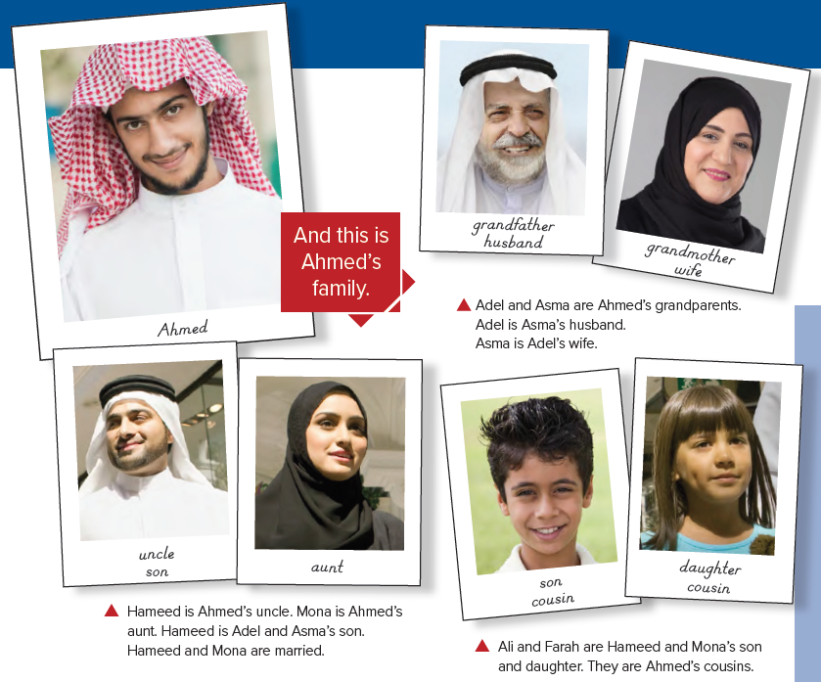

Slide 10
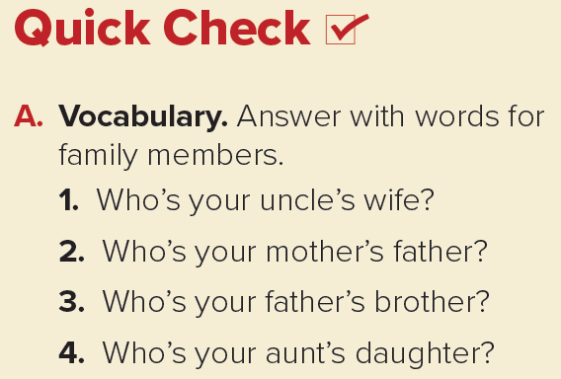
1. my aunt
2. my grandfather
3. my uncle
4. my cousin

Slide 11
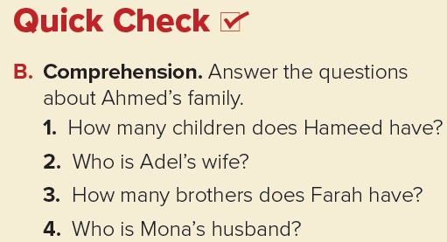
1. He has two children, a son and a daughter.
2. Adel’s wife is Asma.
3. Farah has one brother.
4. Mona’s husband is Hameed.

Slide 12
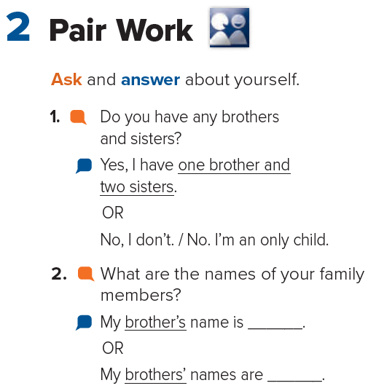

Slide 13
Homework
Page 107

Slide 14
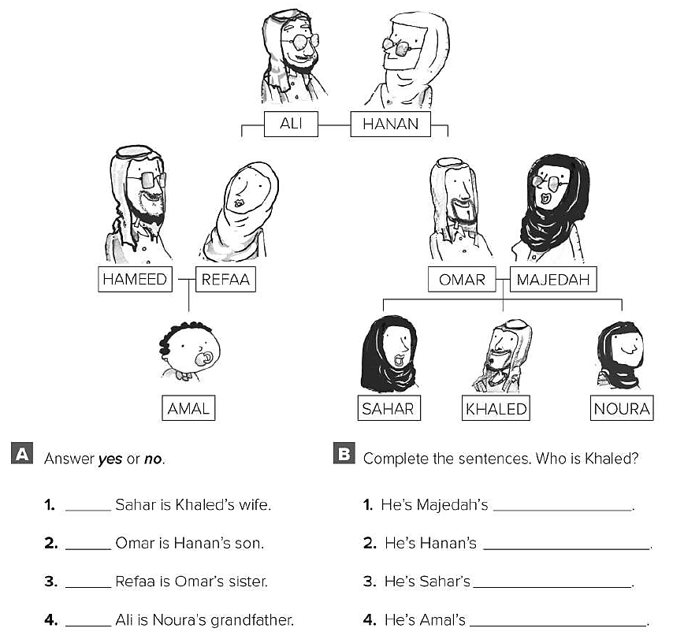
No
Yes
Yes
Yes
son
grandson
brother
cousin

Slide 15
