Slide 1

Unit 3
When Are You Travelling?
Grammar

Slide 2
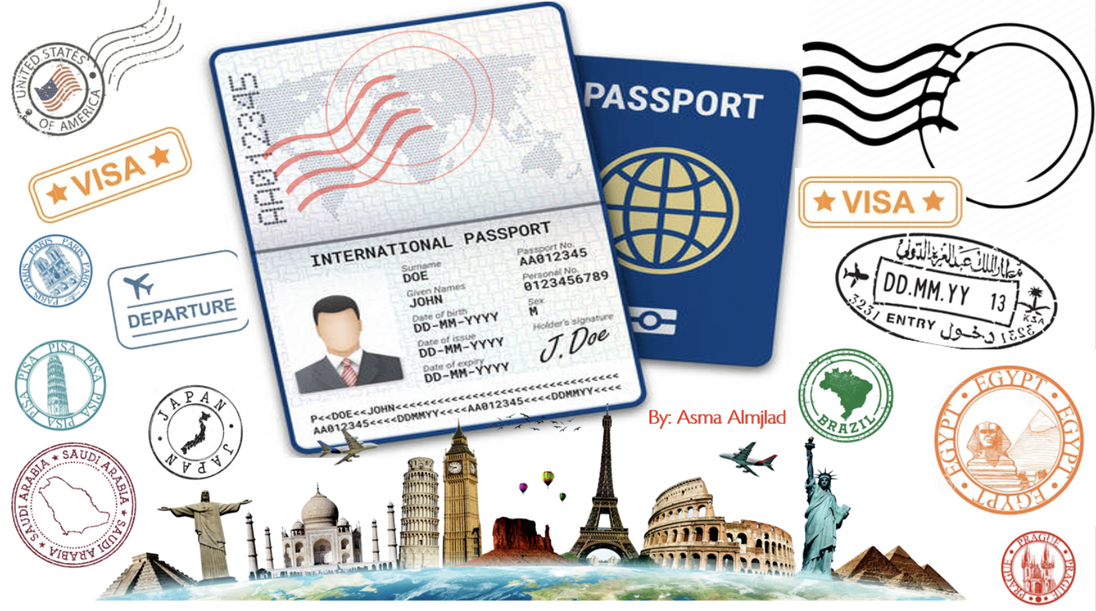

Slide 3
بسم الله الرحمن الرحيم
Day:
Date:

Slide 4


Learning Objectives
use the present progressive correctly
Use ( be + going to ) to talk about future plans
Formulate correct sentences with present progressive tense
Illustrate a reason with the infinitive
use infinitives to give reasons

Slide 5
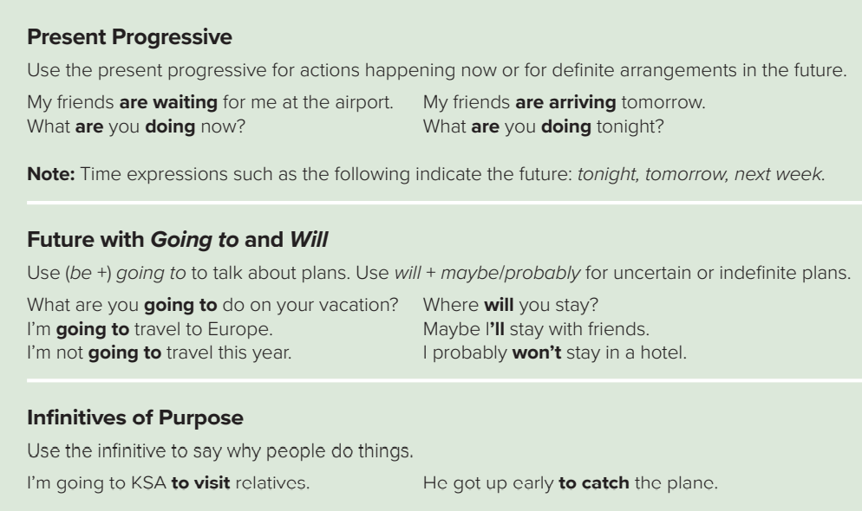
Page: 24 &25

Slide 6
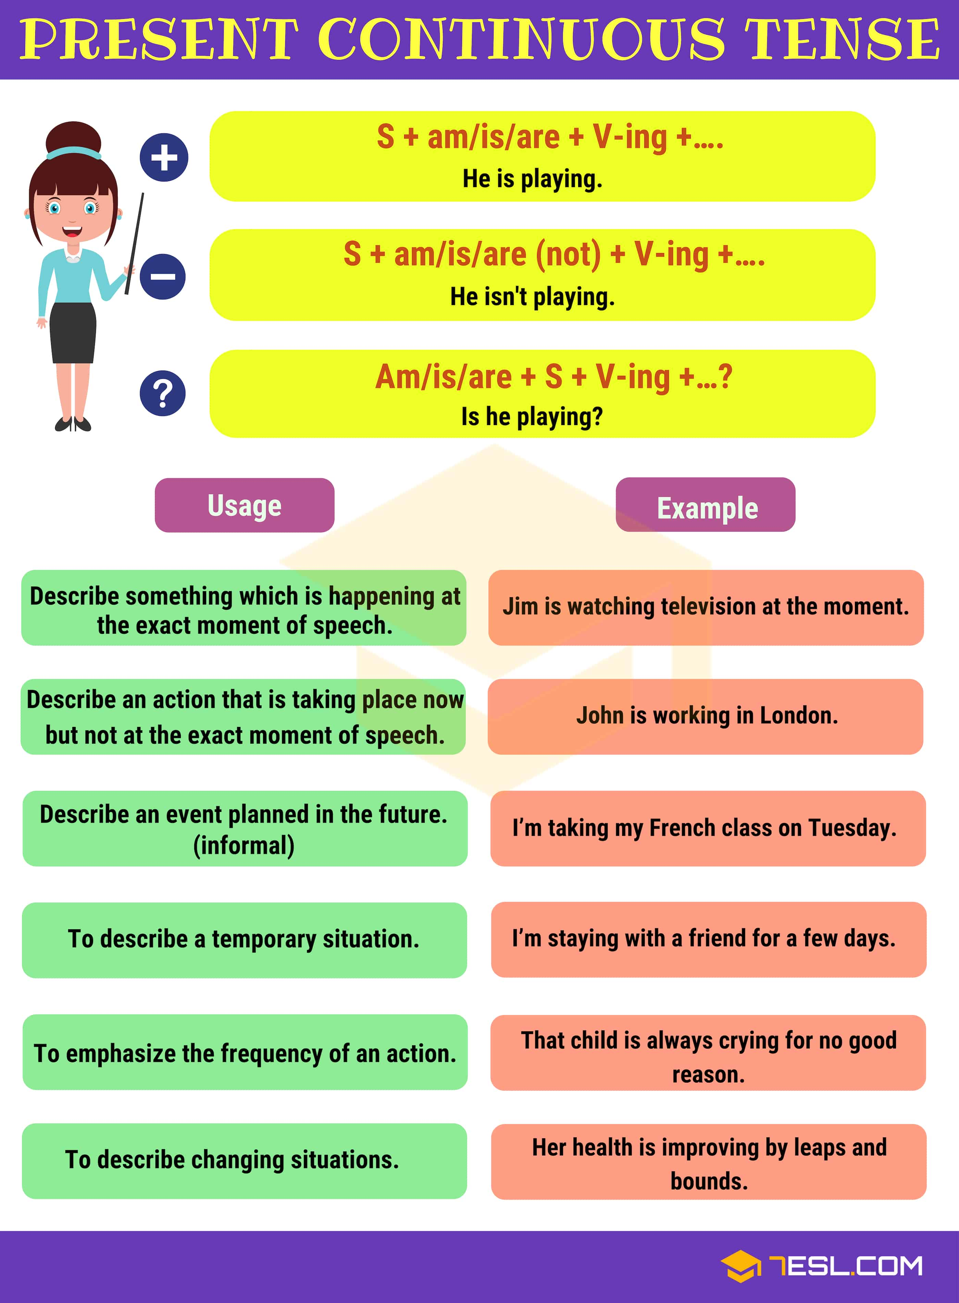

Slide 7

Let’s Practice

Slide 8
Page: 24 &25

Slide 9
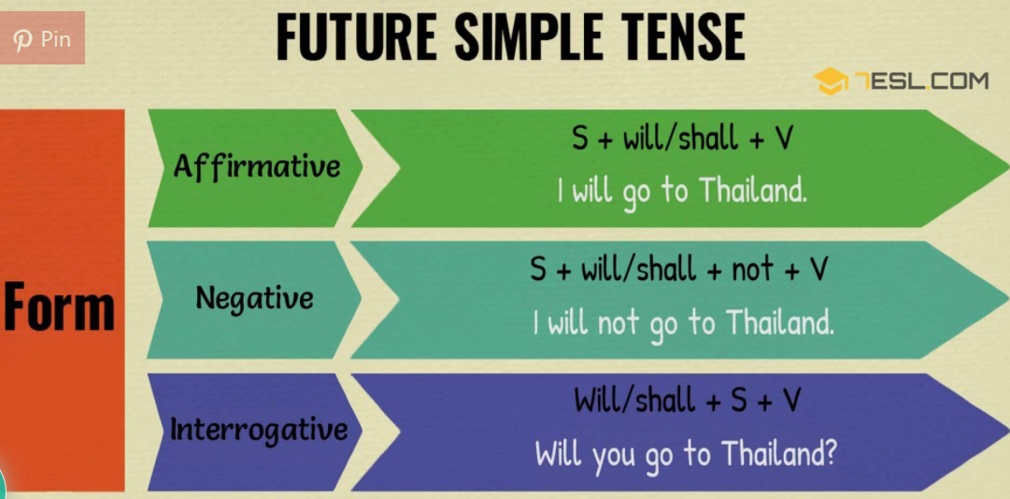

Slide 10
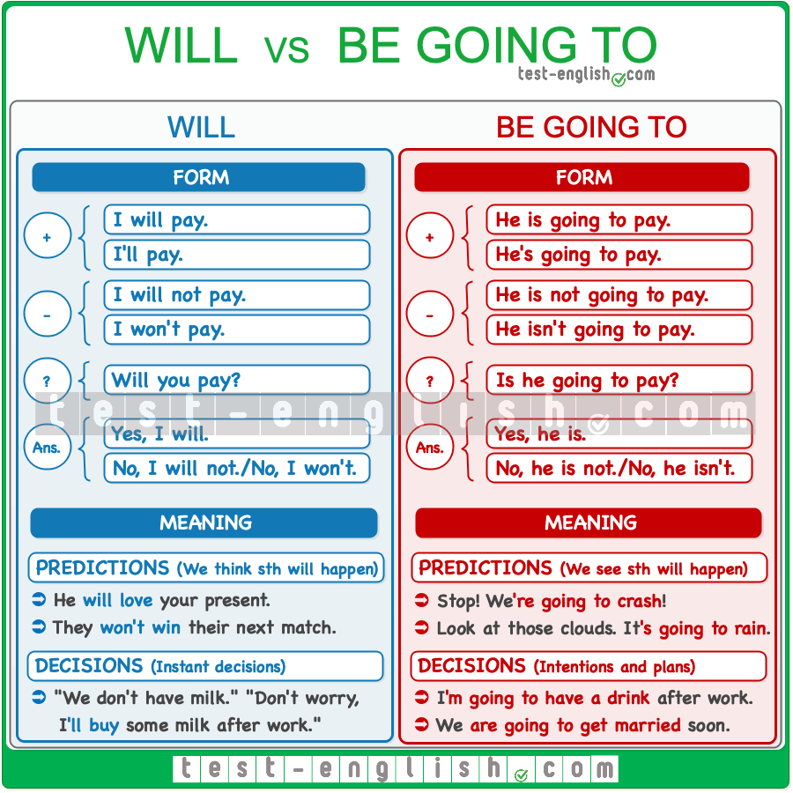

Slide 11

Let’s Practice

Slide 12
Page: 24 &25

Slide 13
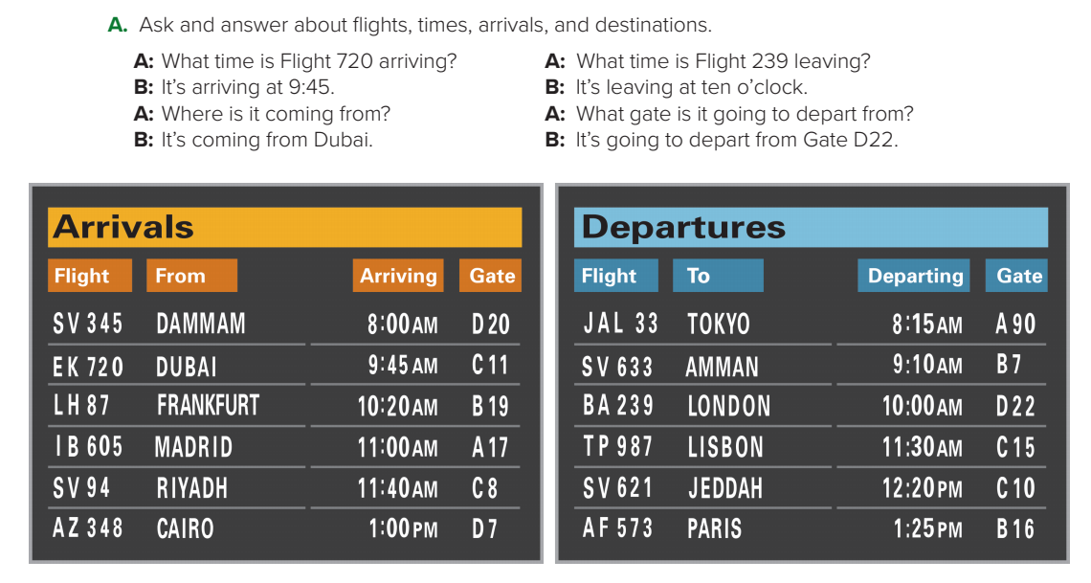
Sample:
A: Where is flight EK720 coming from?
B: It’s coming from DUBAI.
A: What time is it going to arrive?
B: It’s going to arrive at 9:45 a.m.

Slide 14
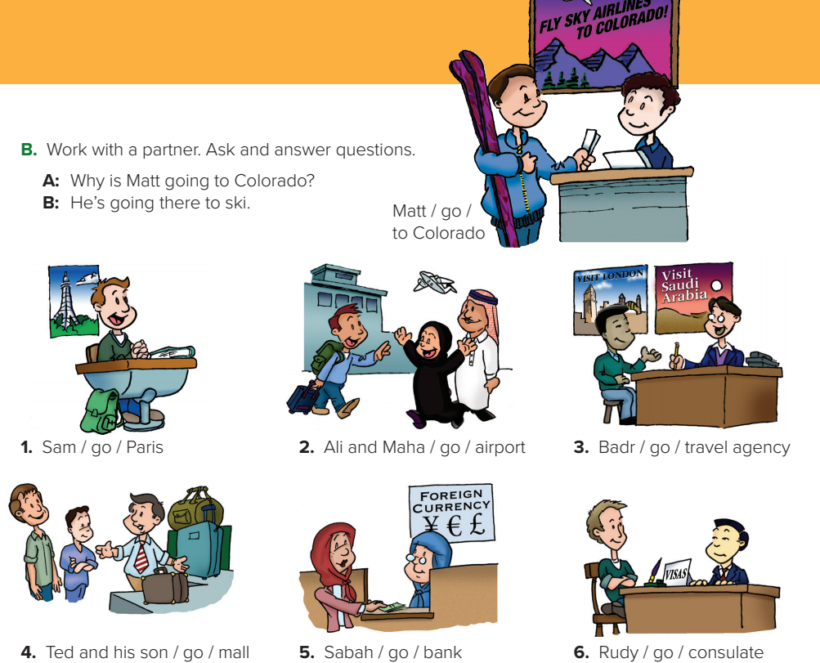
1.A: Why is Sam going to Paris?
B: He’s going to Paris to study French.
A: Why are Ali and Maha going to the airport?
B: They’re going to the airport to meet their son.
A: Why is Badr going to the travel agency?
B He’s going to the travel agency to plan a trip.

Slide 15
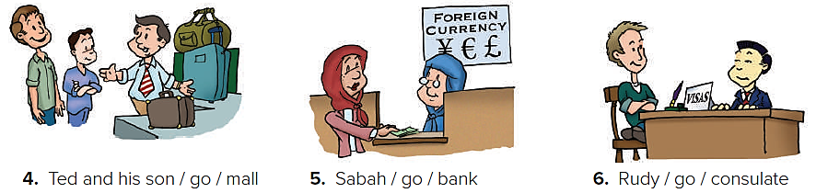
A: Why are Ted and his son going to the mall?
B: They’re going to the mall to buy a suitcase.
A Why is Sabah going to the bank?
B: She’s going to the bank to get foreign currency.
A Why is Rudy going to the consulate?
B: He’s going to the consulate to get a visa.

Slide 16
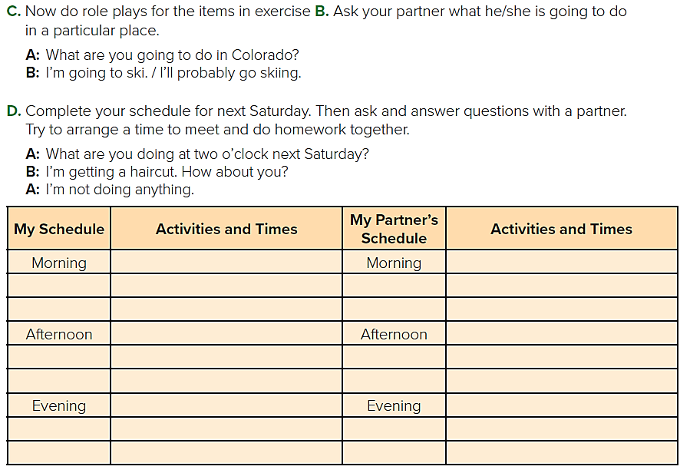
Sample answers
go to the gym at 9:00 a.m.
go to the dentist at 10:15 a.m.
Clean my room
Go shopping

Slide 17

Homework
Workbook
Page 180
( SINGLE LARGE HEADER )

Slide 18
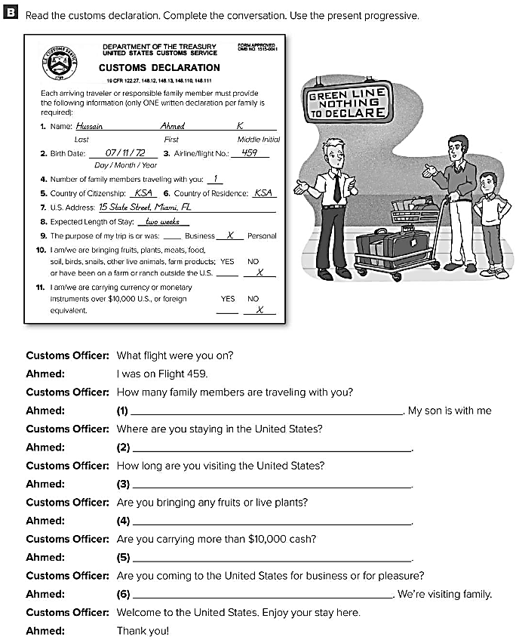
only one
We’re staying in Miami , Florida .
About two weeks .
No , I’m not .
No , I’m not .
We’re coming for pleasure

