Slide 1

Mega Goal 1.1
Unit 2 GAME
Careers
By: Essa Al Hussaini

Slide 2
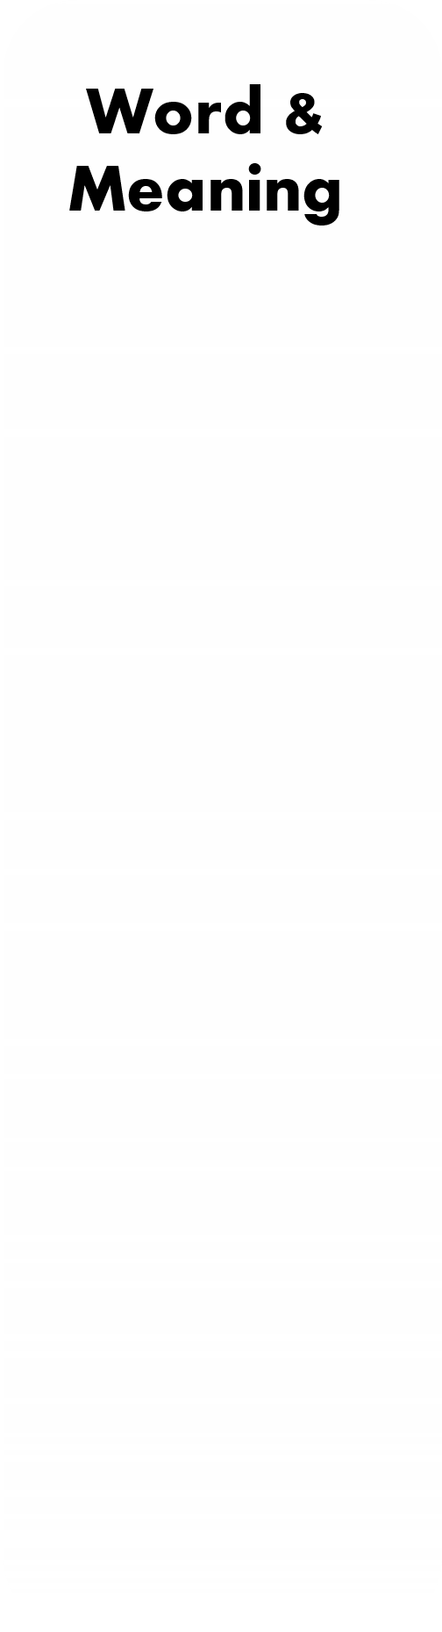
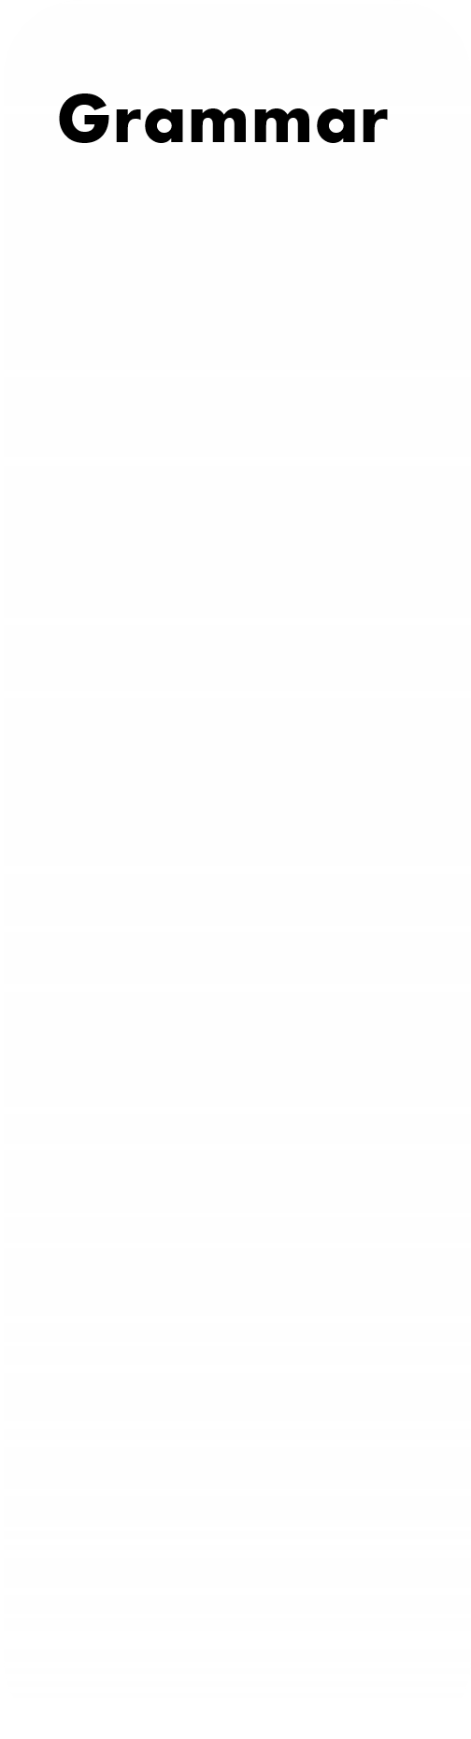
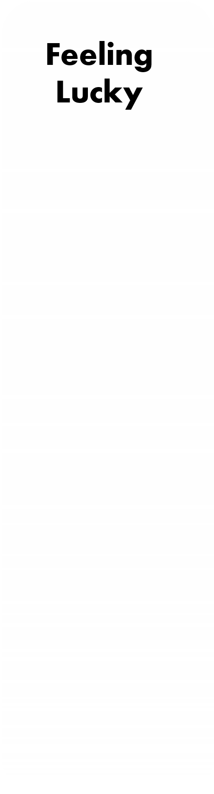

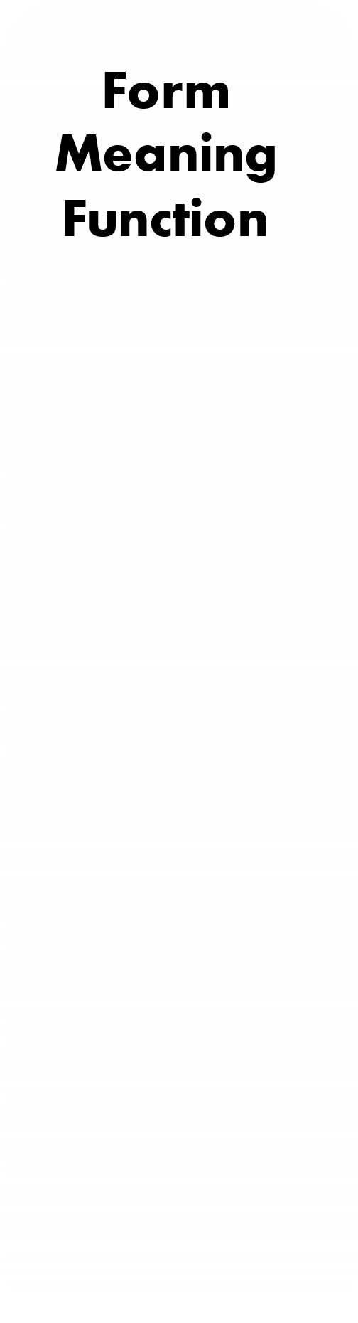

U2
Careers
1
1
1
1
1
2
2
2
2
2
3
3
3
3
3
4
4
4
4
4
5
5
5
5
5

Slide 3


the opposite of "confident" is
sociable
doubtless
uncertain

Slide 4

Oops!!
WRONG
ability to use time and space wisely
ability to solve problems
Computer skills mean
ability to use technology

Slide 5
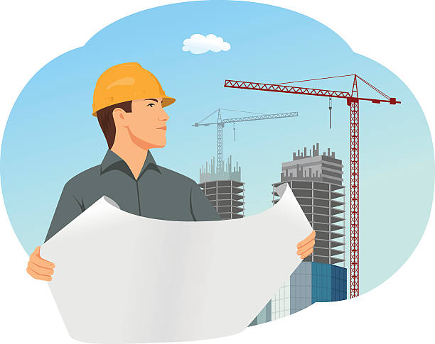

The environmental engineer
needs to be able to read ____________.
blueprints
bluetooth
blue magazine

Slide 6
Oops!!
WRONG
Oops!!
WRONG
ability to get along with people
Analytical skills mean
ability to solve problems
ability to write and speak clearly

Slide 7
To be a TV reporter, you must be friendly and outgoing.
patient
hardworking
sociable

Slide 8

You are good at _________ cars.
repairing
repair
repairs

Slide 9
Ali is _________ reading novels.
interested at
interested in
good in

Slide 10
Nora (read) ______ a book for two hours.
has been reading
have been reading
has reading

Slide 11
I (write) _________ 30 pages.
have been writing
have wrote
have written

Slide 12

Where
lessons has she explained?
Oops!!
WRONG
When
have you been playing football?
How many
do they work?
- They work for a restaurant.
How long

Slide 13

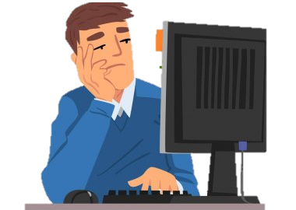
It’s the same thing day after day.
I’m ________. I need to change the routine.
luckily
bored to death
very excited

Slide 14
Cross out the odd word
intelligent
confident
organized
résumé

Slide 15
Cross out the odd word
sculptor
job profile
TV host
designer

Slide 16
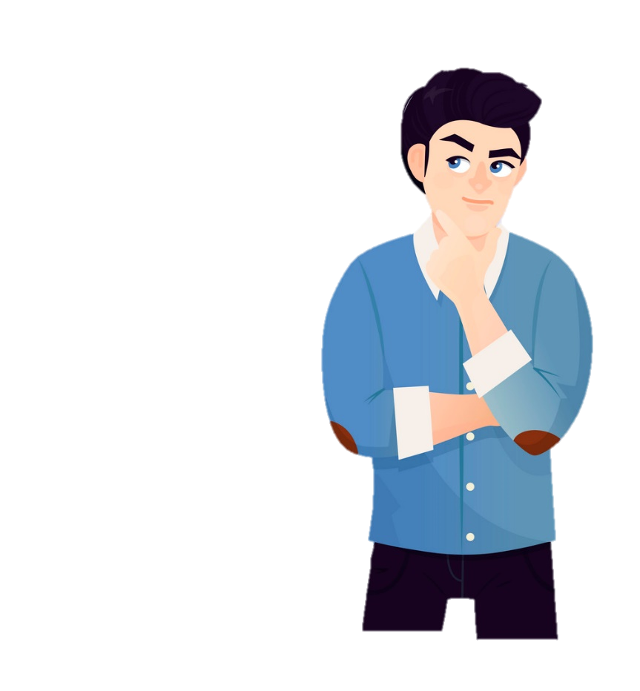
When I was little I used to go to the park ______________ .
bored to death
talk me out of it
day in and day out

Slide 17
a dedicated and enthusiastic professional
Qualification
Oops!!
WRONG
Quality
five successful years in PR in large corporations
Jobs
Experience
Bachelor’s Degree
Master’s Degree

Slide 18

reporter
watch repairer
dentist
are examples of _____________ .
jobs
quality
experience

Slide 19
Khaled has different __________ . He is organized, reliable good at using computer.
degrees
qualities
qualifications

Slide 20
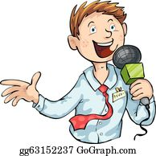
A _____________should be interested in following news events.
TV guest
TV host
journalist

Slide 21
Our interns research information about ______ (exciting) topic.
hot
boring
unwanted

Slide 22
Sara has been working at the bank since (training time) ________ . She gets a lot of satisfaction.
graduation
internship
three month

Slide 23

Jinan _____ (work) at the hospital from Sunday to Thursday.
work
work’s
works

Slide 24
Correct
Ali not visits his brother on the weekend.
doesn’t visits
doesn’t visit
didn’t visits

Slide 25
I saw the man who bought your car.
The underlined word is
a relative pronoun
a question word
a preposition of time

Slide 26
Identify the incorrect use of relative pronouns
The new driver that started work yesterday is very quiet.
The new driver who started work yesterday is very quiet.
The new driver which started work yesterday is very quiet.
1
2
3

Slide 27


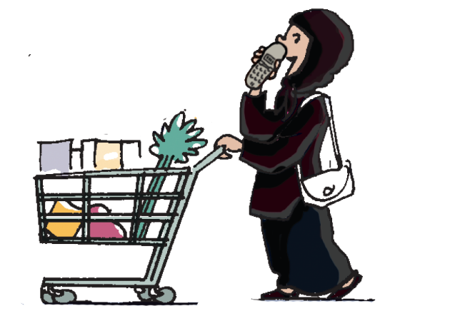
The baby (cry) ________ while Jinan (talk) _________ on the phone
was crying
was talk
was crying
was talking
were crying
was talking

