Slide 1
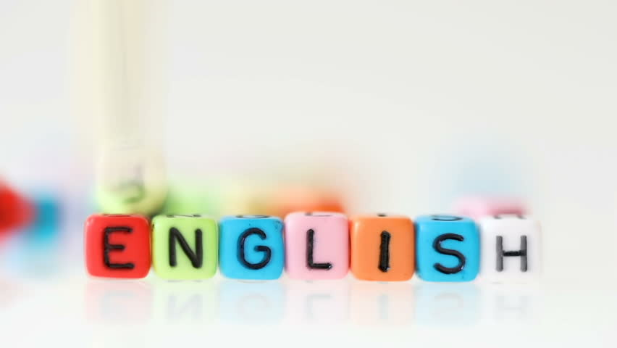

Super goal 1
Unit 2
Lesson 2 Grammar+ listening+ pronunciation
اعداد المعلم / يحيى المنقري متوسطة المأمون بالهفوف

Slide 2

Learning Objectives
*By the end of this lesson, Ss will be able to:
1- use plural possessive adjectives .
2- use IN/ON with dates .
3-make questions using WHAT/WHEN/HOW OLD .

Slide 3
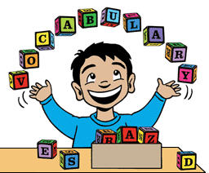

Slide 4
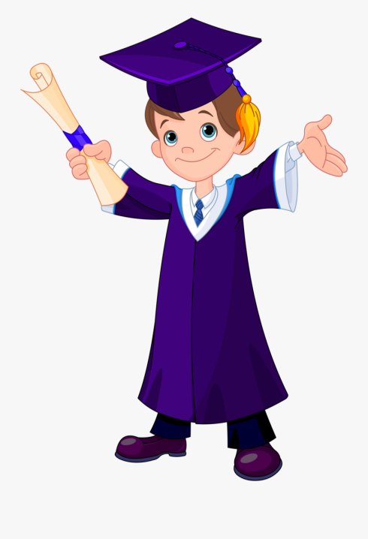
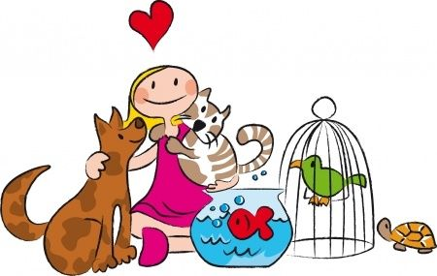
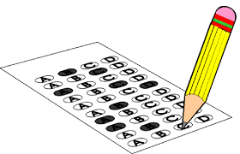


test
Graduation
pet

Slide 5
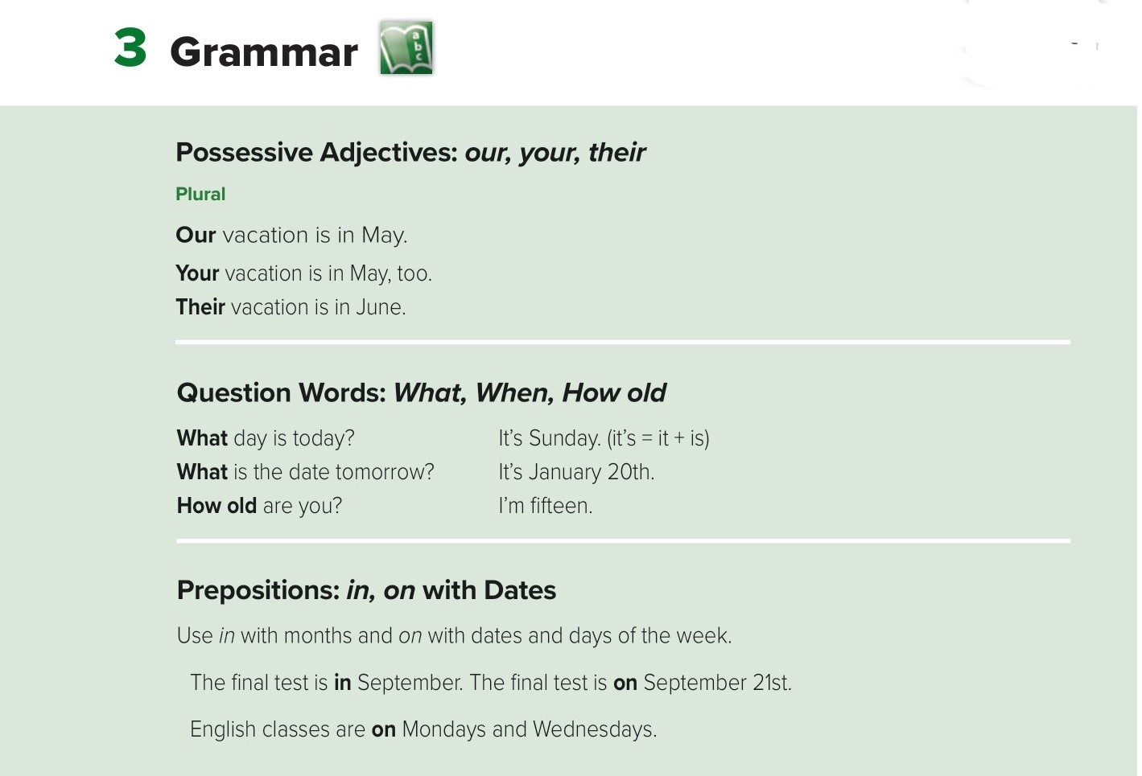
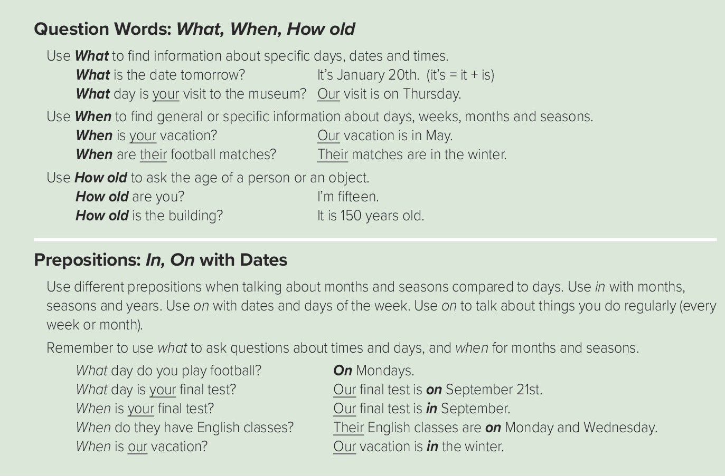
In
+
( Months or years)
on
( Days or dates )
+

Slide 6
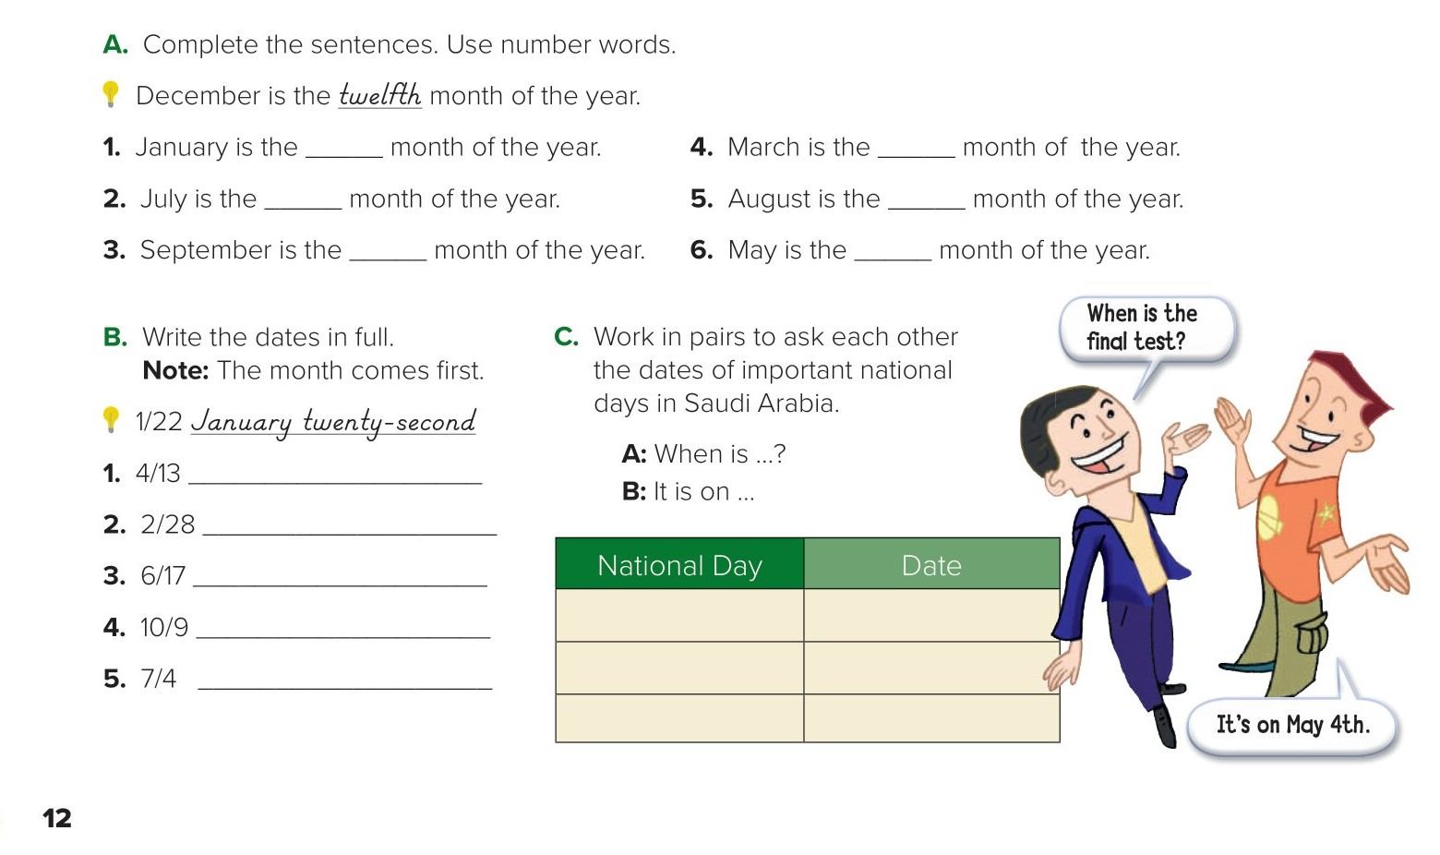
first
third
seventh
eighth
ninth
fifth
national day ?
April thirteenth.
28/11
February twenty-eighth
June seventeenth.
October ninth.
July fourth.

Slide 7
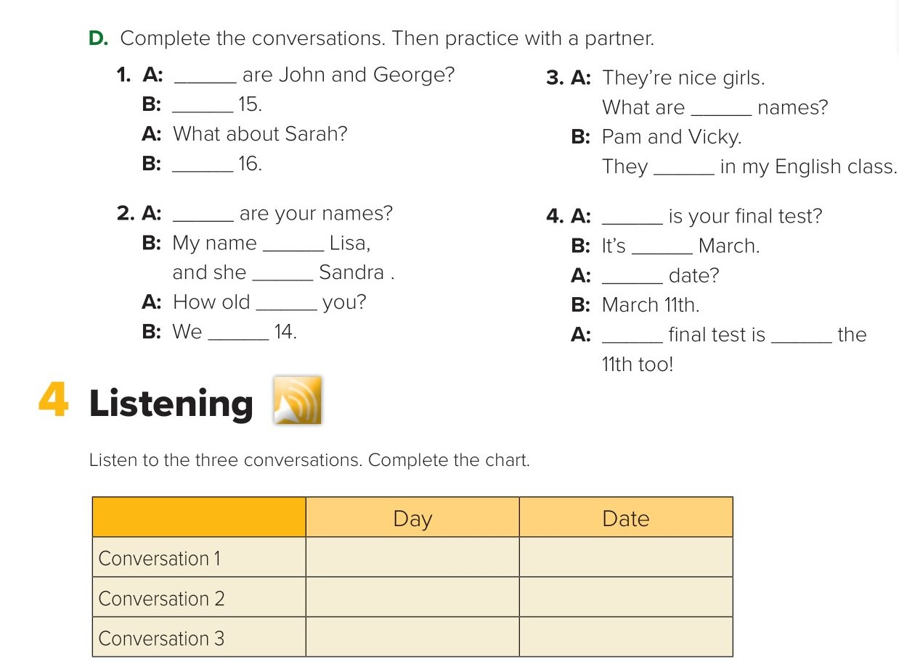
How old
They are
their
She is
are
What
When
is
in
is
What
are
are
My
on
Monday
June first.
Friday
January fourteenth.
Friday
June tenth.

Slide 8
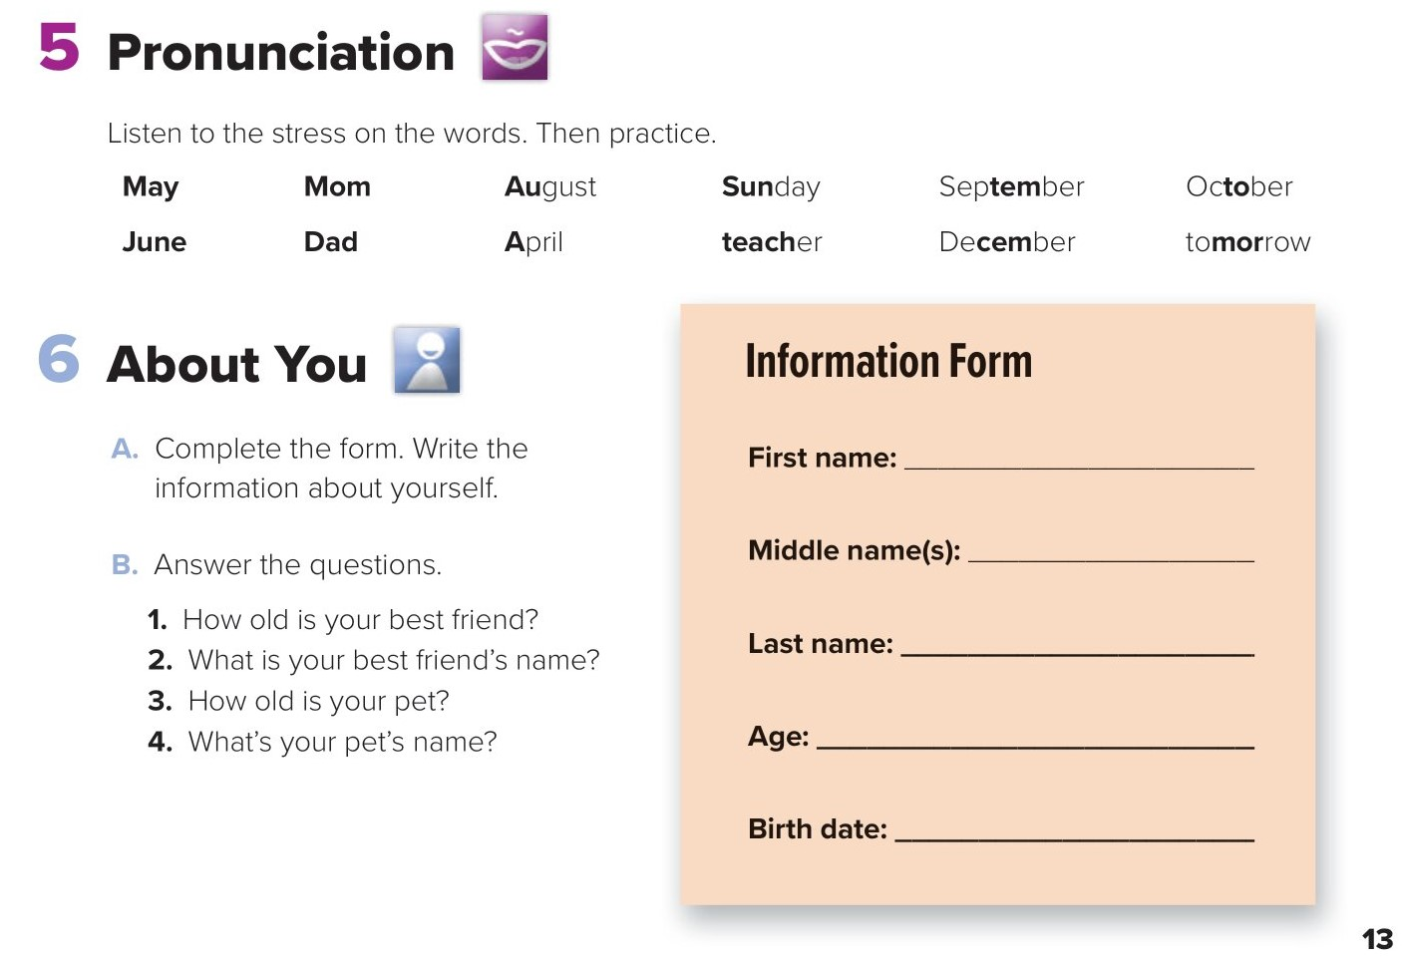
Thamer
Rashed
She is twelve.
Al-Osayme
Rinad
2 years
Nim-nim
thirteen
2/06/2007

Slide 9
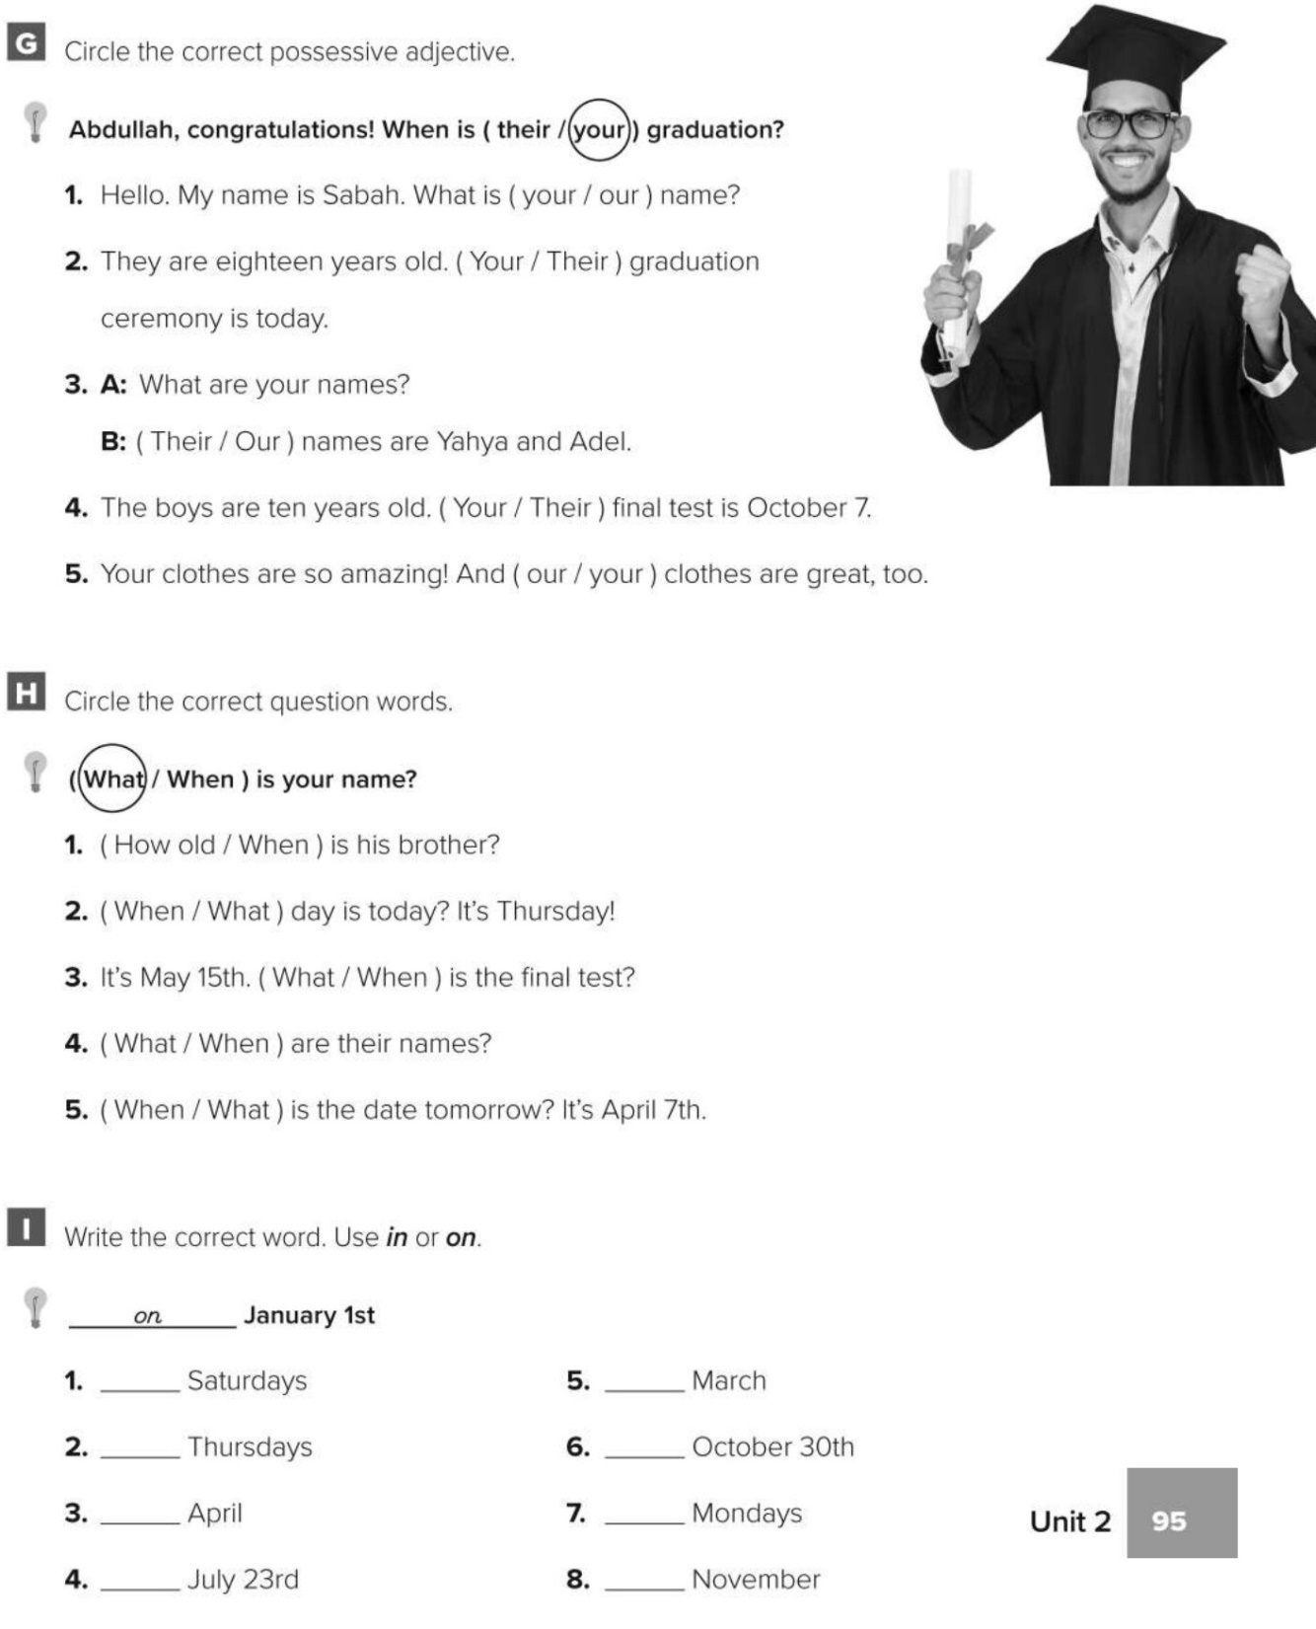

on
in
on
on
in
on
on
in

Slide 10

Choose the correct answer :
1-
English class is ….. Monday
in
on
2-
These are ……….. books
we
our
3-
4-
Graduation
pet
test
test

Slide 11


Slide 12


Back

Slide 13


Back

