Slide 1

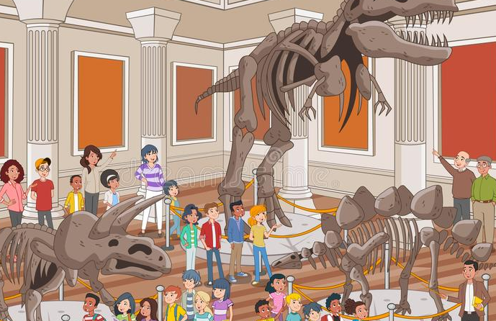
Super Goal 1
Unit 3
Lesson 1
Listen and discuss (18)
What’s That?
Done by: T. Haya B.

Slide 2



Check Homework

Slide 3


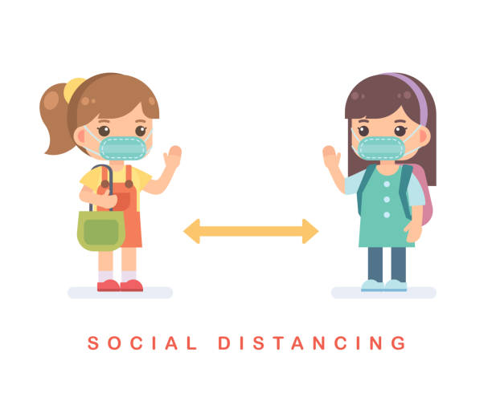
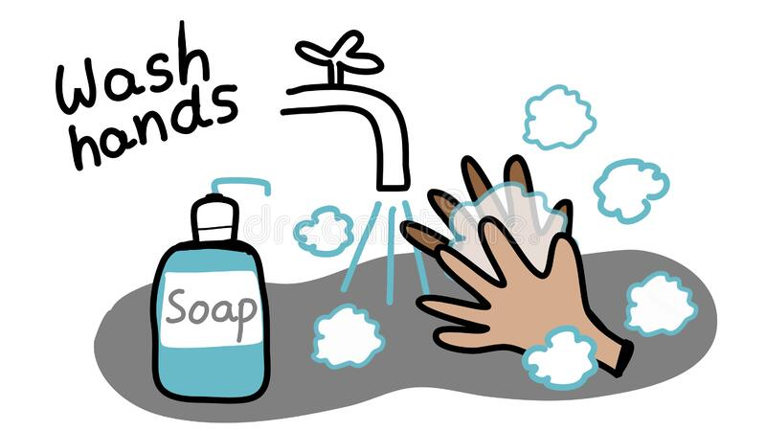

Rules of the classroom
1- avoid gathering.
2- we must wear mask.
3- social distancing is not a choice , it is a must.
4- Wash hands.
5- If you want to answer or ask, please, raise your hand

Slide 4

National day ( Revision )
https://im-a-puzzle.com/ - /play?&ref=user/unit_2_what_day_is_it_today__3urnamp5k&difficulty=3&mode=13

Slide 5
Objectives:
1- listen to the objects.
2- identify the old objects.
3- distinguish between This and Those.
4- answer the question.

Slide 6

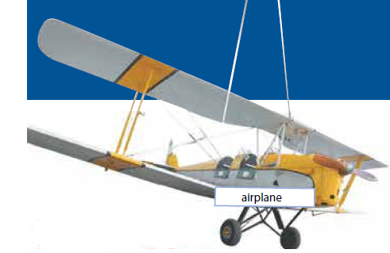
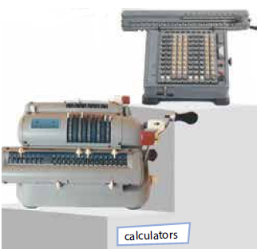
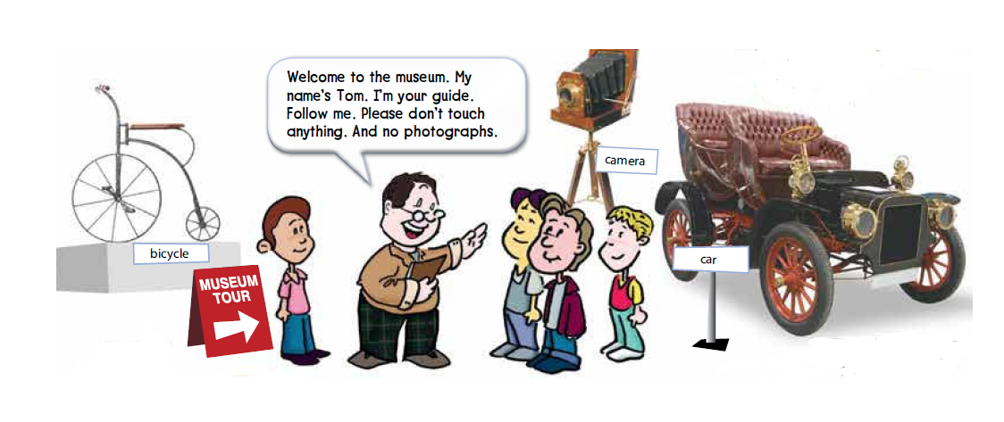
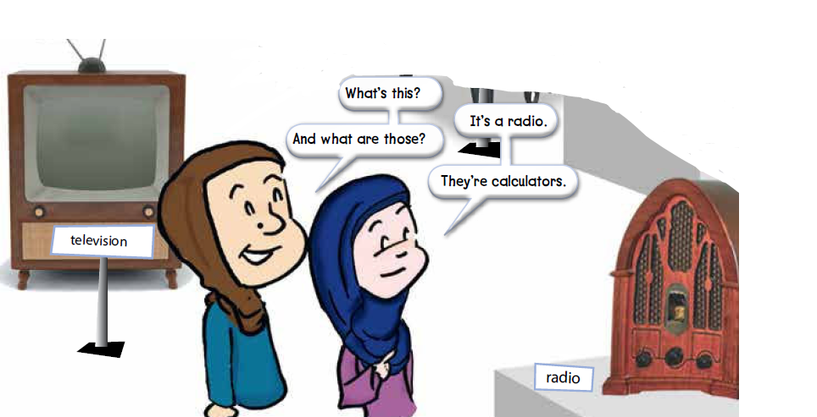
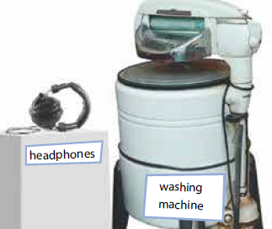
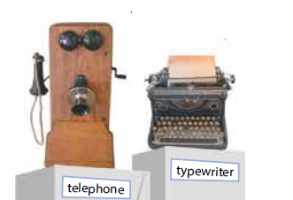
Warm up:
18
Which words do you already know?
Are these objects old or new ?
old
Where are they?
museum

Slide 7


Listen and Discuss:
18
listen and point to each object as you hear the word.

Slide 8
Listen and Discuss:
Where are they?
18
What is the guide’s name?

Slide 9

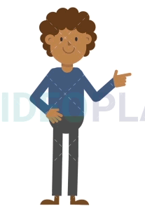

Listen and Discuss:
18
That / This / These / Those
This is a ball
These are balls
That is a ball
Those are balls

Slide 10
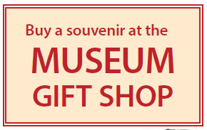

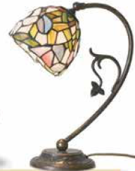
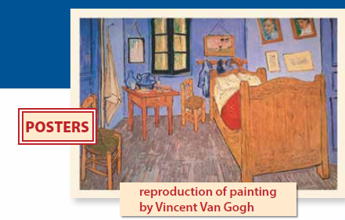
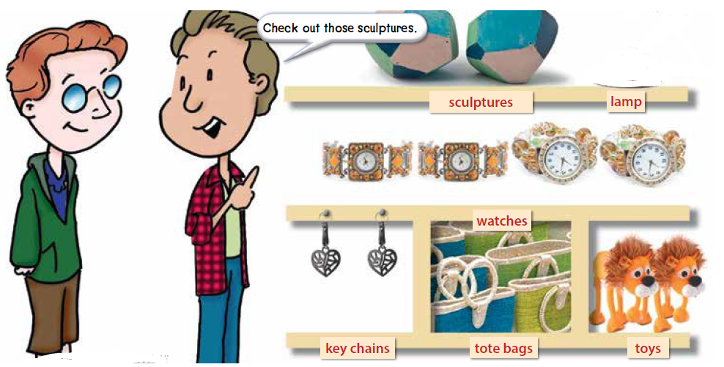
Listen and Discuss:
19
listen and point to each object as you hear the word.
A thing that is kept as a reminder of person or place.
Where do see these objects?
At the museum gift shop

Slide 11
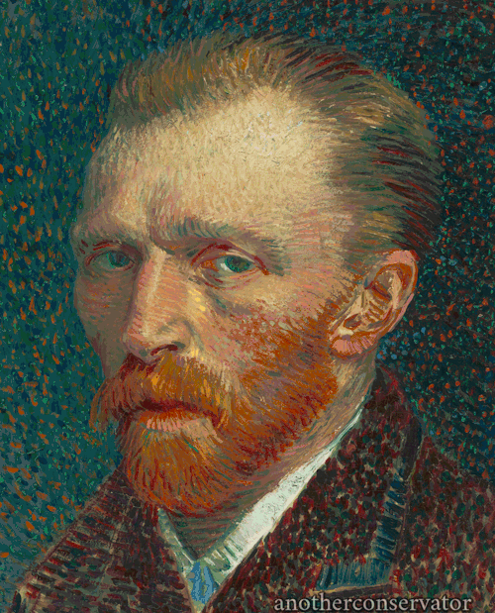
Listen and Discuss:
19
listen and point to each object as you hear the word.
A thing that is kept as a reminder of person or place.
The original painting by Van Gogh shown on this page is titled Bedroom at Arles.
Van Gogh

Slide 12
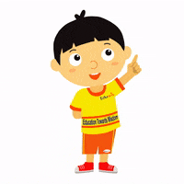

New words:-
19
souvenir
A thing that is kept as a reminder of person or place.
toy
Check out
Something children play with
An informal expression that means look at

Slide 13

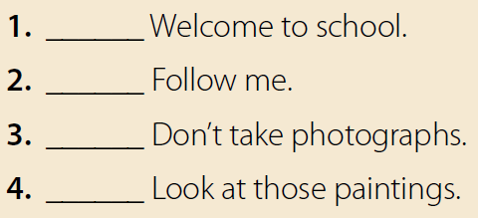
Quick Check:
19
no
yes
yes
no

Slide 14
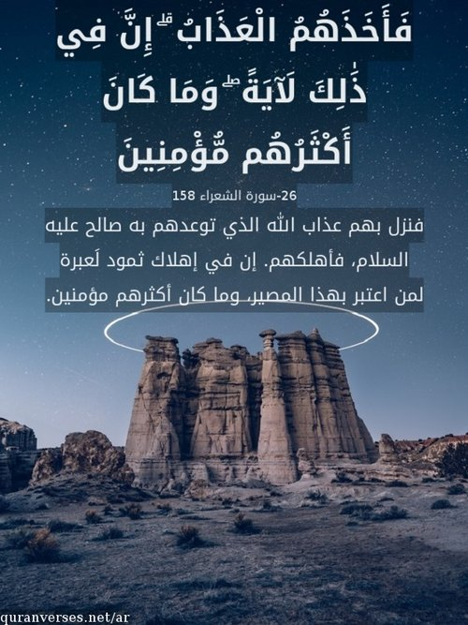
Religious aim:
مدائن صالح

Slide 15

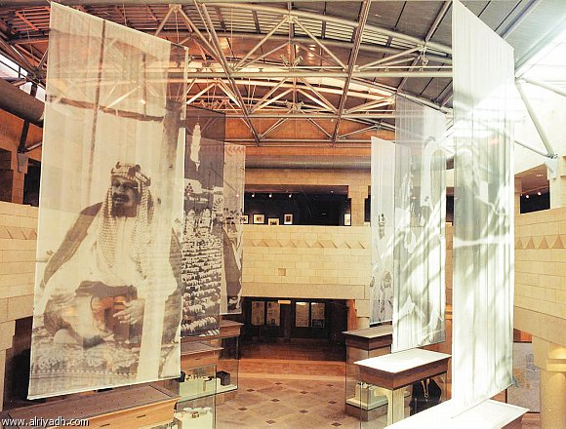
patriotic aim:
King Abdul-Aziz museum

Slide 16

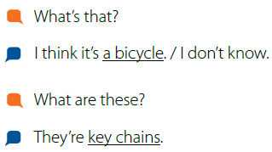
Pair work:
19

Slide 17

Task:
Name some old objects
in the museum.

Slide 18
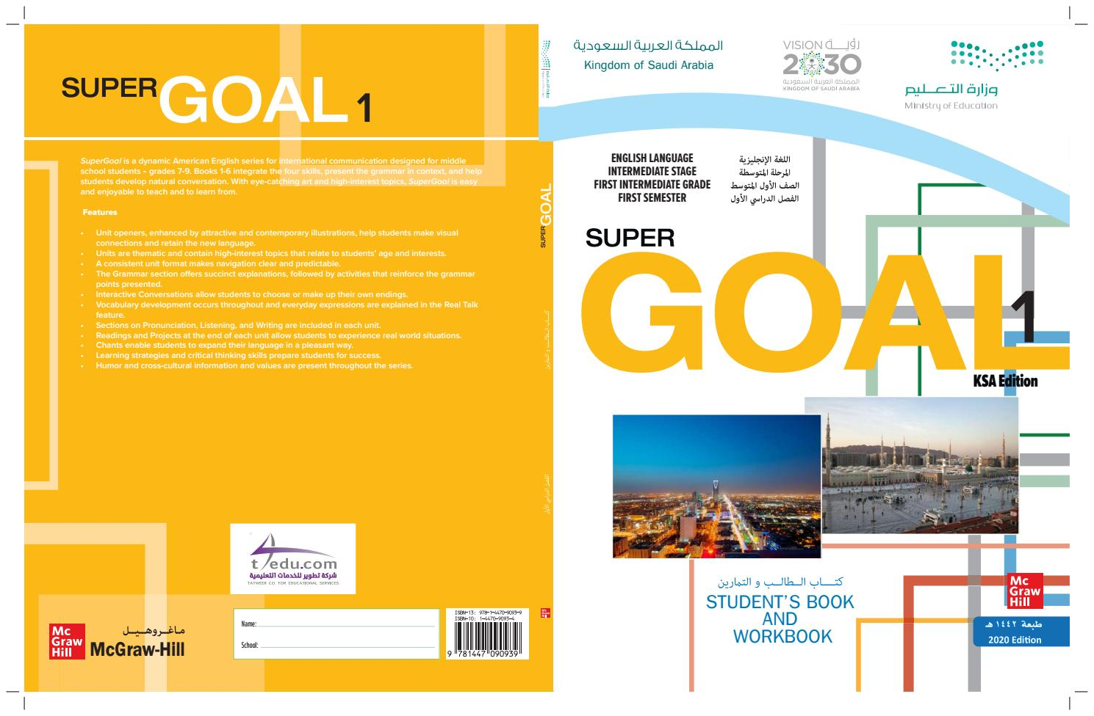
Home work:
On page 97 ( A )

Slide 19


