Slide 1


Where are you from?
How old are
you?
SPIN
What’s your
friend’s name?
How do you spell
Your name?
How are you today?
tekhnologic
Notes:
5 Segments

Slide 2
Revision
https://wordwall.net/ar/resource/4725836
GREEN

Slide 3


GREEN

Slide 4

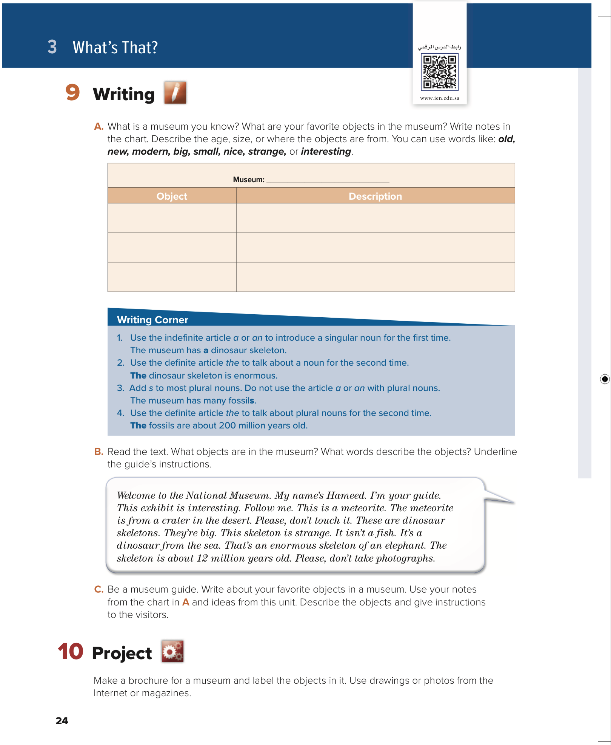
What’s That?
Unit 3
Page 24

Slide 5

Objectives:
use the definite article
use adjectives to describe museums.
read to find specific information

Slide 6

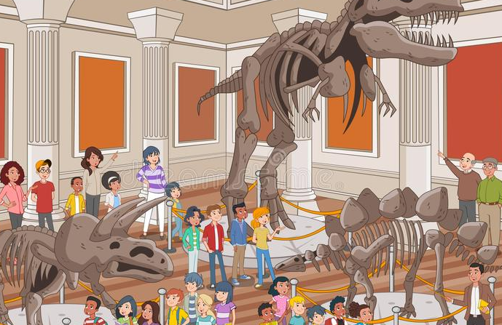
A museum

Slide 7
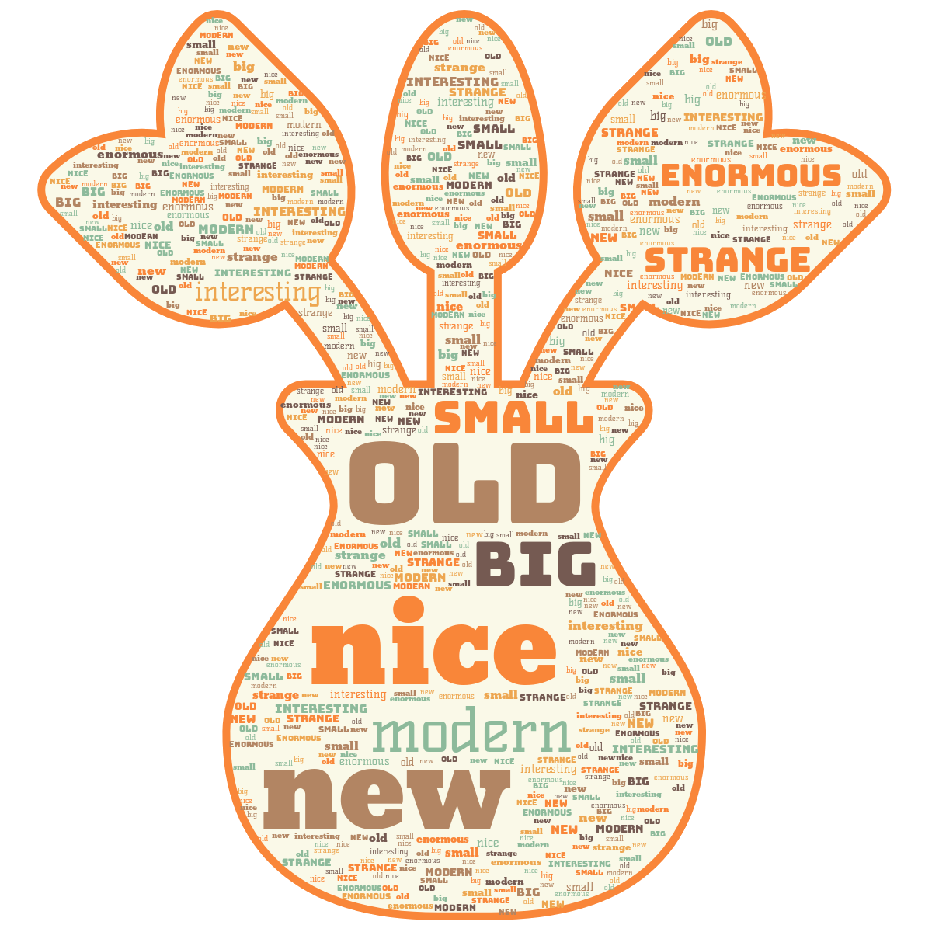

Slide 8
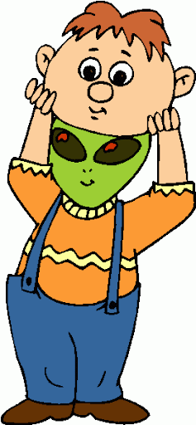
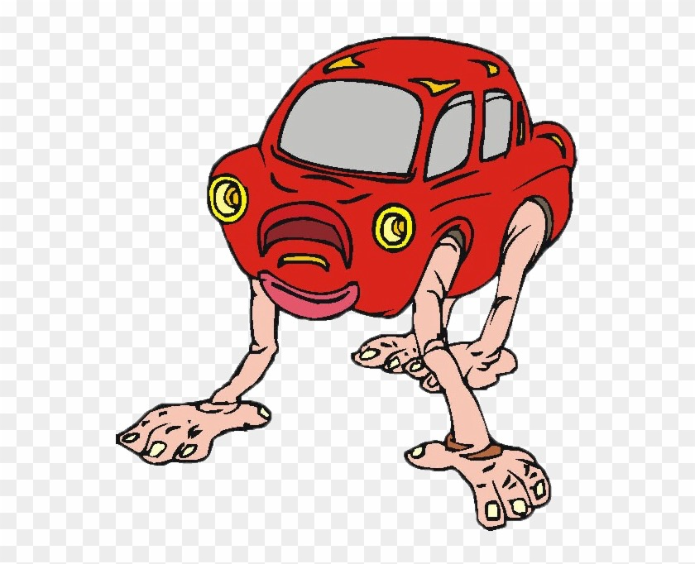

Interesting
Strange

Slide 9

Modern

Slide 10
Warm up
Adjectives - Quiz (wordwall.net)
GREEN

Slide 11


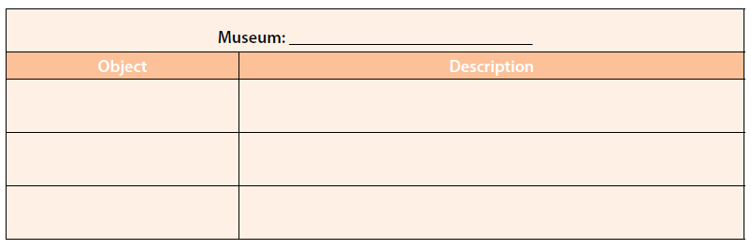
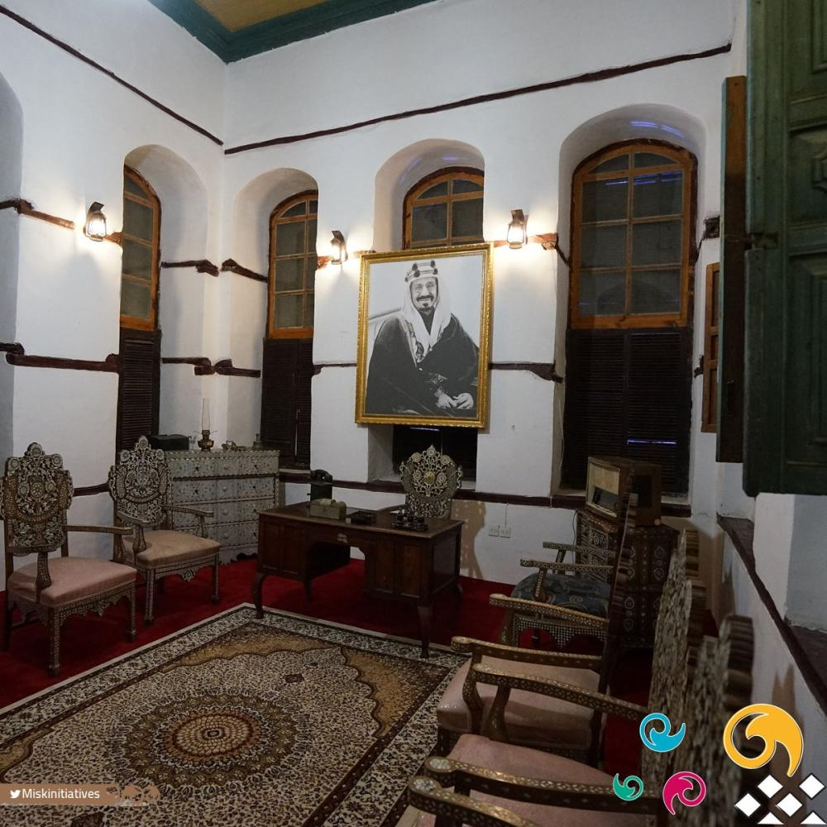
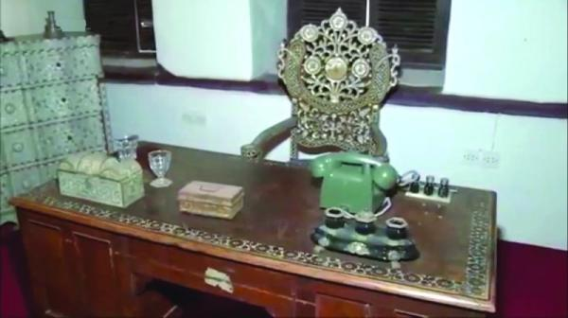
24
https://www.urtrips.com/jeddah-museums/
Bayt Nasseef
They are beautiful.
photos
telephone
It is old.

Slide 12
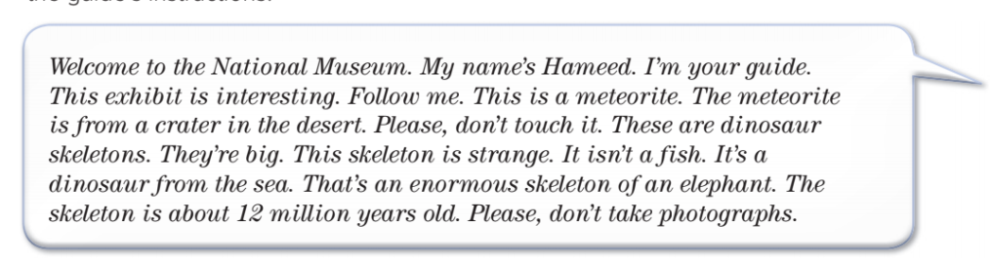
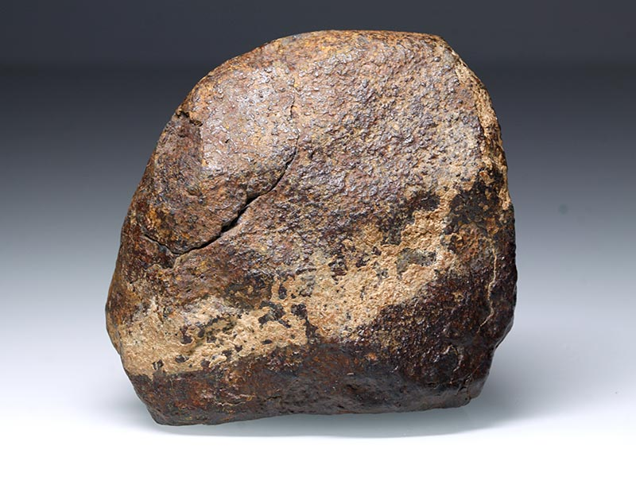
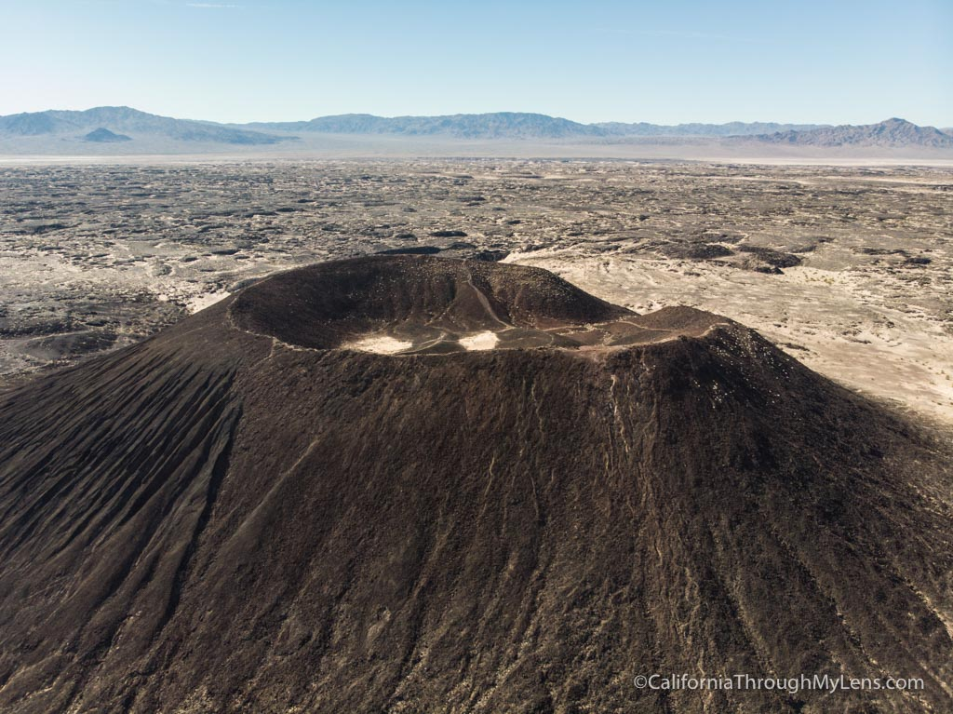
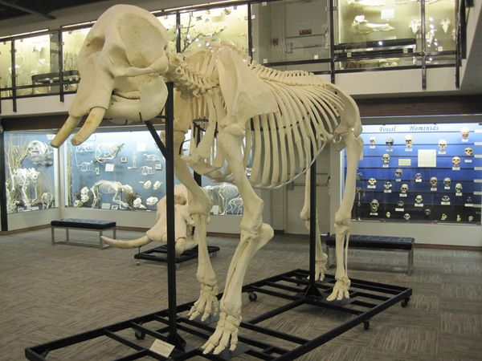
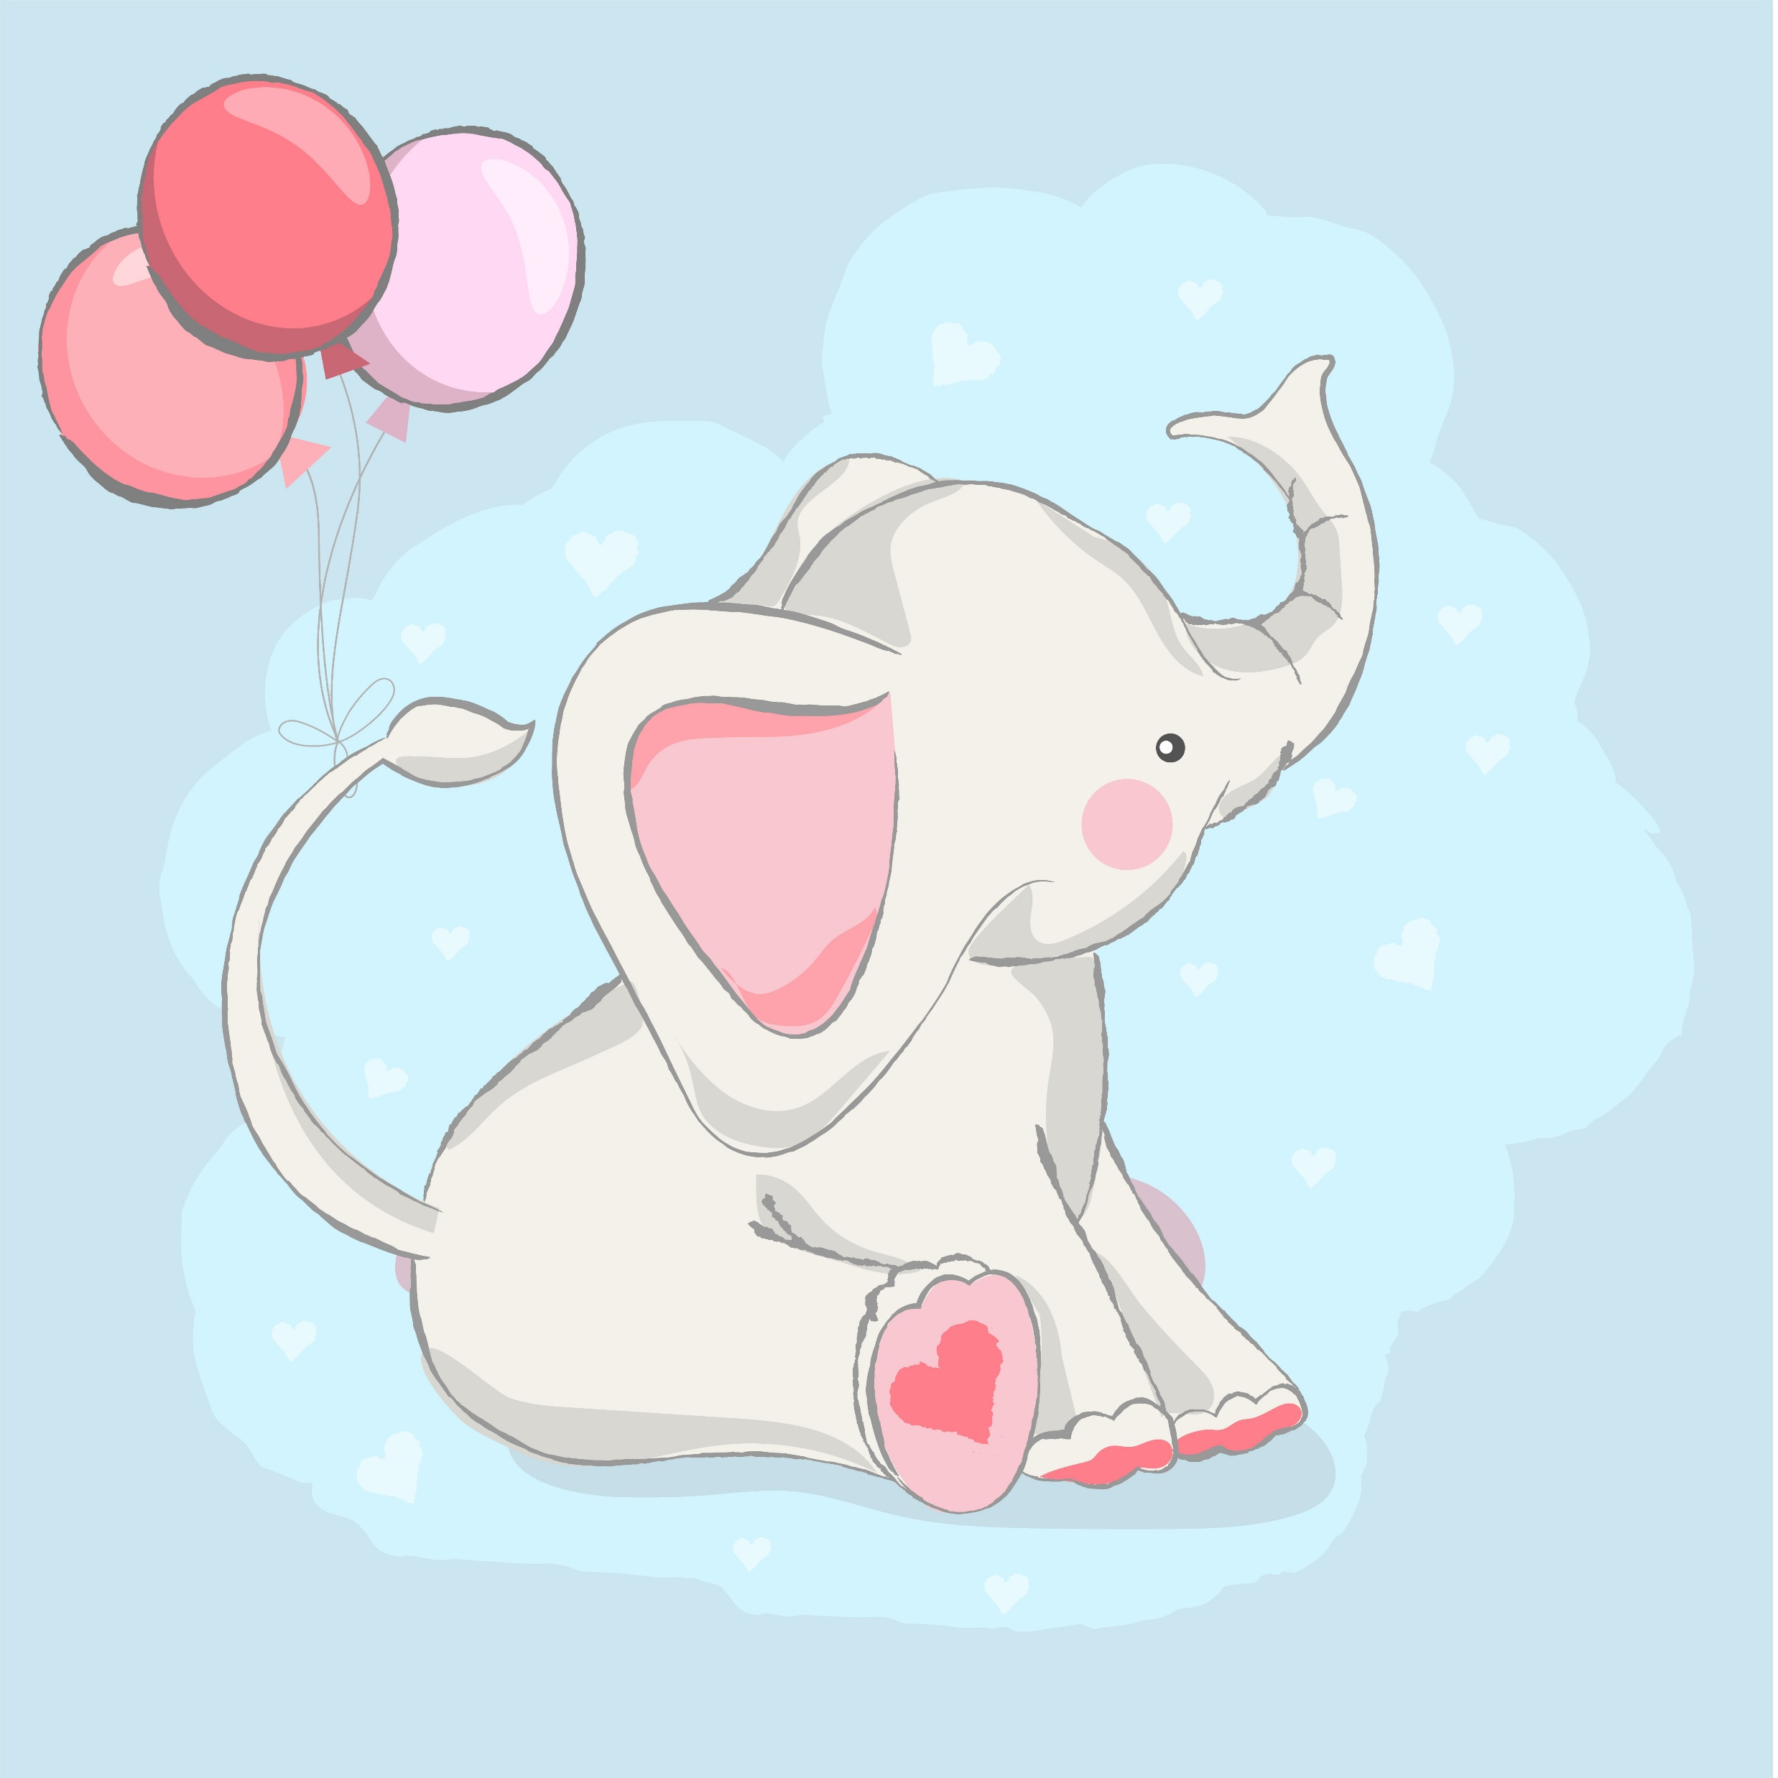
What is the name of the museum?
24
Who is Hameed?
Where is the meteorite from?
Are the dinosaurs’ skeleton big?
How old is the skeleton of the elephant?

Slide 13
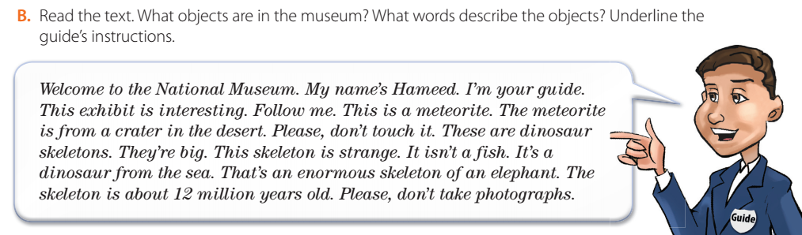
24
Objects: meteorite, dinosaur skeletons
Words to describe objects: interesting, from a crater in the desert, big, strange,
isn’t a fish, from the sea, enormous, of an elephant, about 12 million years old
Instructions: Follow me; Please, don’t touch it; Please, don’t take photographs.

Slide 14

24
Write the paragraphs using the text in exercise B as a model.

Slide 15
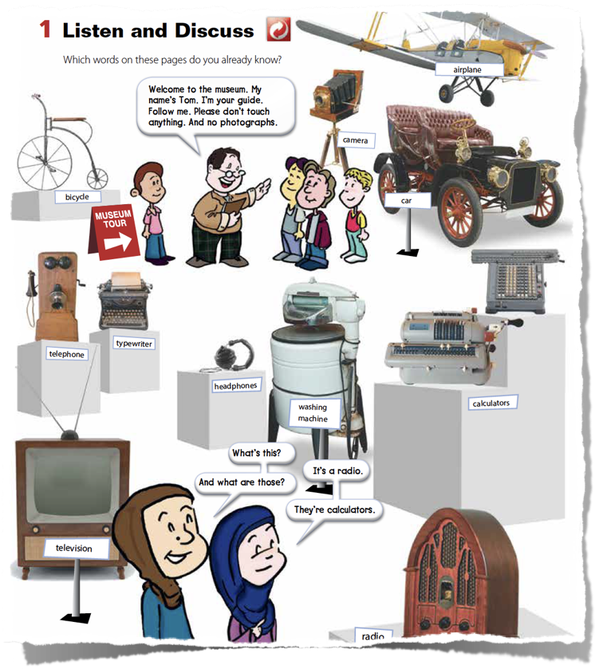






24
How to write the paragraph:
Welcome to the __________ . My name is __________ . I am your guide. I will show you my favorite objects in the museum . Follow me. This is a __________ . It is __________. This is a __________. It is __________. Please, don’t _________ __________✋🏼🚫 and __________ __________ 📸🚫 .
Add some instructions.

Slide 16
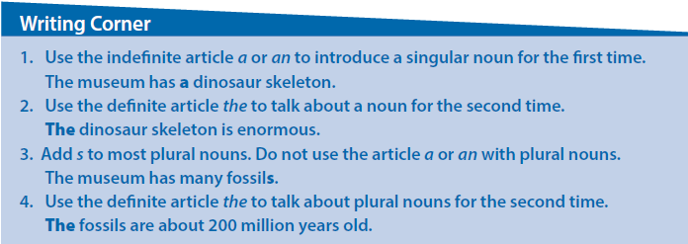
24
a or an is used to introduce something or someone for the first time.
The is used when mentioning the thing or person for the second time.
For example:
1- This is a classroom. The classroom is big.
2- That is an eraser. The eraser is pink.
plural nouns and articles
the article a or an is not used with plural nouns because it means “one.”
For example:
1- These are books. The books are new.
2- Those are desks. The desks are old.

Slide 17

Homework:
H
Page: 198

Slide 18
THANKS!
BYE!

