Slide 1
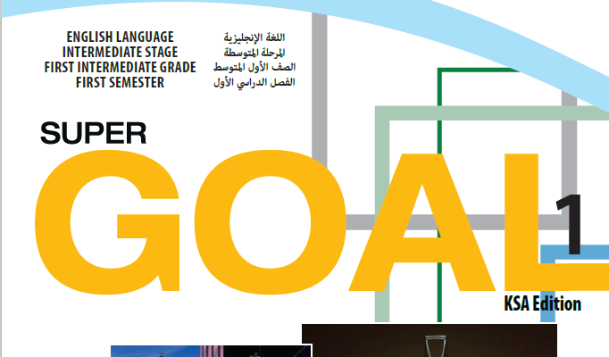

Slide 2


Slide 3


Slide 4

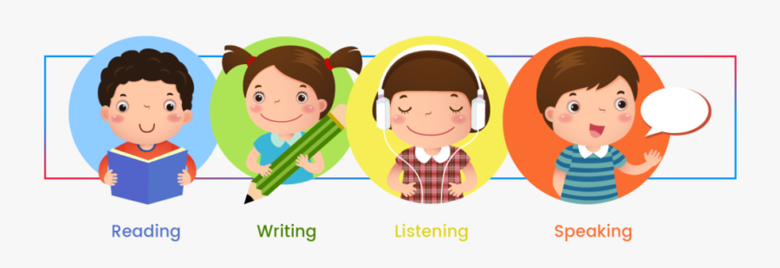

Slide 5
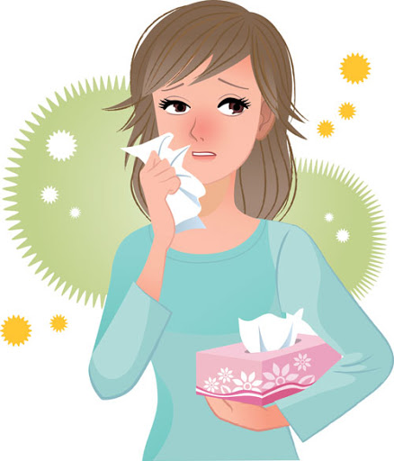
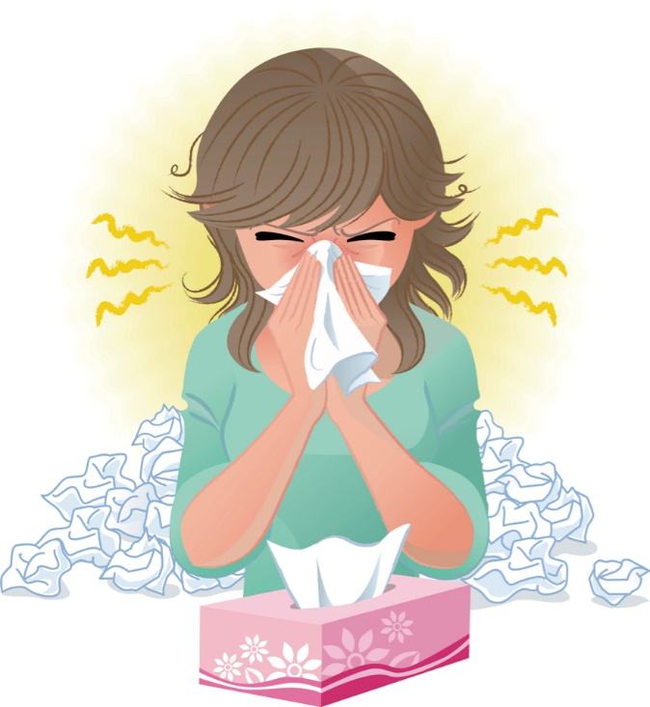
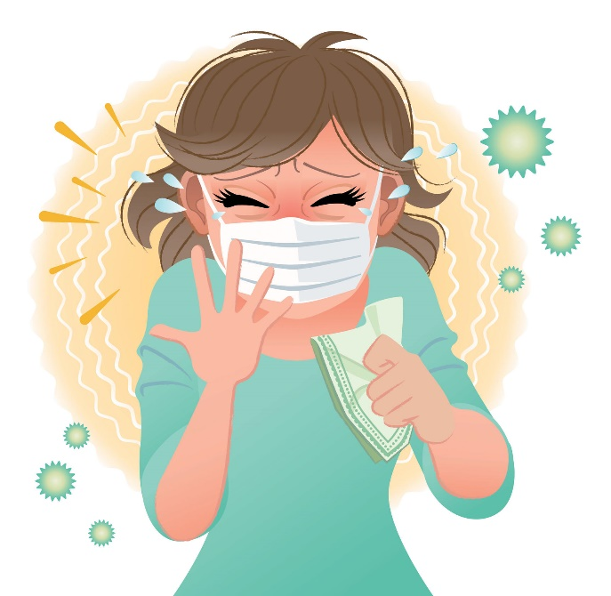
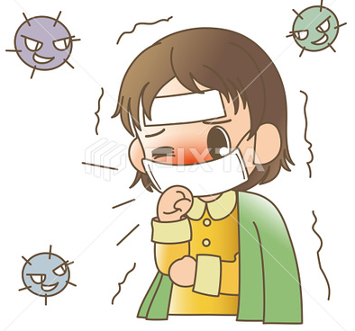
Covid 19
☺Avoid gathering !
☺We must wear a mask before
going out.
☺Social distancing is not a
choice, it is a must!
☺Keep a distance of 2 meters
to avoid accountability
☺wash hands constantly.

Slide 6
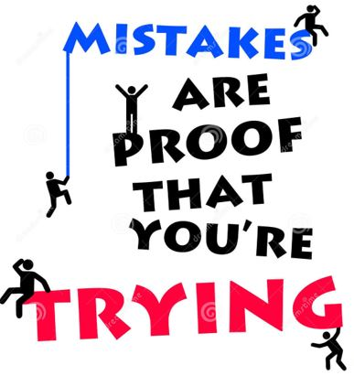

Slide 7
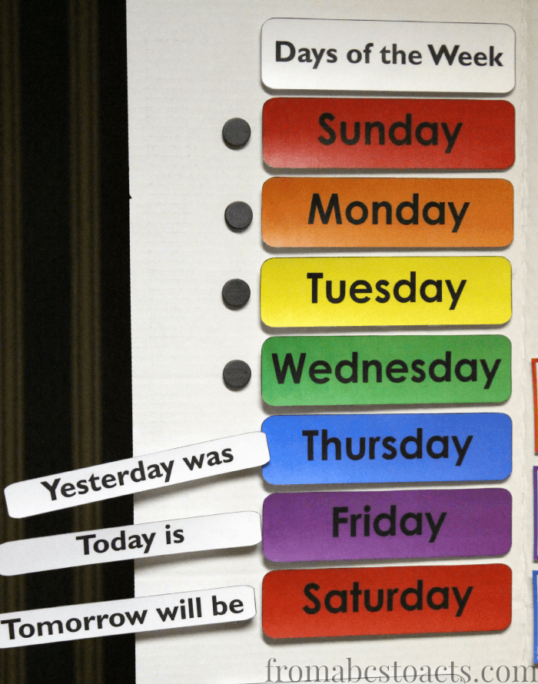

Slide 8




♥
☺
☺
♥

Slide 9
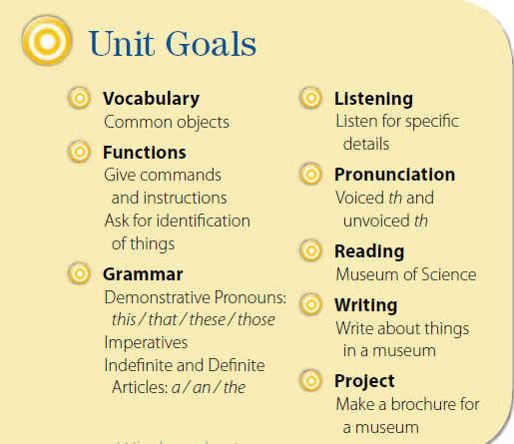

Slide 10
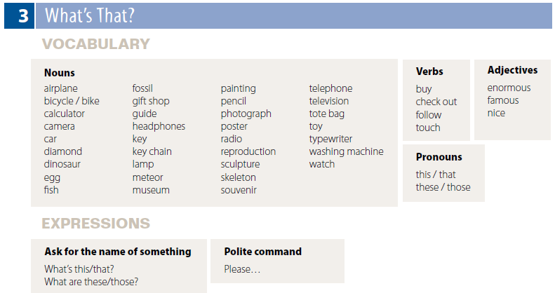

Slide 11


Nouns
airplane
bicycle / bike
calculator
camera
car
diamond
dinosaur
egg
fish
Nouns
fossil
gift shop
guide
headphones
key
key chain
lamp
meteor
museum
Nouns
painting
pencil
photograph
poster
radio
reproduction
sculpture
skeleton
souvenir
Nouns
telephone
television
tote bag
toy
typewriter
washing machine
watch
Verbs
buy
check out
follow
touch
Pronouns
this / that
these / those
Adjectives
enormous
famous
nice

Slide 12
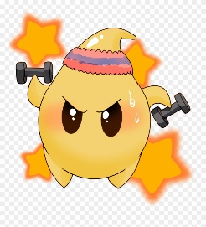

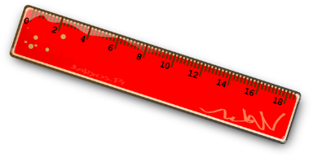
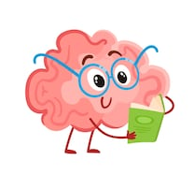
identify common items in the classroom
That’s a window. These are chairs. This is a pencil.
Is this a pencil?
yes or no.

Slide 13
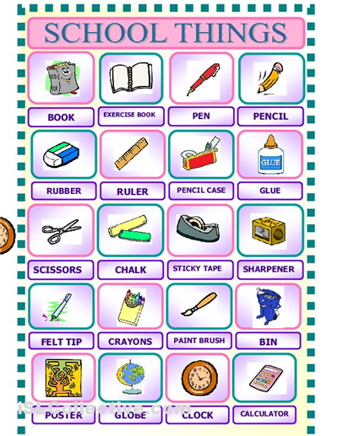

Slide 14
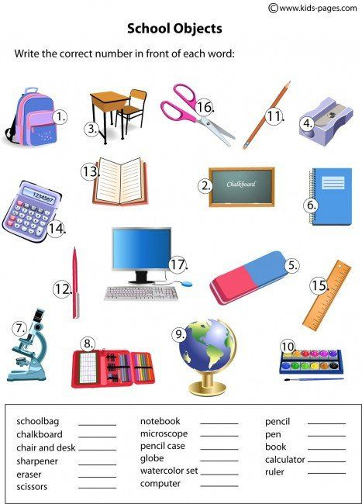

Slide 15

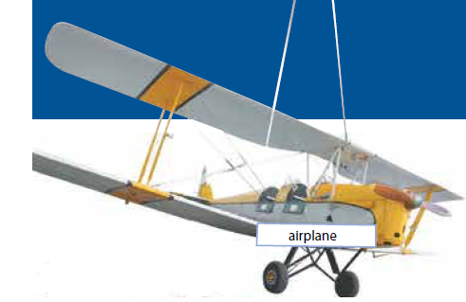

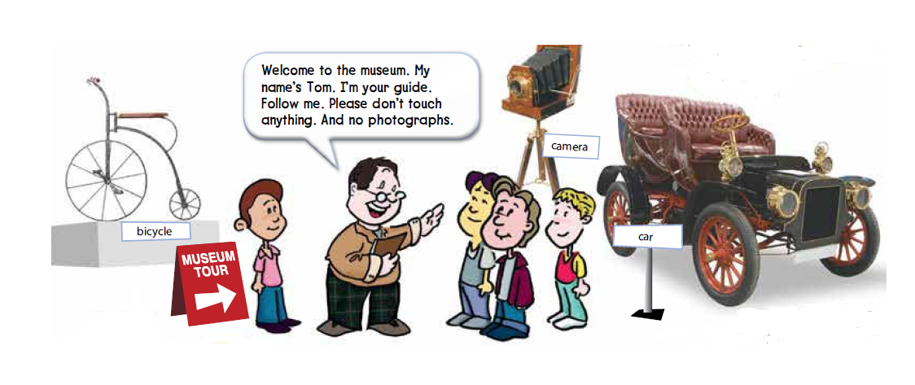
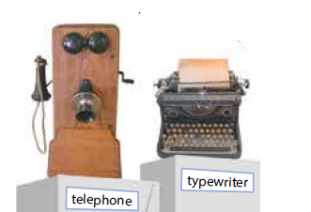
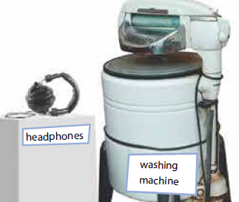
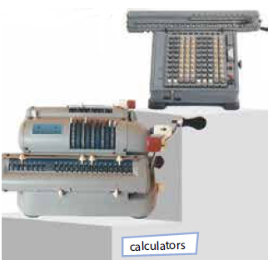
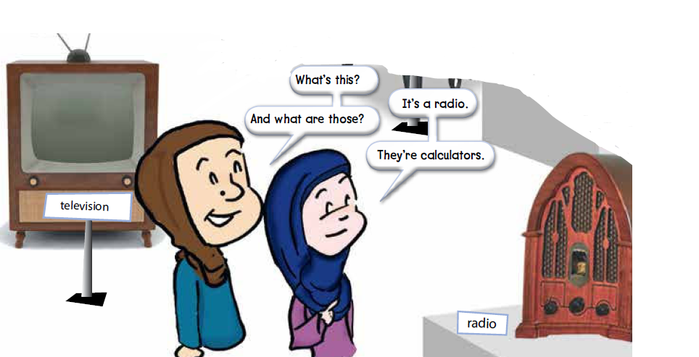
Page 18
Which words do you already know?
Are these objects old or new?
old
Where are they?
in a museum

Slide 16
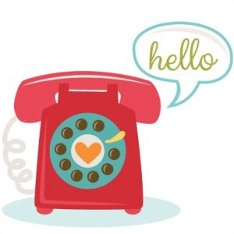

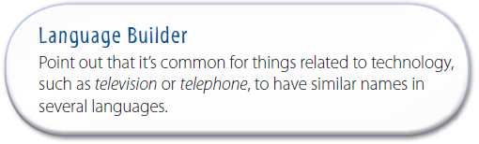

Slide 17



Page 18
listen and point to each object as you hear the word.
listen and repeat
or
speak along with
the recording.
What are they looking at?
the radio and the calculators

Slide 18
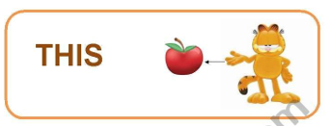
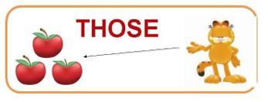
listen and repeat or speak along with the recording.
What’s this? and What are those?
this is singular and it refers to something close by.
The word those is plural and it refers to things that are farther away.
What’s this? and What are those?
It’s a ______. or They’re ______.

Slide 19
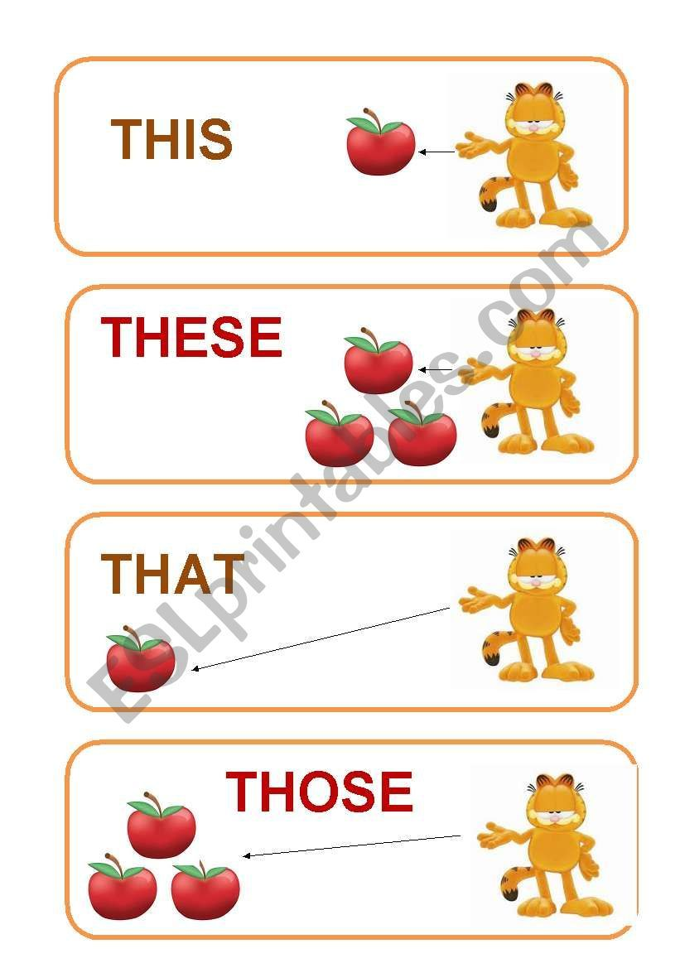

Slide 20
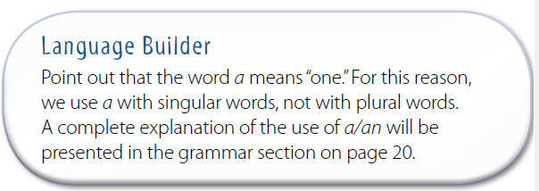

Slide 21
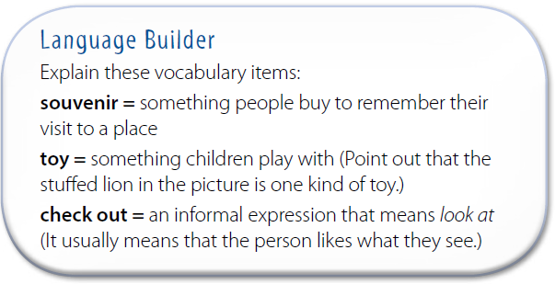

Slide 22
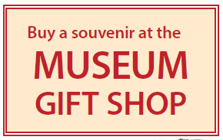
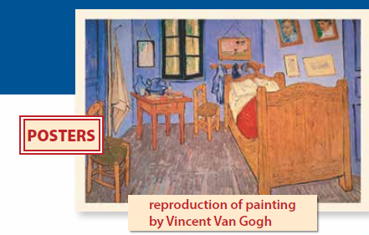
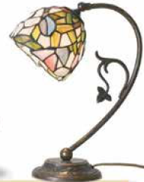
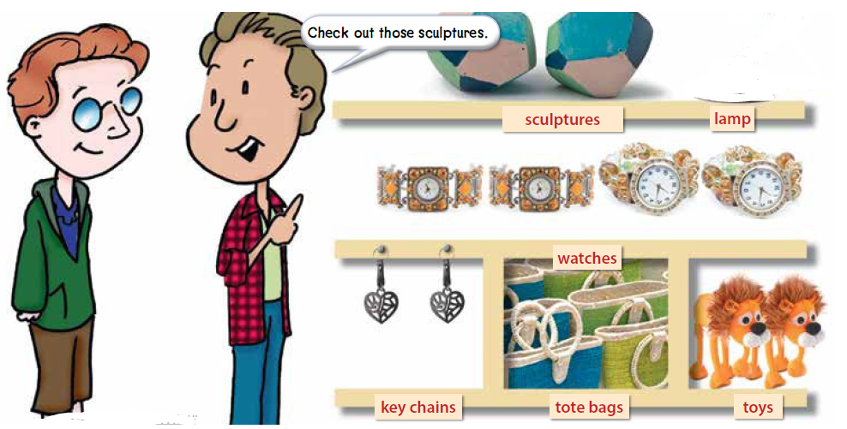
Page 19

Slide 23
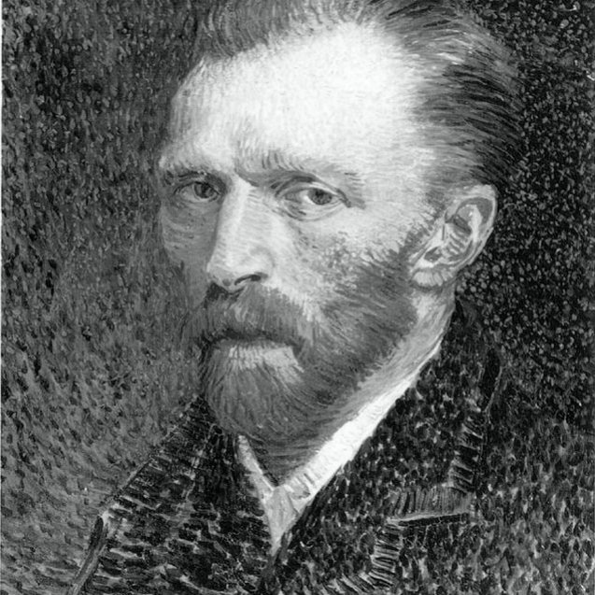
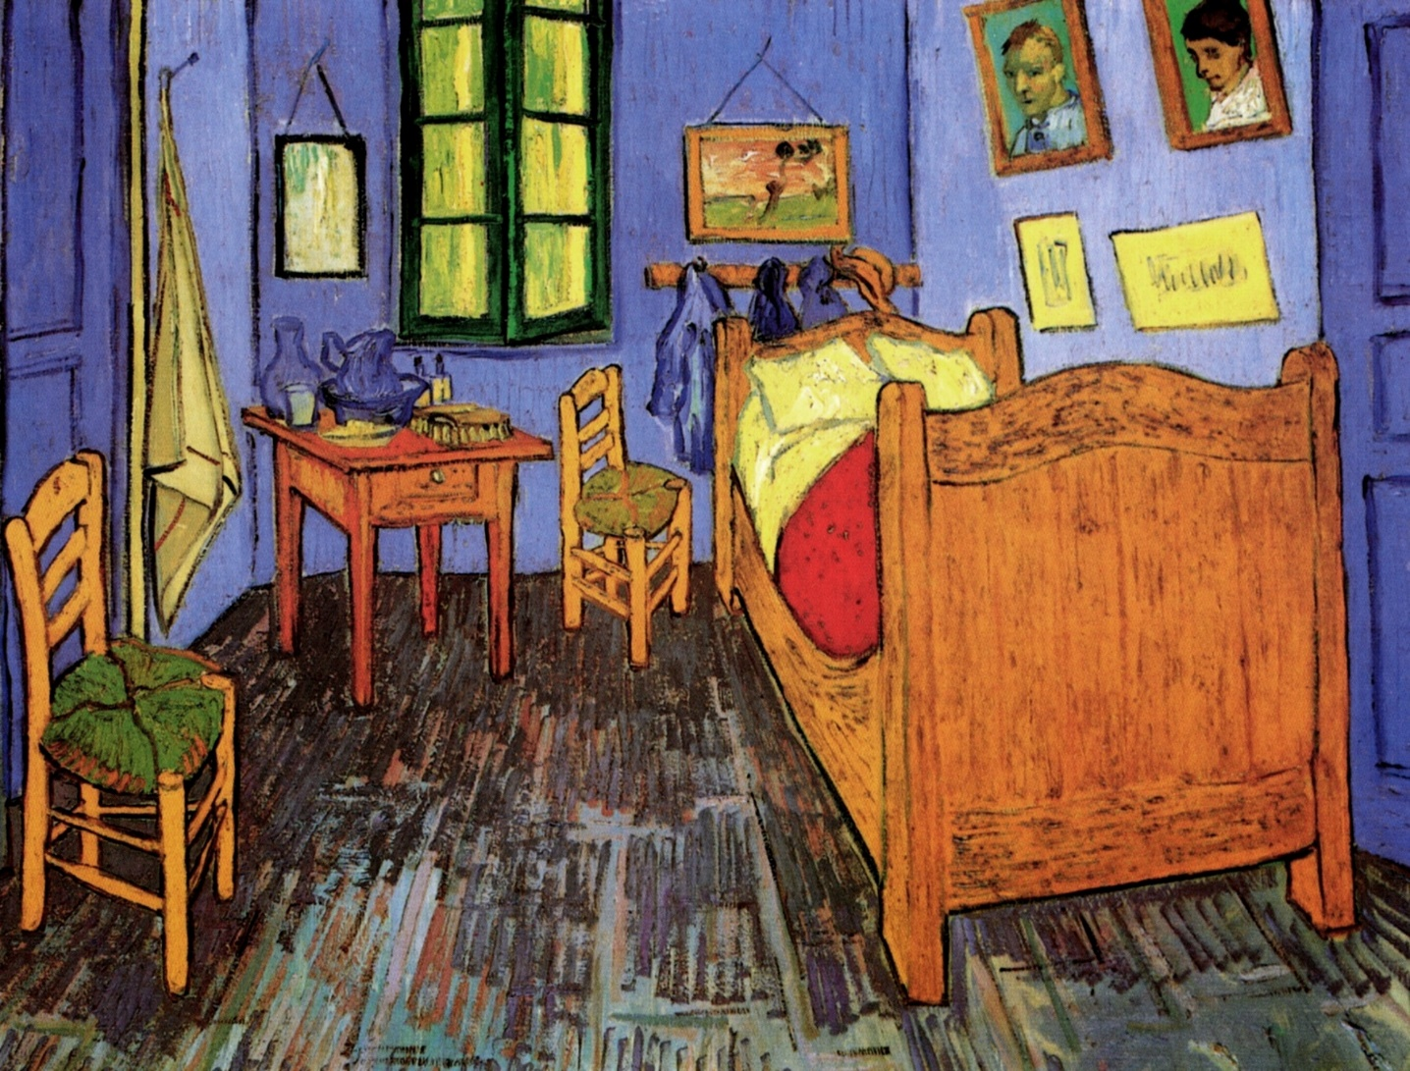
The original painting by Van Gogh shown on this page is titled Bedroom at Arles.
Van Gogh
The most famous painter in the history of Western art.

Slide 24

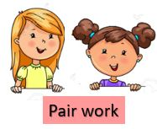


Page 19
list the things that they have
Answers will vary.

Slide 25


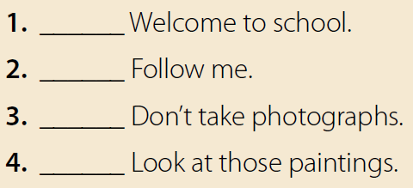
Page 19
no
yes
yes
no

Slide 26




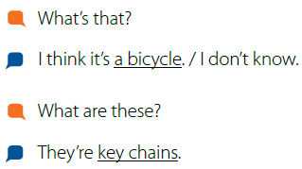
that is singular and these is plural.
we use that to talk about an object that is far away from us.
We use these to talk about more than one object that is close by.
listen and repeat or speak along with the recording.
Use different objects.
I don’t know if they don’t know what something is.

Slide 27


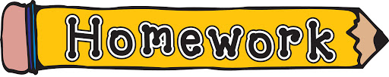




Assign page 97 for practice with vocabulary for common
objects and a/an.

Slide 28
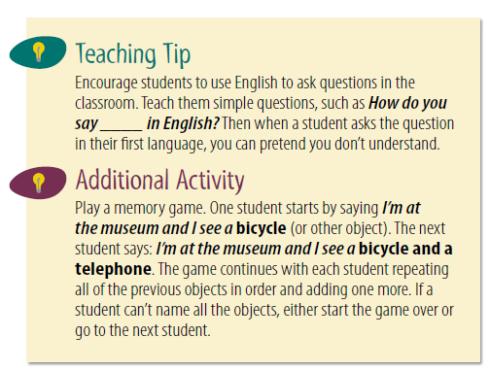
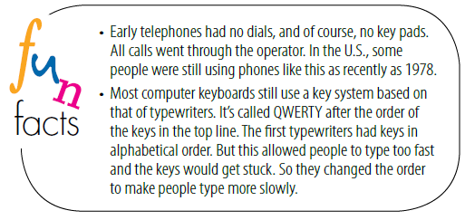

Slide 29


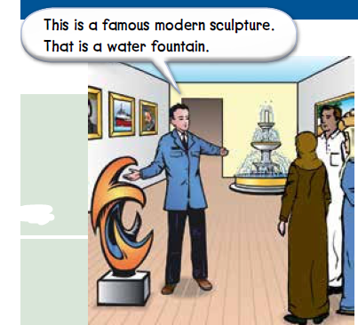
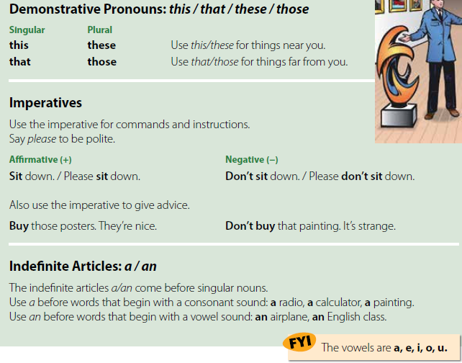
Page 20

Slide 30
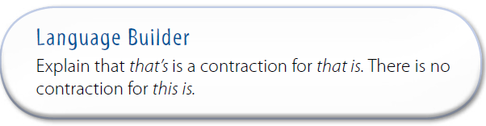

Slide 31
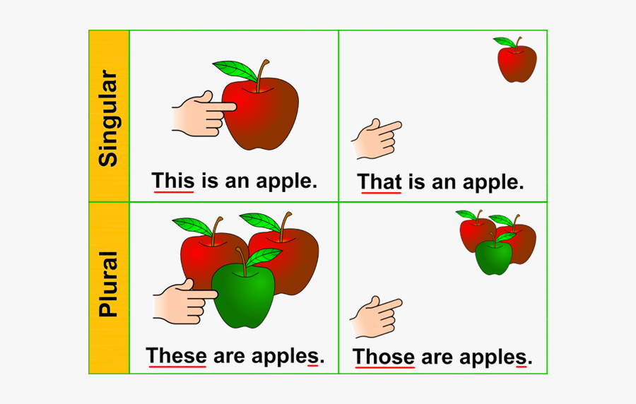

Slide 32
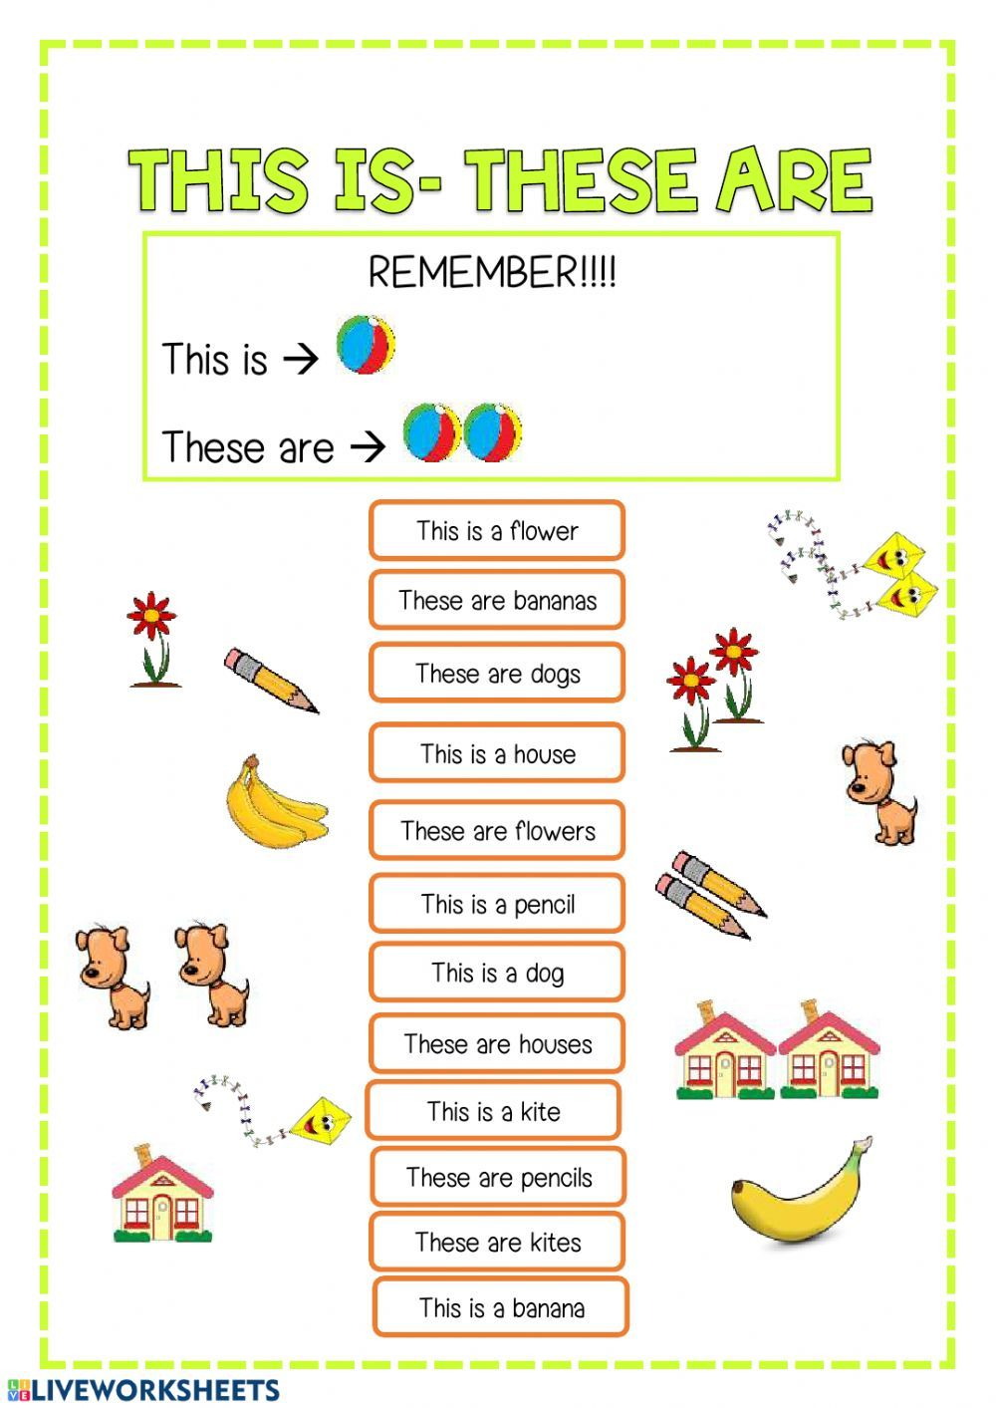

Slide 33
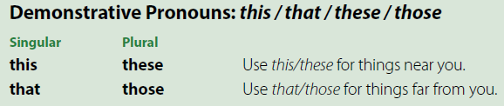
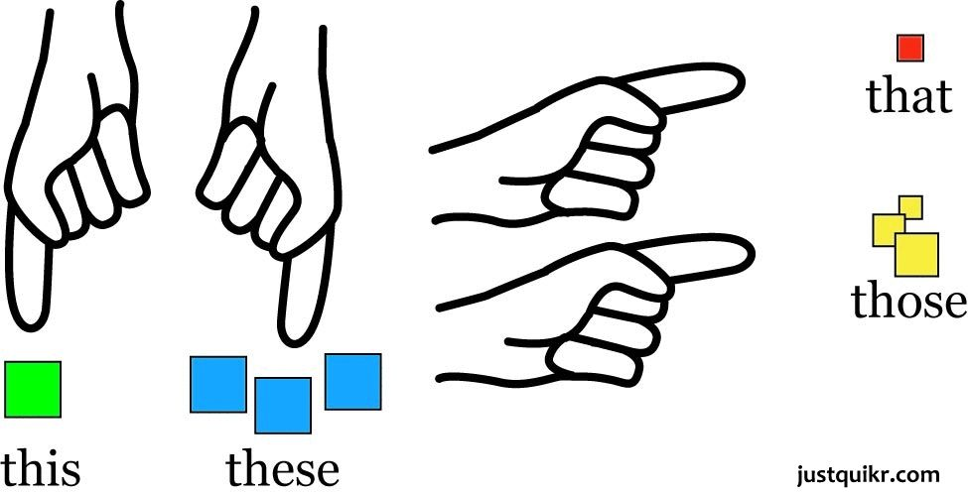
Page 20
The man uses this to refer to the sculpture because it is close to him.
He uses that for the water fountain because it is far away from him.
This is a pencil.
That’s a _____.

Slide 34
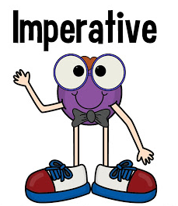

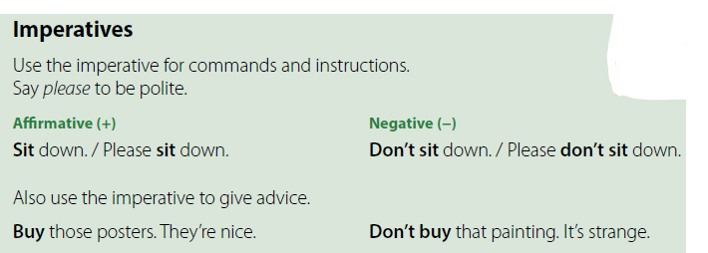
Page 20
an affirmative imperative begins with the verb.
A negative imperative begins with Don’t (Do not) + verb.

Slide 35


Slide 36
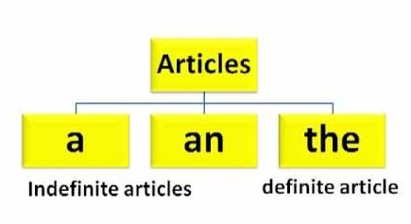

Slide 37


Slide 38


Slide 39


Slide 40



Slide 41



Page 20
a radio and an airplane
It’s easier to say an airplane with the /n/ sound in an.

Slide 42

a
a
an

Slide 43



Page 20
Read the questions and answers in the two examples.
What’s that?
What are those?
What’s this?
It’s a sculpture.
It’s an airplane.
They’re paintings.
What are these?
What are these?
They’re cameras.
What’s that?
They’re headphones.
It’s a bicycle.

Slide 44


Slide 45




Page 21
bike is a short form of bicycle.
Don’t worry if you aren’t great artists. That’s part of the fun of the game.

Slide 46

Page 21
work individually to match the imperatives with the signs.
b
c
d
a

Slide 47



Page 21
report about your partners
What’s in/on (name’s) ______?

Slide 48



Page 21
Circle the things Mark and Andy see.
What objects do you see in the pictures?
name the objects you circled.
clock, sculpture, painting, old airplane, tote bag, toy airplane, stuffed animals, watch
The following items should be circled: sculpture, painting, (old) airplane, tote bag, stuffed animals, and watch.

Slide 49




Sculpture

Slide 50







Page 21
The tongue comes between the top and bottom teeth
when they say the th sound. Tell them they should feel
a tickle or vibration on their tongues when they say
this.
vibration

Slide 51

Consonant Digraphs:
This
tenth
vibration
☺ Symbol
ð
θ

Slide 52


Slide 53










Slide 54
Assign pages 98–99 for practice with the grammar of
the unit.

Slide 55



Slide 56


Slide 57



comic strip.

Slide 58












Page 22
Where are the people? (They’re in a museum.)
Find these items in the pictures.
dinosaur
skeleton
rocks
fossils
fish
Listen
follow along with the text and the pictures.

Slide 59
Page 22

Slide 60


What’s the name of the dinosaur?
Tyrannosaurus Rex
How old is it?
65 million years old

Slide 61




rocks
fossils
skeleton
In it you can find fossils, skeleton and things from old civilization.
dinosaur

Slide 62









Page 22
at the last picture in the comic strip.
What do you think the object is?
which ending you are
agree with.
meteor
is a large rock that falls to earth from space.
is a valuable stone that people often use in rings and other kinds of jewelry.
diamond
which ending is the majority of the class agrees with?

Slide 63




Page 22
Work individually to answer the statements with yes or no.
no
It’s enormous.
yes
no
The skeleton’s name is Jerry.
Mike is one of the men in the story.
yes

Slide 64

Museums are buildings in which we see many things of artistic, cultural, historical, traditional and objects of scientific interest.
Museums exist on almost all topics: Art, history, science, geography, textiles, space, cars, airplanes, architecture, railroads, fashion, animals, natural history, man, woman, children, plants, famous people, computers, wars,

Slide 65



brainstorm
Sculptures
Rosetta Stone
a list of objects found in museums that they could include in their role plays.

Slide 66





Page 22
Choose one of the endings in the box and use it in your conversation
brainstorm a list of objects found in
museums that they could include in their role plays.

Slide 67


Slide 68


Slide 69



Slide 70


Slide 71


Slide 72


Craft Museum Exhibition
an activity in which you make something using
a lot of skill, especially with your hands

Slide 73

dinosaur museum

Slide 74








Page 23
What kinds of things do you see in museums?
craft
old and modern art
arrows
ornaments
paintings
clay models
coins
old and new inventions
huge statue of queen
old manuscripts of the Holy Quran
The Buddha Temple of Spring statue

Slide 75





ornaments
an object that is used as a decoration in a home or garden
an object that you keep in your house because it is beautiful rather than useful
The coins were only ever used for ornament, not as currency.
jewellery

Slide 76






Page 23
READING STRATEGY
Titles and subtitles
this is a brochure for a museum.
the titles and subtitles in the brochure
What kinds of things do you think you can see in this museum?
Can you see a film in this museum?

Slide 77











read along as they listen
Page 23

Slide 78





Page 23
Complete the sentences with words from the brochure
science and technology
human heart
Leonardo da Vinci
Greece

Slide 79








Page 23
Yes, there are.
In Riyadh, there is National History Museum
In it you can find fossils, skeleton and things from old civilization.
My favorite museum is Al Masmak Museum
I love the section about King Abdul Aziz.

Slide 80



Slide 81





Page 24
Abdul Raouf Khalil
Sculptures
like the modern paintings at the National Gallery. They are beautiful.
coins
pre-Islamic history,
an old castle.
It includes several large buildings: a mosque, the front of the citadel, the house of Saudi Arabian Heritage, the House of Islamic Heritage, the House of the International Heritage, and the Public Heritage Exhibition.

Slide 82

Page 24
a or an is used to introduce something or someone for the first time.
The is used when mentioning the thing or person for the second time.
For example:
This is a classroom.
The classroom is big.
That is an eraser.
The eraser is pink.

Slide 83
Page 24
plural nouns and articles
the article a or an is not used with plural nouns because it means “one.”
The is used when mentioning the things or people for the second time.
For example:
These are books. The books are new.
Those are desks. The desks are old.

Slide 84


read parts of the model paragraph aloud
Page 24
Identify the grammar in the instructions (imperative).
What is the name of the museum?
Who is Hameed?
Where is the meteorite from?
Which skeleton is strange?
How old is the skeleton of the elephant?
Is it big?

Slide 85
read parts of the model paragraph aloud
Page 24
Objects: meteorite, dinosaur skeletons
Words to describe objects: interesting, from a crater in the desert, big, strange,
isn’t a fish, from the sea, enormous, of an elephant, about 12 million years old
Instructions: Follow me; Please, don’t touch it; Please, don’t take photographs.

Slide 86


Page 24
You are going to be a museum guide.
You will write a paragraph about your favorite objects in a museum using your notes from the chart in exercise A.
Describe one of your favorite objects in the museum.
Write their paragraphs using the text in exercise B as a model.

Slide 87


Page 24
work in groups
Make your brochure. You can use the Reading as a model.

Slide 88
Assign page 100 for additional vocabulary and writing
practice.

Slide 89

Page 25
The refers to specific objects or people, but it is not used when referring to plural nouns in general.
Examples to show when the article is used and omitted.
For example:
(the is omitted because the sentence refers to any/all students and books in general)
The books we have are in English.
(specific books in our class) Museums have objects.
(general) The objects in the National Museum are interesting.
(specific objects in a specific museum)

Slide 90

Page 25
The refers to specific objects or people, but it is not used when referring to plural nouns in general.
Examples to show when the article is used and omitted.
For example:
(the is omitted because the sentence refers to any/all students and books in general)
The books we have are in English.
(specific books in our class) Museums have objects.
(general) The objects in the National Museum are interesting.
(specific objects in a specific museum)

Slide 91

Page 25
more examples of the names of rivers, seas, deserts, mountain ranges, and monuments.
The Nile River
The Amazon River
The Mississippi River
Arabian Sea
Pacific Ocean
Mediterranean Sea
The Great Victoria Desert
The Sahara Desert
The Rub al Khali desert
The Himalayas Mountains
The Sarawat Mountains
The Alps Mountains.

Slide 92

Page 25
What day is it today?
What time do you eat breakfast?
What do you do on weekdays?
Where do you go after school?

Slide 93


Page 25
Draw a line in the blank if the article is not necessary.
work individually to complete the exercise.
Ꝋ
the
Ꝋ
the
the
the
the
the
the
Ꝋ
the
Ꝋ
Ꝋ
the
Ꝋ

Slide 94



Page 25
an
The
The
Ꝋ
The
Ꝋ
Ꝋ
Ꝋ
a
The
The
The
The
the
a/the

Slide 95
The end
Noureyah Alghamdi

Slide 96




Slide 97

Role play is the act of imitating the character and
behaviour of someone who is different from yourself,
Benefits of Role-Play
☺Build confidence:
☺Develop listening skills:
☺Creative problem-solving:
☺Develops communication and language skills:
☺Allows students to act out and make sense of real-life situations:
☺Develops social skills as children, collaborate with others:
☺Encourages children to express their ideas and feelings in a relaxed environment:
☺Sparks creativity and imagination:

Slide 98



Page 83

Slide 99


