Slide 1
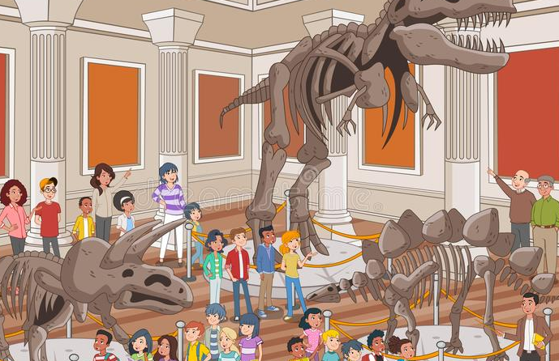
Super Goal 1
Unit 3
Lesson 7
Conversation (22)
What’s That?

Slide 2
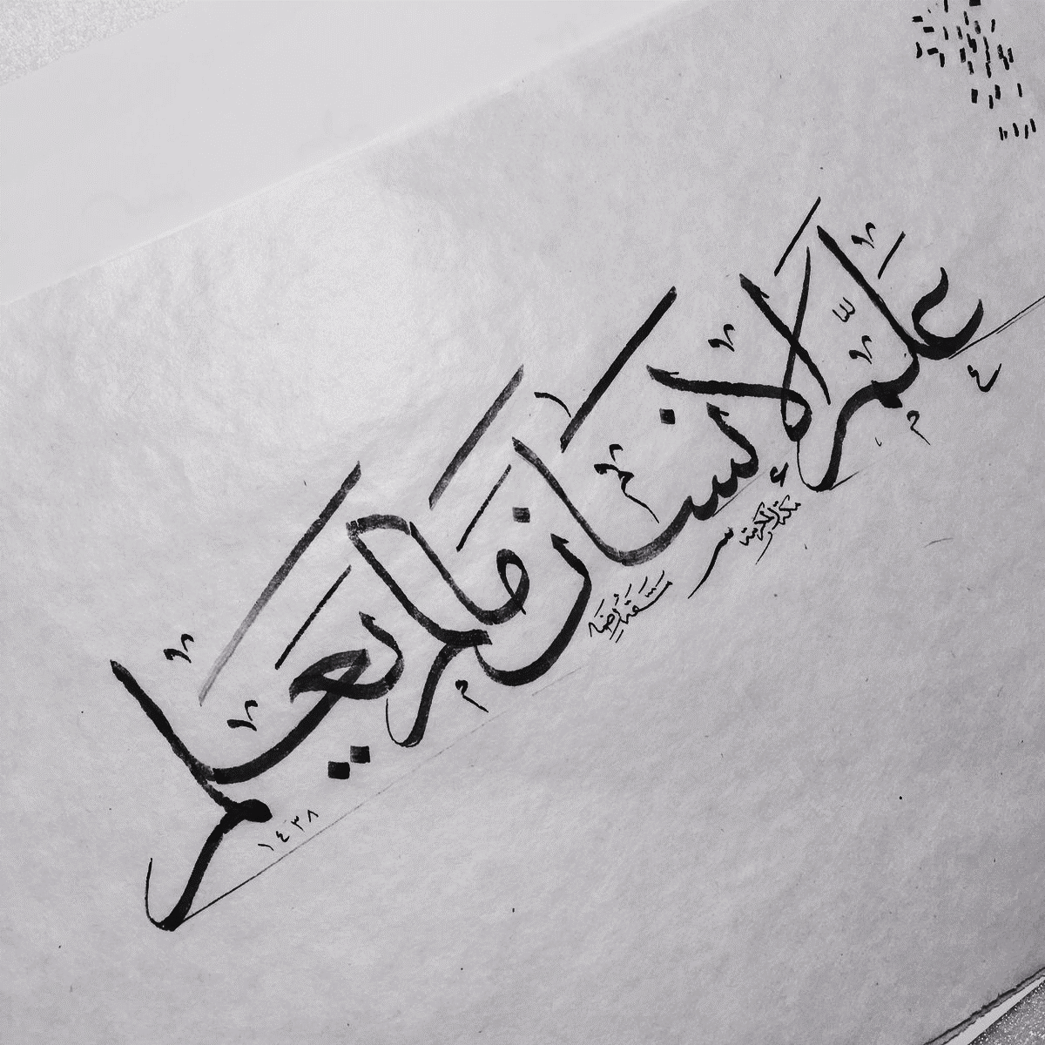

Slide 3
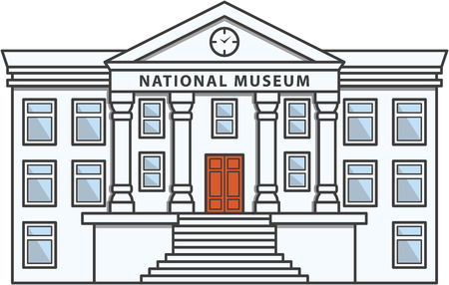


Check Homework

Slide 4
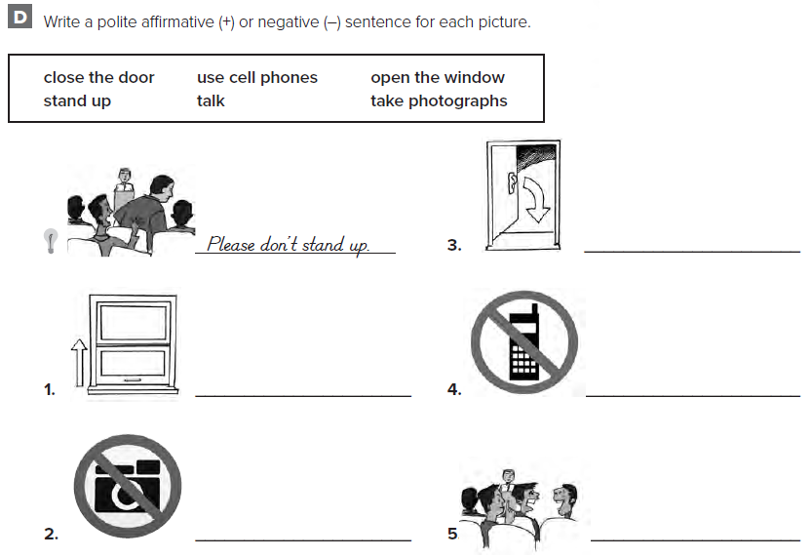
Please close the door
Please open the window
Please no cell phones
Please no photographs
Please don’t talk

Slide 5
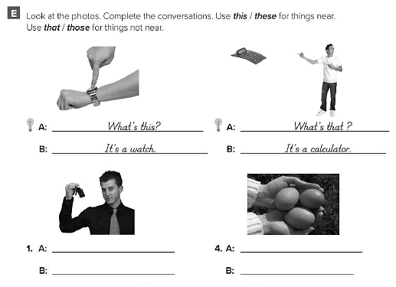
What is this ?
It is a key chain
What are these ?
They are eggs

Slide 6
.
Objectives:
1- read conversation.
2- learn new words.
3- answer the questions.

Slide 7



.
Warm up:
Who am I strategy
Name of animal

Slide 8

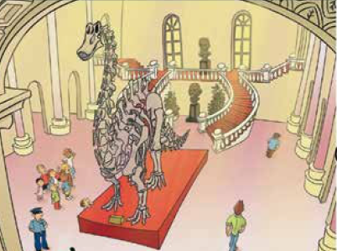
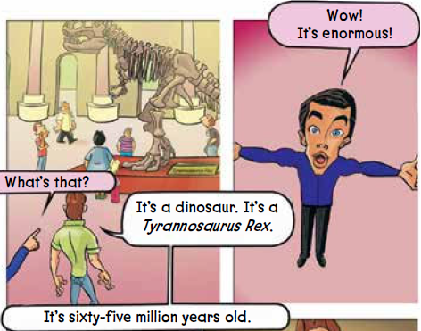
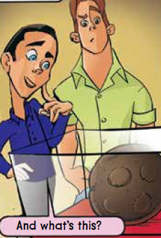
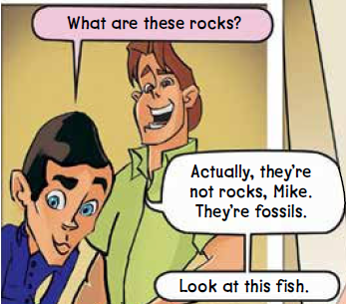
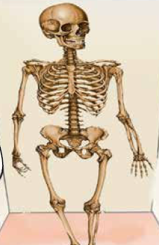
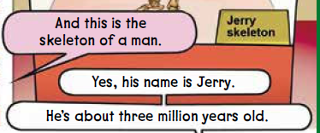
conversation:
22
They are at the museum.
Where are the people?

Slide 9


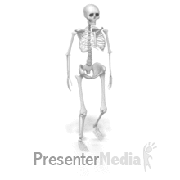
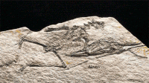

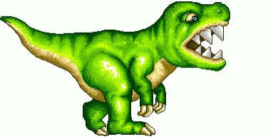
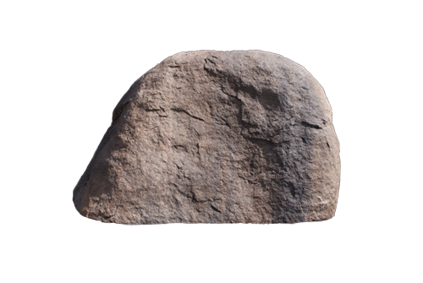
conversation:
22
Brainstorm
strategy
By using brainstorm strategy,
guess the name of the pictures
(1)
dinosaur
(4)
skeleton
(2)
rocks
(5)
fossils
(3)
fish

Slide 10


Conversation:
Sq3r
strategy
22
Before reading
How many pictures?
Five pictures.
How many characters?
Two characters.

Slide 11
Conversation:
Sq3r
strategy
22
during reading
What is the name of dinosaur?
Tyrannosaurus Rex
How old is it?
65 million years old
What does mike see?
Fossils / skeleton
What is the name of skeleton?
jerry
How old is he?
He is about three million years old.

Slide 12
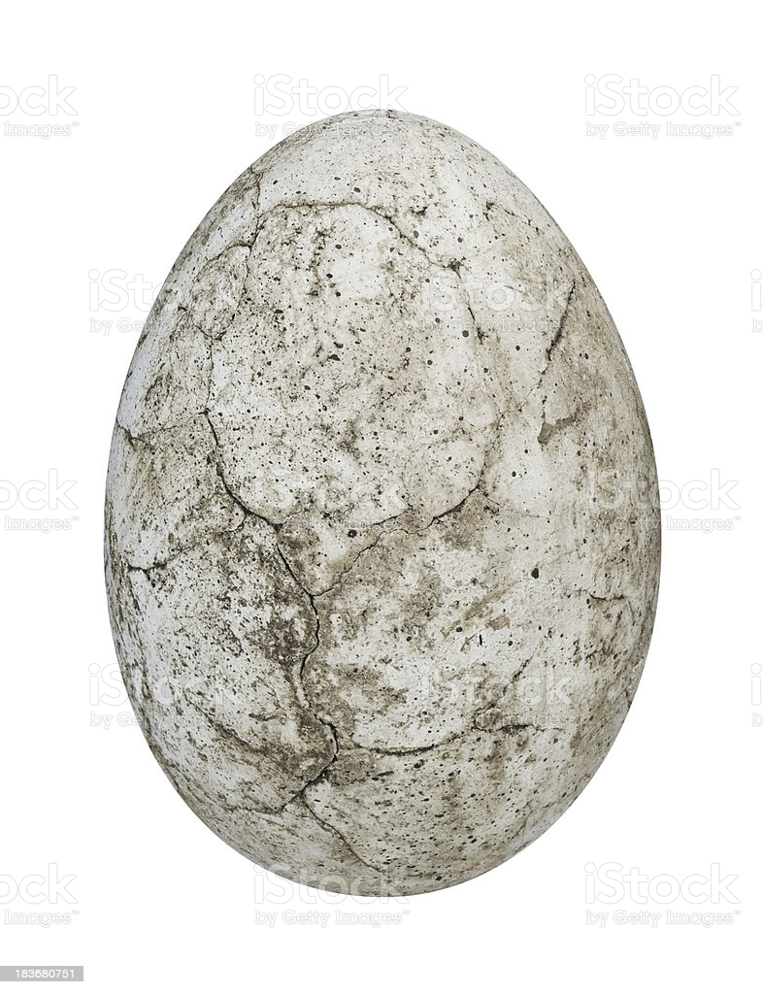
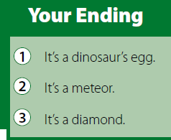
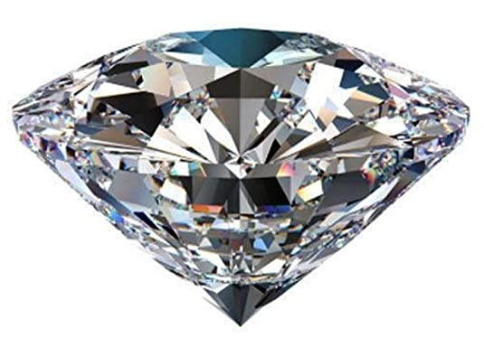
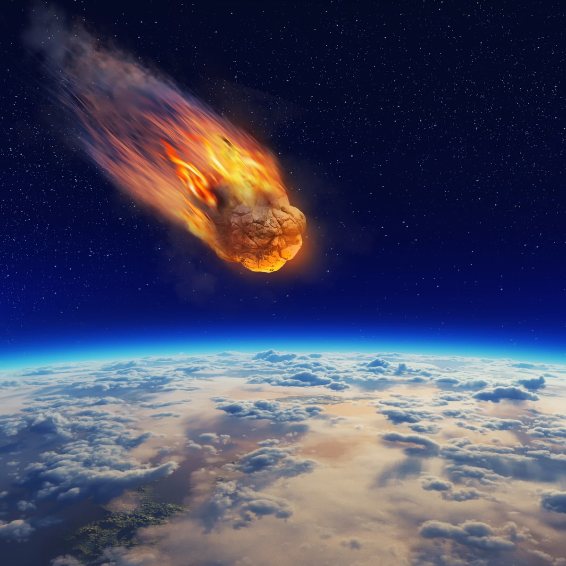
Conversation:
22
which ending you are
agree with.
is a valuable stone that people often use in rings and other kinds of jewelry.
meteor
is a large rock that falls to earth from space.
diamond

Slide 13
Fill the missing letter then match each word with picture:-
22
……keleton
F….ssils
Dinasou….

Slide 14
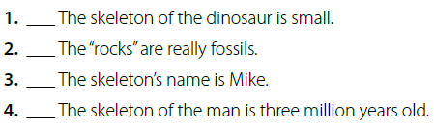
Sq3r
strategy
About the conversation:
22
After reading
no
It’s enormous.
yes
no
The skeleton’s name is Jerry.
yes

Slide 15

فَٱلۡيَوۡمَ نُنَجِّيكَ بِبَدَنِكَ لِتَكُونَ لِمَنۡ خَلۡفَكَ ءَايَةٗۚ
وَإِنَّ كَثِيرٗا مِّنَ ٱلنَّاسِ عَنۡ ءَايَٰتِنَا لَغَٰفِلُونَ
(92) So today We will save you in body[539] that you may be to those who succeed you a sign. And indeed, many among the people, of Our signs, are heedless
It talked about pharaoh,
whose body is in EGYPT

Slide 16

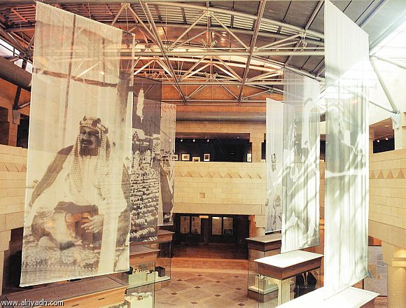
patriotic aim:
King Abdul-Aziz museum

Slide 17
Task:
Name some old objects
in the museum by using mind map or pictures

Slide 18
Home work:
198 (F & G)

Slide 19


