Slide 1
Our lesson today is :
- Unit 4
- Grammar
- P : 28

Slide 2
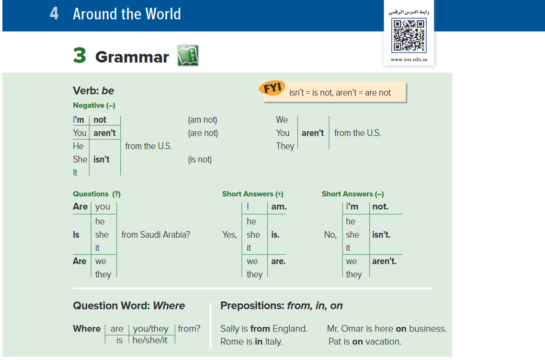

Slide 3
Firstly, let’s revise :
Unit 1 Grammar (verb be) page 4

Slide 4
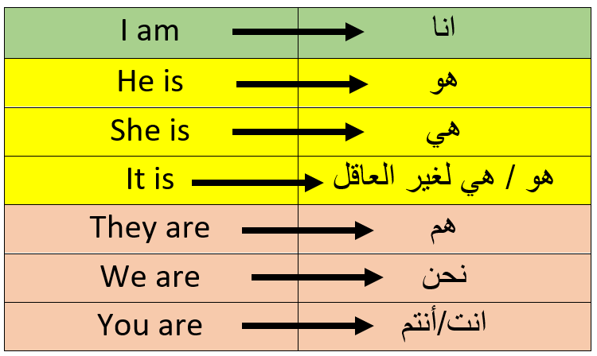
Verb be

Slide 5
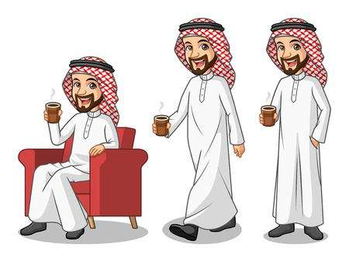
انا I am
انا عمر 1- I am Omar .

Slide 6


هو He is
هو خالد 1- He is Khaled.

Slide 7

هي She is
هي سارة 1- She is Sarah.

Slide 8
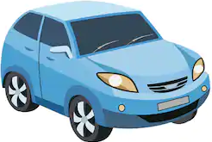

هو/هي لغير العاقل It is
هي سيارة 1- It is a car .
هو عصفور 2- It is a bird.

Slide 9

هم They are
هم اخوان 1- They are brothers.

Slide 10

نحن We are
نحن أصدقاء 1- We are friends.

Slide 11

أنت/أنتم You are
انتم طلاب 1- You are students.
أنت أحمد 2- You are Ahmed.

Slide 12
 Write ( am – is – are ):
1- I ……..……a student .
2- He …………….. Omar.
3- They ………………….. friends.
am
is
are

Slide 13
Now let’s start our lesson today

Slide 15
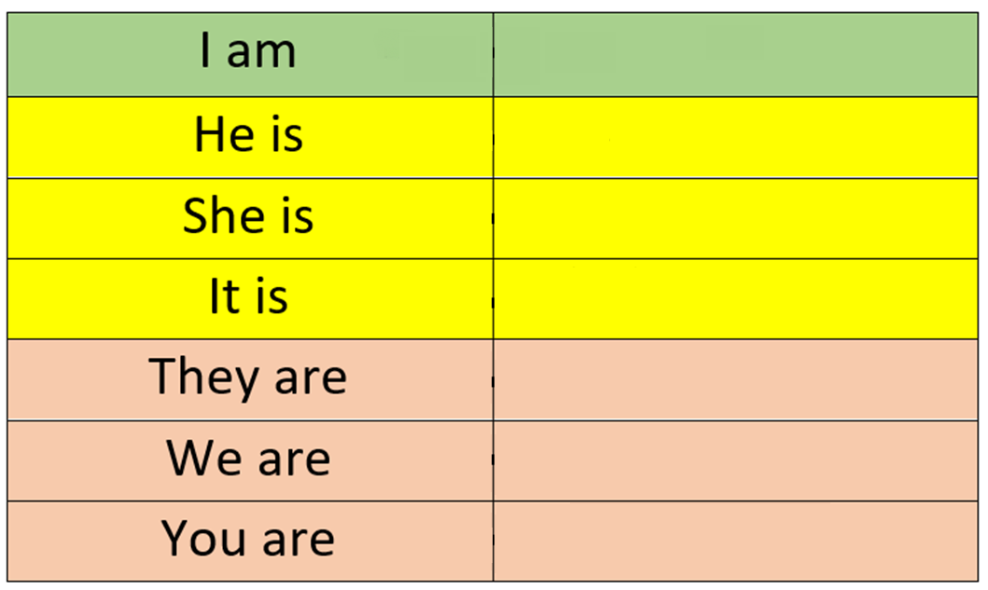
في حالة النفي نستخدم not
Verb be (negative)
الصيغة الكاملة Long form
الصيغة المختصرة Short form
not
I’m not
not
He isn’t
not
She isn’t
not
It isn’t
not
They aren’t
not
We aren’t
not
You aren’t

Slide 16
He is a doctor
I’m Omar
He isn’t a pilot
I’m not Tariq
She is Sarah
They are brothers
They aren’t cousins
She isn’t Norah

Slide 17
Q: Make it negative :
1- He is American.
He isn’t American.
……………………………….…………………..
2- She is a nurse.
She isn’t a nurse.
……………………………….…………………..
3- We are doctors.
We aren’t doctors.
……………………………….…………………..

Slide 18
السؤالQuestions
He is a teacher.
They are students.
Is he a teacher ?
Are they students ?
-Yes , he is
-Yes , they are
-No , he isn’t
-No , they aren’t

Slide 19
Q: Make it a question :
She is a nurse.
You are Saudi.
Is she a nurse ?
Are you Saudi ?
…………………………………………………
…………………………………………………

Slide 20
Question word ( Where )
To ask about place
للسؤال عن مكان
Where ………?
Where are you from ?
Where are they from ?
Where is he from ?
Where is she from ?

Slide 21
Prepositions: from, in, on
in
on
from
I’m from Saudi Arabia
Riyadh is in Saudi Arabia
I’m here on vacation
He is from Kuwait
Paris is in France
I’m here on buisness

