Slide 1

Unit 4
Around the World
part 3

Slide 2
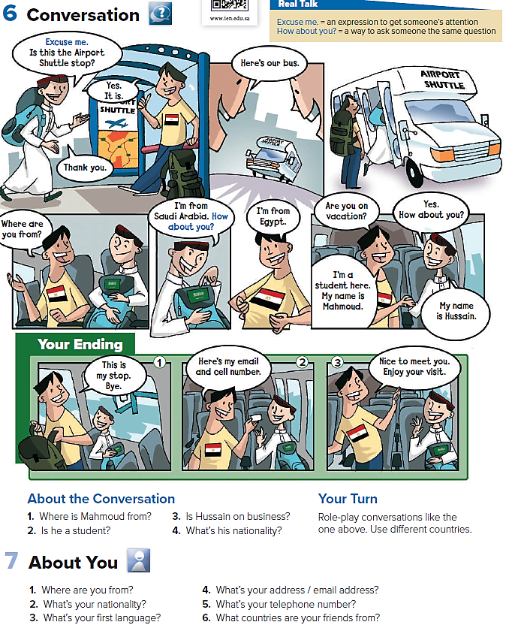
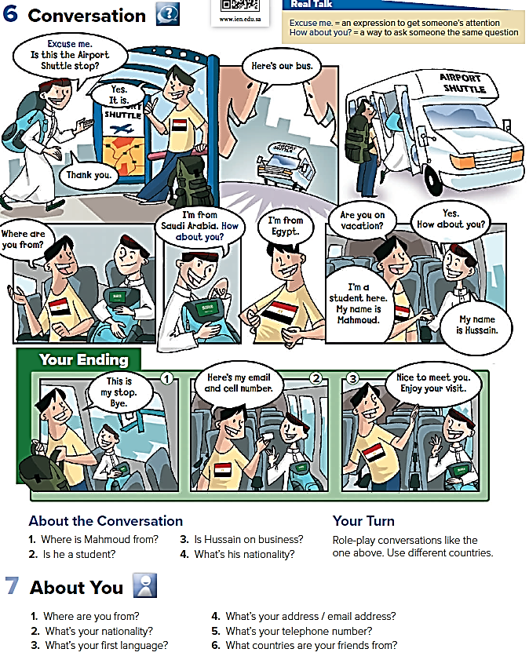
He’s from Egypt
No, He isn’t
Yes, he is
He’s Saudi

Slide 3
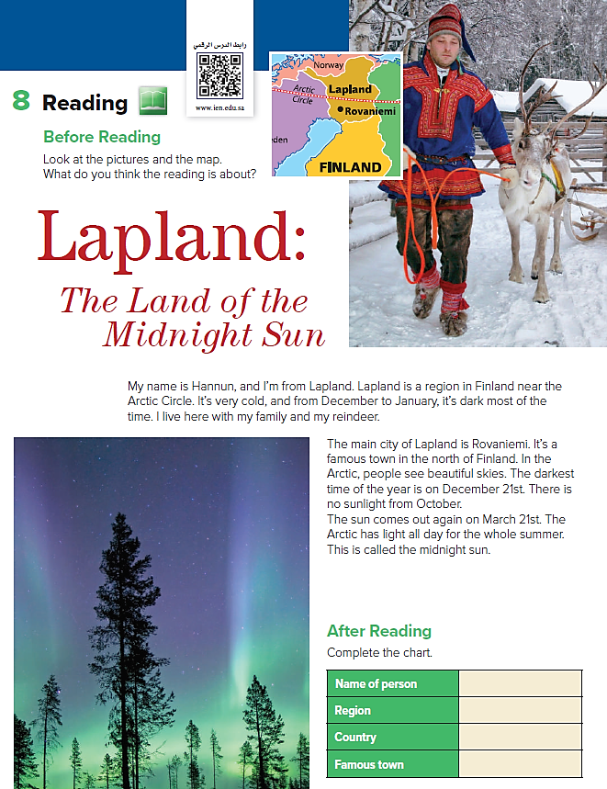

Hannun
Lapland
Finland
Rovaniemi

Slide 4
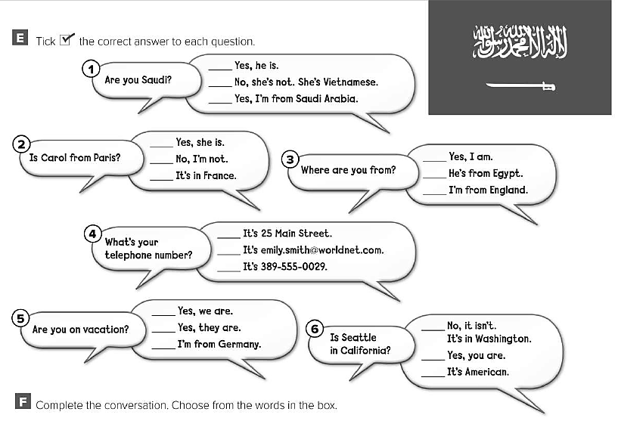


Slide 5
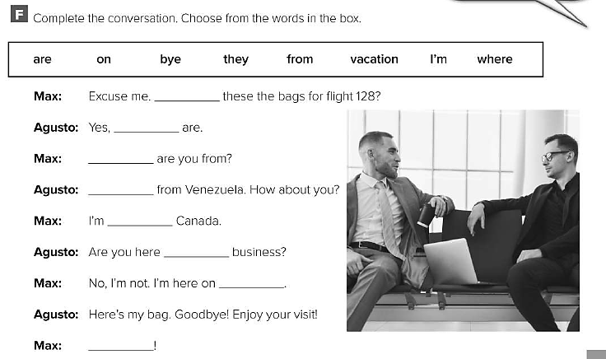
are
they
Where
I’m
from
on
vacation
bye

