Slide 1

Adjective + Preposition+ Gerund
Mega goal 1
Unit : 2
Tr: Kholoud AlGhamdi

Slide 2


Write a list of some Adjectives :
interested
kind
beautiful

Slide 3

Write a list of some prepositions :
at
with
in

Slide 4

What does Gerund mean ??
Verb + ing
sleeping
cooking
speaking

Slide 5
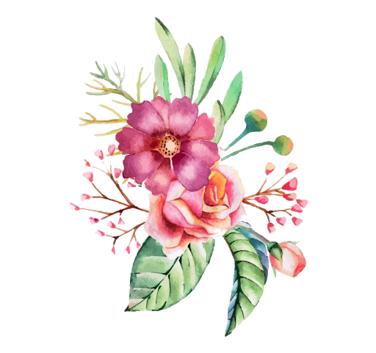
Structure:
Be + adjective + preposition + v- ing (gerund )
Examples :
I’m good at cooking ..
She is interested in watching movies .
He is afraid of swimming .
be
adj
gerund
preposition

Slide 6

Choose the correct answer :
1-Sarah is good at ……………………..stories. ( write / writing/ wrote)
2-They are interested ……………… playing football. (in /on/with)
3- I’m worried about ……………………abroad . ( travelled/travel/travelling)
4- he is afraid of ……………………his speaking skills.(loose/lost/loosing)

Slide 7

Have a nice day ..
Tr: Kholoud AlGhamdi

