Slide 1


Present perfect simple present perfect progressive
Mega goal 1
Unit : 2
Tr : Kholoud Al Ghamdi

Slide 2

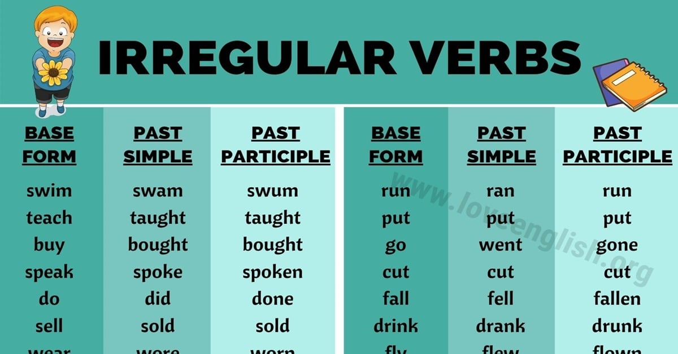
Let’s revise:

Slide 3

Present perfect simple :
Using :
1- to say how many things have been done or how many times something has been done…
2 – to talk about recently completed action..
3- to talk about something happened in the past and continue to the present ,, or past actions with an important present result..
Key words:
Never, ever, already, just ,yet ,since ,and for .

Slide 4

Structure :
Examples :
She
He
It
Singular
I
You
We
They
plural
hasn’t
She has already studied English..
She hasn’t studied English..
Has she studied English ?
has + v3
v3
have + v3
Haven’t
I have cooked pasta three times.
I haven’t cooked pasta.
Have I cooked pasta ?

Slide 5

Present perfect progressive:
Using :
To say how long something has been happening ..
( focus on the duration of the action )
Key words:
For (for two days/ for hours /for five months..)
Since (since the morning/ since 2:am/since yesterday)

Slide 6

Structure :
Examples:
She
He
It
Singular
You
I
We
They
plural
He has been working since 3:pm.
He hasn’t been working since 3:pm .
Has he been working since 3:pm ?
has+ been + v-ing
V-ing
I have been studying for two hours.
I haven’t been studying for two hours.
Have I been studying for two hours ?
Have + been + v - ing

Slide 7
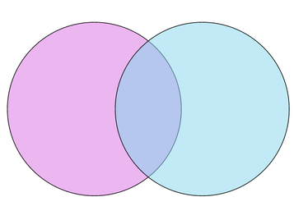
Venn diagram :
Present perfect progressive
Present perfect simple
How many times something has been done and how many things have been done
How long something has been happening
Have
Has
Since
For
S+ have/has +been + v-ing
S+ have/has + v3
They have been reading for three hours.
Sarah has already read 3 books

Slide 8


Let’s make sentences :
He has swum five times
He has been swimming since the morning
How many times
How long

Slide 9
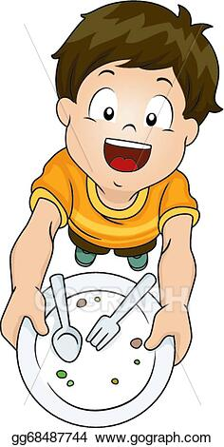
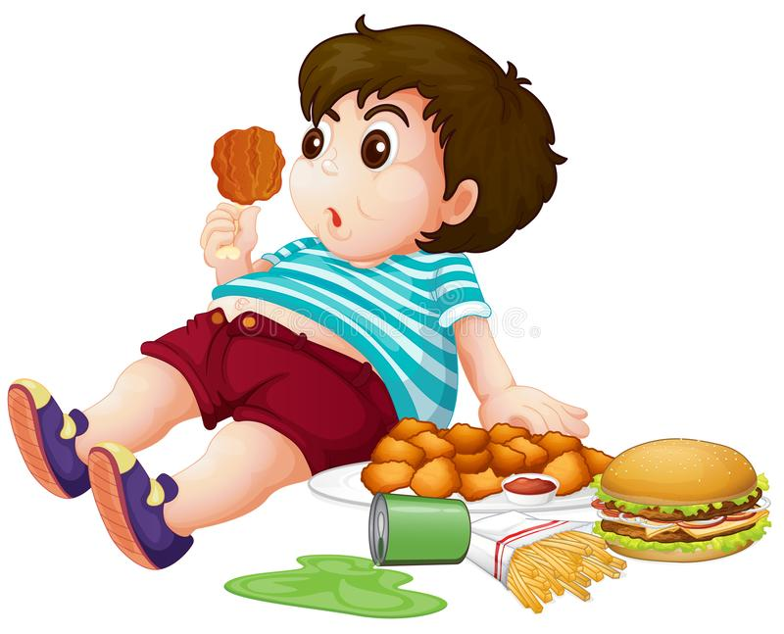
.
I have just eaten my lunch .
I have been eating for two hours .
Recently finished
How long

Slide 10
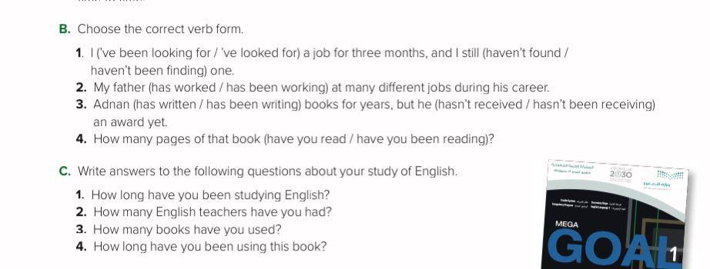

Open your book and do the exercises . P22

Slide 11
Have a nice day
Tr: Kholoud Al Ghamdi

