Slide 1



Slide 2


Slide 3
Unit-3-
What Will Be ,Will Be
L7 About you
L8 Conversation

Slide 4


Objectives
Identify future sentences in a video
Create a situation to use "real talk" in
Draw an intelligent house
Analyze a text to its elements
Share positively in pair work
Use the "real talk" phrases in new sentences

Slide 5

L7 About You

Slide 6

In pairs, ask and answer the questions. Then switch roles
1. Do you believe that people can predict the future? Explain.
2. Do you know of any predictions that came true? Explain.
3. What changes do you predict for the next 50 years?
4. What do you think you’ll be doing 20 years from now?
5. What kind of TV programs will people be watching in 50 years?
6. What will schools be like in 20 years?

Slide 7

L8 Conversation

Slide 8


Slide 9


Would you like to have a robot do your housework?
What are the advantages and disadvantages

Slide 10

Scan
What are the reporter questions?
Read the questions?

Slide 11


Reporter: What happens after I enter the house?
Engineer: The lights will come on if it’s night, the
climate control will be activated, and
surround sound will automatically play
your favorite radio station.
Reporter: What special facilities will there be in
the kitchen?
Engineer: You’ll be able to “call” your refrigerator
when you’re at the supermarket and find
out how much milk there is or how many
eggs you have left.
Reporter: That’s wonderful. What about the
housework? I hate doing that.
Engineer: The house will come equipped with a
robot that will do the cleaning, the
washing, and the cooking.
Reporter: No kidding? Can I buy the robot
without the house?
Find and underline some of the words you practiced in the pronunciation
section. Practice reading the conversation in pairs.
Reporter: Would you tell us about the new intelligent home of
the future?
Engineer: Certainly. The concept of Intelligent Buildings is to monitor and
optimize lighting, security, ventilation, heating, audiovisual and
entertainment systems, and so on. It’s an
integrated household system that will
make people’s lives easier.
Reporter: How will the house actually function?
Engineer: When you arrive at the front door, you
won’t need a key. The door will open with
a touch of your finger. The system will
recognize your fingerprint.

Slide 12
What is the concept of intelligent buildings?
How do you open the front door?
What makes the refrigerator “smart”?

Slide 13
Real Talk
Certainly = used to say yes
No kidding? = to express surprise, in this case, pleasant surprise

Slide 14
About the Conversation
In pairs, ask and answer the questions. Then switch roles.
1. What are some features of the intelligent house?
2. What will happen after a person enters the house?
3. What will you be able to do over the phone?
4. Why is the reporter interested in the robot?
1. They will monitor lighting, security, ventilation, heating, and audiovisual systems.
2. the lights will come on at night, the climate control will be activated, and surround sound will automatically play your favorite radio station.
3. Call your refrigerator and find out about the things in it.
4. He would like a robot to do the cleaning, washing, and cooking.

Slide 15

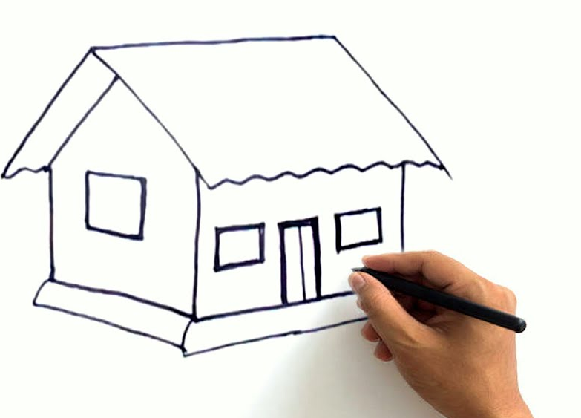
Draw an intelligent house that you
would like to have one day. Write
sentences about the intelligent
features and how they work.

Slide 16



Slide 17


Slide 18


