Slide 1
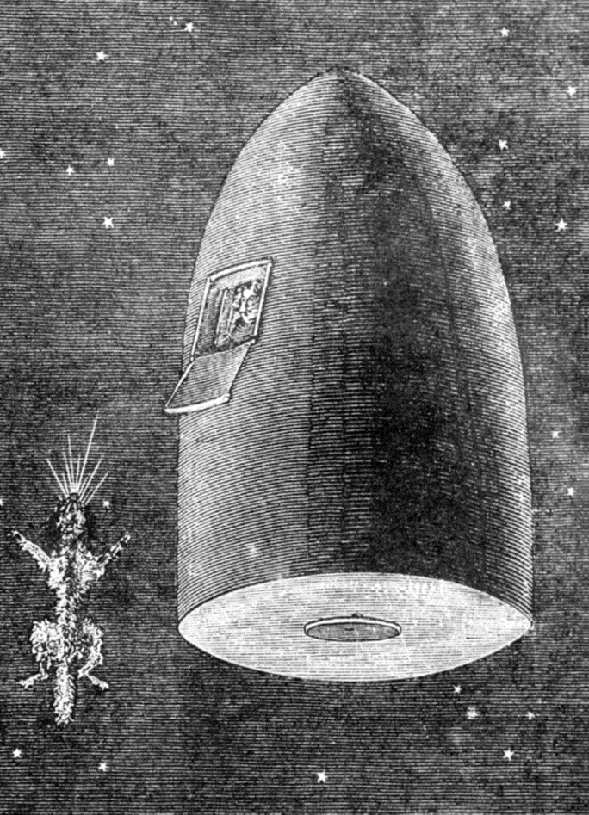


Slide 2

Good Morning

Slide 3
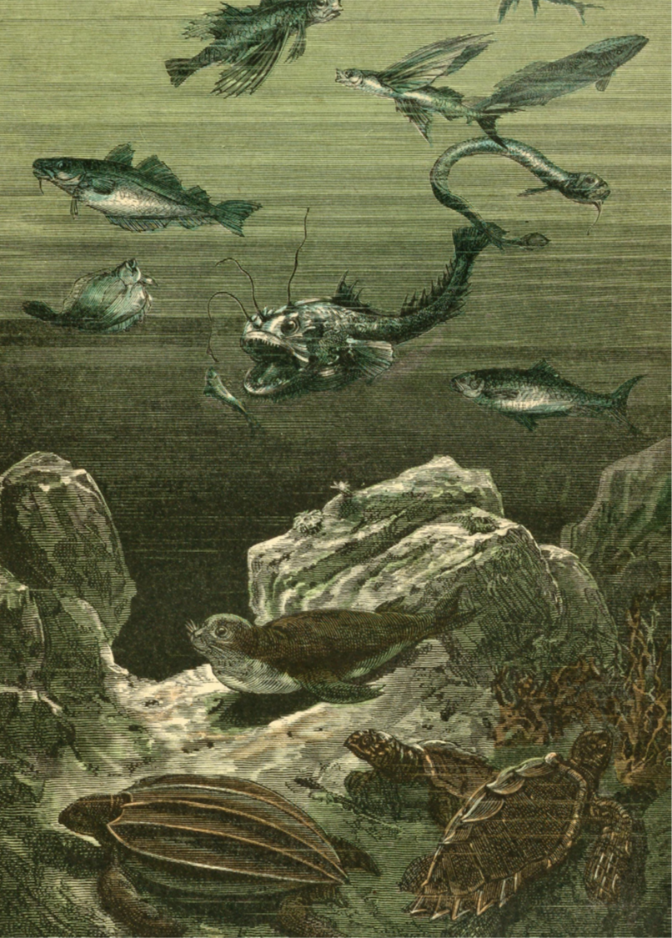
Unit-3
What Will Be , Will Be
L1 Listen and Discuss

Slide 4

Tongue Twister
She sells seashells by the seashores

Slide 5



List 3 things changed radically in last five years
Infer the meaning of (what will be will be)
Compare people's opinions now and then
Predict changes on an item in the future
Recognize words related to the future
Find the completion of vocabulary within the text
Find out which prediction came true.
Find words that have a connection with the unit's title
Find words in the text about the future
Find words in the text about the past

Slide 6

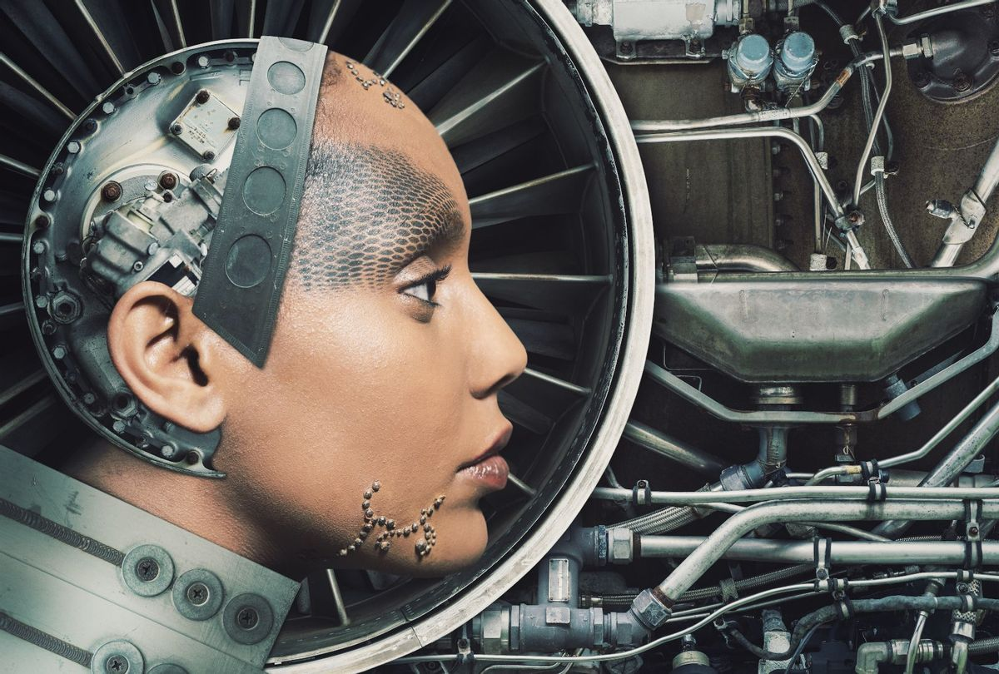
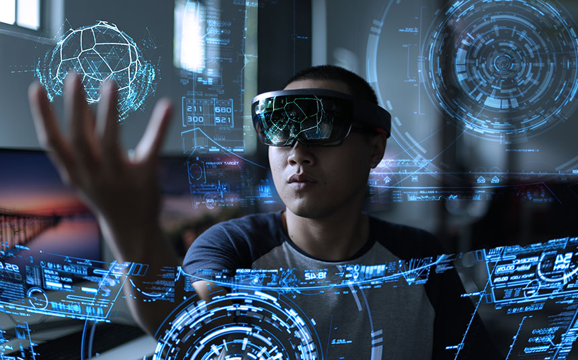
Warm Up
look at the unit title , what do you think it means ?
Who is
Jules Verne?
Do we have a similar one in our culture ?
Notes:
Language Builder
Explain how centuries are referred to. Write on the board: 1800–1899. Ask: What century was this? (the 19th)
Write: 1900–1999. Ask: What century was this? (the 20th)
Then ask: What century are we in now? (the 21st)

Slide 7


Find the question that Jules Verne asked.
Why did he use will in his question?

Slide 8


A Vision of the Future
The French writer Jules Verne wrote several books in the late 1800s. In them, he wrote about the future. He asked, “What will life be like at the end of the 20th century—one hundred years from now?” In one of his adventure novels (From the Earth to the Moon), his characters traveled to the moon in a rocket. In another novel (20,000 Leagues Under the Sea), his characters dove through the depths of the ocean in a submarine in the shape of a whale. In a novel titled Paris in the Twentieth Century, Verne described a city with skyscrapers of glass and steel, high-speed trains, gas-powered automobiles, and a global communications network. Space rockets and submarines and other things in his novels didn’t exist in Verne’s time, but many of the inventions that Verne imagined became reality by the end of the 1900s. That’s why people call Verne a visionary
Notes:
What did Jules Verne say life would be like? Have students give specifics from the paragraph.
Say: Vision means the ability to see. Ask: Why do people call him a visionary? (He could “see” into the future.)

Slide 9
Comments Made in the United States in 1955:
Right or Wrong Predictions?
Read the predictions below. Find the sentences that talk about the future.
“I seriously doubt that fast food restaurants will ever catch on.”
“Have you seen the new cars coming out next year?
It won’t be long before $1,500 won’t even buy a used car.”
“Did you see where some baseball player just signed a contract for $75,000 a year just to play ball? It wouldn’t surprise me if someday they’ll be making more than the president.”
“Soon all our kitchen appliances will be electric. They are even making electric typewriters now.”
“I’ll tell you one thing, if things keep going the way they are, it’s going to be impossible to buy a week’s groceries for $20.”
“If they think I’ll pay 50 cents for a haircut, forget it.”
Notes:
What a dollar bought in 1955 would take about $9.65 to buy in 2020, because of inflation. The average baseball player makes nearly $4.5 million a year. Today a haircut for a man costs an average of $28.
Language Builder
Explain that for something to catch on, it goes from being just a fad to something that is part of the culture. For example, when fast food restaurants were first introduced, many people didn’t believe they would last because most people cooked all their meals at home. This is obviously no longer true.

Slide 10


Quick Check
A. Vocabulary.
Complete the following with words from the texts
1. ________ novel
2. ________ restaurant
3. ________ car
4. ________ appliance
5. ________ cut
Adventure
fast food
Used
Kitchen
hair

Slide 11
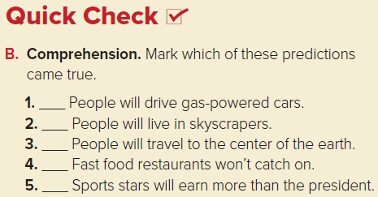


Slide 12
2 Pair Work
There won’t be any more cars. People will travel in vehicles that ride through the air.
Think of one thing we use now. Write down some of its features. Think how each of these features may change in 30 to 40 years. Make predictions of how people will use it in the year 2050

Slide 13


